Slide 1
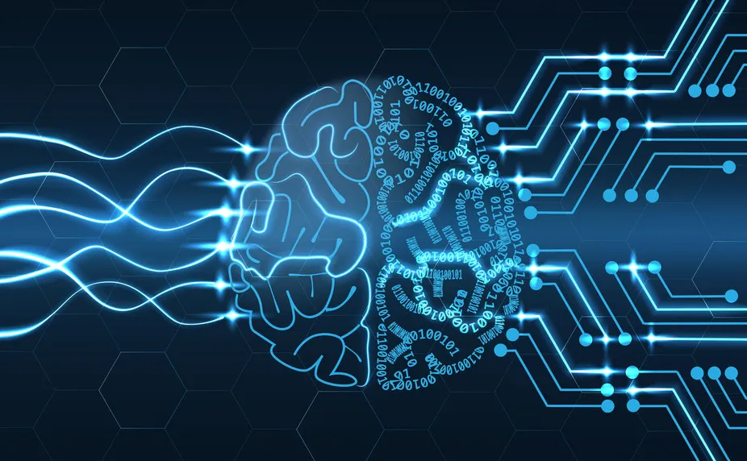
AI: The Good,
the Bad &
the Ugly
A Christian in the Age of AI
GENESIS 1 · PSALM 20 · COLOSSIANS 1
AI concept · replace credit as needed
made in God’s image — in the age of artificial ones

Slide 2

So — what is AI?
Create. Act. Move.
words · images · video · voice · code · humanoid robots
Yet it doesn’t think or feel — it predicts patterns.

Slide 3



BEFORE WE START — A FEW FUN FACTS
A few fun facts
100M in 2 months
2.5 billion a day
ChatGPT got there faster than any app before it — Facebook took 4½ years.
messages ChatGPT now answers, every day.
since 1920
1 in 3
“robot” is a Czech word — for “forced labour.”
Americans say AI’s spiritual advice is as trustworthy as a pastor’s.

Slide 4


TWO EASY REACTIONS
or
Embrace it blindly
Reject it in fear
use everything, no guardrails, no questions
refuse it all, and hide from the world
We won’t settle that debate today. Instead — three questions the Bible actually answers.

Slide 5



THE THREE MOST-ASKED QUESTIONS
Will AI replace me? — identity
Should I even use it? — calling
Will I trust it — or God? — reliance

Slide 6
QUESTION ONE
Will AI replace me?
The Image Given · Genesis 1:27

Slide 7
We’ve always feared the new thing
1450s
The printing press
“Cheap books will drown us in error.”
1900s
The motorcar
“Too fast — it will kill us.”
1900s
The aeroplane
“Man was never meant to fly.”
2000s
Social media
“It will isolate and rewire us.”
Today
AI
“…and here we are again.”
Every generation feared the new thing. Fear has never once been our master.

Slide 8
THE FEAR IS REAL
“
AI could eliminate half of all entry-level white-collar jobs — and spike unemployment to 10–20% — within one to five years.
Dario Amodei
CEO, Anthropic
Axios · May 2025

Slide 9
SO — WHAT ABOUT MY JOB?
Some work will change. Some jobs will go. New ones will come.
Learn it, adapt, steward it well — that is wisdom, not fear.
But your job was never your worth.
“Look at the birds of the air… your heavenly Father feeds them. Are you not of more value than they?”
Matthew 6:26 · ESV
Notes:
Absorb the honest data here: Anthropic's own Economic Index (2026) found little widespread job loss YET; Amodei warns of big entry-level disruption; Yale — the youngest hit first. Name it honestly, then land the gospel: work will shift, but your worth is not your output — the Father feeds the birds and values you far more.

Slide 10



AND HERE’S WHAT IT CAN NEVER DO
It cannot be present
Heavy AI-companion use is linked to MORE loneliness, not less. (APA, 2026)
Be truly present
Weep at a wedding
look you in the eye, share a meal, hold your hand — human to human.
rejoice with you, and mean it.
Be the church
Truly know you
a caring person that shows up with a cake and a prayer.
love is not information — and God is not lonely-proofing us with a bot.

Slide 11

QUESTION 1 · IT THINKS LIKE US
Its “brain” lights up —
like ours.
Anthropic looked inside Claude and found “features” — patterns of neurons that switch on for a single idea. Turn up the “Golden Gate Bridge” feature and Claude can’t stop talking about the bridge. There are even features for emotions.
Anthropic, “Scaling Monosemanticity,” 2024

Slide 12
QUESTION 1 · THEY HAD TO ASK
They hired someone to ask:
does it feel?
In 2024, Anthropic appointed its first “AI welfare researcher” — to study whether the models might have real experiences. His honest verdict:
we can’t prove it’s conscious — and we can’t rule it out.
Kyle Fish, Anthropic’s AI welfare researcher · TIME100 AI, 2025

Slide 13
GENESIS 2:7
Lighting up is not feeling.
A mirror of a mind is not a
soul.
We don’t bear God’s image because our neurons fire —
but because He
breathed into us.

Slide 14
GENESIS 1:27 · ESV
“So God created man in his own image, in the image of God he created him; male and female he created them.”
AI is made in our image. You are made in His.

Slide 15
They can copy what you do.
They can never be what you
are.
Your worth was never your output.

Slide 16
QUESTION TWO
Should I even use it?
The Image Commissioned · Genesis 1:28

Slide 17
GENESIS 1:28 · ESV
“Be fruitful and multiply and fill the earth and subdue it, and have dominion… over every living thing that moves on the earth.”
We are tool-makers by design. AI is a tool.
A hammer builds a home — or breaks a window. The tool takes the shape of the hand that holds it.

Slide 18
Different tools for different jobs
ChatGPT
Gemini
Claude
Perplexity
everyday all-rounder
built into Google
careful writing & reasoning
research, with sources
Gamma
Runway
NotebookLM
DeepSeek
learns from your notes
builds slide decks
AI video & editing
powerful & low-cost
Not one “AI” — many tools. Each good at different things.

Slide 19




AI FOR GOOD — A GIFT
AI for good — a gift
Genesis 1:28 — “subdue… have dominion”
Two Nobel Prizes
AlphaFold
AI honoured in Physics & Chemistry (2024).
A 50-year problem solved; 3M+ scientists fight disease.
nobelprize.org
deepmind.google
Be My Eyes
Flood Hub
AI describes the world aloud to blind users.
AI flood warnings shield ~460 million people.
bemyeyes.com
sites.research.google/floods
Notes:
You don’t need all four — pick 2–3 and BUILD them; more than that and the list numbs the room. NOBEL (2024): AI won two Nobel Prizes — Physics (neural networks: Hinton & Hopfield) and Chemistry (AlphaFold: Hassabis & Jumper). ALPHAFOLD: cracked a 50-year ‘protein-folding’ problem; 3M+ scientists in 190+ countries now use it to design medicines against cancer and disease — a gift to the sick. BE MY EYES: an app where AI describes surroundings aloud, so a blind person can ‘read’ a label or ‘see’ a room. FLOOD HUB: Google’s AI forecasts floods days ahead, protecting ~460M people. This is Genesis 1:28 ingenuity used to heal, help, protect — genuinely good.

Slide 20




BUT THE SAME TOOL — IN THE WRONG HAND
AI for evil — a weapon
A hammer builds a home — or breaks a window.
$25.6M stolen
A cloned voice
A deepfake “CFO” on a video call fooled a firm into wiring millions.
criminals fake your child’s or parent’s voice to beg for money.
Arup, 2024 · CNN
FTC warning
Fake, degrading images
Lies at scale
real people — even children — turned into images they never posed for.
convincing fakes flood the world; the truth gets harder to find.
Notes:
Same rule — pick 2–3, land fast, don’t dwell in the dark. DEEPFAKE FRAUD: in 2024 a finance worker at engineering firm Arup wired US$25.6M after a video call where the ‘CFO’ and colleagues were all AI deepfakes (CNN, Fortune). VOICE CLONE: scammers copy a loved one’s voice from a few seconds of audio to fake an emergency and extort money (FTC warnings). DEGRADING IMAGES: AI is used to make non-consensual fake images of real people — including minors — a real, growing harm. LIES AT SCALE: convincing fakes flood the internet; truth gets harder to find. The point: SAME tool as the ‘good’ slide — the only difference is the hand and the heart. Turn quickly to: the question is never just ‘what can it do?’ but ‘who is holding it, and why?’

Slide 21
SPEAKING TO OUR STUDENTS
“The greatest risk of AI in education isn’t cheating —
it’s the
erosion of learning itself.”
Phys.org, 2026 · (detectors also wrongly flag non-native English speakers — NBC)
So ask a better question — not “is this cheating?”
but “is this making me
wise — or just look smart?”

Slide 22


THE SAME TOOL — AIMED AT THE MISSION
Aimed at the mission
985 → 544
Closed lands
languages still without a Bible — AI is drafting them now.
seekers ask a gospel bot what they can’t ask a person.
Wycliffe / SIL
Our church
Your work
the app we built with AI — to serve you.
a tool to free your time for the people only you can love.
app.clichurch.com

Slide 23
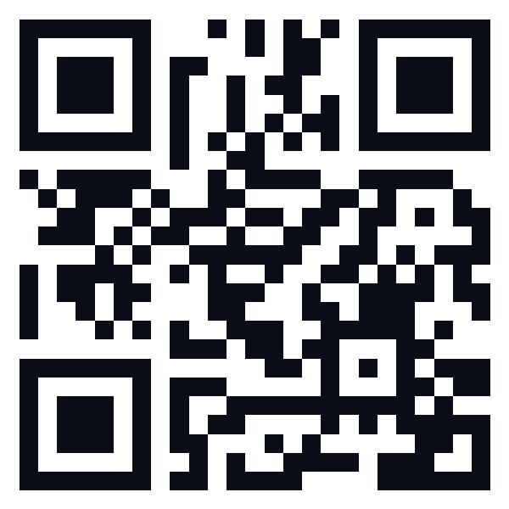

app.clichurch.com
Scan to open
We didn’t bow.
We didn’t burn.
We redeemed it — to serve God and His people.
CLIC
Notes:
Reveal live. Frame as freedom, not cleverness. Invite the room to open it now. Spoken ‘And you?’: How could you use this tool to serve — to share the good news, to build something, to bless people — for God, and not just yourself?

Slide 24
QUESTION THREE
Will I trust it — or God?
Reliance, not just salvation · Psalm 20:7

Slide 25
EVEN THE PEOPLE BUILDING IT ARE UNEASY
In 2026, Anthropic’s own CEO called for a globally coordinated pause on the most advanced AI — likening it to nuclear arms control.
Dario Amodei / Anthropic, 2026
The heads of OpenAI, DeepMind & Anthropic jointly warned:
“Mitigating the risk of extinction from AI should be a global priority.”
Center for AI Safety, 2023

Slide 26
AND THEY WENT TO THE POPE
In 2026, a co-founder of Anthropic — the makers of Claude — sat beside Pope Leo XIV as he released his letter on AI, and admitted they’re finding “unsettling” things inside their own models.
The Pope’s challenge: build “a new Tower of Babel” — or “the city where God and humanity dwell together.”
Encyclical “Magnifica Humanitas,” Pope Leo XIV, 2026

Slide 27
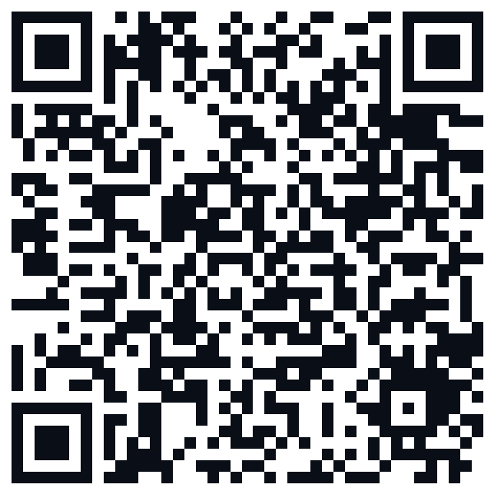
GO DEEPER — A RESOURCE
The Pope’s letter on AI
“Magnifica Humanitas” (2026)
Scan to read · vatican.va

Slide 28
WHERE WE’RE QUIETLY DRIFTING
1 in 3
Americans say AI’s spiritual advice is as trustworthy as a pastor’s.
65%
of practicing Christians fear AI becoming “a replacement for God.”
48%
of practicing Christians already trust AI to help them grow spiritually.
According to Barna Group research — “AI Is Becoming a Spiritual Authority,” 2025

Slide 29
A TRUE STORY, 2024
“
An “AI priest” told a user it was fine to baptise a baby with Gatorade — and was pulled within days.
“Father Justin,” Catholic Answers, 2024 · Decrypt, NCRegister, Futurism

Slide 30
PSALM 20:7 · ESV
“Some trust in chariots and some in horses, but we trust in the name of the LORD our God.”
Chariots were the cutting-edge tech of the day.
Where do you turn
first?

Slide 31
AI can answer — but it cannot forgive.
It can imitate — but it cannot save.
It cannot die for you.
It cannot rise.
Only One ever did both.
Notes:
Slow. Mark the silences — the gospel centre.

Slide 32
2 CORINTHIANS 3:18
You are being remade into His image.
The machine mirrors you.
The Spirit
transforms you.

Slide 33

SO — THREE THINGS ARE SETTLED
Identity made in His image — AI cannot replace you.
Calling commissioned with His tools — for His mission.
Trust lean on God, not the machine — He alone saves.
Every answer is a Person — Jesus.

Slide 34
Some trust in chariots and some in horses,
but we trust in the name
of the LORD our God.
PSALM 20:7
don’t bow · don’t burn · redeem

Slide 35

Come to the Table
The true Image — broken and given for you.
Take. Remember. Trust.

