Slide 1
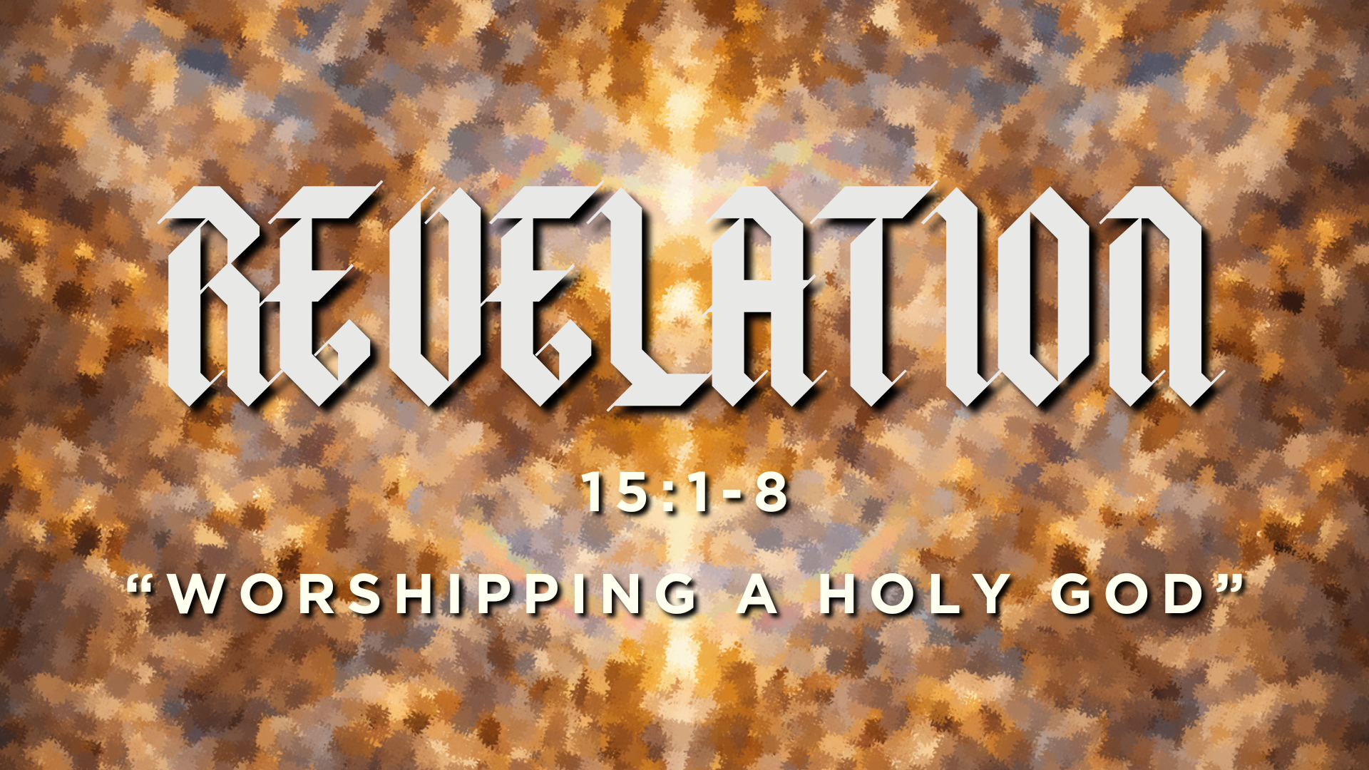

Slide 2
Worldview: the lens through which we see and interpret the world.

Slide 3


Slide 4
Q: “How does understanding God’s holiness affect the way we worship Him?”

Slide 5


Slide 6
“Then I saw another sign in heaven, great and amazing, seven angels with seven plagues, which are the last, for with them the wrath of God is finished.”
Revelation 15:1

Slide 7
“Great and amazing are your deeds,
O Lord God the Almighty!
Just and true are your ways,
O King of the nations!
Who will not fear, O Lord,
and glorify your name?
For you alone are holy.”
(Revelation 15:3-4)

Slide 8
“Holy is the way God is. To be holy He does not conform to a standard. He is that standard. He is absolutely holy with an infinite, incomprehensible fullness of purity that is incapable of being other than it is. Because He is holy, His attributes are holy; that is, whatever we think of as belonging to God must be thought of as holy.”
—A.W. Tozer

Slide 9
God is love.
God is justice.
God is wisdom.

Slide 10
God is love.
God is justice.
God is wisdom.

Slide 11
The name, “Yahweh (I AM) suggests the awesome meaning: ‘HE WHO IS’…One named ‘I am because I am,’ suggests that there is no external cause for God’s existence outside himself.”
—Thomas Oden

Slide 12
Why does God’s holiness matter to us?

Slide 13
“So the knowledge of God in true Christian experience will be sensible knowledge. It will differ from mere speculative knowledge in the same way that the taste of honey differs from the mere understanding that honey is sweet.”
—Jonathan Edwards

Slide 14
