Slide 1


Slide 2
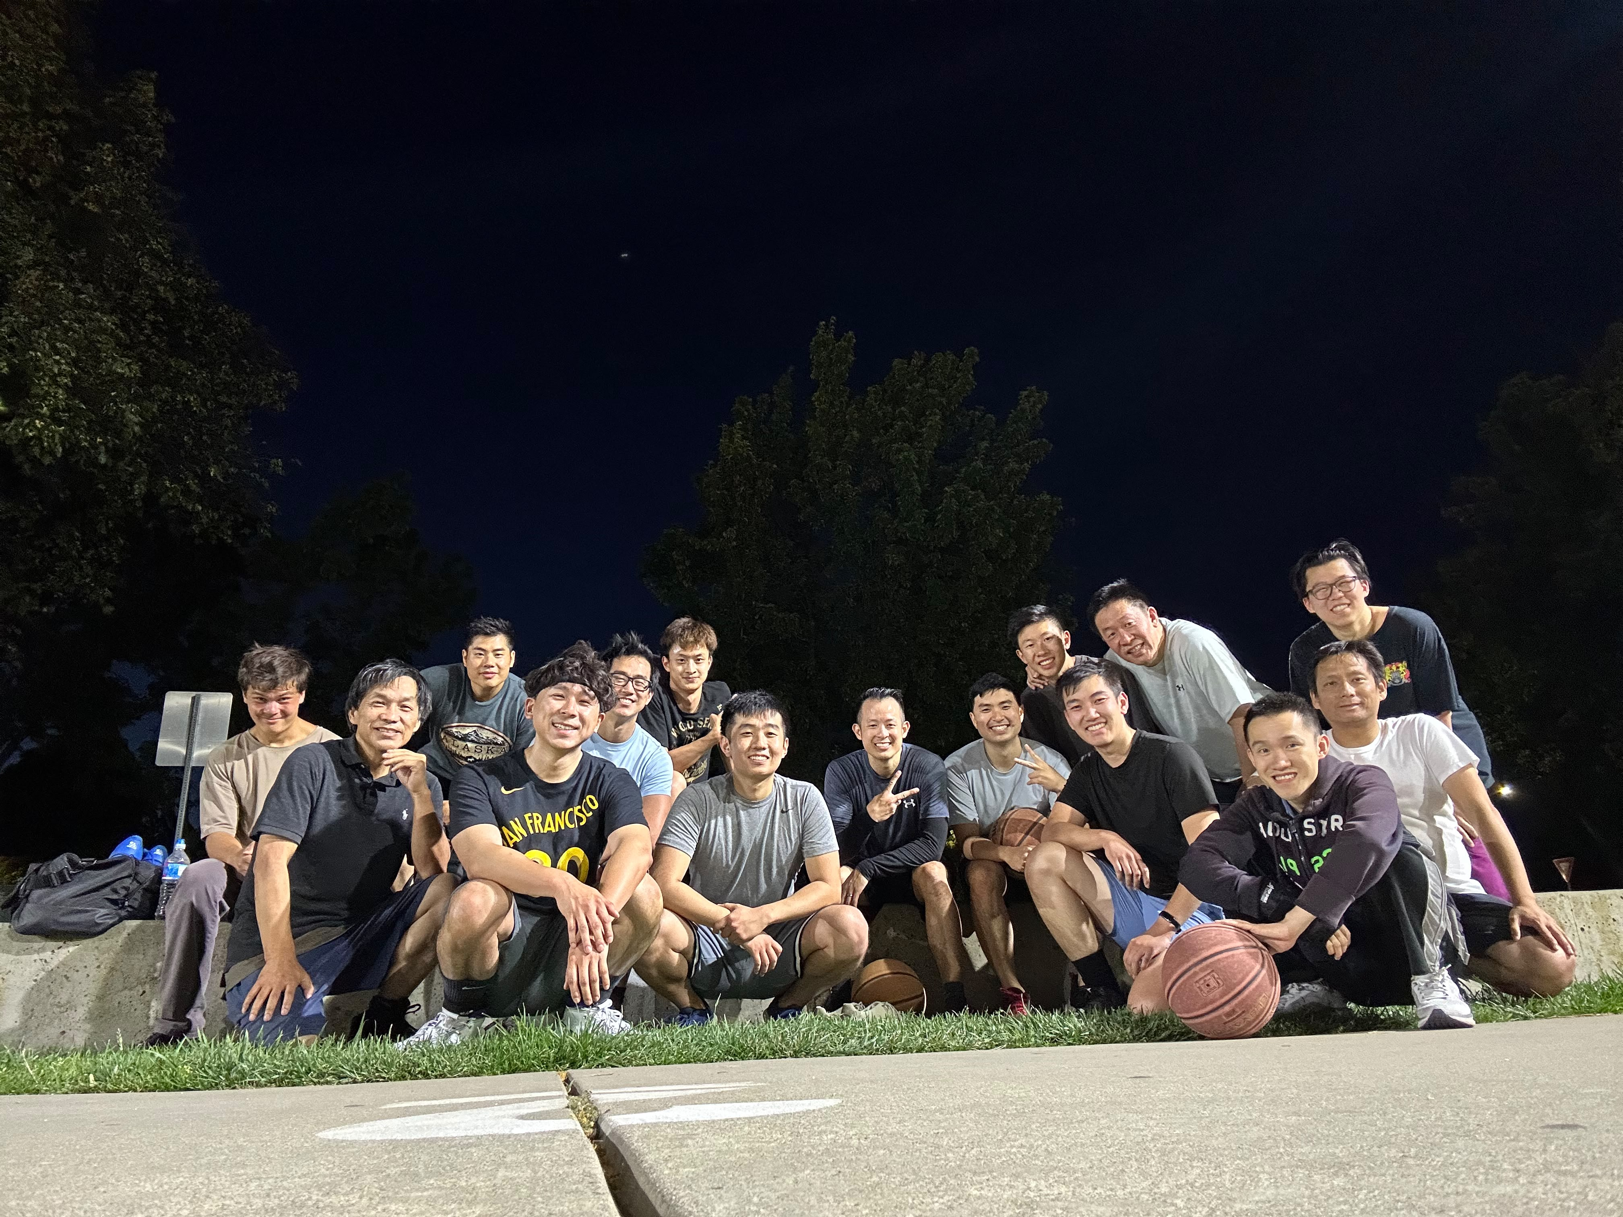

Slide 3
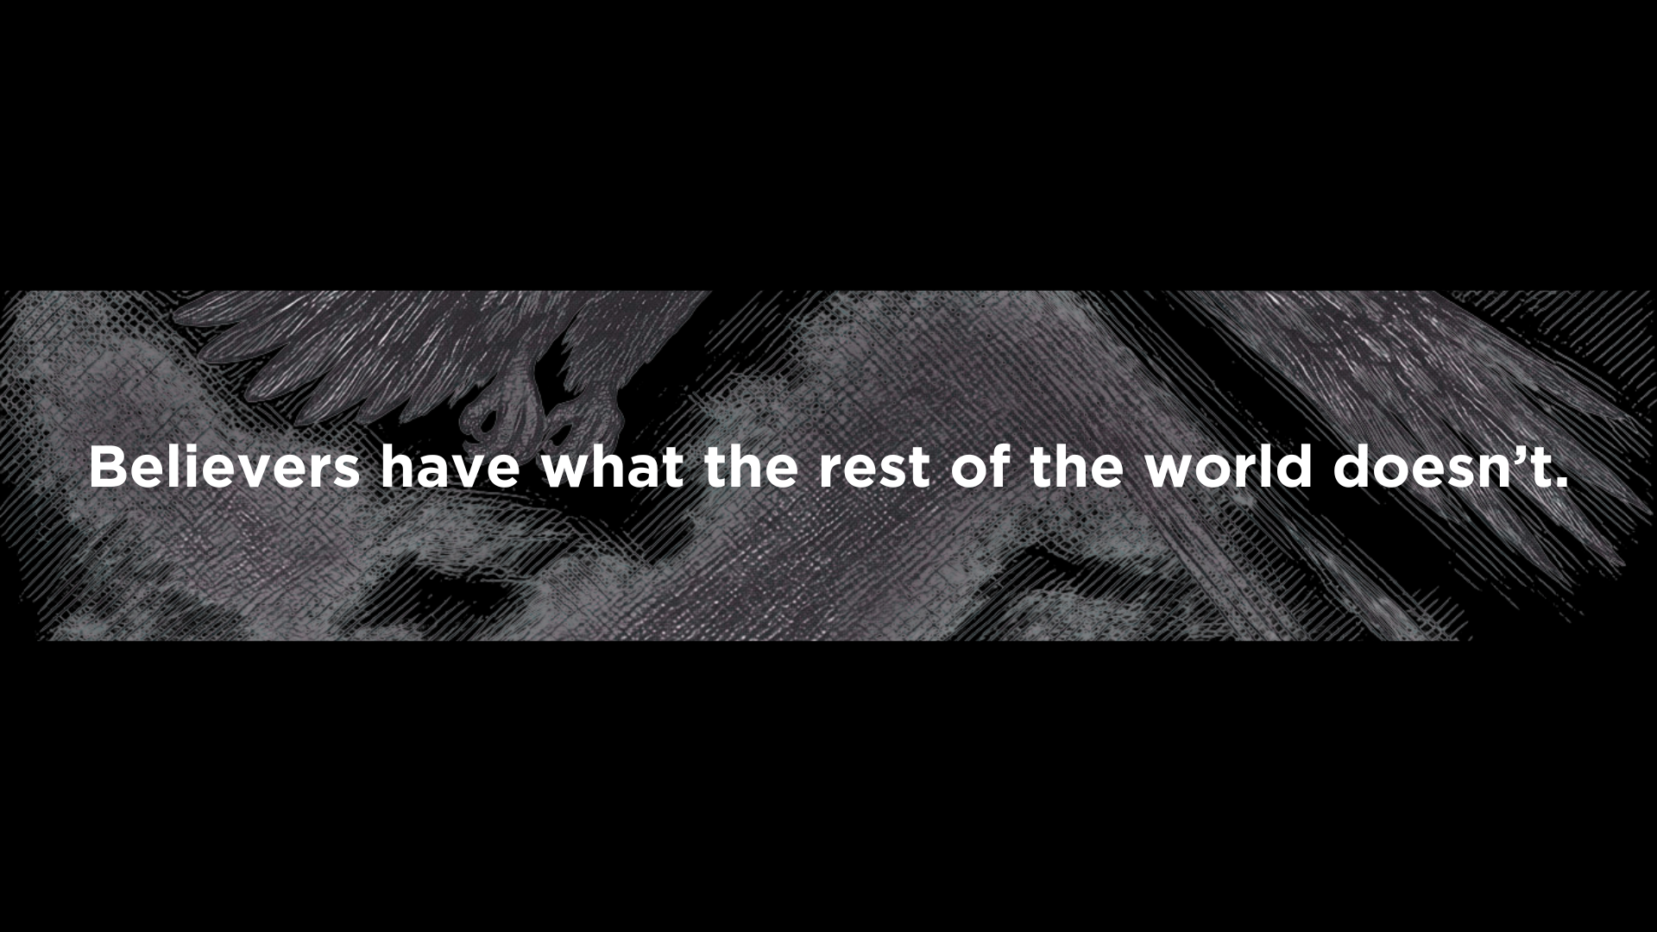

Slide 4
Earth Dwellers | God's People
"Those who dwell on the earth" (Rev. 3:10; 6:10; 8:13; 11:10; 13:8, 14; 17:2, 8) | Saints, servants, overcomers, those who dwell in heaven (Rev. 12:12; 13:6)
Worship the beast (Rev. 13:8, 12) | Worship God and the Lamb (Rev. 7:9–12; 15:3–4)
Receive the beast's mark (Rev. 13:16–17) | Bear God's name and the Lamb's name (Rev. 7:3; 14:1; 22:4)
Refuse to repent (Rev. 9:20–21; 16:9, 11, 21) | Fear God and give Him glory (Rev. 14:7)

Slide 5
Q: Are we aware of the worldly things we instinctively rely on instead of God?

Slide 6
How careful are we as Christians to avoid dependence on this system or compromise with it?
How closely and regularly do we examine the values governing our attitude toward money and material success?
Do we depend on some aspect of the world and its physical security, which God intends to remove at the end of history?
G.K. Beale

Slide 7

16:1-11 (The world is judged)
16:12-21 (The judgment is complete)

Slide 8
“Behold, I am coming like a thief! Blessed is the one who stays awake, keeping his garments on, that he may not go about naked and be seen exposed!” (Revelation 16:15)
Remember, then, what you received and heard. Keep it, and repent. If you will not wake up, I will come like a thief, and you will not know at what hour I will come against you. (Revelation 3:3)

Slide 9
The church is commanded to be watchful and observe the way they live.

Slide 10
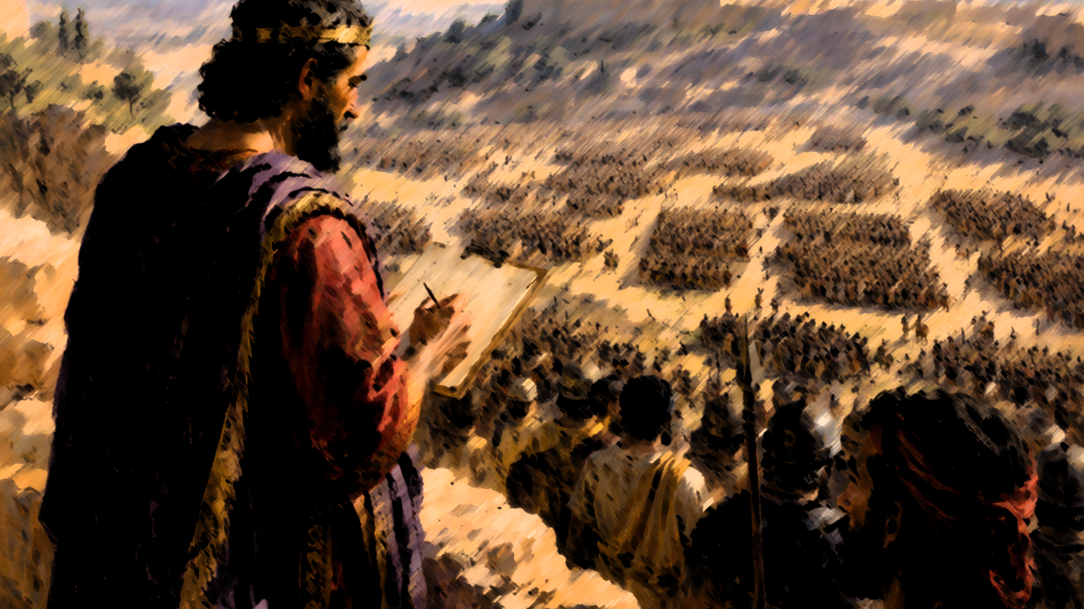

Slide 11
As for the rich in this present age, charge them not to be haughty, nor to set their hopes on the uncertainty of riches, but on God, who richly provides us with everything to enjoy.
1 Timothy 6:17

Slide 12
13 And I saw, coming out of the mouth of the dragon and out of the mouth of the beast and out of the mouth of the false prophet, three unclean spirits like frogs. 14 For they are demonic spirits, performing signs, who go abroad to the kings of the whole world, to assemble them for battle on the great day of God the Almighty.
Revelation 16:13-14

Slide 13
“That they are going to war illustrates the insanity and deception that have captured the hearts and minds of the kings and their followers since they are going to war against almighty God.”
-Thomas Schreiner

Slide 14
Q: Are we aware of the worldly things we instinctively rely on instead of God?

Slide 15
If then you have been raised with Christ, seek the things that are above, where Christ is, seated at the right hand of God. Set your minds on things that are above, not on things that are on earth. For you have died, and your life is hidden with Christ in God. When Christ who is your life appears, then you also will appear with him in glory.
Colossians 3:1–4

