Slide 1

Eyes Wide Shut
Michael Christie

Slide 2



Slide 3
Is there such a thing in human nature as readiness to accept lies? … A willingness to deceive ourselves seems to be an essential part of our makeup... Show business lives entirely from our willingness to suspend our disbelief. We buy tickets for a magical performance, where we are quite willingly misled. Wrestling bouts are another instance. They draw huge audiences, even though everyone knows they‘re not real fights, but highly choreographed spectacles.
- WERNER HERZOG
The Future of Truth

Slide 4
DANIEL 8: 1-2, 15-27
¹ In the third year of King Belshazzar’s reign, I, Daniel, had a vision, after the one that had already appeared to me.
² In my vision I saw myself in the citadel of Susa in the province of Elam; in the vision I was beside the Ulai Canal…

Slide 5
¹⁵ While I, Daniel, was watching the vision and trying to understand it, there before me stood one who looked like a man. ¹⁶ And I heard a man’s voice from the Ulai calling, “Gabriel, tell this man the meaning of the vision.”
¹⁷ As he came near the place where I was standing, I was terrified and fell prostrate. “Son of man,” he said to me, “understand that the vision concerns the time of the end.”

Slide 6
¹⁸ While he was speaking to me, I was in a deep sleep, with my face to the ground. Then he touched me and raised me to my feet.
¹⁹ He said: “I am going to tell you what will happen later in the time of wrath, because the vision concerns the appointed time of the end.
²⁰ The two-horned ram that you saw represents the kings of Media and Persia.

Slide 7
²¹ The shaggy goat is the king of Greece, and the large horn between its eyes is the first king. ²² The four horns that replaced the one that was broken off represent four kingdoms that will emerge from his nation but will not have the same power.
²³ “In the latter part of their reign, when rebels have become completely wicked, a fierce-looking king, a master of intrigue, will arise.

Slide 8
²⁴ He will become very strong, but not by his own power. He will cause astounding devastation and will succeed in whatever he does. He will destroy those who are mighty, the holy people.
²⁵ He will cause deceit to prosper, and he will consider himself superior. When they feel secure, he will destroy many and take his stand against the Prince of princes. Yet he will be destroyed, but not by human power.

Slide 9
²⁶ “The vision of the evenings and mornings that has been given you is true, but seal up the vision, for it concerns the distant future.”
²⁷ I, Daniel, was worn out. I lay exhausted for several days. Then I got up and went about the king’s business. I was appalled by the vision; it was beyond understanding.

Slide 10
Turbulent World: BUT God
I am going to tell you what will happen later... The two-horned ram that you saw represents the kings of Media and Persia. The shaggy goat is the king of Greece, and the large horn between its eyes is the first king. The four horns … represent four kingdoms that will emerge from his nation...
- DANIEL 8:19-22

Slide 11
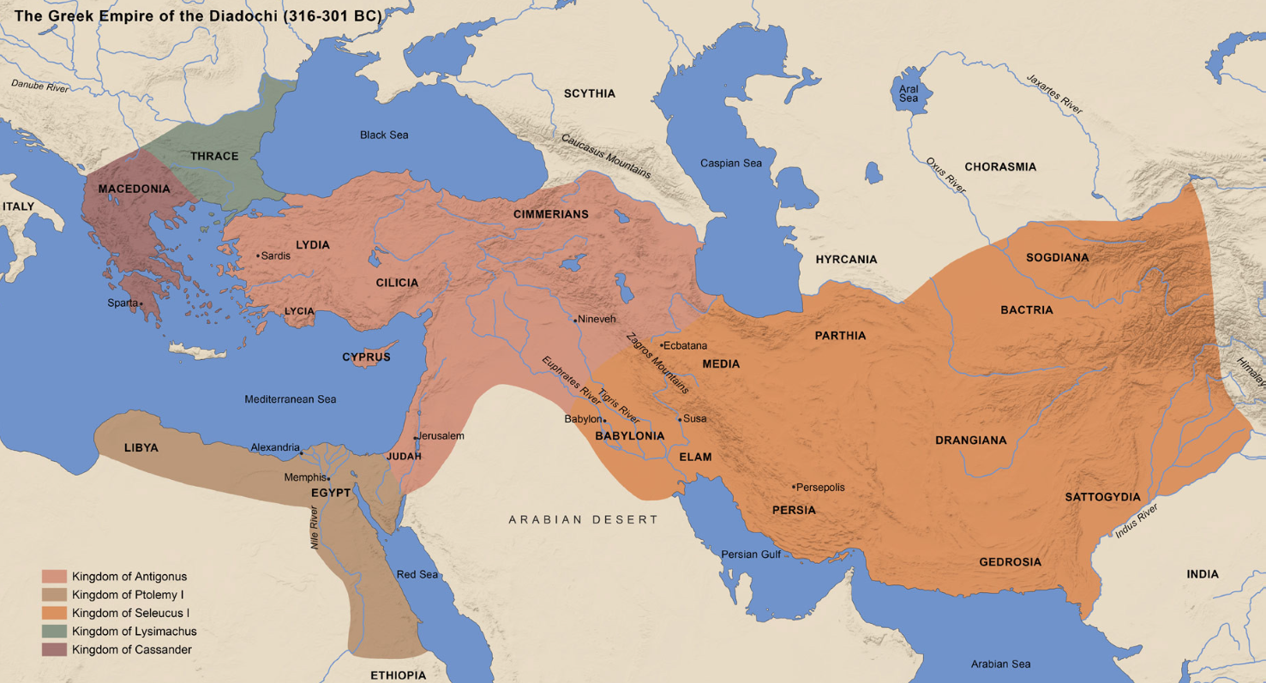

Slide 12
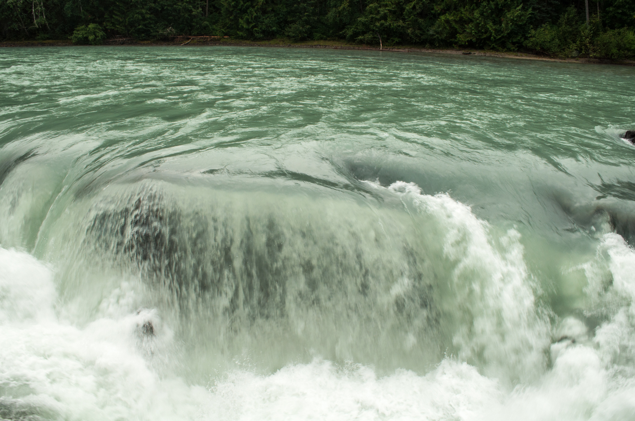

Slide 13
We have this hope as an anchor for the soul, firm and secure.
- HEBREWS 6:19

Slide 14
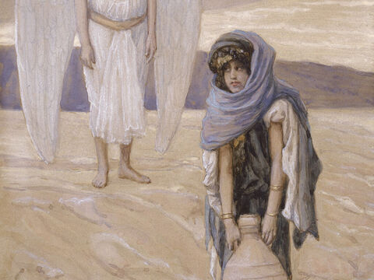
She gave this name to the Lord who spoke to her: “You are the God who sees me,” for she said, “I have now seen the One who sees me.
- GENESIS 16:13

Slide 15
Terrible Evil: BUT God
when rebels have become completely wicked, a fierce-looking king, a master of intrigue, will arise. He will become very strong, but not by his own power. He will cause astounding devastation and will succeed in whatever he does. He will destroy those who are mighty, the holy people. He will cause deceit to prosper, and he will consider himself superior. When they feel secure, he will destroy many and take his stand against the Prince of prince. Yet, he will be destroyed, but not by human power.
- DANIEL 8:23-25

Slide 16
Children, it is the last hour. And as you have heard that antichrist is coming, even now many antichrists have come.
- 1 JOHN 2:18

Slide 17
Beware the Enemy Tactics:
1. To remove your daily sacrifice.

Slide 18
Beware the Enemy Tactics:
To remove your daily sacrifice.
To defile/throw away His sanctuary

Slide 19
Beware the Enemy Tactics:
To remove your daily sacrifice.
To defile/throw away His sanctuary
To throw away truth.

Slide 20


Slide 21
Trust to Endure: BUT God
The vision of the evenings and mornings that has been given you is true, but seal up the vision, for it concerns the distant future.” I, Daniel, was worn out. I lay exhausted for several days. Then I got up and went about the king’s business. I was appalled by the vision; it was beyond understanding.
- DANIEL 8:26-27

Slide 22


Slide 23
But because of his great love for us, God, who is rich in mercy, made us alive with Christ…
- EPHESIANS 2:4-5

Slide 24
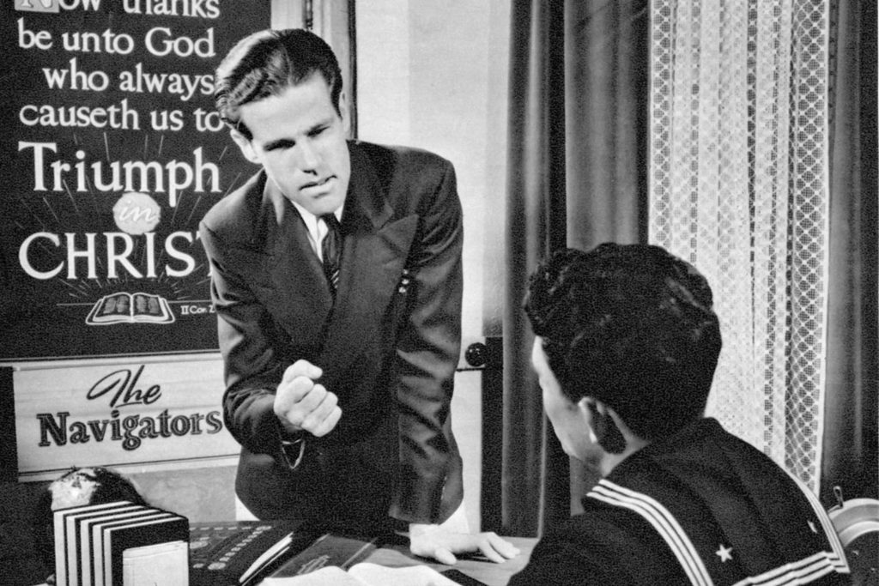

Slide 25
God's calling to us today is to recognise that our circumstances, as difficult as they may be, as hard as they may be to understand, do not counteract the eternal truth that our God sits upon the throne.
- DAWSON TROTMAN

Slide 26


