Slide 1
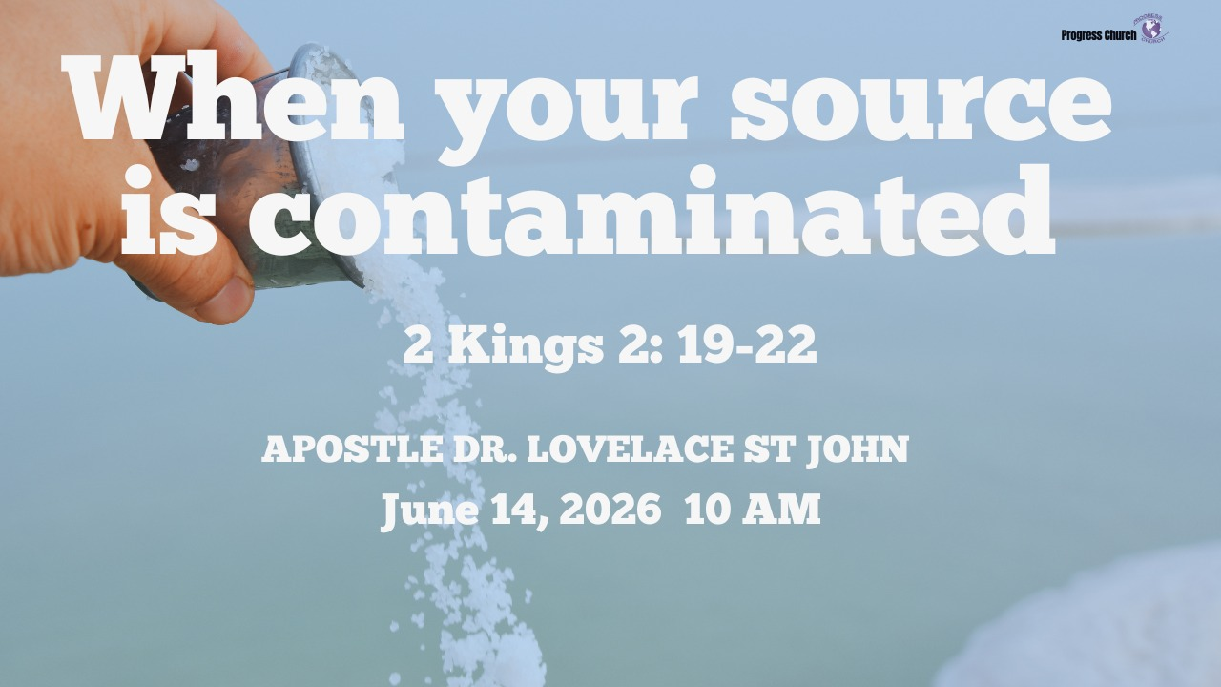

Slide 2





PROGRESS CHURCH
TITLE: WHEN YOUR SOURCE IS CONTAMINATED
SCRIPTURE: 2 KINGS 2: 19 – 22
DATE: JUNE 14, 2026
SPEAKER: Apostle Dr. Lovelace St John

Slide 3


Scripture:
2 KINGS 2: 19 – 22

Slide 4
INTRODUCTION: LOOKING GOOD BUT DYING INSIDE
Everything around Jericho looked attractive. It was strategically located. It was fertile in appearance. It was blessed with natural beauty.
But beneath the pleasant scenery was a hidden problem.
The source was contaminated.

Slide 5
INTRODUCTION (cont): LOOKING GOOD BUT DYING INSIDE
The water was poisoned.
The land was unproductive.
Death was flowing from the very thing designed to produce life.

Slide 6
1. THE PLEASANT SURROUNDINGS
"The situation of this city is pleasant..." (v.19)
A. The men of Jericho begin with a compliment.
B. Many Lives Look Pleasant
C. The Danger of Being Satisfied with Appearances

Slide 7
2. THE BAD WATER - "...but the water is bad..." (v.19)
A. Everything depended upon the water source.
B. Whatever Feeds You Shapes You
C. Spiritual Sources Can Become Contaminated
D. The Source Problem

Slide 8
3. THE UNPRODUCTIVE LAND - "...and the ground barren." (v.19)
A. Unfruitfulness Is Often a Source Issue
B. Areas of Spiritual Barrenness
C. God's Desire Is Fruitfulness

Slide 9
4. THE NEW BOWL AND THE SALT
A. The New Bowl
B. The Symbolism of Salt
Salt speaks of:
1. Purification
2. Preservation
3. Covenant
4. Influence

Slide 10
5. THE PROPHET WENT TO THE SOURCE
"Then he went out to the source of the water..." (v.21)
A. God Always Works at the Root
B. We Must Allow God to Reach the Source

Slide 11
6. THE TURNAROUND FROM DEATH AND INFERTILITY. - "Thus says the Lord: I have healed this water..." (v.21)
A. Notice who speaks. Not Elisha. Not the city leaders. The Lord.
B. God Declares Healing

Slide 12
6. THE TURNAROUND FROM DEATH AND INFERTILITY (cont) - "Thus says the Lord: I have healed this water..." (v.21)
C. The Two Enemies Removed
Death
Barrenness
D. God's Pattern

Slide 13
CONCLUSION: GO TO THE SOURCE
A. The story begins with: A pleasant city. It ends with: A healed city.
B. After God touched the source, it became productive. The water changed. The land changed. The future changed.

Slide 14
CONCLUSION (cont): GO TO THE SOURCE
C. What is your source? If the source is healed:
Death can become life.
Barrenness can become fruitfulness.
Discouragement can become hope.
Brokenness can become restoration.
Contamination can become consecration.

