Slide 1

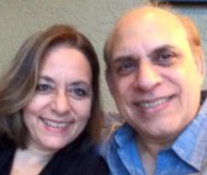
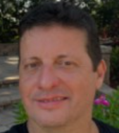
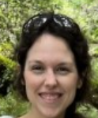
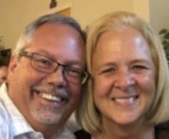
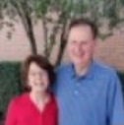
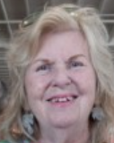
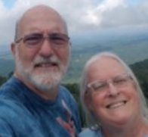
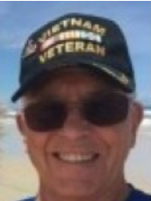
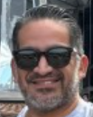
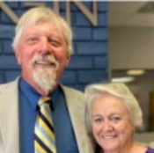
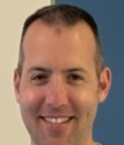
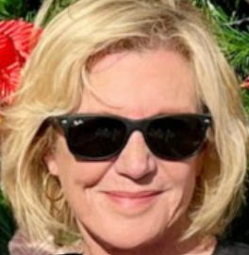
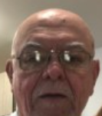
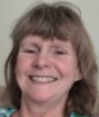
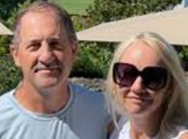
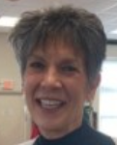
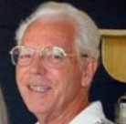
Leadership Team
Jimmy Durso
Audio / Video /
Board Treasurer
Marco Carvajal
Worship Leader
Christine Anasagasti
Nursery
Tom & Elaine Lajoie
Technology, Board
Church Admin
Bobby McCrimmon
Deacon
Nancy Miller
Prayer Coordinator
Al Friedberg
Rodeheaver
Board Member
Stephen Bolding
Deacon
Julio Urrutia
Youth
Ed Gilkey
Deacon Chair
Board Member
Elaine McCrimmon
Women’s Ministry
Charles Anasagasti
Youth
JoAnne Rountree
Church Operations
John Gavin
Men’s Ministry
Michelle Bridges
Veterans
Chris Maiocco
Senior Pastor
Board President
Nancy Zedar
Singles Ministry
Terry Hall
Security

