Slide 1

Don’t Give Up on God
Michael Christie

Slide 2


https://www.facebook.com/thequittersdc/

Slide 3
The only fight which is lost
is that which we give up.
- DIETRICH BONHOEFFER

Slide 4
DANIEL 6:3-11, 16-23
³ Now Daniel so distinguished himself among the administrators and the satraps by his exceptional qualities that the king planned to set him over the whole kingdom. ⁴ At this, the administrators and the satraps tried to find grounds for charges against Daniel in his conduct of government affairs, but they were unable to do so.

Slide 5
They could find no corruption in him, because he was trustworthy and neither corrupt nor negligent.
⁵ Finally these men said, “We will never find any basis for charges against this man Daniel unless it has something to do with the law of his God.”
⁶ So these administrators and satraps went as a group to the king and said: “May King Darius live forever!

Slide 6
⁷ The royal administrators, prefects, satraps, advisers and governors have all agreed that the king should issue an edict and enforce the decree that anyone who prays to any god or human being during the next thirty days, except to you, Your Majesty, shall be thrown into the lions’ den. ⁸ Now, Your Majesty, issue the decree and put it in writing so that it cannot be altered—in accordance with the law of the Medes and Persians, which cannot be repealed.”

Slide 7
⁹ So King Darius put the decree in writing. ¹⁰ Now when Daniel learned that the decree had been published, he went home to his upstairs room where the windows opened toward Jerusalem.
Three times a day he got down on his knees and prayed, giving thanks to his God, just as he had done before.
¹¹ Then these men went as a group and found Daniel praying and asking God for help…

Slide 8
¹⁶ So the king gave the order, and they brought Daniel and threw him into the lions’ den. The king said to Daniel, “May your God, whom you serve continually, rescue you!”
¹⁷ A stone was brought and placed over the mouth of the den, and the king sealed it with his own signet ring and with the rings of his nobles, so that Daniel’s situation might not be changed.

Slide 9
¹⁸ Then the king returned to his palace and spent the night without eating and without any entertainment being brought to him. And he could not sleep.
¹⁹ At the first light of dawn, the king got up and hurried to the lions’ den. ²⁰ When he came near the den, he called to Daniel in an anguished voice, “Daniel, servant of the living God, has your God, whom you serve continually, been able to rescue you from the lions?”

Slide 10
²¹ Daniel answered, “May the king live forever! ²² My God sent his angel, and he shut the mouths of the lions. They have not hurt me, because I was found innocent in his sight. Nor have I ever done any wrong before you, Your Majesty.” ²³ The king was overjoyed and gave orders to lift Daniel out of the den. And when Daniel was lifted from the den, no wound was found on him, because he had trusted in his God.

Slide 11
A RISE: We are Distinctive
Daniel so distinguished himself among the administrators and the satraps by his exceptional qualities that the king planned to set him over the whole kingdom… They could find no corruption in him, because he was trustworthy and neither corrupt nor negligent.
- DANIEL 6:3-4

Slide 12
The world may not know the details of doctrine or the intimacies of worship with God, but they can tell a bad temper, selfishness, conceitedness, or dishonesty when they see it.
- DAVID GUZIK

Slide 13
You are the salt of the earth. But if the salt loses its saltiness, how can it be made salty again? It is no longer good for anything...
- MATTHEW 5:13

Slide 14
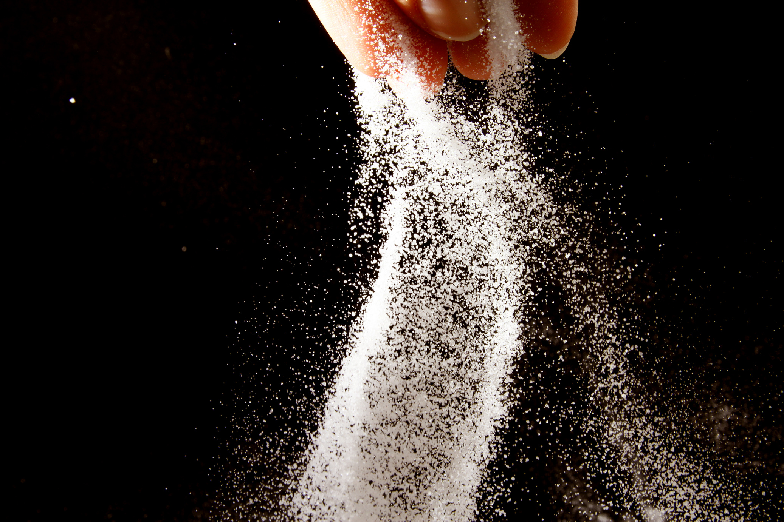

Slide 15
A RESISTANCE: We are Despised
Finally, these men said, “We will never find any basis for charges against this man Daniel unless it has something to do with the law of his God.
- DANIEL 6:5

Slide 16
Temptation to compromise is never an isolated incident in our spiritual life, but it is part of the larger strategy of Satan against us… Many Christians mistaking one battle for the whole war have shielded from one attack but then… let their guard down and they have been defeated when the enemy comes in like a flood.
- SINCLAIR FERGUSON

Slide 17
Blessed are you when people insult you, persecute you and falsely say all kinds of evil against you because of me. Rejoice and be glad, because great is your reward in heaven.
- MATTHEW 5:11-12

Slide 18
A RELIANCE: We are dependent
When Daniel learned that the decree had been published, he went home to his upstairs room where the windows opened toward Jerusalem. Three times a day he got down on his knees and prayed, giving thanks to his God, just as he had done before. Then these men went as a group and found Daniel praying and asking God for help.
- DANIEL 6:10-11

Slide 19
[Prayer is] the soul’s native language… our natural posture is attentive openness to the divine.
- DAVID G. BENNER
Opening to God
In the circle of successful living, prayer is the hub that holds the wheel together.
- CONRAD HILTON
Be My Guest

Slide 20
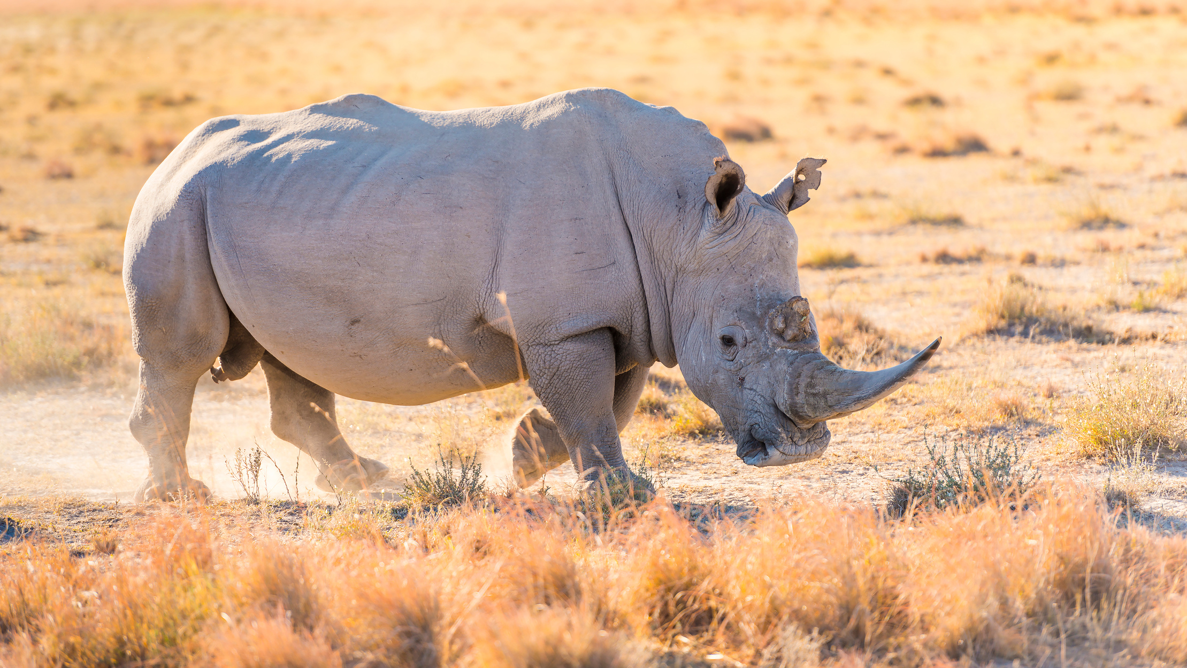

Slide 21
The paradox of prayer is that it asks for a serious effort while it can only be received as a gift. We cannot plan, organise or manipulate God; but without a careful discipline, we cannot receive him either.
- HENRI NOUWEN
Reaching Out

Slide 22
It is a common temptation of Satan to make us give up the reading of the Word and prayer when our enjoyment is gone; as if it were of no use to read the scriptures when we do not enjoy them, and as if it were no use to pray when we have no spirit of prayer. The truth is that, in order to enjoy the Word, we ought to continue to read it, and the way to obtain a spirit of prayer is to continue praying. The less we read the Word of God, the less we desire to read it, and the less we pray, the less we desire to pray.
- GEORGE MULLER

Slide 23
A RESURRECTION: We are Delivered
At the first light of dawn, the king got up and hurried to the lions’ den. When he came near the den, he called to Daniel in an anguished voice, “Daniel, servant of the living God, has your God, whom you serve continually, been able to rescue you from the lions?” Daniel answered, “… My God sent his angel, and he shut the mouths of the lions. They have not hurt me, because I was found innocent in his sight.
- DANIEL 6:19-23

Slide 24
Jesus was left in the blackness utterly alone and abandoned by God, suffering the fate that we, the guilty ones, deserved. God did not shut the mouths of Jesus’ lions like he did Daniel’s; he let them tear him apart… But he was bearing my sin. He went into that pit for me.
- SALLY LLOYD-JONES

Slide 25
