Slide 1
Welcome to Holy Hermits Online Worship
3rd Sunday After Pentecost
Today we are remembering
Holy Hermit St. Julian of Norwich
Service Prep: Kris | Chat Host: Rachel | First Reader: Liz
Music: Wiggles | Welcomer: Julie | Second Reader: Helen
Proof-reader: Chris | Priest: N/A | Preacher: Lauren
Broadcaster: Lauren | Deacon: Lauren | Fellowship: Julie
Backup Broadcaster: Barry | Leader: Julie | Safety Officer: Chris
Zoom Buttons: Lauren | Cantor: Vanessa | Attendance: Rachel

Slide 2






Hospitality
Leader:
Please mute for the service unless invited to offer your voice as part of the service ministry
Have the video camera on or off and turn the volume and brightness up or down on your device if things are too loud 🔉🔊or too bright🔅🔆
Our Cantor acts as our voice, offering the responses, in Bold Text, which we say together
Feel welcome to use the chat and reaction emojis 👍
🙏 Please take care of yourself in this space. 🙏 Come and go as you need
😴 It is great to take rest in this space, so falling asleep is also OK 😴
👂️ Remember, pastoral care is available to all in the community, if you'd like to speak to someone about anything spiritual. ❤️ Visit the help page at the website to reach out 🌐
Our Being Together ethos and safeguarding practices can also be accessed on the website 🫶​
🙌 Come as you are – we are all here together! 🙌
Notes:
Used Lent 2022

Slide 3
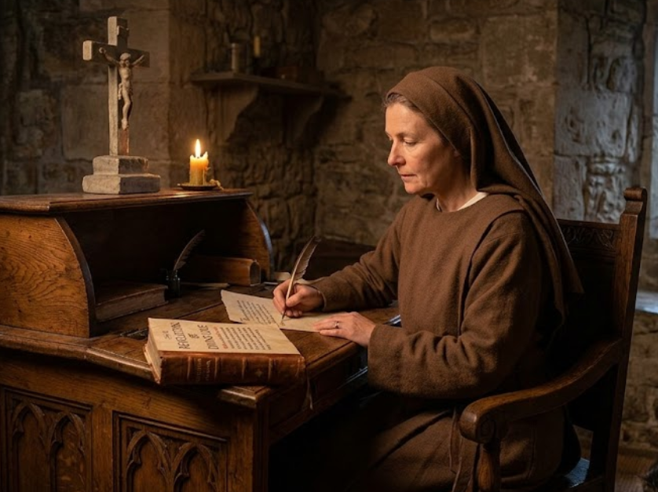
Leader: Our Holy Hermit today is St. Julian of Norwich
Born in Norwich in 1342, Julian miraculously recovered from the Black Death in 1373 after experiencing sixteen profound spiritual visions while staring at a priest's crucifix. Following this divine encounter, she penned a brief account of her healing, later expanding it around 1394 into Revelations of Divine Love, historically recognized as the first English book authored by a woman.

Slide 4
Seeking a life of quiet contemplation, she became a secluded anchoress at St. Julian’s Church. Residing in a small 100-square-foot cell with an enclosed garden, her highly structured days were governed by the Ancrene Rywle. Julian dedicated herself to prayer seven times daily, provided confidential spiritual counseling through a street-facing window, wore plain garments, and kept a cat to ward off vermin.​
It is believed she developed a close relationship with her cat, and she is known as both the patron saint of contemplatives and of cats.
To read more about our hermits click the link​​ in the send out

Slide 5
Invitation
Leader: As we come into worship let’s take a few deep breaths,
Let go of anything that isn’t serving us,
And become aware of God’s presence here with us.
Opening Music: https://www.youtube.com/watch?v=FvcEiMQ-2Dc

Slide 6
Leader and Cantor unmute
The Greeting
Leader: The grace of the Lord Jesus Christ,
and the love of God,
and the fellowship of the Holy Spirit,
be with you all.
All: And also with you.

Slide 7
Gathering Prayer
Leader: The kingdom of heaven is near.
Come, let us explore it together.
God the healer, the friend is calling.
Proclaim the good news.
Turn to one another and declare:
The kingdom of heaven is near.
People find wholeness, people find healing.
The kingdom of heaven is near.
Come, let us explore it together.
Notes:
Use Call to Worship Prayer

Slide 8
Gathering Prayer
All: Jesus, Lord, help us to find
you in the unexpected.
Enable us to listen to your call and
fill us with your power.
Shake us out of complacency,
to see where you want us to be.
And give us courage to follow your lead.
Amen.
Notes:
Use gathering prayer

Slide 9
Sentence
Leader: I invite our Cantor to proclaim the sentence for today.
Cantor: The harvest is plentiful, but the labourers are few; ask therefore the Lord of the harvest to send out labourers into his harvest.
Matthew 9.37-38

Slide 10
Prayer of Approach
Leader: We pray the prayer of approach together
All: Jesus called the disciples and gave them a job,
gave them authority to carry it out,
took them out of their comfort zone.
Lord God, we are here today as a fellowship,
a worshipping, serving community.
We are not on our own, your Holy Spirit is with us.
As we gather here, make us ready to follow you,
stepping out in faith, going wherever you lead us. Amen.

Slide 11
Leader unmutes
Our first Hymn
Oh, For a Thousand Tongues to Sing
https://www.youtube.com/watch?v=CFJvBwgmK_c
We stay on mute
Leader mutes

Slide 12
The Deacon or LA introduces the Confession​
God is steadfast in love and infinite in mercy, welcoming sinners and inviting them to the Lord's table.
Silence may be kept.​
Let us confess our sins in penitence and faith, with a sincere and a true heart.

Slide 13
All: ​Merciful God, our maker and our judge, ​
we have sinned against you ​in thought, word, and deed, ​
and in what we have failed to do: ​
we have not loved you with our whole heart; ​
we have not loved our neighbours as ourselves; ​
we repent, and are sorry for all our sins.​
Father, forgive us. Strengthen us to love and obey you
in newness of life; ​through Jesus Christ our Lord. ​
Amen.​

Slide 14
Words of Assurance offered by the Deacon or LA
These words of assurance from the First Letter of John declare that:
If anyone sins, we have an advocate with the Father, Jesus Christ the righteous. He is the perfect offering for our sin, and not for ours only, but for the sins of the whole world.
(1 John 2: 1-2)
In this is love, not that we loved God, but that he loved us and sent his Son to be the perfect offering for our sins.
(1 John 4:10)

Slide 15
Collect
Leader: All-powerful God,
in Jesus Christ you turned death into life,
and defeat into victory:
increase our faith and trust in him,
that we may triumph over evil,
in the strength of the same Jesus Christ our Lord,
who lives and reigns with you and the Holy Spirit,
one God, for ever and ever. Amen.

Slide 16
The 1st reader unmutes
Leader: I invite the 1st reader to unmute and offer the 1st lesson when ready.
Reader 1: The 1st Reading is from Genesis 18.1-15
¹ The Lord appeared to Abraham by the oaks of Mamre, as he sat at the entrance of his tent in the heat of the day. ² He looked up and saw three men standing near him. When he saw them, he ran from the tent entrance to meet them, and bowed down to the ground. ³ He said, ‘My lord, if I find favour with you, do not pass by your servant.
Continue…

Slide 17
⁴ Let a little water be brought, and wash your feet, and rest yourselves under the tree. ⁵ Let me bring a little bread, that you may refresh yourselves, and after that you may pass on—since you have come to your servant.’ So they said, ‘Do as you have said.’ ⁶ And Abraham hastened into the tent to Sarah, and said, ‘Make ready quickly three measures of choice flour, knead it, and make cakes.’ ⁷ Abraham ran to the herd, and took a calf, tender and good, and gave it to the servant, who hastened to prepare it.
Continue…

Slide 18
⁸ Then he took curds and milk and the calf that he had prepared, and set it before them; and he stood by them under the tree while they ate. ⁹ They said to him, ‘Where is your wife Sarah?’ And he said, ‘There, in the tent.’ ¹⁰ Then one said, ‘I will surely return to you in due season, and your wife Sarah shall have a son.’ And Sarah was listening at the tent entrance behind him. ¹¹ Now Abraham and Sarah were old, advanced in age; it had ceased to be with Sarah after the manner of women.
Continue…

Slide 19
¹² So Sarah laughed to herself, saying, ‘After I have grown old, and my husband is old, shall I have pleasure?’ ¹³ The Lord said to Abraham, ‘Why did Sarah laugh, and say, “Shall I indeed bear a child, now that I am old?” ¹⁴ Is anything too wonderful for the Lord ? At the set time I will return to you, in due season, and Sarah shall have a son.’ ¹⁵ But Sarah denied, saying, ‘I did not laugh’; for she was afraid. He said, ‘Oh yes, you did laugh.’
For the word of the Lord. Thanks be to God.​

Slide 20
Leader: We now say the psalm antiphonally, I invite the first
reader to lead, and we will all respond with our cantor as our voice.
Psalm
116.1-2
116.11-18
¹ I love the Lord, because he heard my voice:
the voice of my supplication;
² Because he inclined his ear to me:
in the day that I called to him.
¹¹ How shall I repay the Lord:
for all his benefits to me?
Continue…

Slide 21
¹² I will take up the cup of salvation:
and call upon the name of the Lord.
¹³ I will pay my vows to the Lord:
in the presence of all his people.
¹⁴ Grievous in the sight of the Lord:
is the death of his faithful ones.
¹⁵ O Lord, I am your servant,
your servant and the child of your handmaid:
you have unloosed my bonds.
Continue…

Slide 22
¹⁶ I will offer you a sacrifice of thanksgiving:
and call upon the name of the Lord.
¹⁷ I will pay my vows to the Lord:
in the presence of all his people,
¹⁸ In the courts of the house of the Lord:
even in your midst, O Jerusalem. Praise the Lord.

Slide 23
The 2nd reader unmutes
Leader: I invite the 2nd reader to unmute and offer the 2nd lesson when ready.
Reader 2: The 2nd Reading is from Romans 5.1-11
¹ Therefore, since we are justified by faith, we have peace with God through our Lord Jesus Christ, ² through whom we have obtained access to this grace in which we stand; and we boast in our hope of sharing the glory of God.
Continue…

Slide 24
³ And not only that, but we also boast in our sufferings, knowing that suffering produces endurance, ⁴ and endurance produces character, and character produces hope, ⁵ and hope does not disappoint us, because God’s love has been poured into our hearts through the Holy Spirit that has been given to us. ⁶ For while we were still weak, at the right time Christ died for the ungodly. ⁷ Indeed, rarely will anyone die for a righteous person—though perhaps for a good person someone might actually dare to die.
Continue…

Slide 25
⁸ But God proves his love for us in that while we still were sinners Christ died for us. ⁹ Much more surely then, now that we have been justified by his blood, will we be saved through him from the wrath of God. ¹⁰ For if while we were enemies, we were reconciled to God through the death of his Son, much more surely, having been reconciled, will we be saved by his life. ¹¹ But more than that, we even boast in God through our Lord Jesus Christ, through whom we have now received reconciliation.
For the word of the Lord. Thanks be to God.​

Slide 26

We pause before
​the Gospel ​​

Slide 27
Deacon: The Gospel of our Lord Jesus Christ according to St Matthew Chapter 9 beginning at the 35th verse
All: Glory to you Lord Jesus Christ.
9 ³⁵ Then Jesus went about all the cities and villages, teaching in their synagogues, and proclaiming the good news of the kingdom, and curing every disease and every sickness. ³⁶ When he saw the crowds, he had compassion for them, because they were harassed and helpless, like sheep without a shepherd.
Continue…

Slide 28
³⁷ Then he said to his disciples, ‘The harvest is plentiful, but the labourers are few; ³⁸ therefore ask the Lord of the harvest to send out labourers into his harvest.’
10 ¹ Then Jesus summoned his twelve disciples and gave them authority over unclean spirits, to cast them out, and to cure every disease and every sickness. ² These are the names of the twelve apostles: first, Simon, also known as Peter, and his brother Andrew; James son of Zebedee, and his brother John; ³ Philip and Bartholomew; Thomas and Matthew the tax-collector;
Continue…

Slide 29
James son of Alphaeus, and Thaddaeus; ⁴ Simon the Cananaean, and Judas Iscariot, the one who betrayed him.
⁵ These twelve Jesus sent out with the following instructions: ‘Go nowhere among the Gentiles, and enter no town of the Samaritans, ⁶ but go rather to the lost sheep of the house of Israel. ⁷ As you go, proclaim the good news, “The kingdom of heaven has come near.” ⁸ Cure the sick, raise the dead, cleanse the lepers, cast out demons. You received without payment; give without payment.
This is the Gospel of the Lord. Praise to you Lord Jesus Christ.

Slide 30

We pause
after ​the Gospel ​​

Slide 31
Leader: The Sermon is recorded to YouTube for sharing later.
Only the preacher's video and audio will be recorded.
The chat and other participants' feeds remain out of sight of the recording.
Leader and Cantor mute
Broadcaster exits screenshare
Preacher unmutes
Zoom buttons ”pins” preacher’s screen + selects “record to the cloud”
Sermon

Slide 32
Leader unmutes
Our next Hymn
Go to the World!
https://www.youtube.com/watch?v=FDXtb6omS3Q
We stay on mute
Leader mutes

Slide 33
The Leader and Cantor unmute
The Greeting of Peace
Leader: We are the body of Christ
All: God’s Spirit is with us
Leader: The peace of the Lord be always with you.
All: And also with you.
Leader: A sign of peace may be exchanged
You may like to type 'Peace' into the chat, use the 'raise hand’ or other reaction buttons, or just simply wave via the screen with your video turned on
(Broadcaster exits shared screen for a few moments for the exchange of peace)

Slide 34

Prayer of Thanksgiving before Intercessions
Leader: As we enter prayer, I invite the second reader to unmute to lead our intercessions following the prayer of thanksgiving on the next slide. Please feel free to change your body position as you need.
Continue…

Slide 35
Leader: Lord, as we read the names of your disciples, chosen by you, we thank you because suddenly they become more real to us, real people who stepped out of their comfort zone for you, real examples for us.
(spend a quiet moment focusing on your own name,
thanking God for his plans for you)
Amen.
Notes:
Prayer of praise and thanksgiving

Slide 36
Intercessions
Reader 2: We pray for creation and communities we share our lives with. We pause for a few moments to name either in our hearts, or out loud, or in the chat, those environments and communities we bring to the Lord in prayer.
PAUSE…
Continue…

Slide 37
Intercessions
Reader 2: We entrust to you the community of Holy Hermits Online and our ministry partners:
Prosper the work of our hands and show us the way to your new creation.
Creator God, Hear our prayer.
St John's Cathedral Brisbane The Anglican Diocese of Southern Queensland St Gabriel’s, Carindale Benedictus Contemplative Church, Canberra Anglican Focus and Tithe.ly

Slide 38

Reader 2: Loving Creator, we entrust to you all animals, especially those who are sick, anxious, ageing, lost, at risk, lonely, sad, hungry, in pain, homeless, abused, living in fear, encountering violence of any kind, in need of comfort, rehabilitation or transformation.

Slide 39

Reader 2: We invite your loving compassion for:
We name in our hearts, out loud or in the chat,
the animals we bring to the Lord in prayer. PAUSE…
Jasmine, ​
Leese(y), ​
Sid, Toots & Lulu​
Polly and Suki​
Fred, George & Percy​
Koshka ​
Jax
Lambert ​​
Kala, Nigel & Little One ​​
Toby​​
Taco​​
Paddy ​​
Rosie​

Slide 40
Reader 2: Eternal Trinity of Love, we uphold to you the people we love and carry cares for:
Kerry, Les & Jake Julie, Ray, Tracey & Shane Mark, Desley & Bob ​​ Rachel, Mervyn & Gillian ​​Rev'd Shane & Janette​​ Alecia, Martin & Aidan​​ Kirsten, Greg, Daphne & Beau Bill & Marjorie​​ Aaron & Andrea Liz’s Godchildren | Barry​​ Dr Julie ​​ Ruth​​ Phil​ May Susan Tanya​ Neva Kathy ​Gayanne Tina | ​​ | Alan & Gaylene​ Jess & Leah ​​ Barry & Gwen Matthew & Nicholas​ Bob & Di​ Pat & Julie Dilys & Tony, Paul & Darhon Judy & Mary Miriam Lorelei

Slide 41
Reader 2:
We name in our hearts, out loud or in the chat, those we bring to the Lord in prayer.
PAUSE…
We entrust to you those who have died, those who have died peacefully and those who have died tragically, The old and the young. Receive them into your Kingdom. Lord in your mercy, Hear our prayers. Amen.

Slide 42
Pray Daily Cycle of Prayer
Leader: Loving God, joining with the Church in our cycle of prayer, we ask your blessings on:
The Church of the Province of South-East Asia
Ministry with the Torres Strait Island People of Australia – Rose
The Parish of Manly: Dianne, Judith
Epic Employment Service Incorporated – Brisbane, Gold Coast, Sunshine Coast, North Brisbane, Fraser Coast, Capricornia: Dean – CEO & Br Donald SSF - Chair
St Margaret’s Anglican Girls School, Ascot: Principal - Roslyn; Chaplain - Jasmine; Chair of School Council – Lisa; School Council members; staff & students

Slide 43
Commitment prayer for the week
Leader: Our commitment prayer for the week is for Deliverance Ministry.
Come Holy Spirit and make the hearts of your servants,
Reverend Claye and the deliverance ministry team, your dwelling place and home. ​May darkness be dispelled by your light, and troubles calmed by your peace. ​
Lord Jesus, we ask that you protect, guide and strengthen them, and all whom they encounter. ​​Give them courage, ability, wisdom and discernment. ​​​
Continue…
Notes:
Link to prayer group ministry page for weekly commitment prayer https://holyhermits.com.au/ministries/prayer-group

Slide 44
​​Surround them with sound advice and support, that they may have insight and discretion. ​​Drawing on the Holy Spirit may they be strong in vocation and trust in you. ​​​
We pray for those in need of healing and their ongoing relationship with you, as they journey towards the fullness and freedom of eternal life. ​May all evil and pain be transformed through the suffering of Christ and all dying glorified by your risen life. ​
Amen.​
Notes:
Link to prayer group ministry page for weekly commitment prayer https://holyhermits.com.au/ministries/prayer-group

Slide 45
Leader: Let us pray together the prayer which Jesus gave us saying:
All: Our Father in heaven, hallowed be your name,
your kingdom come, your will be done, on earth as in heaven.
Give us today our daily bread.
Forgive us our sins
as we forgive those who sin against us.
Save us from the time of trial and deliver us from evil.
For the kingdom, the power, and the glory are yours
now and for ever.
Amen.

Slide 46
Devotions

Slide 47
Holy Hermit
St. Julian of Norwich
In her revelations or “shewings”, Julian had new insights into the nature of God, particularly God’s warmth, closeness, tenderness and compassion. She showed optimism and hope in a time when the world was very much in need of these things.

Slide 48
Hermit Wisdom
One of St. Julian's best-known revelations of hope was when the Lord said to her, “But all things shall be well, and all manner of things shall be well”. Julian also increased her faith and trust in God, saying, “God is the still point at my centre”. Her time as an anchoress helped her develop a deep inner prayer life, reflecting, “For in the human soul is God’s true dwelling” as, “utterly at home, He lives in us forever”.

Slide 49

​
Leader: ​As we enter a few minutes of silence together, you are invited to pray the prayer of adoration on the next slide and/or spend this time in contemplation. ​
The Spiritual Communion prayer follows on the slide after that.
Let us be still.
Leader and Cantor Mute.
Continue…

Slide 50

Lord Jesus,
you had compassion on the crowds
because they were harassed and helpless,
like sheep without a shepherd.
We, too, know that feeling.
We bow before you now,
silently reflecting on all you mean to us,
all you are to us, our glorious shepherd.
We come to you, O God, to worship and adore.
Amen.
​
Notes:
Prayer for all ages

Slide 51

Oh, my Lord Jesus I turn to you present at the Altar and in the Tabernacle. I believe that you are present in the Holy Sacrament of your most Sacred Body and Blood. I love you above all things and I desire to receive you into my Soul. I cannot at this moment receive you Sacramentally in Holy Communion. Come spiritually into my heart. Purify it, Sanctify it. Render my heart like your own heart. I embrace you as if you were already there and unite myself wholly with you. Never permit me to be separated from you. Lord, I am not worthy to receive you, but only say the word and I shall be healed. Amen
Making a
Spiritual Communion
(Prayed in silence)

Slide 52
Leader unmutes
Our final song is
Let Go and Let God
https://www.youtube.com/watch?v=HBnxu5W6eb4
​We stay on mute
Leader and Cantor mute

Slide 53
Leader and cantor unmute
Sending Prayer
Leader: We pray our sending prayer together.
All: My Lord, you send us out in your name.
You give us your authority.
You give us your power.
Give us the courage to go where you send us.
Go ahead to lead and guide.
Follow behind to encourage and help.
Lord, you send us out. And we choose to go.
Amen.

Slide 54
The Benediction
Leader: Let us all invite God’s blessings together,
All: May the Lord bless us and keep us.
May the Lord’s face shine upon us and be gracious to us.
May the Lord’s countenance be lifted upon us,
and bring us peace. Amen

Slide 55
Notices
Second Sunday Saint Spotlight in fellowship today.
3D Dialogue: Joy and Hope, a beautiful partnershipis this afternoon @ 5pm. All are welcome.
Wednesday @6pm we continue our study on the Trinity; Embracing The Divine Flow: Living in the Divine Flow of the Trinity. It’s not too late to come along or sign up for access to the videos.
See HHO Events page for further upcoming events HHO Events

Slide 56
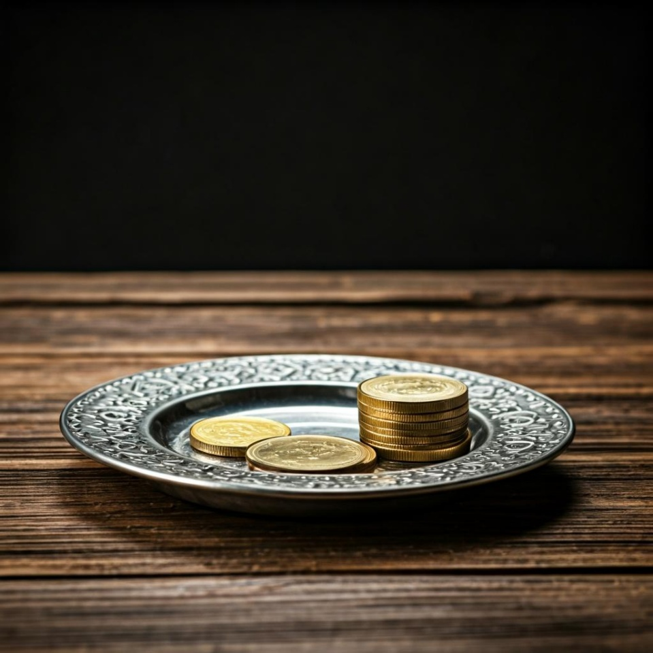
Leader: Thank you for your regular gifts to this ministry. Offerings are most welcome via:
The HHO App
Direct Debit
International Direct Debit
Please consider a one-off donation
or leaving a legacy in your Will
For further information go to HHO give page
https://holyhermits.com.au/give

Slide 57
Serving next week
21st June 2026
4th Sunday after Pentecost
9:00 am AEST
Service Prep: Lauren | Chat Host: Viki | First Reader: Vanessa
Music: Lauren | Welcomer: Chris | Second Reader: Bob
Proof-reader: Kris | Priest: N/A | Preacher: Lauren
Broadcaster: Barry | Deacon: Lauren | Fellowship: Lauren
Backup Broadcaster: Lauren | Leader: Jeremy | Safety Officer: Chris
Zoom Buttons: Viki | Cantor: Margo | Attendance: Viki
Thank you for your ministry gifts
New Servers always welcome!
Please email Rev’d Lauren to get involved
holyhermits@anglicanchurchsq.org.au

Slide 58
The Dismissal
Leader: I invite everyone to unmute for the Dismissal
Leader: Go in peace to love and serve the Lord.
All: In the name of Christ, Amen.

Slide 59
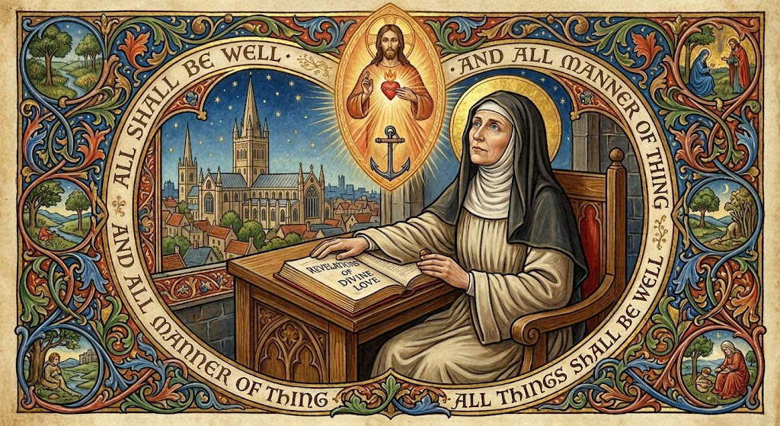
Fellowship and Saint Spotlight time
Thank you, Julie for leading Fellowship
Please feel welcome to linger or pop a message in the chat and head off when you are ready.​
Extra resources developed
by Roots on the Web

Slide 60
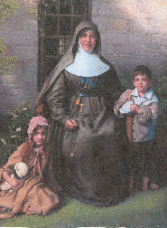
Saint Spotlight:
Saint Mary MacKillop - Mother Mary of the Cross

