Slide 1
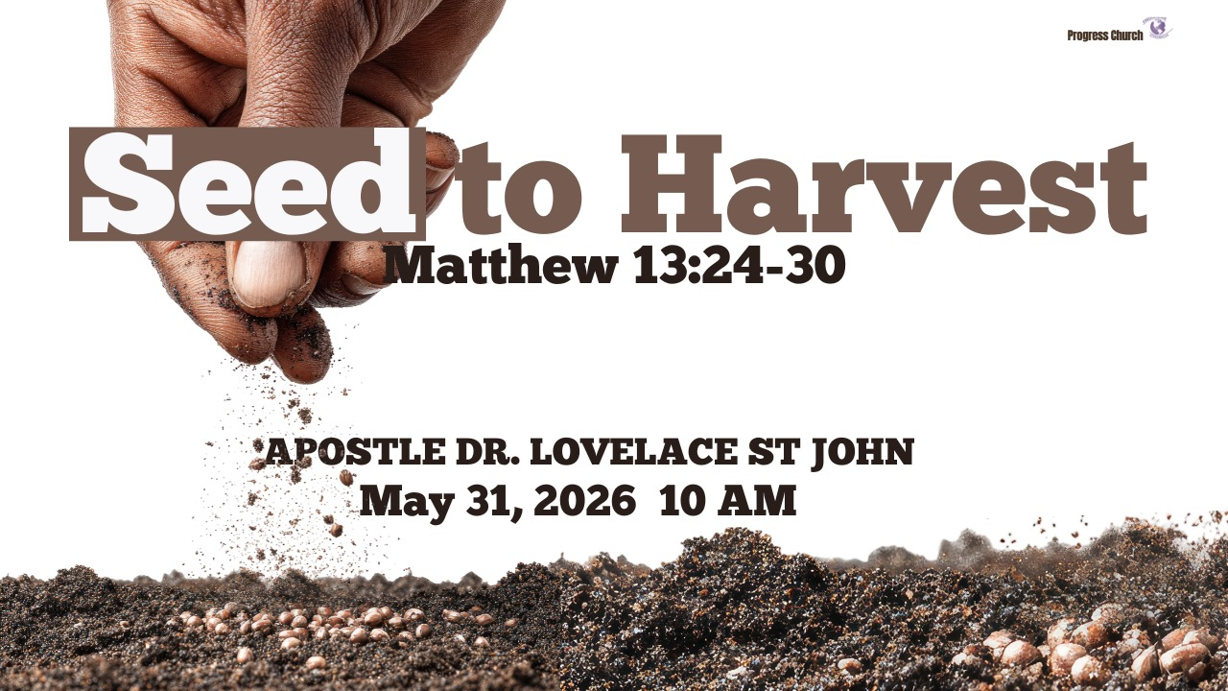

Slide 2



Scripture:
MATTHEW 13: 24 – 30

Slide 3
INTRODUCTION
Jesus describes:
A farmer sowing good seed
An enemy sowing weeds
Servants are becoming discouraged by what they see
A master who understands the process
A future harvest that is guaranteed

Slide 4
INTRODUCTION con’t
This is a Kingdom mission parable. Jesus reveals that:
The world is a field
The seed is valuable
The enemy is active
Growth takes time
Harvest is certain

Slide 5
1. Sowing Good Seed (Matthew 13:24)
The field belongs to God even when the environment looks difficult.
Your community is God’s field
Your city is God’s field
Your workplace is God’s field
Your neighborhood is God’s field
The nations belong to God

Slide 6
2. Living Among the Tares (Matthew 13:25–27)
While men slept, the enemy sowed darnel (a weed that looks exactly like wheat until it matures).
The presence of opposition does not mean the absence of God's work.
We will always encounter opposition and confusion; that does not nullify the sowing mandate.
The enemy also works in the field.

Slide 7
3. Allowing Both to Grow (Matthew 13:28–30)
The servants want to rip the weeds out immediately, but the Master says, "No, let both grow together until the harvest.”
We must learn to coexist with a broken world while staying distinct from it, trusting God with the timing.
Harvest is God’s promise to faithful Sowers.
The harvest may not come immediately, but it will come eventually.

Slide 8
4. CONCLUSION
Every harvest begins with something almost invisible.
A seed buried in darkness looks forgotten, unnoticed, and insignificant. Yet hidden inside that seed is a future field.

Slide 9
4. CONCLUSION cont
Missions often feel like seed work.
You pray for one person.
You invite one family.
You serve one neighborhood.
You plant one act of kindness.
At first, nothing appears to happen.
The mission is not to abandon the field because of resistance. The mission is to remain faithful until harvest time.

