Slide 1


Slide 2
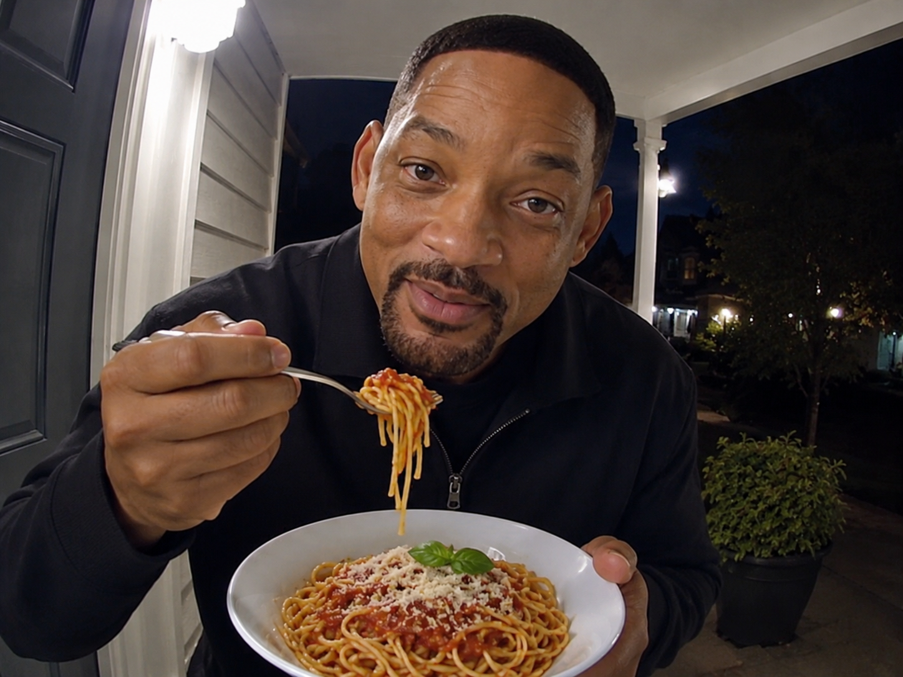
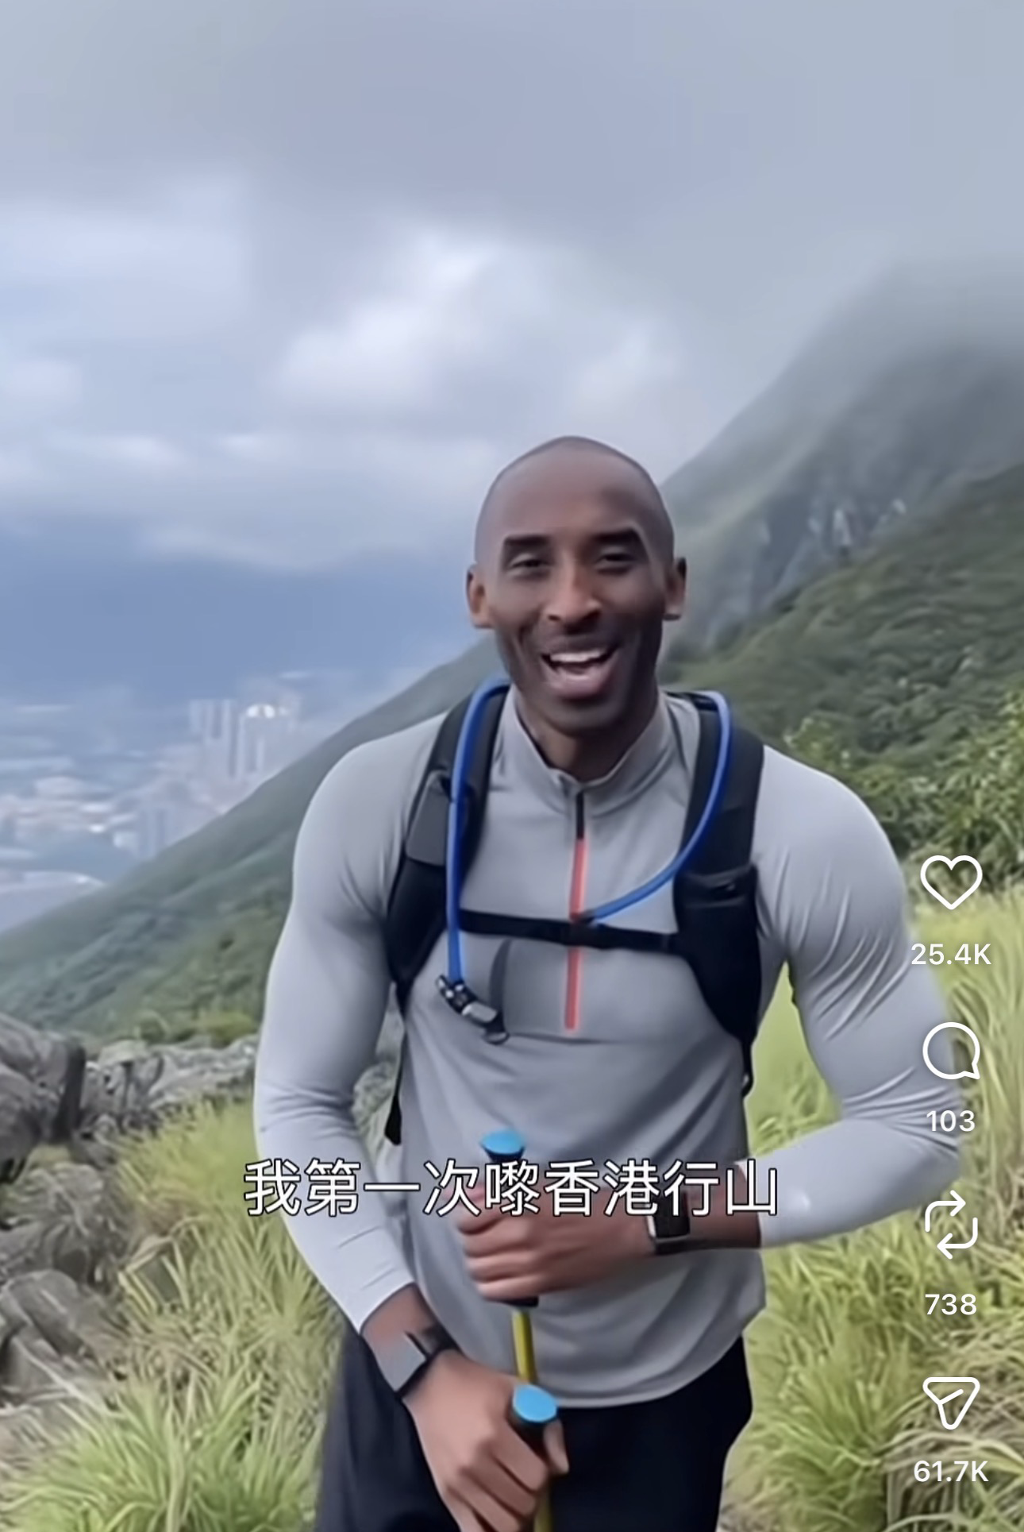

Slide 3


Slide 4


Slide 5
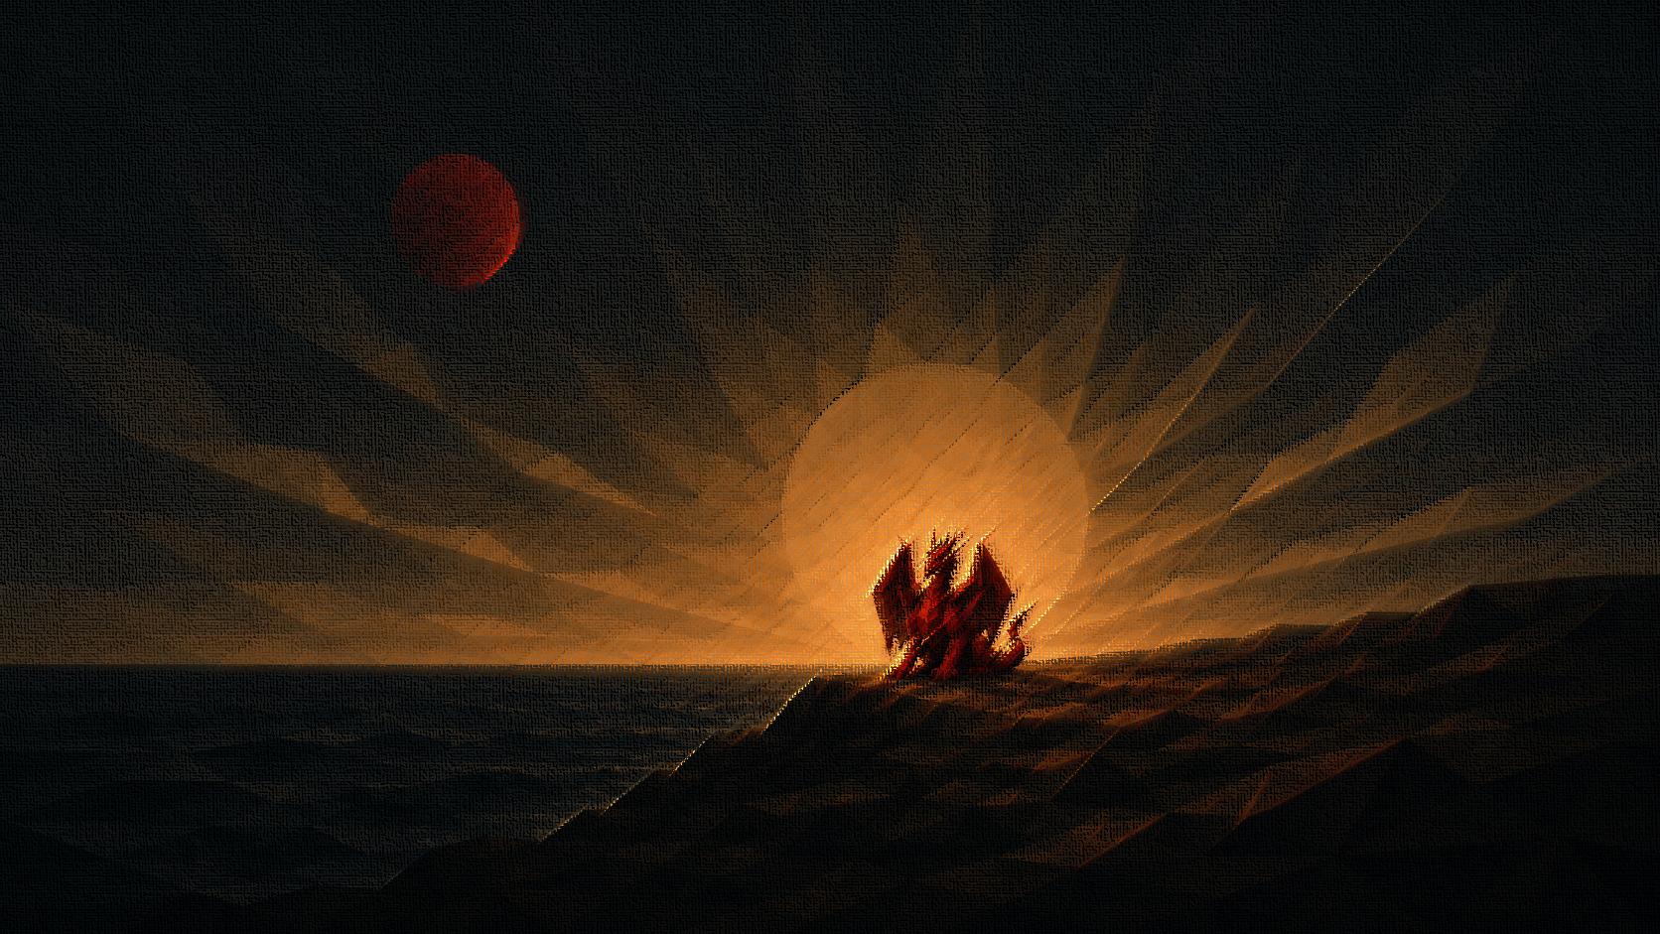

Slide 6
"For false christs and false prophets will arise and perform great signs and wonders, so as to lead astray, if possible, even the elect."
Matthew 24:24

Slide 8
And I saw a beast rising out of the sea, with ten horns and seven heads, with ten diadems on its horns and blasphemous names on its heads. 2 And the beast that I saw was like a leopard; its feet were like a bear's, and its mouth was like a lion's mouth. And to it the dragon gave his power and his throne and great authority.
Revelation 13:1-2
Ref. Daniel chapter 7

Slide 9
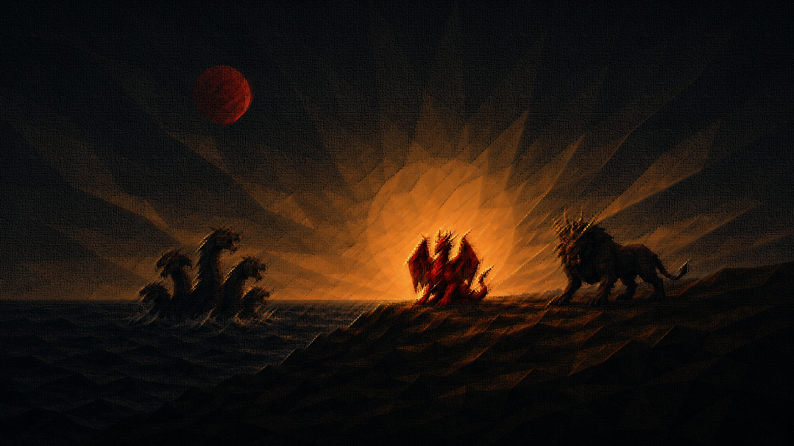

Slide 10
The dragon gave the beast his power and his throne and great authority. (13:2)
One of its heads seemed to have a mortal wound, but its mortal wound was healed. (13:3)
This leads to the worship of the beast. (13:4)
This beast was allowed to attack God’s people and persecute them. (13:7)

Slide 11

"If anyone has an ear, let him hear." (13:9)

Slide 12

“Here is a call for the endurance and faith of the saints.” (13:10)

Slide 13
“If you just worship me, I will give you everything.”

Slide 14


Slide 15
What are the things in my life that tempt me to compromise my loyalty to Jesus?

Slide 16

We need to distinguish good from evil.

Slide 17
…It had two horns like a lamb and it spoke like a dragon.
Revelation 13:11

Slide 18
…no one can buy or sell unless he has the mark, that is, the name of the beast or the number of its name. 18 This calls for wisdom: let the one who has understanding calculate the number of the beast, for it is the number of a man, and his number is 666.
Revelation 13:17-18

Slide 19
HEAR (to pay attention)
ENDURE (to stand firm and remain loyal)
DISCERN (to distinguish good from evil)

Slide 20


