Slide 1

Loving the Unlovable
Luke 6:27–36
Luke Sermon Series #8 · Sunday 7 June 2026

Slide 2
TAKE A MOMENT.
Who in your life
is unlovable?

Slide 3
DISCIPLESHIP
What does it cost to follow Jesus?
Luke 5: Called.
Luke 5: Healed.
Luke 6: Named.
Luke 6: Commanded — love your enemies.

Slide 4
"But I say to you who hear, Love your enemies, do good to those who hate you, bless those who curse you, pray for those who abuse you."
LUKE 6:27–28 · ESV

Slide 5
"To one who strikes you on the cheek, offer the other also, and from one who takes away your cloak do not withhold your tunic either. Give to everyone who begs from you, and from one who takes away your goods do not demand them back. And as you wish that others would do to you, do so to them."
LUKE 6:29–31 · ESV

Slide 6
"If you love those who love you, what benefit is that to you? For even sinners love those who love them. And if you do good to those who do good to you, what benefit is that to you? For even sinners do the same. And if you lend to those from whom you expect to receive, what credit is that to you? Even sinners lend to sinners, to get back the same amount."
LUKE 6:32–34 · ESV

Slide 7
"But love your enemies, and do good, and lend, expecting nothing in return, and your reward will be great, and you will be sons of the Most High, for he is kind to the ungrateful and the evil. Be merciful, even as your Father is merciful."
LUKE 6:35–36 · ESV

Slide 8
THE PROBLEM
Who is an enemy?

Slide 9
Jesus tells us in his own words:
Those who hate you.
Those who curse you.
Those who abuse you.
Those who strike you.
Those who take from you.
LUKE 6:27–30

Slide 10
THE LADDER
How do we usually deal with enemies?

Slide 11
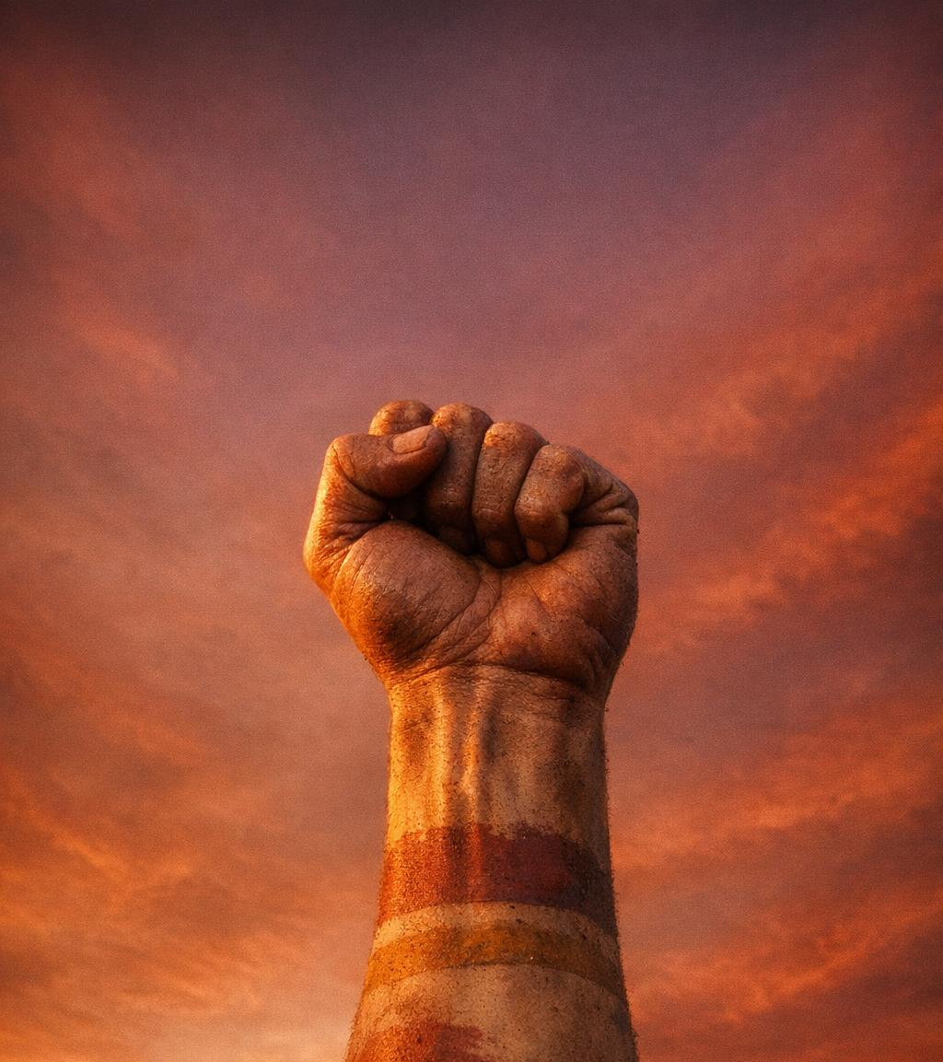
RUNG 1
Revenge

Slide 12
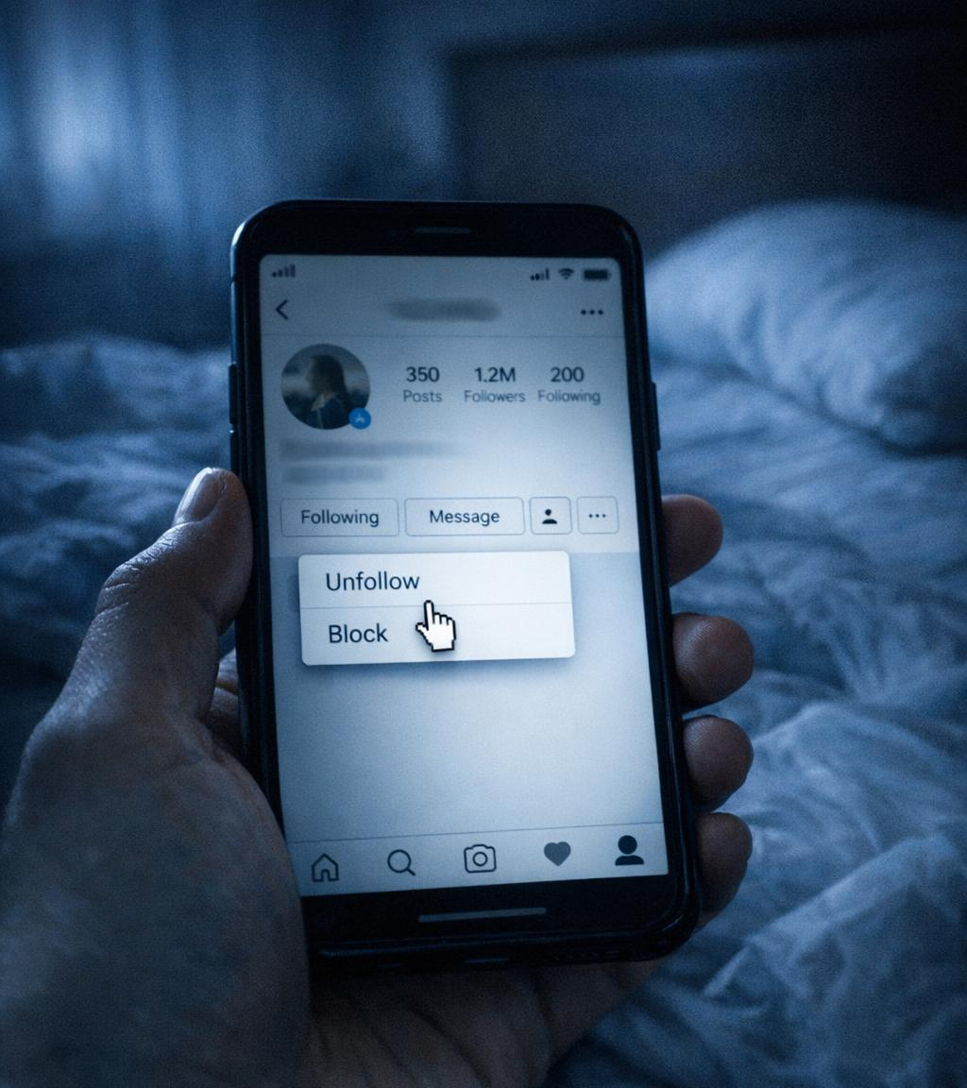
RUNG 2
Avoidance

Slide 13
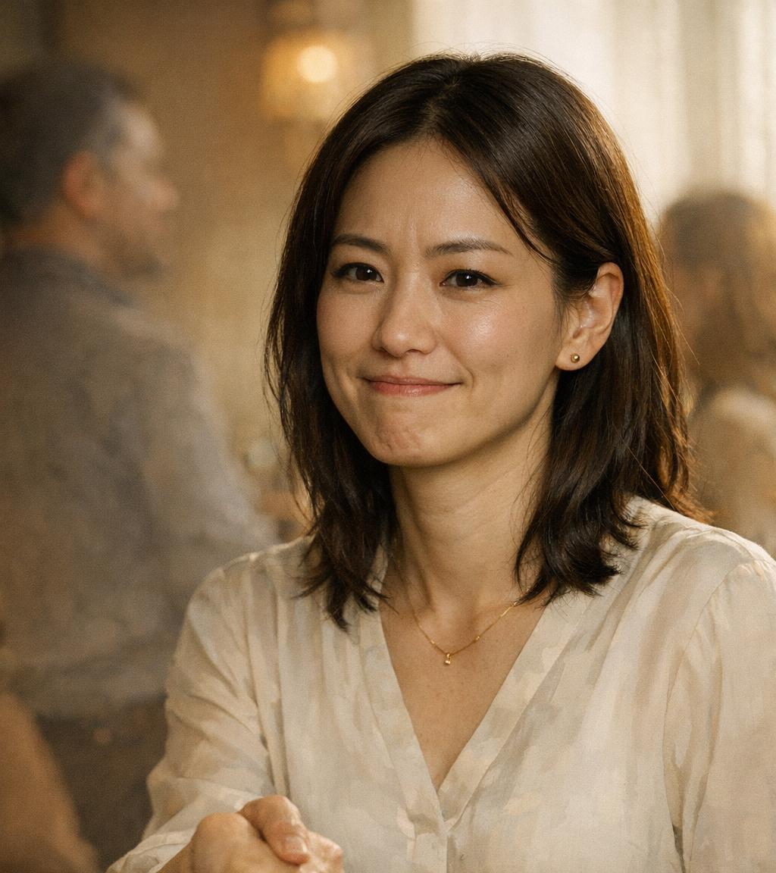
RUNG 3
Professional

Slide 14
JESUS'S DEMAND
What Jesus actually asks.

Slide 15
What does Jesus say?

Slide 16
Love
›
Do good
›
Bless
›
Pray
Enemies
›
Haters
›
Cursers
›
Abusers
4 commands × 4 objects

Slide 17
A PASTORAL WORD
But is this justice?

Slide 18
"Beloved, never avenge yourselves, but leave it to the wrath of God,
for it is written, 'Vengeance is mine, I will repay, says the Lord.'"
ROMANS 12:19
Jesus takes vengeance out of your hands.
He does not take justice out of God's hands.

Slide 19
The Cheek
Refusing to retaliate when shamed.
"To one who strikes you on the cheek, offer the other also."
LUKE 6:29a

Slide 20
Cloak: the protected garment.
Tunic: the last garment.
"From one who takes away your cloak do not withhold your tunic either."
LUKE 6:29b

Slide 21
Give to Everyone
Open hand. Free heart.
"Give to everyone who begs from you, and from one who takes away your goods do not demand them back."
LUKE 6:30

Slide 22
The Golden Rule
Freed from the scoresheet.
"As you wish that others would do to you, do so to them."
LUKE 6:31

Slide 23
This is impossible.

Slide 24
Listen to Jesus's question:
v.32 — "If you love those who love you, what benefit is that to you?"
v.33 — "If you do good to those who do good to you, what benefit is that to you?"
v.34 — "If you lend to those from whom you expect to receive, what credit is that to you?"
Three times. Same Greek word. χάρις.

Slide 25
χάρις
= grace
Three times Jesus asks:
"Can you even call that grace?"
v.32 · v.33 · v.34

Slide 26
You think you're loving like a Christian.
Jesus says you're loving like everyone else.

Slide 27
Who is the enemy?

Slide 28
"For while we were enemies, we were reconciled to God by the death of his Son."
ROMANS 5:10

Slide 29
He tore it up for you.

Slide 30
FAMILY DNA
Now — how do we love our enemy?
"He is kind to the ungrateful and the evil."
LUKE 6:35

Slide 31
"Be merciful, even as your Father is merciful."
LUKE 6:36

Slide 32
γίνεσθε
— be becoming.
You're already his child.
You're still growing into looking like him.

Slide 33
Family DNA

Slide 34
THE WORLD'S WAY
"I love because you love me."
THE FATHER'S WAY
"I love because I am loved."
Where are you?

Slide 35
THE HEART OF COMMUNION
"But God shows his love for us
in that while we were still sinners,
Christ died for us."
ROMANS 5:8

