Slide 1
Welcome to Holy Hermits Online Worship
2nd Sunday After Pentecost
Today we are remembering
Holy Hermit St Endelienta
Service Prep: Lauren | Chat Host: Rachel | First Reader: Viki
Music: Wiggles | Welcomer: Julie | Second Reader: Bob
Proof-reader: Viki | Priest: N/A | Preacher: Lauren
Broadcaster: Barry | Deacon: Lauren | Fellowship: Lauren
Backup Broadcaster: Lauren | Leader: Jeremy | Safety Officer: Julie
Zoom Buttons: Rachel | Cantor: Kieron | Attendance: Rachel

Slide 2






Hospitality
Leader:
Please mute for the service unless invited to offer your voice as part of the service ministry
Have the video camera on or off and turn the volume and brightness up or down on your device if things are too loud 🔉🔊or too bright🔅🔆
Our Cantor acts as our voice, offering the responses, in Bold Text, which we say together
Feel welcome to use the chat and reaction emojis 👍
🙏 Please take care of yourself in this space. 🙏 Come and go as you need
😴 It is great to take rest in this space, so falling asleep is also OK 😴
👂️ Remember, pastoral care is available to all in the community, if you'd like to speak to someone about anything spiritual. ❤️ Visit the help page at the website to reach out 🌐
Our Being Together ethos and safeguarding practices can also be accessed on the website 🫶​
🙌 Come as you are – we are all here together! 🙌
Notes:
Used Lent 2022

Slide 3
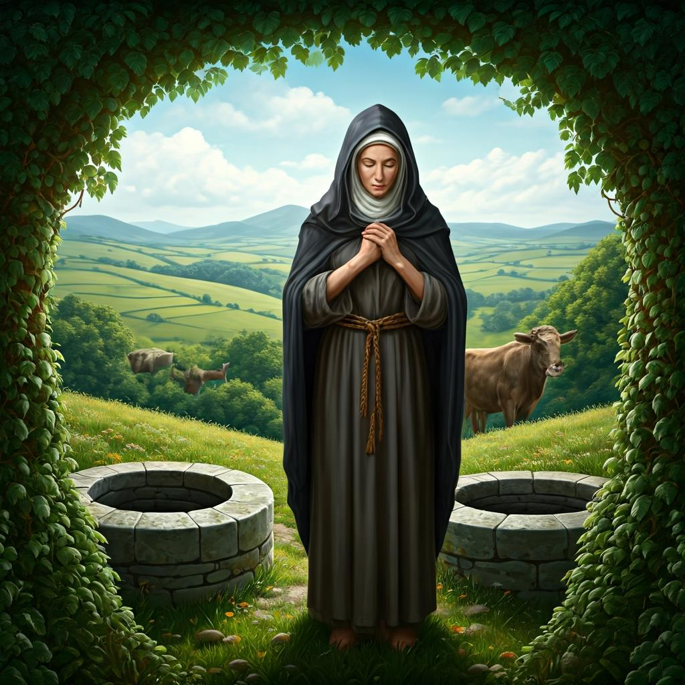
Leader: Our Holy Hermit today is Saint Endelienta
St Endelienta, daughter of King Brychan, crossed from Wales to evangelise North Cornwall and lived as a hermit near Trenteny with only a cow and two wells for sustenance. After her cow was killed, she miraculously restored both it and its killer to life.

Slide 4
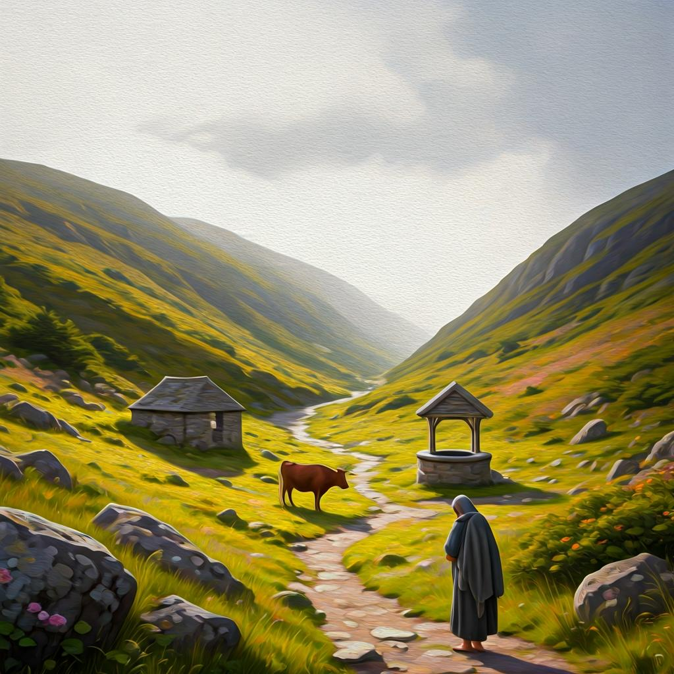
Foreseeing her death, she instructed that oxen should guide her body to its burial place. Martyred around 29 April in the mid‑6th century, possibly by Saxon raiders, she was laid to rest on a hill where a church was later built in her honour.
To read more about our hermits click the link​​ in the send out

Slide 5
Invitation
Leader: As we come into worship let’s take a few deep breaths,
Let go of anything that isn’t serving us,
And become aware of God’s presence here with us.
Opening Music: https://www.youtube.com/watch?v=XeLwO0aoEuY

Slide 6
Leader and Cantor unmute
The Greeting
Leader: The grace of the Lord Jesus Christ,
and the love of God,
and the fellowship of the Holy Spirit,
be with you all.
All: And also with you.

Slide 7
Gathering Prayer
Leader:
When we think we are beyond hope:
God’s restoring love offers a fresh start.
When life is too messed up, beyond hope:
God’s restoring peace gives hope in our darkness.
When we think we are not good enough:
Jesus comes offering hope beyond hope.
Notes:
Use Call to Worship Prayer

Slide 8
Gathering Prayer
All: Jesus, receive us as we are.
We come with hopes and fears,
but we are glad that you make all things possible
and, so, we trust in you. Amen.
Notes:
Use gathering prayer

Slide 9
Sentence
Leader: I invite our Cantor to proclaim the sentence for today.
Cantor: Those who are well have no need of a physician, but those who are sick. For I have come to call not the righteous but sinners.
Matthew 9.12–13

Slide 10
Prayer of Approach
Leader: We pray the prayer of approach together
All: Jesus saw Matthew sitting in his tax collector’s booth.
He knew the man needed his help.
‘Follow me,’ he said. And Matthew did.
Lord, however beyond hope we might feel,
may we hear your call, unable to resist you.
Would we do as Matthew did and follow you.
Amen.

Slide 11
Leader unmutes
Our first Hymn
Lord of All Hopefulness
https://www.youtube.com/watch?v=9-D_aT8CXyc&t=10s
We stay on mute
Leader mutes

Slide 12
The Deacon or LA introduces the Confession​
God is steadfast in love and infinite in mercy, welcoming sinners and inviting them to the Lord's table.
Silence may be kept.​
Let us confess our sins in penitence and faith, with a sincere and a true heart.

Slide 13
All: ​Merciful God, our maker and our judge, ​
we have sinned against you ​in thought, word, and deed, ​
and in what we have failed to do: ​
we have not loved you with our whole heart; ​
we have not loved our neighbours as ourselves; ​
we repent, and are sorry for all our sins.​
Father, forgive us. Strengthen us to love and obey you
in newness of life; ​through Jesus Christ our Lord. ​
Amen.​

Slide 14
Words of Assurance offered by the Deacon or LA
These words of assurance from the First Letter of John declare that:
If anyone sins, we have an advocate with the Father, Jesus Christ the righteous. He is the perfect offering for our sin, and not for ours only, but for the sins of the whole world.
(1 John 2: 1-2)
In this is love, not that we loved God, but that he loved us and sent his Son to be the perfect offering for our sins.
(1 John 4:10)

Slide 15
Collect
Leader:
O Lord,
from whom alone all good things come:
grant that by your holy inspiration
we may think those things that are good,
and by your merciful guiding may perform them;
through our Lord Jesus Christ.
Amen.

Slide 16
The 1st reader unmutes
Leader: I invite the 1st reader to unmute and offer the 1st lesson when ready.
Reader 1: The 1st Reading is from Genesis 12.1-9
¹ Now the Lord said to Abram, ‘Go from your country and your kindred and your father’s house to the land that I will show you. ² I will make of you a great nation, and I will bless you, and make your name great, so that you will be a blessing. ³ I will bless those who bless you, and the one who curses you I will curse; and in you all the families of the earth shall be blessed.’
Continue…

Slide 17
⁴ So Abram went, as the Lord had told him; and Lot went with him. Abram was seventy-five years old when he departed from Haran. ⁵ Abram took his wife Sarai and his brother’s son Lot, and all the possessions that they had gathered, and the persons whom they had acquired in Haran; and they set forth to go to the land of Canaan. When they had come to the land of Canaan, ⁶ Abram passed through the land to the place at Shechem, to the oak of Moreh. At that time the Canaanites were in the land.
Continue…

Slide 18
⁷ Then the Lord appeared to Abram, and said, ‘To your offspring I will give this land.’ So he built there an altar to the Lord , who had appeared to him. ⁸ From there he moved on to the hill country on the east of Bethel, and pitched his tent, with Bethel on the west and Ai on the east; and there he built an altar to the Lord and invoked the name of the Lord . ⁹ And Abram journeyed on by stages towards the Negeb.
For the word of the Lord. Thanks be to God.​

Slide 19
Leader: We now say the psalm antiphonally, I invite the first
reader to lead, and we will all respond with our cantor as our voice.
Psalm
33.1-12
¹ Rejoice in the Lord, you righteous:
for it befits the just to praise him.
² Give the Lord thanks upon the harp:
and sing his praise to the lute of ten strings.
³ O sing him a new song:
make sweetest melody, with shouts of praise.
Continue…

Slide 20
⁴ For the word of the Lord is true:
and all his works are faithful.
⁵ He loves righteousness and justice:
the earth is filled with the loving-kindness of the Lord.
⁶ By the word of the Lord were the heavens made:
and their numberless stars by the breath of his mouth.
⁷ He gathered the waters of the sea as in a water-skin:
and laid up the deep in his treasuries.
Continue…

Slide 21
⁸ Let the whole earth fear the Lord:
and let all the inhabitants of the world
stand in awe of him.
⁹ For he spoke, and it was done:
he commanded, and it stood fast.
¹⁰ The Lord frustrates the counsels of the nations:
he brings to nothing the devices of the peoples.
Continue…

Slide 22
¹¹ But the counsels of the Lord shall endure for ever:
the purposes of his heart from generation to generation.
¹² Blessed is that nation whose God is the Lord:
the people he chose to be his own possession.

Slide 23
The 2nd reader unmutes
Leader: I invite the 2nd reader to unmute and offer the 2nd lesson when ready.
Reader 2: The 2nd Reading is from Romans 4.13-25
¹³ For the promise that he would inherit the world did not come to Abraham or to his descendants through the law but through the righteousness of faith. ¹⁴ If it is the adherents of the law who are to be the heirs, faith is null and the promise is void. ¹⁵ For the law brings wrath; but where there is no law, neither is there violation.
Continue…

Slide 24
¹⁶ For this reason it depends on faith, in order that the promise may rest on grace and be guaranteed to all his descendants, not only to the adherents of the law but also to those who share the faith of Abraham (for he is the father of all of us, ¹⁷ as it is written, ‘I have made you the father of many nations’)—in the presence of the God in whom he believed, who gives life to the dead and calls into existence the things that do not exist. ¹⁸ Hoping against hope, he believed that he would become ‘the father of many nations’, according to what was said,
Continue…

Slide 25
‘So numerous shall your descendants be.’ ¹⁹ He did not weaken in faith when he considered his own body, which was already as good as dead (for he was about a hundred years old), or when he considered the barrenness of Sarah’s womb. ²⁰ No distrust made him waver concerning the promise of God, but he grew strong in his faith as he gave glory to God, ²¹ being fully convinced that God was able to do what he had promised. ²² Therefore his faith ‘was reckoned to him as righteousness.’
Continue…

Slide 26
²³ Now the words, ‘it was reckoned to him’, were written not for his sake alone, ²⁴ but for ours also. It will be reckoned to us who believe in him who raised Jesus our Lord from the dead, ²⁵ who was handed over to death for our trespasses and was raised for our justification.
For the word of the Lord. Thanks be to God.​

Slide 27

We pause before
​the Gospel ​​

Slide 28
Deacon: The Gospel of our Lord Jesus Christ according to St Matthew Chapter 9 beginning at the 9th verse
All: Glory to you Lord Jesus Christ.
⁹ As Jesus was walking along, he saw a man called Matthew sitting at the tax booth; and he said to him, ‘Follow me.’ And he got up and followed him. ¹⁰ And as he sat at dinner in the house, many tax-collectors and sinners came and were sitting with him and his disciples. ¹¹ When the Pharisees saw this, they said to his disciples, ‘Why does your teacher eat with tax-collectors and sinners?’
Continue…

Slide 29
¹² But when he heard this, he said, ‘Those who are well have no need of a physician, but those who are sick. ¹³ Go and learn what this means, “I desire mercy, not sacrifice.” For I have come to call not the righteous but sinners.’
¹⁸ While he was saying these things to them, suddenly a leader of the synagogue came in and knelt before him, saying, ‘My daughter has just died; but come and lay your hand on her, and she will live.’ ¹⁹ And Jesus got up and followed him, with his disciples.
Continue…

Slide 30
²⁰ Then suddenly a woman who had been suffering from haemorrhages for twelve years came up behind him and touched the fringe of his cloak, ²¹ for she said to herself, ‘If I only touch his cloak, I will be made well.’ ²² Jesus turned, and seeing her he said, ‘Take heart, daughter; your faith has made you well.’ And instantly the woman was made well. ²³ When Jesus came to the leader’s house and saw the flute-players and the crowd making a commotion,
Continue…

Slide 31
²⁴ he said, ‘Go away; for the girl is not dead but sleeping.’ And they laughed at him. ²⁵ But when the crowd had been put outside, he went in and took her by the hand, and the girl got up. ²⁶ And the report of this spread throughout that district.
This is the Gospel of the Lord. Praise to you Lord Jesus Christ.

Slide 32

We pause
after ​the Gospel ​​

Slide 33
Leader: The Sermon is recorded to YouTube for sharing later.
Only the preacher's video and audio will be recorded.
The chat and other participants' feeds remain out of sight of the recording.
Leader and Cantor mute
Broadcaster exits screenshare
Preacher unmutes
Zoom buttons ”pins” preacher’s screen + selects “record to the cloud”
Sermon

Slide 34
Leader unmutes
Our next Hymn
Healing Grace
https://www.youtube.com/watch?v=RY0YnNoYS8s
We stay on mute
Leader mutes

Slide 35
The Leader and Cantor unmute
The Greeting of Peace
Leader: We are the body of Christ
All: God’s Spirit is with us
Leader: The peace of the Lord be always with you.
All: And also with you.
Leader: A sign of peace may be exchanged
You may like to type 'Peace' into the chat, use the 'raise hand’ or other reaction buttons, or just simply wave via the screen with your video turned on
(Broadcaster exits shared screen for a few moments for the exchange of peace)

Slide 36

Prayer of Thanksgiving before Intercessions
Leader: As we enter prayer, I invite the second reader to unmute to lead our intercessions following the prayer of thanksgiving on the next slide. Please feel free to change your body position as you need.
Continue…

Slide 37
Leader: Thank you, Lord, that you are with us always,
to the very end of the age.
You gave all your disciples authority to spread your word.
Thank you that we are your disciples also,
and you do the same for us.
May we praise you with our words and actions,
as we seek first your kingdom in our lives.
Thank you, Lord.
Amen.
Notes:
Prayer of praise and thanksgiving

Slide 38
Intercessions
Reader 2: We pray for creation and communities we share our lives with. We pause for a few moments to name either in our hearts, or out loud, or in the chat, those environments and communities we bring to the Lord in prayer.
PAUSE…
Continue…

Slide 39
Intercessions
Reader 2: We entrust to you the community of Holy Hermits Online and our ministry partners:
Prosper the work of our hands and show us the way to your new creation.
Creator God, Hear our prayer.
St John's Cathedral Brisbane The Anglican Diocese of Southern Queensland St Gabriel’s, Carindale Benedictus Contemplative Church, Canberra Anglican Focus and Tithe.ly

Slide 40

Reader 2: Loving Creator, we entrust to you all animals, especially those who are sick, anxious, ageing, lost, at risk, lonely, sad, hungry, in pain, homeless, abused, living in fear, encountering violence of any kind, in need of comfort, rehabilitation or transformation.

Slide 41

Reader 2: We invite your loving compassion for:
We name in our hearts, out loud or in the chat,
the animals we bring to the Lord in prayer. PAUSE…
Jasmine, ​
Leese(y), ​
Sid, Toots & Lulu​
Polly and Suki​
Fred, George & Percy​
Koshka ​
Jax
Lambert ​​
Kala, Nigel & Little One ​​
Toby​​
Taco​​
Paddy ​​
Rosie​

Slide 42
Reader 2: Eternal Trinity of Love, we uphold to you the people we love and carry cares for:
Kerry, Les & Jake Julie, Ray, Tracey & Shane Mark, Desley & Bob ​​ Rachel, Mervyn & Gillian ​​Rev'd Shane & Janette​​ Alecia, Martin & Aidan​​ Kirsten, Greg, Daphne & Beau Bill & Marjorie​​ Aaron & Andrea Liz’s Godchildren | Barry​​ Dr Julie ​​ Ruth​​ Phil​ May Susan Tanya​ Neva Kathy ​Gayanne Tina | ​​ | Alan & Gaylene​ Jess & Leah ​​ Barry & Gwen Matthew & Nicholas​ Bob & Di​ Pat & Julie Dilys & Tony, Paul & Darhon Judy & Mary Miriam Lorelei

Slide 43
Reader 2:
We name in our hearts, out loud or in the chat, those we bring to the Lord in prayer.
PAUSE…
We entrust to you those who have died, those who have died peacefully and those who have died tragically, The old and the young. Receive them into your Kingdom. Lord in your mercy, Hear our prayers. Amen.

Slide 44
Pray Daily Cycle of Prayer
Leader: Loving God, joining with the Church in our cycle of prayer, we ask your blessings on:
The Scottish Episcopal Church
The Diocese of Brisbane: †Jeremy; Assistant Bishops – †Cameron, †John, †Sarah; Clergy and People
The Parish of Kenmore-Brookfield: Deb, Colin, Sandra, Jane, Graham, George, Josie
St Francis College – current Grow (Formation) students: Paul, Naomi, Stephen, Alison, Juliet, Troy, Elise, Keith, Fionn, Hilda, Kevin, Rachel, Simon
Hillbrook Anglican School, Enoggera: Principal – Mark; Chaplain – David; Chair of School Council – David; members of School Council; staff & students

Slide 45
Commitment prayer for the week
Leader: Our commitment prayer for the week is for Companion animals
Creator God, we give thanks for your call to develop a Companion Animal Ministry at Holy Hermits Online. ​
​We ask for your grace to guide us, as we build this ministry together. ​
​Holy Spirit we ask your presence to be with us as we continue to develop resources together in this new season. ​
​
Continue…
Notes:
Link to prayer group ministry page for weekly commitment prayer https://holyhermits.com.au/ministries/prayer-group

Slide 46
​​Provide us with wisdom and with compassion and with a sense of fun as we celebrate our companion animals and live this mission to outreach. ​
​Alongside Holy Hermit St. Francis, we ask you Lord Jesus Christ, to enliven us in this ministry space. ​
​Amen.
Notes:
Link to prayer group ministry page for weekly commitment prayer https://holyhermits.com.au/ministries/prayer-group

Slide 47
Leader: Let us pray together the prayer which Jesus gave us saying:
All: Our Father in heaven, hallowed be your name,
your kingdom come, your will be done, on earth as in heaven.
Give us today our daily bread.
Forgive us our sins
as we forgive those who sin against us.
Save us from the time of trial and deliver us from evil.
For the kingdom, the power, and the glory are yours
now and for ever.
Amen.

Slide 48
Devotions

Slide 49
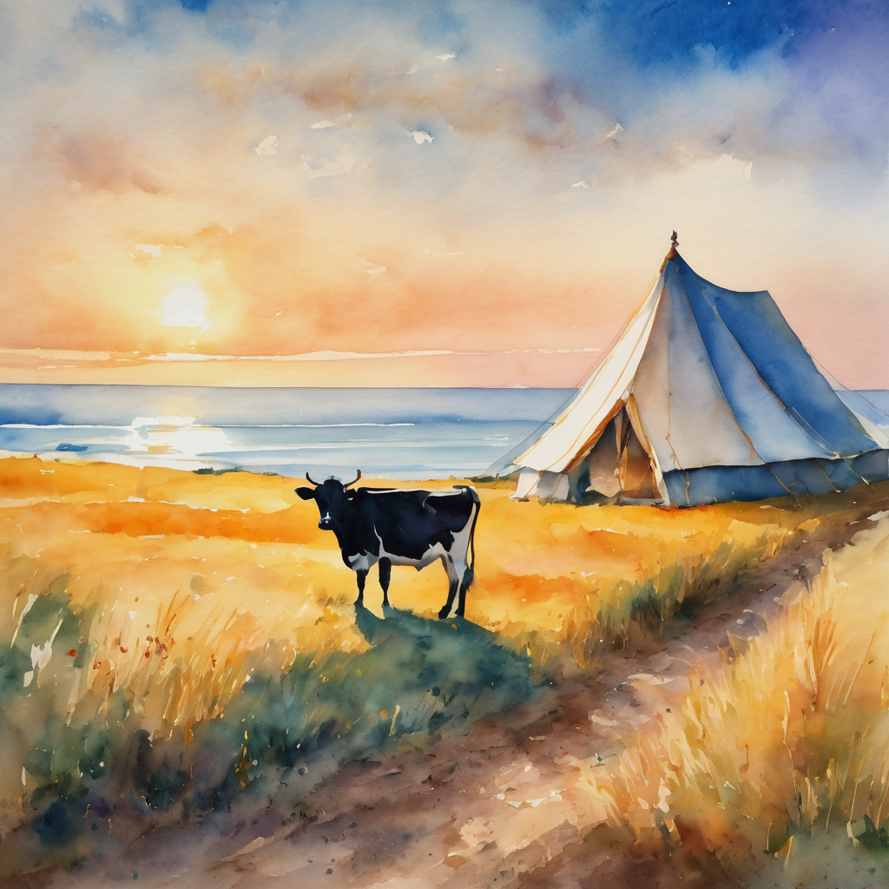
Holy Hermit
St Endelienta

Slide 50
Hermit Wisdom
A prayer inspired by St Endelienta;
Holy Spirit, we give you thanks for the life and example of Endelienta, a Hermit who had enormous trust in you. As she encourages us to go with the flow of your life guiding presence, may we be reminded of the great love you have entrusted us to bear for our fellow creatures. When we witness to your Gospel with those around us may they be struck by our own trust in your purposes and goodness. Amen.

Slide 51

​
Leader: ​As we enter a few minutes of silence together, you are invited to pray the prayer of adoration on the next slide and/or spend this time in contemplation. ​
The Spiritual Communion prayer follows on the slide after that.
Let us be still.
Leader and Cantor Mute.
Continue…

Slide 52

​
God, you are our hope,
even when we feel we are beyond hope.
God, you give us hope,
help us to be your hope for one another,
and spread your hope to our community.
Amen.
Notes:
Prayer for all ages

Slide 53

Oh, my Lord Jesus I turn to you present at the Altar and in the Tabernacle. I believe that you are present in the Holy Sacrament of your most Sacred Body and Blood. I love you above all things and I desire to receive you into my Soul. I cannot at this moment receive you Sacramentally in Holy Communion. Come spiritually into my heart. Purify it, Sanctify it. Render my heart like your own heart. I embrace you as if you were already there and unite myself wholly with you. Never permit me to be separated from you. Lord, I am not worthy to receive you, but only say the word and I shall be healed. Amen
Making a
Spiritual Communion
(Prayed in silence)

Slide 54
Leader unmutes
Our final song is
Reach out to Jesus
https://www.youtube.com/watch?v=-nJsh2FS550
​We stay on mute
Leader and Cantor mute

Slide 55
Leader and cantor unmute
Sending Prayer
Leader: We pray our sending prayer together.
All: May God, who is never-ending,
put his hope around us.
May Jesus, the hope of the world,
be known as he goes with us.
May the Holy Spirit, our great enabler,
empower us to bring hope to others. Amen.

Slide 56
The Benediction
Leader: Let us all invite God’s blessings together,
All: May the Lord bless us and keep us.
May the Lord’s face shine upon us and be gracious to us.
May the Lord’s countenance be lifted upon us,
and bring us peace. Amen

Slide 57
Notices
Today 3D Dialogue: Joy in connection, learning to live with one another again is this afternoon @ 5pm. All are welcome.
Wednesday @6pm we continue our study on the Trinity; Embracing The Divine Flow: Prepared for unity with God. It’s not too late to come along.
Thursday @6pm is our next Prayer and Praise with our Animal Friends. We welcome Troy our guest speaker for DRU
See HHO Events page for further upcoming events HHO Events

Slide 58

Leader: Thank you for your regular gifts to this ministry. Offerings are most welcome via:
The HHO App
Direct Debit
International Direct Debit
Please consider a one-off donation
or leaving a legacy in your Will
For further information go to HHO give page
https://holyhermits.com.au/give

Slide 59
Serving next week
14th June 2026
3rd Sunday after Pentecost
9:00 am AEST
Service Prep: Kris | Chat Host: Rachel | First Reader: Liz
Music: Wiggles | Welcomer: Julie | Second Reader: Helen
Proof-reader: Chris | Priest: N/A | Preacher: Lauren
Broadcaster: Lauren | Deacon: Lauren | Fellowship: Julie
Backup Broadcaster: Barry | Leader: Julie | Safety Officer: Chris
Zoom Buttons: Lauren | Cantor: Vanessa | Attendance: Rachel
Thank you for your ministry gifts
New Servers always welcome!
Please email Rev’d Lauren to get involved
holyhermits@anglicanchurchsq.org.au

Slide 60
The Dismissal
Leader: I invite everyone to unmute for the Dismissal
Leader: Go in peace to love and serve the Lord.
All: In the name of Christ, Amen.

Slide 61
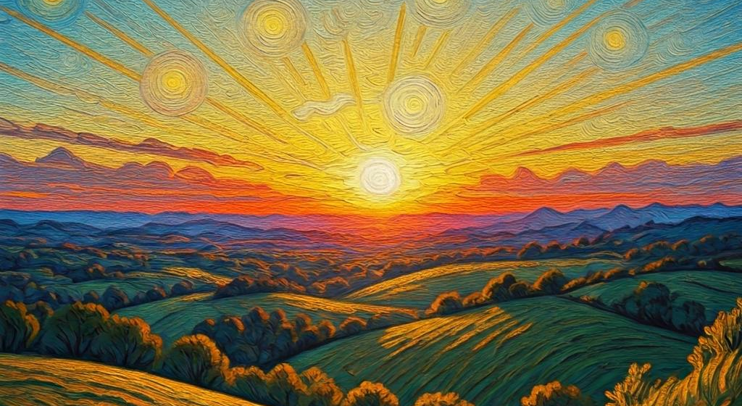
Fellowship time
Thank you, Lauren for leading Fellowship
Please feel welcome to linger or pop a message in the chat and head off when you are ready.​
Extra resources developed
by Roots on the Web

