Slide 1
Welcome to Holy Hermits Online Worship
Pentecost
Today we are remembering
Holy Hermit St Mary of Egypt
Service Prep: Lauren | Chat Host: Rachel | First Reader: Phil
Music: Lauren | Welcomer: Julie | Second Reader: Paul
Proof-reader: Viki | Priest: N/A | Preacher: Lauren
Broadcaster: Kieron | Deacon: Lauren | Fellowship: Rachel
Backup Broadcaster: Lauren | Leader: Julie | Safety Officer: Julie
Zoom Buttons: Viki | Cantor: Jeremy | Attendance: Viki

Slide 2






Hospitality
Leader:
Please mute for the service unless invited to offer your voice as part of the service ministry
Have the video camera on or off and turn the volume and brightness up or down on your device if things are too loud 🔉🔊or too bright🔅🔆
Our Cantor acts as our voice, offering the responses, in Bold Text, which we say together
Feel welcome to use the chat and reaction emojis 👍
🙏 Please take care of yourself in this space. 🙏 Come and go as you need
😴 It is great to take rest in this space, so falling asleep is also OK 😴
👂️ Remember, pastoral care is available to all in the community, if you'd like to speak to someone about anything spiritual. ❤️ Visit the help page at the website to reach out 🌐
Our Being Together ethos and safeguarding practices can also be accessed on the website 🫶​
🙌 Come as you are – we are all here together! 🙌
Notes:
Used Lent 2022

Slide 3
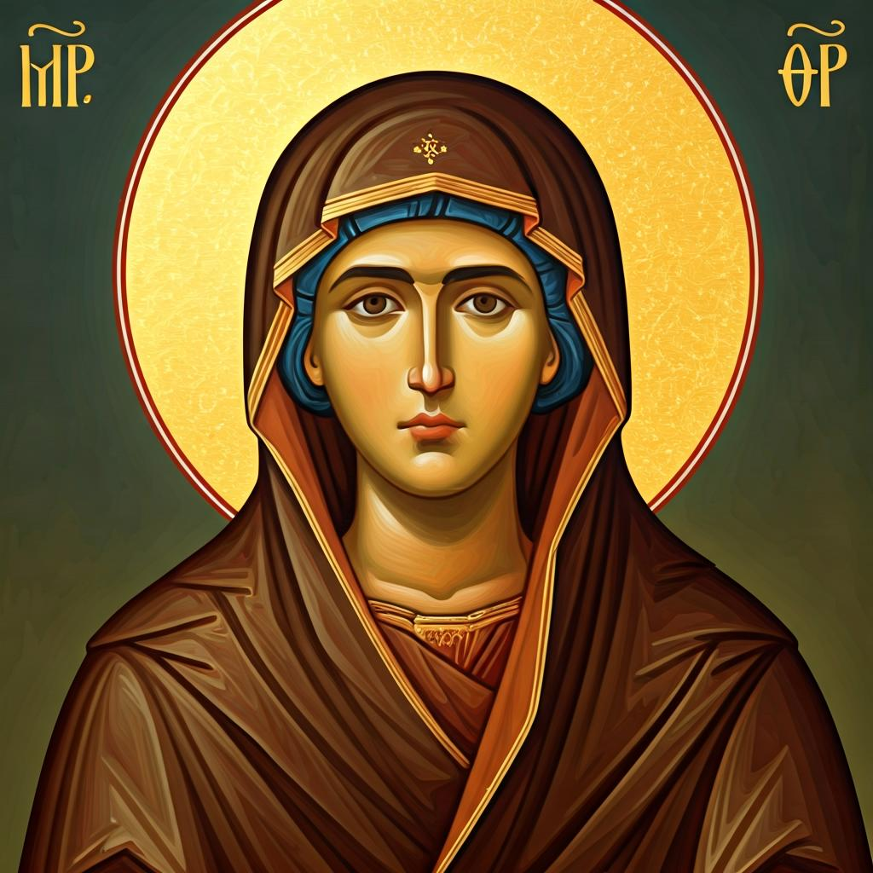
Leader: Our Holy Hermit today is St Mary of Egypt
St Mary of Egypt, the saint of penitents, life reads like a dramatic arc of ruin, revelation, and radiant transformation. Fleeing to Alexandria at twelve, she spent seventeen years in reckless excess. Selling her body and living among strangers until she had an experience of transformation at the Holy Sepulchre in Jerusalem which made her change from a person of the flesh, to a person of the spirit.

Slide 4
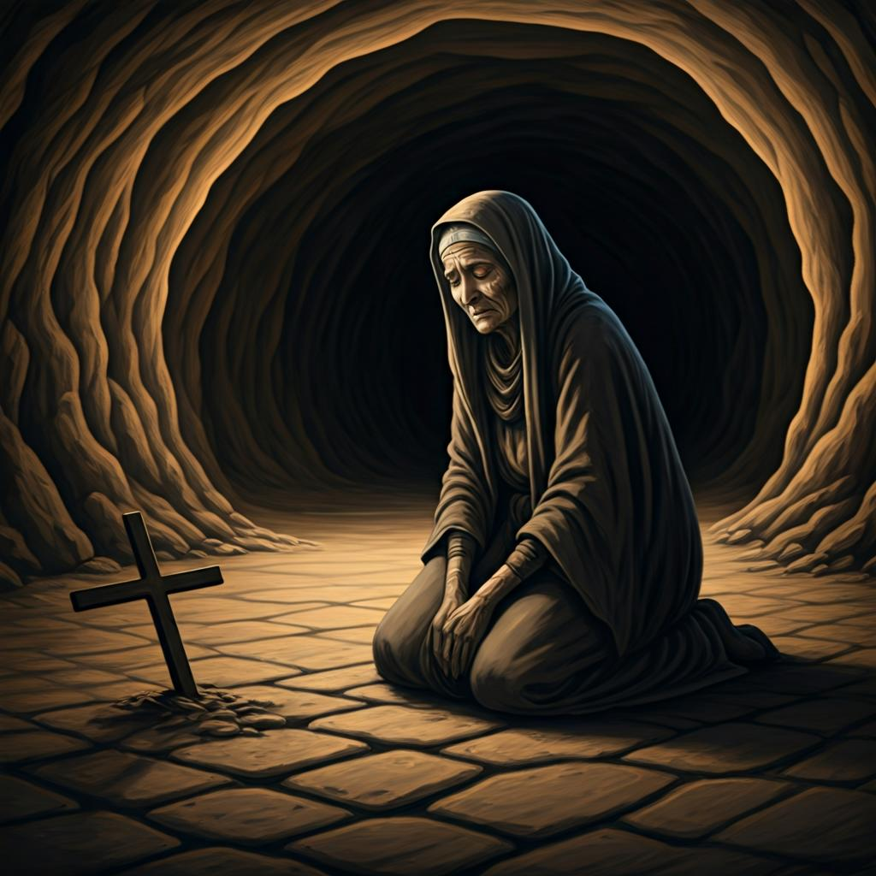
Guided by a divine voice, she crossed the Jordan and embraced decades of desert solitude. Near her death, she met Zosimas, walked across the Jordan’s waters to receive Communion, and died that same night. Found incorrupt and buried with a lion’s help, she endures as icon of radical repentance and grace.
To read more about our hermits click the link​​ in the send out

Slide 5
Invitation
Leader: As we come into worship let’s take a few deep breaths,
Let go of anything that isn’t serving us,
And become aware of God’s presence here with us.
Opening Music:
Veni Creator Spiritus – Gregorian chant
https://www.youtube.com/watch?v=HEKuxUOPzk8

Slide 6
Leader and Cantor unmute
The Greeting
Leader: Christ has risen, Alleluia!
All: Christ is risen indeed, Alleluia!

Slide 7
Gathering Prayer
Leader:
We are different but united in our commitment to Jesus.
Let us stand together, using the gifts he has given us.
Let us worship him and receive his commands,
responding to his call and being a blessing to others.

Slide 8
Gathering Prayer
All: Jesus, we gather here today waiting for you to come among us,
to share your peace with us and to fill us again with your Holy Spirit.
We welcome you now and ask that you breathe upon us
and lead our worship that we might glorify your name together.
Amen.

Slide 9
Sentence
Leader: I invite our Cantor to proclaim the sentence for today.
Cantor: ‘Let anyone who is thirsty come to me,’ says the Lord; ‘and let the one who believes in me drink. For out of your heart shall flow rivers of living water.’
John 7.38

Slide 10
Prayer of Approach
Leader: We pray the prayer of approach together
All: Lord, on this day of Pentecost,
we come to you in awe and anticipation,
in expectation of our hearts being strangely warmed.
We wait on you, ready to receive the gift of your Holy Spirit.
Ready to receive your blessing,
so that we, in turn, may be a blessing to others.
Amen.

Slide 11
All: ​Merciful God, our maker and our judge, ​
we have sinned against you ​in thought, word, and deed, ​
and in what we have failed to do: ​
we have not loved you with our whole heart; ​
we have not loved our neighbours as ourselves; ​
we repent, and are sorry for all our sins.​
Father, forgive us. Strengthen us to love and obey you
in newness of life; ​through Jesus Christ our Lord. ​
Amen.​

Slide 12
Words of Assurance offered by the Deacon
These words of assurance from the First Letter of John declare that:
If anyone sins, we have an advocate with the Father, Jesus Christ the righteous. He is the perfect offering for our sin, and not for ours only, but for the sins of the whole world.
(1 John 2: 1-2)
In this is love, not that we loved God, but that he loved us and sent his Son to be the perfect offering for our sins.
(1 John 4:10)

Slide 13
The Gloria​
Leader: We now sing the Gloria together
https://www.youtube.com/watch?v=Zn4SQmcFqUQ
Leader Mutes

Slide 14
Collect
Leader: Almighty God,
at the feast of Pentecost you sent your Holy Spirit to the disciples,
filling them with joy and boldness to preach the gospel:
empower us with that same Spirit to witness to your redeeming love
and draw all people to you;
through Jesus Christ our Lord,
who lives and reigns with you and the Holy Spirit,
one God, now and for ever. Amen.

Slide 15
The 1st reader unmutes
Leader: I invite the 1st reader to unmute and offer the 1st lesson when ready.
Reader 1: The 1st Reading is from Acts 2.1-21
¹ When the day of Pentecost had come, they were all together in one place.² And suddenly from heaven there came a sound like the rush of a violent wind, and it filled the entire house where they were sitting.³ Divided tongues, as of fire, appeared among them, and a tongue rested on each of them.⁴ All of them were filled with the Holy Spirit and began to speak in other languages, as the Spirit gave them ability.
Continue…

Slide 16
⁵ Now there were devout Jews from every nation under heaven living in Jerusalem.⁶ And at this sound the crowd gathered and was bewildered, because each one heard them speaking in the native language of each.⁷ Amazed and astonished, they asked, ‘Are not all these who are speaking Galileans?⁸ And how is it that we hear, each of us, in our own native language?⁹ Parthians, Medes, Elamites, and residents of Mesopotamia, Judea and Cappadocia, Pontus and Asia,¹⁰ Phrygia and Pamphylia, Egypt and the parts of Libya belonging to Cyrene, and visitors from Rome, both Jews and proselytes, ¹¹ Cretans and Arabs—
Continue…

Slide 17
in our own languages we hear them speaking about God’s deeds of power.’ ¹² All were amazed and perplexed, saying to one another, ‘What does this mean?’ ¹³ But others sneered and said, ‘They are filled with new wine.’
¹⁴ But Peter, standing with the eleven, raised his voice and addressed them: ‘Men of Judea and all who live in Jerusalem, let this be known to you, and listen to what I say.¹⁵ Indeed, these are not drunk, as you suppose, for it is only nine o’clock in the morning.¹⁶ No, this is what was spoken through the prophet Joel:
Continue…

Slide 18
¹⁷ “In the last days it will be, God declares,
that I will pour out my Spirit upon all flesh,
and your sons and your daughters shall prophesy,
and your young men shall see visions,
and your old men shall dream dreams.
¹⁸ Even upon my slaves, both men and women,
in those days I will pour out my Spirit;
and they shall prophesy.
Continue…

Slide 19
¹⁹ And I will show portents in the heaven above
and signs on the earth below,
blood, and fire, and smoky mist.
²⁰ The sun shall be turned to darkness
and the moon to blood,
before the coming of the Lord’s great and glorious day.
²¹ Then everyone who calls on the name of the Lord shall be saved.”
For the word of the Lord. Thanks be to God.​

Slide 20
Leader: We now say the psalm antiphonally, I invite the first
reader to lead, and we will all respond with our cantor as our voice.
Psalm
104.26-36
²⁶ Lord, how various are your works:
in wisdom you have made them all,
and the earth is full of your creatures.
²⁷ There is the wide, immeasurable sea:
there move living things without number, great and small;
Continue…

Slide 21
²⁸ There go the ships, to and fro:
and there is that Leviathan
whom you formed to sport in the deep.
²⁹ These all look to you:
to give them their food in due season.
³⁰ When you give it to them, they gather it:
when you open your hand
they are satisfied with good things.
Continue…

Slide 22
³¹ When you hide your face, they are troubled:
when you take away their breath,
they die and return to their dust.
³² When you send forth your spirit they are created:
and you renew the face of the earth.
³³ May the glory of the Lord endure for ever:
may the Lord rejoice in his works.
³⁴ If he look upon the earth, it shall tremble:
if he but touch the mountains, they shall smoke.
Continue…

Slide 23
³⁴ Ascribe power to God, whose majesty is over Israel:
³⁵ I will sing to the Lord as long as I live:
I will praise my God while I have any being.
³⁶ May my meditation be pleasing to him:
for my joy shall be in the Lord.

Slide 24
The 2nd reader unmutes
Leader: I invite the 2nd reader to unmute and offer the 2nd lesson when ready.
Reader 2: The 2nd Reading is from 1 Corinthians 12.1-13
¹ Now concerning spiritual gifts, brothers and sisters, I do not want you to be uninformed. ² You know that when you were pagans, you were enticed and led astray to idols that could not speak. ³ Therefore I want you to understand that no one speaking by the Spirit of God ever says ‘Let Jesus be cursed!’ and no one can say ‘Jesus is Lord’ except by the Holy Spirit.
Continue…

Slide 25
⁴ Now there are varieties of gifts, but the same Spirit; ⁵ and there are varieties of services, but the same Lord; ⁶ and there are varieties of activities, but it is the same God who activates all of them in everyone. ⁷ To each is given the manifestation of the Spirit for the common good. ⁸ To one is given through the Spirit the utterance of wisdom, and to another the utterance of knowledge according to the same Spirit, ⁹ to another faith by the same Spirit, to another gifts of healing by the one Spirit,
Continue…

Slide 26
¹⁰ to another the working of miracles, to another prophecy, to another the discernment of spirits, to another various kinds of tongues, to another the interpretation of tongues. ¹¹ All these are activated by one and the same Spirit, who allots to each one individually just as the Spirit chooses. ¹² For just as the body is one and has many members, and all the members of the body, though many, are one body, so it is with Christ. ¹³ For in the one Spirit we were all baptized into one body—Jews or Greeks, slaves or free—and we were all made to drink of one Spirit.
For the word of the Lord. Thanks be to God.​

Slide 27

We pause before
​the Gospel ​​

Slide 28
Deacon: The Gospel of our Lord Jesus Christ according to St John Chapter 20 beginning at the 19th verse
All: Glory to you Lord Jesus Christ.
¹⁹ When it was evening on that day, the first day of the week, and the doors of the house where the disciples had met were locked for fear of the Jews, Jesus came and stood among them and said, ‘Peace be with you.’ ²⁰ After he said this, he showed them his hands and his side. Then the disciples rejoiced when they saw the Lord.
Continue…

Slide 29
²¹ Jesus said to them again, ‘Peace be with you. As the Father has sent me, so I send you.’ ²² When he had said this, he breathed on them and said to them, ‘Receive the Holy Spirit. ²³ If you forgive the sins of any, they are forgiven them; if you retain the sins of any, they are retained.’
This is the Gospel of the Lord. Praise to you Lord Jesus Christ.

Slide 30

We pause
after ​the Gospel ​​

Slide 31
Leader: .
Leader and Cantor mute
Broadcaster exits screenshare
Flashback Sermon:
Dreams, Visions and Revelation
https://www.youtube.com/watch?v=zxJujaFOsrI

Slide 32
Leader unmutes
Our next Hymn
Spirit of Gentleness
https://www.youtube.com/watch?v=9q0ydibNHcs
We stay on mute
Leader mutes

Slide 33
The Leader and Cantor unmute
The Greeting of Peace
Leader: We are the body of Christ
All: God’s Spirit is with us
Leader: The peace of the Lord be always with you.
All: And also with you.
Leader: A sign of peace may be exchanged
You may like to type 'Peace' into the chat, use the 'raise hand’ or other reaction buttons, or just simply wave via the screen with your video turned on
(Broadcaster exits shared screen for a few moments for the exchange of peace)

Slide 34
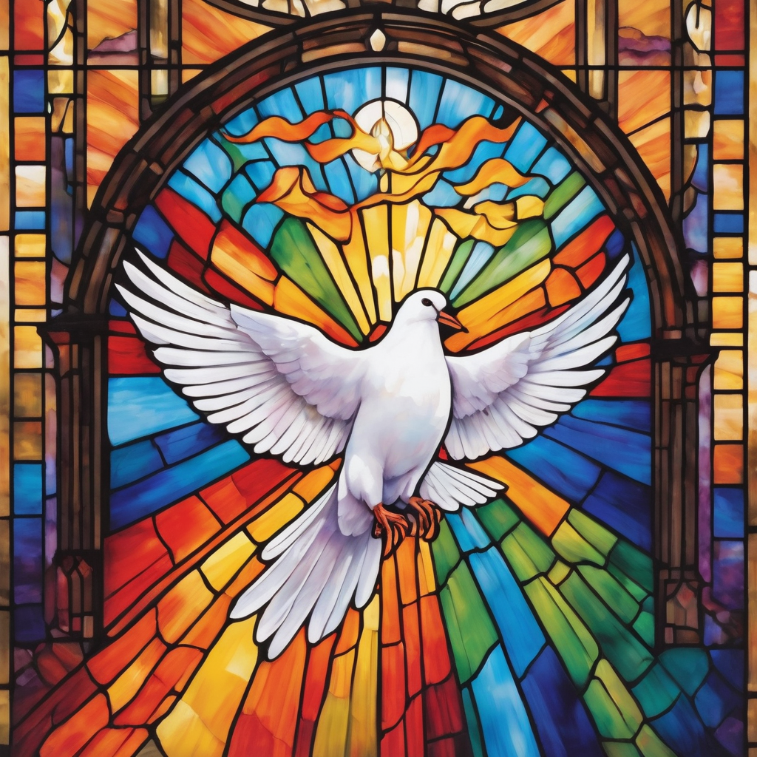
Prayer of Thanksgiving before Intercessions
Leader: As we enter prayer, I invite the second reader to unmute to lead our intercessions following the prayer of thanksgiving on the next slide. Please feel free to change your body position as you need.
Continue…

Slide 35
Leader:
Lord God,
we thank you that you are at work in the world,
although we sometimes struggle to see it.
We thank you that, in you, we are all part of one body.
We thank you that the gifts we have come from you.
They are perfectly right for us.
Thank you that you are at work in us.
Amen.

Slide 36
Intercessions
Reader 2: We pray for creation and communities we share our lives with. We pause for a few moments to name either in our hearts, or out loud, or in the chat, those environments and communities we bring to the Lord in prayer.
PAUSE…

Slide 37
Intercessions
Reader 2: We entrust to you the community of Holy Hermits Online and our ministry partners:
Prosper the work of our hands and show us the way to your new creation.
Creator God, Hear our prayer.
St John's Cathedral Brisbane The Anglican Diocese of Southern Queensland St Gabriel’s, Carindale Benedictus Contemplative Church, Canberra Anglican Focus and Tithe.ly

Slide 38

Reader 2: Loving Creator, we entrust to you all animals, especially those who are sick, anxious, ageing, lost, at risk, lonely, sad, hungry, in pain, homeless, abused, living in fear, encountering violence of any kind, in need of comfort, rehabilitation or transformation.

Slide 39

Reader 2: We invite your loving compassion for:
We name in our hearts, out loud or in the chat,
the animals we bring to the Lord in prayer. PAUSE…
Jasmine, ​
Leese(y), ​
Sid, Toots & Lulu​
Polly and Suki​
Fred, George & Percy​
Koshka ​
Jax
Lambert ​​
Kala, Nigel & Little One ​​
Toby​​
Taco​​
Paddy ​​
Rosie​

Slide 40
Reader 2: Eternal Trinity of Love, we uphold to you the people we love and carry cares for:
Kerry, Les & Jake Julie, Ray, Tracey & Shane Mark, Desley & Bob ​​ Rachel, Mervyn & Gillian ​​Rev'd Shane & Janette​​ Alecia, Martin & Aidan​​ Kirsten, Greg, Daphne & Beau Bill & Marjorie​​ Aaron & Andrea Bonnie & girls Liz’s Godchildren | Barry​​ Dr Julie ​​ Ruth​​ Phil​ May Susan Tanya​ Neva Kathy ​Gayanne Tina | ​​ | Alan & Gaylene​ Jess & Leah ​​ Barry & Gwen Matthew & Nicholas​ Bob & Di​ Pat & Julie Dilys & Tony, Paul & Darhon Judy & Mary Miriam Lorelei

Slide 41
Reader 2:
We name in our hearts, out loud or in the chat, those we bring to the Lord in prayer.
PAUSE…
We entrust to you those who have died, those who have died peacefully and those who have died tragically, The old and the young. Receive them into your Kingdom. Lord in your mercy, Hear our prayers. Amen.

Slide 42
Pray Daily Cycle of Prayer
Leader: Loving God, joining with the Church in our cycle of prayer, we ask your blessings on:
The Missionary Diocese of Zambezia – Igreja Anglicana de Mocambique e Angola
The Diocese of Riverina: †Donald; Clergy and People
The Parish of Goonaneman: Iain
Mission to Seafarers – Honorary Chaplains Steven & Ian
West Moreton Anglican College, Karrabin: Principal – Andrew; Chaplain – Jane; Chair of College Council – Bruce; members of School Council; staff & students

Slide 43
Commitment prayer for the week
Leader: Our commitment prayer for the week is for People in need
God who gives shelter, we give thanks for opportunities to offer support and prayers for those that are struggling at this time to put a permanent roof over their heads and to shelter those they love.​​​​
Please shine a light on homelessness for the people and animals experiencing this and provide a way for homes to be found and others to help, especially governments and churches.​​​​
Continue…
Notes:
Link to prayer group ministry page for weekly commitment prayer https://holyhermits.com.au/ministries/prayer-group

Slide 44
Please protect all living rough and give safety and security to families and young people, and those who are supporting them.​​​​
Please help us channel and inspire the hospitality that Jesus and his followers sought and encouraged in their day, and especially strengthen those already offering this ministry.​​​​
Awaken compassion in the hearts of all people to reach out with a loving hand.
Continue…
Notes:
Link to prayer group ministry page for weekly commitment prayer https://holyhermits.com.au/ministries/prayer-group

Slide 45
When we feel disheartened by this unfolding situation, please refocus our energies to keep praying and finding small ways to help so we don't feel so overwhelmed.​​​​
Usher in a wave of change for systems to be transformed and ways made for large scale transformation. Amen.​
Notes:
Link to prayer group ministry page for weekly commitment prayer https://holyhermits.com.au/ministries/prayer-group

Slide 46
Leader: Let us pray together the prayer which Jesus gave us saying:
All: Our Father in heaven, hallowed be your name,
your kingdom come, your will be done, on earth as in heaven.
Give us today our daily bread.
Forgive us our sins
as we forgive those who sin against us.
Save us from the time of trial and deliver us from evil.
For the kingdom, the power, and the glory are yours
now and for ever.
Amen.

Slide 47
Devotions

Slide 48
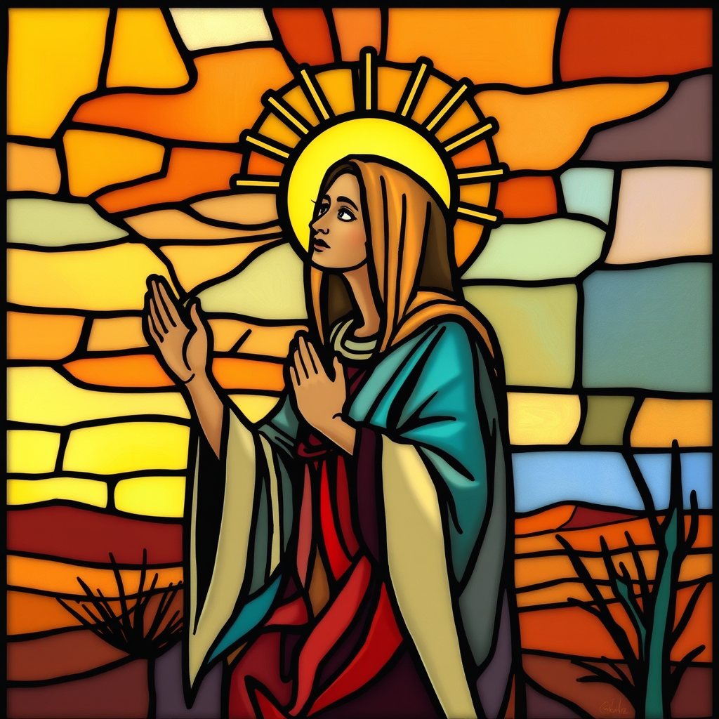
Holy Hermit
St Mary of Egypt

Slide 49
Hermit Wisdom
St Mary was able to see herself as she really was; a beloved child of God who just needed to let God love her.
A prayer inspired by St Mary: Merciful Lord, who raises up sinners by your boundless compassion and mercy: Cause the desert sun to burn away our coarseness and to melt our hardness of heart, that, like your servant Mary of Egypt, we may not depart from this life until we understand the ways of repentance and the benefits of prayer; through Jesus Christ our Lord, who lives and reigns with you and the Holy Spirit, one God, now and forever. Amen.

Slide 50

​
Leader: ​As we enter a few minutes of silence together, you are invited to pray the prayer of adoration on the next slide and/or spend this time in contemplation. ​
The Spiritual Communion prayer follows on the slide after that.
Let us be still.
Leader and Cantor Mute.
Continue…

Slide 51
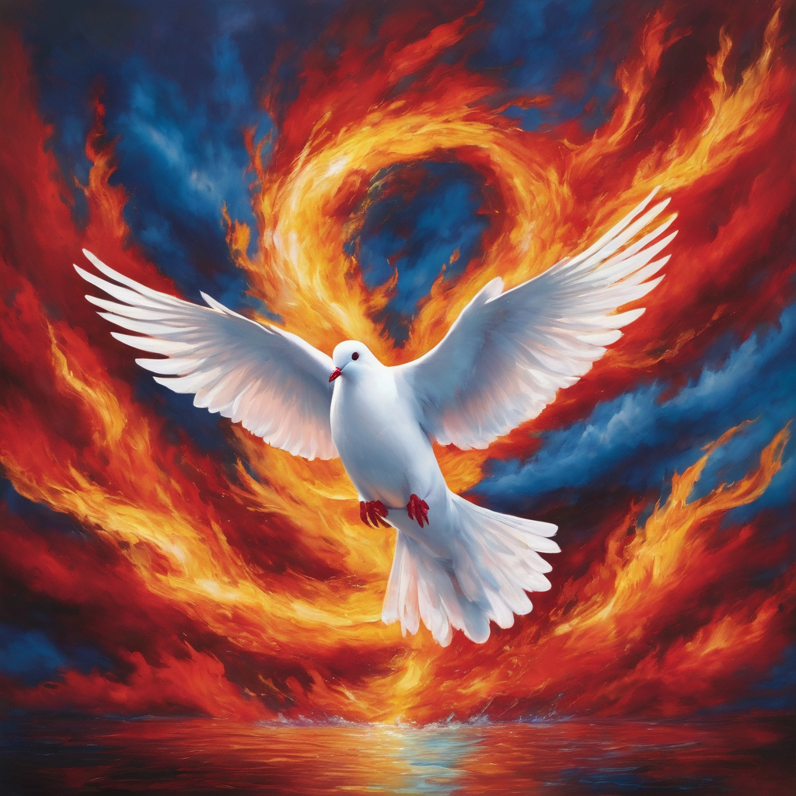
​
Jesus, thank you for the gift of the Holy Spirit.
Breathe on us again and enable us to see your life in us
and in the people around us.
Amen.

Slide 52
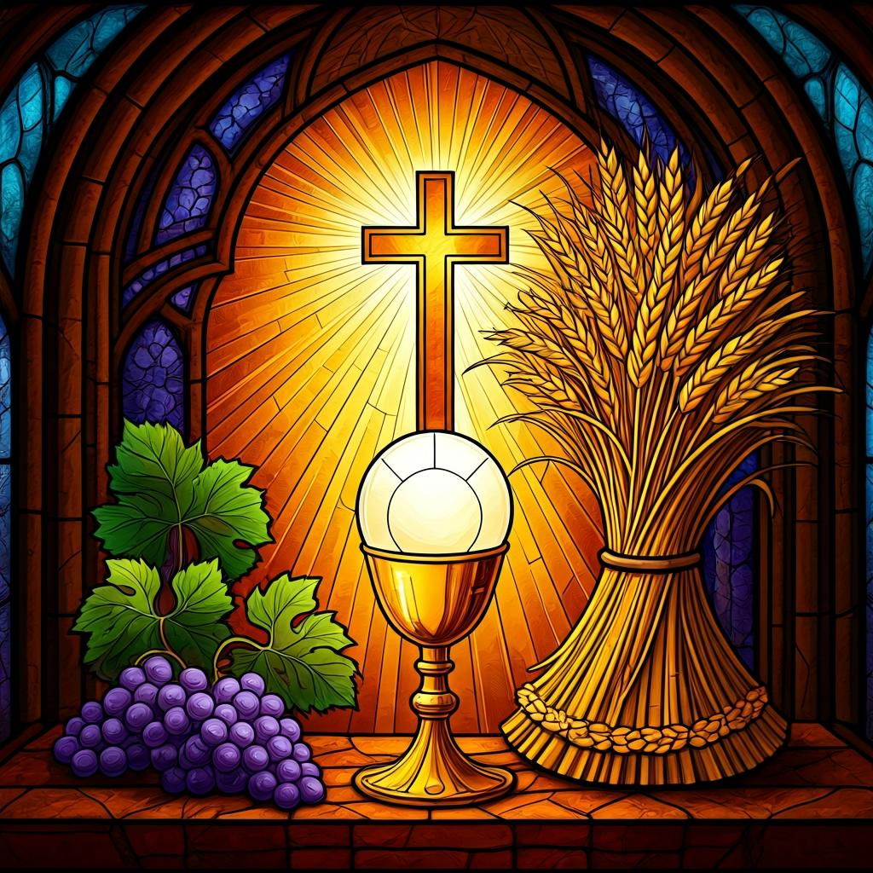
Oh, my Lord Jesus I turn to you present at the Altar and in the Tabernacle. I believe that you are present in the Holy Sacrament of your most Sacred Body and Blood. I love you above all things and I desire to receive you into my Soul. I cannot at this moment receive you Sacramentally in Holy Communion. Come spiritually into my heart. Purify it, Sanctify it. Render my heart like your own heart. I embrace you as if you were already there and unite myself wholly with you. Never permit me to be separated from you. Lord, I am not worthy to receive you, but only say the word and I shall be healed. Amen
Making a
Spiritual Communion
(Prayed in silence)

Slide 53
Leader unmutes
Our final song is
Holy Spirit Living Breath of God
https://www.youtube.com/watch?v=kDYjn-YdnD4
​We stay on mute
Leader and Cantor mute

Slide 54
Leader and cantor unmute
Sending Prayer
Leader: We pray our sending prayer together.
All: Jesus, grow your gifts in us so that we might work
for the good of those around us.
Please give us the courage to share our gifts with others,
knowing that all good things have come from you.
Amen.

Slide 55
The Benediction
Leader: Let us all invite God’s blessings together,
All: Come, Holy Spirit,
with wind to move us,
with fire to cleanse us,
with breath to fill us:
send us from this place
to love boldly,
to serve gladly,
and to live as Christ’s own. Amen.
Made with help of Cathey AI

Slide 56
Notices
Volunteers for our Saint Spotlight are still needed, if interested please contact Rev’d Lauren.
Today 3D Dialogue @5pm, it’s not too late to sign up or email Rev’s Lauren lauren.martin@anglicanchurchsq.org.au
Wednesday Study group starts Embracing The Divine Flow @6pm, all are welcome. The Sign up link is in the Send Out or email holyhermits@anglicanchurchsq.org.au
See HHO Events page for further upcoming events HHO Events

Slide 57
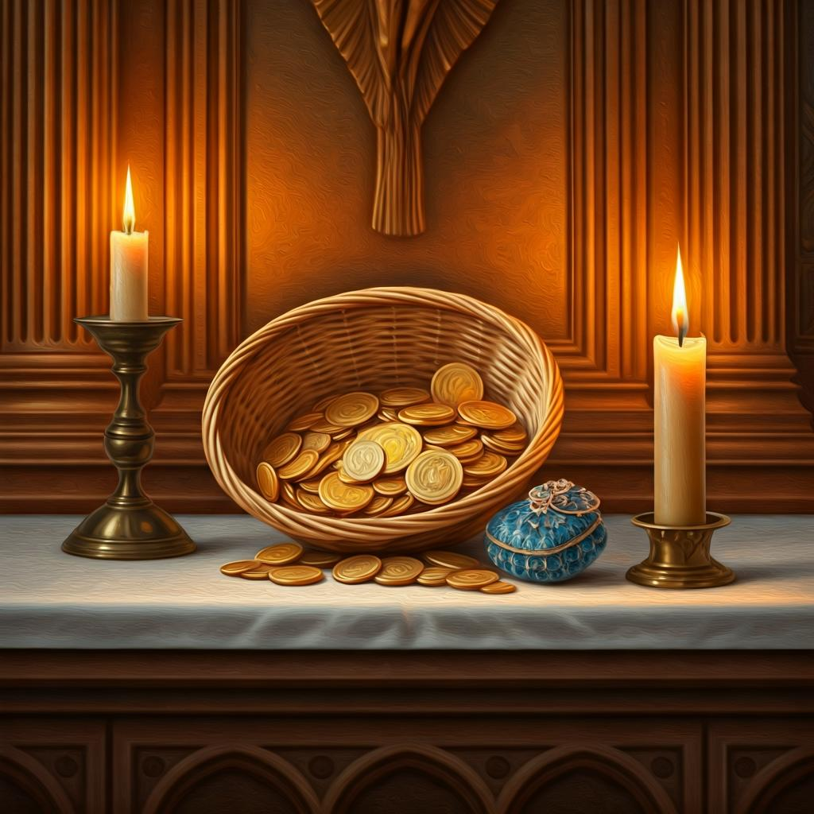
Leader: Thank you for your regular gifts to this ministry. Offerings are most welcome via:
The HHO App
Direct Debit
International Direct Debit
Please consider a one-off donation
or leaving a legacy in your Will
For further information go to HHO give page
https://holyhermits.com.au/give

Slide 58
Serving next week
24 May 2026
Pentecost
9:00 am AEST
Service Prep: Kris | Chat Host: Viki | First Reader: Viki
Music: Wiggles | Welcomer: Chris | Second Reader: Liz
Proof-reader: Rachel | Priest: N/A | Preacher: Lauren
Broadcaster: Lauren | Deacon: Lauren | Fellowship: Julie
Backup Broadcaster: Paul | Leader: Jeremy | Safety Officer: Chris
Zoom Buttons: Rachel | Cantor: Barry | Attendance: Rachel
Thank you for your ministry gifts
New Servers always welcome!
Please email Rev’d Lauren to get involved
holyhermits@anglicanchurchsq.org.au

Slide 59
The Dismissal
Leader: I invite everyone to unmute for the Dismissal
Leader: Go in peace to love and serve the Lord.
All: In the name of Christ, Amen.

Slide 60
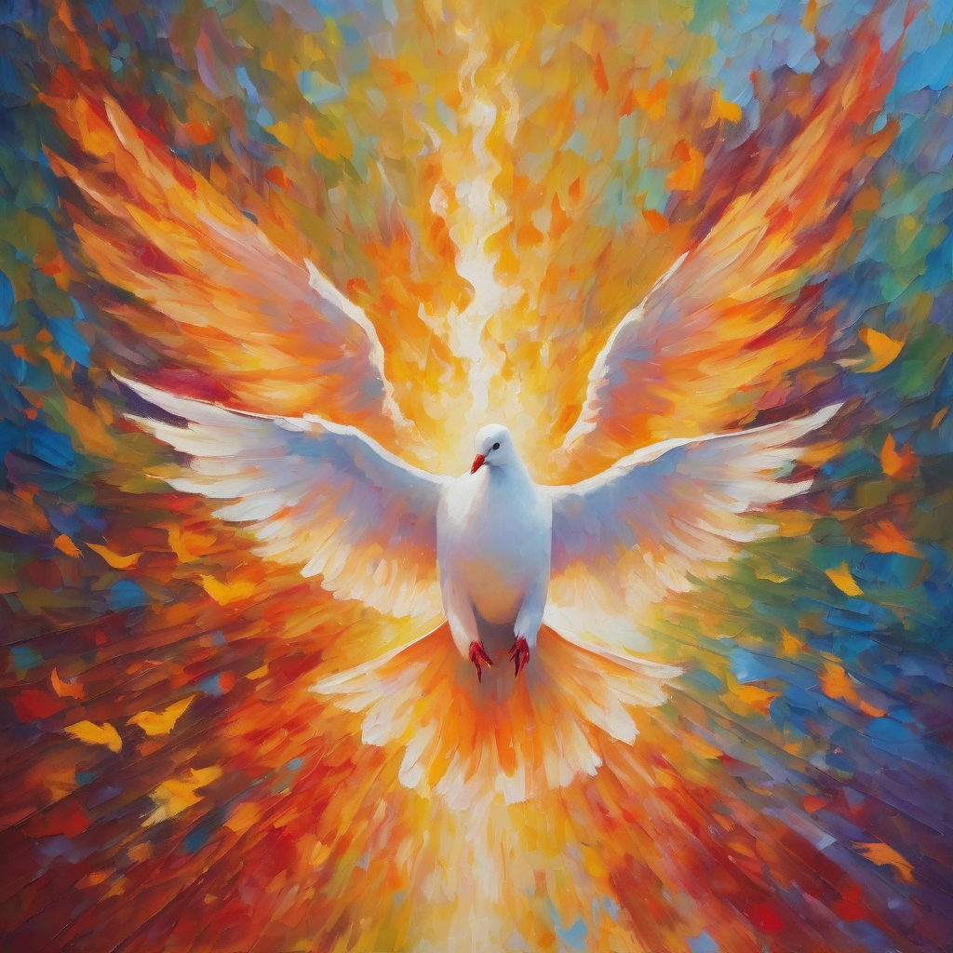
Fellowship time
Thank you, Rachel, for leading Fellowship
Please feel welcome to linger or pop a message in the chat and head off when you are ready.​
Artwork from Padlet
Extra resources developed
by Roots on the Web

