Slide 1
Welcome to Holy Hermits Online Worship
Seventh Sunday in Easter
Today we are remembering
Holy Hermit Walter Hilton of Thurgarton
Service Prep: Paul | Chat Host: Viki | First Reader: Margo
Music: Paul | Welcomer: Chris | Second Reader: Roselyn
Proof-reader: Kris | Priest: N/A | Preacher: Lauren
Broadcaster: Paul | Deacon: Lauren | Fellowship: Lauren
Backup Broadcaster: Lauren | Leader: Jeremy | Safety Officer: Chris
Zoom Buttons: Barry | Cantor: Vanessa | Attendance: Viki

Slide 2






Hospitality
Leader:
Please mute for the service unless invited to offer your voice as part of the service ministry
Have the video camera on or off and turn the volume and brightness up or down on your device if things are too loud 🔉🔊or too bright🔅🔆
Our Cantor acts as our voice, offering the responses, in Bold Text, which we say together
Feel welcome to use the chat and reaction emojis 👍
🙏 Please take care of yourself in this space. 🙏 Come and go as you need
😴 It is great to take rest in this space, so falling asleep is also OK 😴
👂️ Remember, pastoral care is available to all in the community, if you'd like to speak to someone about anything spiritual. ❤️ Visit the help page at the website to reach out 🌐
Our Being Together ethos and safeguarding practices can also be accessed on the website 🫶​
🙌 Come as you are – we are all here together! 🙌
Notes:
Used Lent 2022

Slide 3
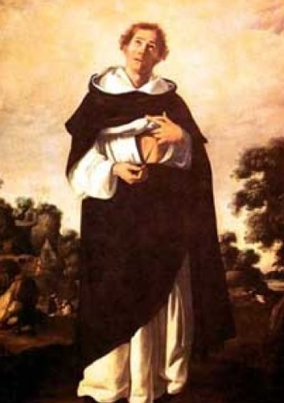
Leader: Our Holy Hermit today is Walter Hilton of Thurgarton
Walter Hilton lived during the dark times of the 14th century. Plague, papal schism, peasant revolts, along with famine, war, and church controversies in England marked his day. It is believed he was born around 1340 in the East Midlands, later attending Cambridge University studying law.
Hilton became dissatisfied with law and felt drawn to a life seeking God through prayer, meditation, and contemplation.

Slide 4
Eventually, he joined the community of Augustinian canons at the Priory Church in Thurgarton. Hilton became known as a gracious and wise spiritual guide. He died in 1396.
His most famous work, The Ladder of Perfection, became a very popular work in the 14th and 15th centuries, read not just by monks and anchoresses, but by ordinary people. Other well-known mystics of the 14th century Julian of Norwich and Margery Kempe were familiar with some of Hilton’s works
To read more about our hermits click the link​​ in the send out

Slide 5
Invitation
Leader: As we come into worship let’s take a few deep breaths,
Let go of anything that isn’t serving us,
And become aware of God’s presence here with us.
Opening Music:
Prelude for the Ascension of Our Lord Jesus Christ
by Olivier Messiaen
https://youtu.be/oLW4AdEVS5A?si=7tIsJPc5-OwGME8G

Slide 6
Leader and Cantor unmute
The Greeting
Leader: Christ has risen, Alleluia!
All: Christ is risen indeed, Alleluia!

Slide 7
Gathering Prayer
Leader:
We come to God today,
carrying the difficulties and struggles of the week.
We know that God meets us and cares for us,
however heavy our burden.
Let us cast our anxieties onto him
and seek his face together.

Slide 8
Gathering Prayer
All: Almighty God, thank you that you see us and know us.
Thank you that, when we struggle,
we are following in Jesus’ footsteps.
Help us to give our burdens to you this day
and to give you the glory.
Amen.

Slide 9
Sentence
Leader: I invite our Cantor to proclaim the sentence for today.
Cantor: This is eternal life, that we may know you, the only true God, and Jesus Christ whom you have sent.
John 17.3

Slide 10
Prayer of Approach
Leader: We pray the prayer of approach together
All: Lord God, as we come to this place today,
we each come with our own troubles,
knowing you didn’t promise us a life without trials.
We come before you, acknowledging your presence.
We cast our cares on you because you care for us. Amen.

Slide 11
The Gloria​
(to be sung every Sunday during the Season of Easter)
Leader: We now sing the Gloria together
https://www.youtube.com/watch?v=sZNsKic0vmw
Leader Mutes

Slide 12
Collect
Leader: O God,
whose Son, Jesus, prayed for his disciples,
and sent them into the world
to proclaim the coming of your kingdom:
by your Holy Spirit,
hold the Church in unity, and keep it faithful to your word,
so that, breaking bread together,
we may be one with Christ in faith and love and service,
now and for ever. Amen.

Slide 13
The 1st reader unmutes
Leader: I invite the 1st reader to unmute and offer the 1st lesson when ready.
Reader 1: The 1st Reading is from Acts 1.6-14
⁶ So when they had come together, they asked him, ‘Lord, is this the time when you will restore the kingdom to Israel?’ ⁷ He replied, ‘It is not for you to know the times or periods that the Father has set by his own authority. ⁸ But you will receive power when the Holy Spirit has come upon you; and you will be my witnesses in Jerusalem, in all Judea and Samaria, and to the ends of the earth.’
Continue…

Slide 14
⁹ When he had said this, as they were watching, he was lifted up, and a cloud took him out of their sight. ¹⁰ While he was going and they were gazing up towards heaven, suddenly two men in white robes stood by them. ¹¹ They said, ‘Men of Galilee, why do you stand looking up towards heaven? This Jesus, who has been taken up from you into heaven, will come in the same way as you saw him go into heaven.’ ¹² Then they returned to Jerusalem from the mount called Olivet, which is near Jerusalem, a sabbath day’s journey away.
Continue…

Slide 15
¹³ When they had entered the city, they went to the room upstairs where they were staying, Peter, and John, and James, and Andrew, Philip and Thomas, Bartholomew and Matthew, James son of Alphaeus, and Simon the Zealot, and Judas son of James. ¹⁴ All these were constantly devoting themselves to prayer, together with certain women, including Mary the mother of Jesus, as well as his brothers.
For the word of the Lord. Thanks be to God.​

Slide 16
Leader: We now say the psalm antiphonally, I invite the first
reader to lead, and we will all respond with our cantor as our voice.
Psalm 68.1-10; 68.32-35
¹ God shall arise, and his enemies shall be scattered:
those that hate him shall flee before his face.
² As smoke is dispersed, so shall they be dispersed:
as wax melts before a fire,
so shall the wicked perish at the presence of God.
³ But the righteous shall be glad and exult before God:
they shall rejoice with gladness.
Continue…

Slide 17
⁴ O sing to God, sing praises to his name:
glorify him that rode through the deserts,
him whose name is the Lord, and exult before him.
⁵ He is the father of the fatherless,
he upholds the cause of the widow:
God in his holy dwelling place.
⁶ He gives the desolate a home to dwell in,
and brings the prisoners out into prosperity:
but rebels must dwell in a barren land.
Continue…

Slide 18
⁷ O God, when you went out before your people:
when you marched through the wilderness,
⁸ The earth shook, the heavens poured down water:
before the God of Sinai, before God, the God of Israel.
⁹ You showered down a generous rain, O God:
you prepared the land of your possession
when it was weary.
Continue…

Slide 19
¹⁰ And there your people settled:
in the place that your goodness, O God,
had made ready for the poor.
³² Sing to God, you kingdoms of the earth:
O sing praises to the Lord,
³³ To him that rides upon the highest heavens,
that were from the beginning:
who utters his voice, which is a mighty voice.
Continue…

Slide 20
³⁴ Ascribe power to God, whose majesty is over Israel:
and his might is in the clouds.
³⁵ Terrible is God who comes from his holy place:
the God of Israel who gives power
and strength to his people. Blessed be God.

Slide 21
The 2nd reader unmutes
Leader: I invite the 2nd reader to unmute and offer the 2nd lesson when ready.
Reader 2: The 2nd Reading is from 1 Peter 5
¹ Now as an elder myself and a witness of the sufferings of Christ, as well as one who shares in the glory to be revealed, I exhort the elders among you ² to tend the flock of God that is in your charge, exercising the oversight, not under compulsion but willingly, as God would have you do it—not for sordid gain but eagerly. ³ Do not lord it over those in your charge, but be examples to the flock.
Continue…

Slide 22
⁴ And when the chief shepherd appears, you will win the crown of glory that never fades away.
⁵ In the same way, you who are younger must accept the authority of the elders. And all of you must clothe yourselves with humility in your dealings with one another, for
‘God opposes the proud,
but gives grace to the humble.’
⁶ Humble yourselves therefore under the mighty hand of God, so that he may exalt you in due time. ⁷ Cast all your anxiety on him, because he cares for you.
Continue…

Slide 23
⁸ Discipline yourselves; keep alert. Like a roaring lion your adversary the devil prowls around, looking for someone to devour.
⁹ Resist him, steadfast in your faith, for you know that your brothers and sisters throughout the world are undergoing the same kinds of suffering. ¹⁰ And after you have suffered for a little while, the God of all grace, who has called you to his eternal glory in Christ, will himself restore, support, strengthen, and establish you.
¹¹ To him be the power for ever and ever. Amen.
Continue…

Slide 24
¹² Through Silvanus, whom I consider a faithful brother, I have written this short letter to encourage you, and to testify that this is the true grace of God. Stand fast in it. ¹³ Your sister church in Babylon, chosen together with you, sends you greetings; and so does my son Mark.
¹⁴ Greet one another with a kiss of love. Peace to all of you who are in Christ.
For the word of the Lord. Thanks be to God.​

Slide 25

We pause before
​the Gospel ​​

Slide 26
Deacon: The Gospel of our Lord Jesus Christ according to St John Chapter 17 beginning at the 1st verse
All: Glory to you Lord Jesus Christ.
¹ After Jesus had spoken these words, he looked up to heaven and said, ‘Father, the hour has come; glorify your Son so that the Son may glorify you, ² since you have given him authority over all people, to give eternal life to all whom you have given him. ³ And this is eternal life, that they may know you, the only true God, and Jesus Christ whom you have sent. ⁴ I glorified you on earth by finishing the work that you gave me to do.
Continue…

Slide 27
⁵ So now, Father, glorify me in your own presence with the glory that I had in your presence before the world existed. ⁶ ‘I have made your name known to those whom you gave me from the world. They were yours, and you gave them to me, and they have kept your word. ⁷ Now they know that everything you have given me is from you; ⁸ for the words that you gave to me I have given to them, and they have received them and know in truth that I came from you; and they have believed that you sent me. ⁹ I am asking on their behalf; I am not asking on behalf of the world, but on behalf of those whom you gave me, because they are yours.
Continue…

Slide 28
¹⁰ All mine are yours, and yours are mine; and I have been glorified in them. ¹¹ And now I am no longer in the world, but they are in the world, and I am coming to you. Holy Father, protect them in your name that you have given me, so that they may be one, as we are one.
This is the Gospel of the Lord. Praise to you Lord Jesus Christ.

Slide 29
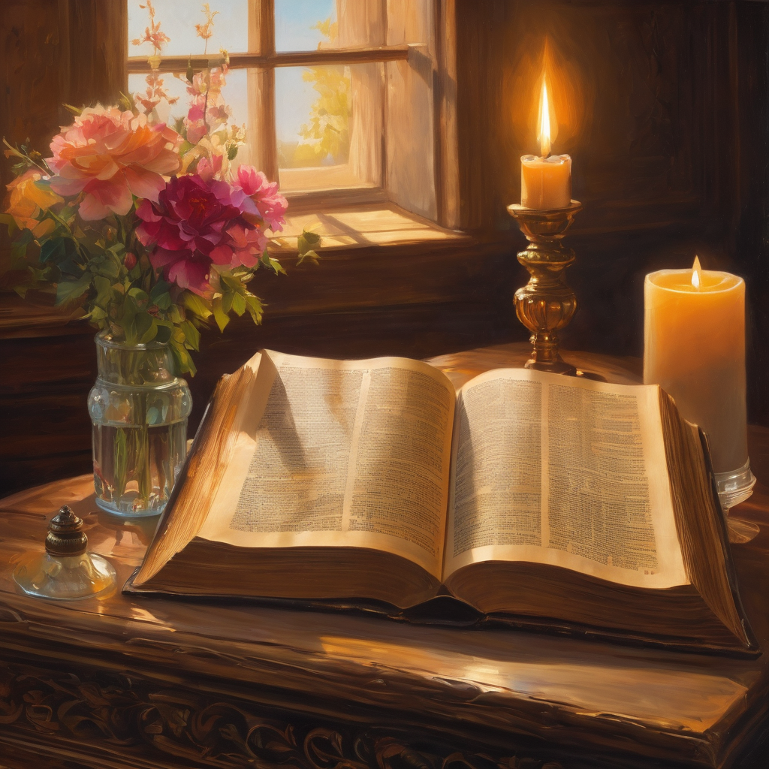
We pause
after ​the Gospel ​​

Slide 30
Leader: . The Sermon is recorded to YouTube for sharing later.
Only the preacher's video and audio will be recorded.
The chat and other participants' feeds remain out of sight of the recording.
Leader and Cantor mute
Broadcaster exits screenshare
Preacher unmutes
Zoom buttons ”pins” preacher’s screen + selects “record to the cloud”
Sermon

Slide 31
Leader unmutes
Our next Hymn
With Joy We Meditate the Grace
https://youtu.be/_JFpMX7YexQ?si=XcUinrH-ylPoeWgl
We stay on mute
Leader mutes

Slide 32
The Leader and Cantor unmute
The Greeting of Peace
Leader: We are the body of Christ
All: God’s Spirit is with us
Leader: The peace of the Lord be always with you.
All: And also with you.
Leader: A sign of peace may be exchanged
You may like to type 'Peace' into the chat, use the 'raise hand’ or other reaction buttons, or just simply wave via the screen with your video turned on
(Broadcaster exits shared screen for a few moments for the exchange of peace)

Slide 33
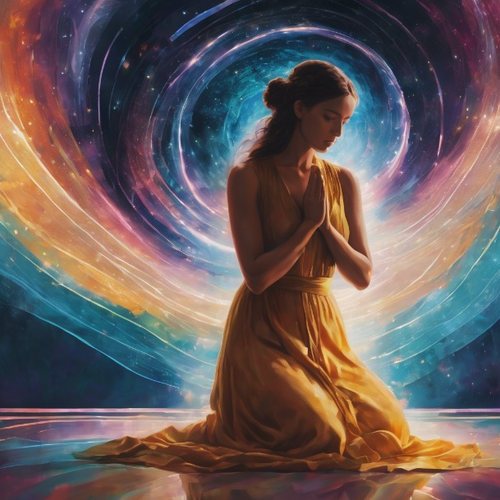
Prayer of Thanksgiving before Intercessions
Leader: As we enter prayer, I invite the second reader to unmute to lead our intercessions following the prayer of thanksgiving on the next slide. Please feel free to change your body position as you need.
Continue…

Slide 34
Leader: Lord, sometimes we think it would be lovely
to have ‘not a care in the world’.
Thank you that we do have cares, cares for other people.
As you put your love in our hearts for others,
we thank you that you are bigger
than all our prayers put together.
You support us, as we support each other.
Thank you, Lord.
Amen.

Slide 35
Intercessions
Reader 2: We pray for creation and communities we share our lives with. We pause for a few moments to name either in our hearts, or out loud, or in the chat, those environments and communities we bring to the Lord in prayer.
PAUSE…
Continue…

Slide 36
Intercessions
Reader 2: We entrust to you the community of Holy Hermits Online and our ministry partners:
Prosper the work of our hands and show us the way to your new creation.
Creator God, Hear our prayer.
St John's Cathedral Brisbane The Anglican Diocese of Southern Queensland St Gabriel’s, Carindale Benedictus Contemplative Church, Canberra Anglican Focus and Tithe.ly

Slide 37
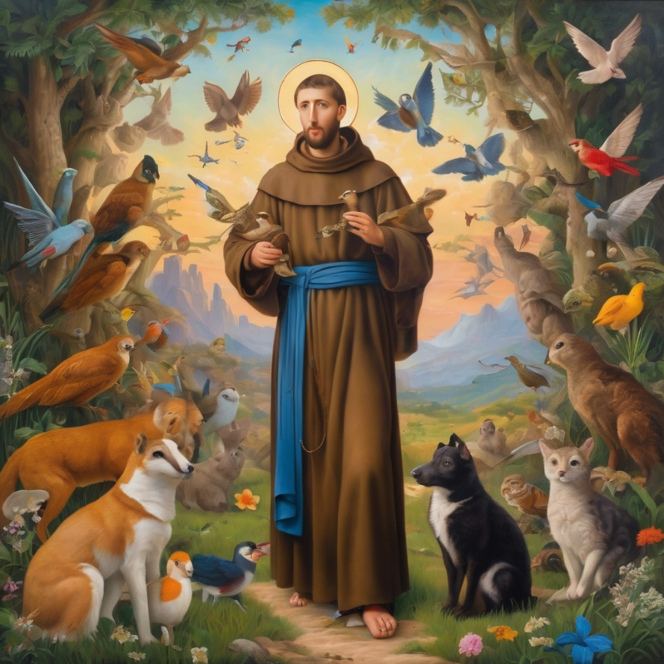
Reader 2: Loving Creator, we entrust to you all animals, especially those who are sick, anxious, ageing, lost, at risk, lonely, sad, hungry, in pain, homeless, abused, living in fear, encountering violence of any kind, in need of comfort, rehabilitation or transformation.
Continue…

Slide 38
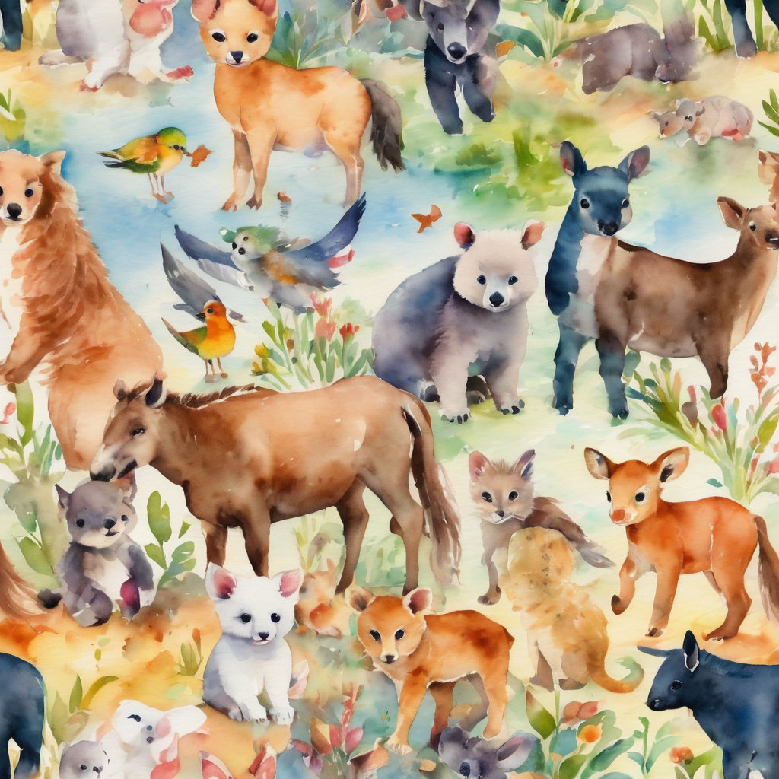
Reader 2: We invite your loving compassion for:
We name in our hearts, out loud or in the chat,
the animals we bring to the Lord in prayer. PAUSE…
Jasmine, ​
Leese(y), ​
Sid, Toots & Lulu​
Polly and Suki​
Fred, George & Percy​
Koshka ​
Jax
Lambert ​​
Kala, Nigel & Little One ​​
Toby​​
Taco​​
Paddy ​​
Rosie​

Slide 39
Reader 2: Eternal Trinity of Love, we uphold to you the people we love and carry cares for:
Kerry, Les & Jake Julie, Ray, Tracey & Shane Mark, Desley & Bob ​​ Rachel, Mervyn & Gillian ​​Rev'd Shane & Janette​​ Alecia, Martin & Aidan​​ Kirsten, Greg, Daphne & Beau Bill & Marjorie​​ Aaron & Andrea Bonnie & girls Liz’s Godchildren | Barry​​ Dr Julie ​​ Ruth​​ Phil​ May Susan Tanya​ Neva Kathy ​Gayanne Tina | ​​ | Alan & Gaylene​ Jess & Leah ​​ Barry & Gwen Matthew & Nicholas​ Bob & Di​ Pat & Julie Dilys & Tony, Paul & Darhon Judy & Mary Miriam
Continue…

Slide 40
Reader 2:
We name in our hearts, out loud or in the chat, those we bring to the Lord in prayer.
PAUSE…
We entrust to you those who have died, those who have died peacefully and those who have died tragically, The old and the young. Receive them into your Kingdom. Lord in your mercy, Hear our prayers. Amen.

Slide 41
Pray Daily Cycle of Prayer
Leader: Loving God, joining with the Church in our cycle of prayer, we ask your blessings on:
The Anglican Church of Papua New Guinea
The Diocese of North Queensland: †Keith; Clergy and People
The Parish of Gold Coast North: Stephan, Gary, Don, Lynette, †Len, Roseanne, Bill, Martin, Medha
Sudanese & South Sudanese Congregations in Anglican Church Southern QLD: Bishop Daniel
The Southport School, Southport: Headmaster – Andrew; Chaplain – John; Chair of School Council – Adam; members of School Council; staff & students

Slide 42
Commitment prayer for the week
Leader: Our commitment prayer for the week is
A Prayer of Lament
https://www.youtube.com/watch?v=d8tLRZWOAcw
Notes:
Link to prayer group ministry page for weekly commitment prayer https://holyhermits.com.au/ministries/prayer-group

Slide 43
Leader: Let us pray together the prayer which Jesus gave us saying:
All: Our Father in heaven, hallowed be your name,
your kingdom come, your will be done, on earth as in heaven.
Give us today our daily bread.
Forgive us our sins
as we forgive those who sin against us.
Save us from the time of trial and deliver us from evil.
For the kingdom, the power, and the glory are yours
now and for ever.
Amen.

Slide 44
Devotions

Slide 45

Holy Hermit
Walter Hilton of Thurgarton

Slide 46
Hermit Wisdom
Hilton defined prayer as, “Nothing but the desire of the heart rising into God.”
Hilton wrote, “What is a man, but his thoughts and his loves?”
"We therefore need to know the gifts given us by God, so that we may use them, for by these we shall be saved."
"When you attack the roots of sin, fix your thought more on the God you desire than on the sin you abhor.“
"What is humility but truthfulness? There is no real difference."

Slide 47
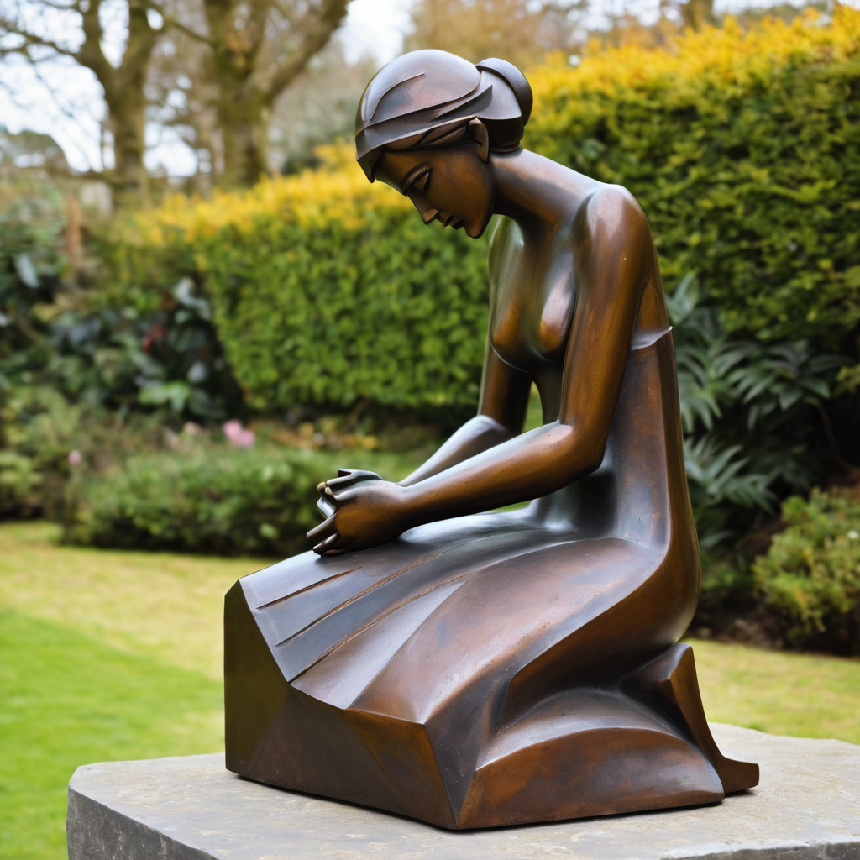
​
Leader: ​As we enter a few minutes of silence together, you are invited to pray the prayer of adoration on the next slide and/or spend this time in contemplation. ​
The Spiritual Communion prayer follows on the slide after that.
Let us be still.
Leader and Cantor Mute.
Continue…

Slide 48
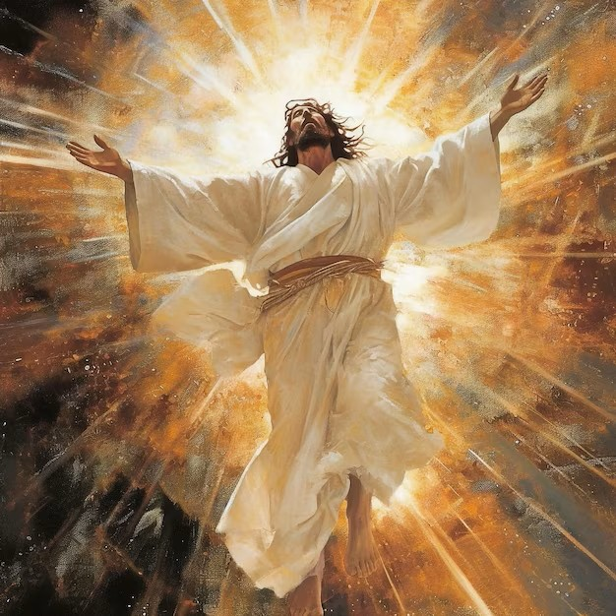
Most holy and powerful God,
we marvel how you called us
to your eternal glory in your Son, Jesus Christ.
We are reminded of all he went through for us.
We await your glory being revealed in fullness.
We praise you for the glimpses we already see.
We adore you. Amen.
​

Slide 49

Oh, my Lord Jesus I turn to you present at the Altar and in the Tabernacle. I believe that you are present in the Holy Sacrament of your most Sacred Body and Blood. I love you above all things and I desire to receive you into my Soul. I cannot at this moment receive you Sacramentally in Holy Communion. Come spiritually into my heart. Purify it, Sanctify it. Render my heart like your own heart. I embrace you as if you were already there and unite myself wholly with you. Never permit me to be separated from you. Lord, I am not worthy to receive you, but only say the word and I shall be healed. Amen
Making a
Spiritual Communion
(Prayed in silence)

Slide 50
Leader unmutes
Our final song is
From rising sun ‘til kingdom come - Faithfulness
https://www.youtube.com/watch?v=3K0WphJSz9Q
​We stay on mute
Leader and Cantor mute

Slide 51
Leader and cantor unmute
Sending Prayer
Leader: We pray our sending prayer together.
All: Mighty God,
we have cast our burdens on you,
trusting in your love and your strength.
Be with us in our trials this week and help us to rejoice,
knowing that we are becoming more like you. Amen.

Slide 52
The Benediction
Leader: Let us all invite God’s blessings together,
All: As we leave, leave with us, Lord,
walk with us always.
Be there as we share bread
and help us to share with others in need.
Amen.

Slide 53
Notices
If anyone is interested in sharing some information on a Saint, or Holy Hermit for our 2nd Sunday Saint Spotlight in June please contact Rev’d Lauren.
Companion Animal Ministry Workshop @11am today.
Next Sunday 3D Dialogue @5pm
Next Wednesday Embracing The Divine Flow @6pm
See HHO Events page for further upcoming events HHO Events

Slide 54
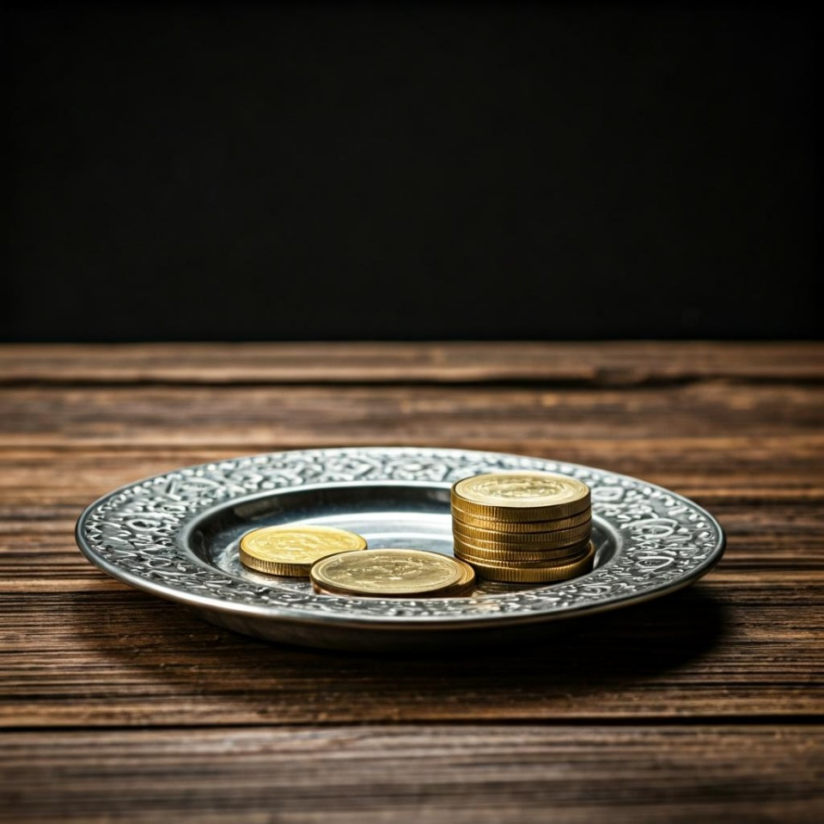
Leader: Thank you for your regular gifts to this ministry. Offerings are most welcome via:
The HHO App
Direct Debit
International Direct Debit
Please consider a one-off donation
or leaving a legacy in your Will
For further information go to HHO give page
https://holyhermits.com.au/give

Slide 55
Serving next week
24 May 2026
Pentecost
9:00 am AEST
Service Prep: Lauren | Chat Host: Rachel | First Reader: Phil
Music: Lauren | Welcomer: Julie | Second Reader: Paul
Proof-reader: Viki | Priest: N/A | Preacher: Lauren
Broadcaster: Kieron | Deacon: Lauren | Fellowship: Rachel
Backup Broadcaster: Lauren | Leader: Julie | Safety Officer: Julie
Zoom Buttons: Viki | Cantor: Jeremy | Attendance: Viki
Thank you for your ministry gifts
New Servers always welcome!
Please email Rev’d Lauren to get involved
holyhermits@anglicanchurchsq.org.au

Slide 56
The Dismissal
Leader: I invite everyone to unmute for the Dismissal
Leader: Go in peace to love and serve the Lord.
All: In the name of Christ, Amen.

Slide 57
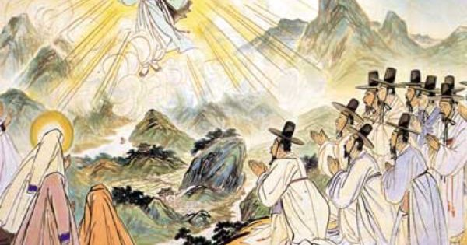
Fellowship time
Thank you, Lauren, for leading Fellowship
Please feel welcome to linger or pop a message in the chat and head off when you are ready.​
Artist Ki-Chang Kim
Extra resources developed
by Roots on the Web

