Slide 1
Welcome to Holy Hermits Online Worship
Trinity Sunday
(1st Sunday after Pentecost)
Today we are remembering
Holy Hermit St Teresa of Jesus of Los Andes
Service Prep: Kristine 🌷 | Chat Host: Viki | First Reader: Viki
Music: Wiggles 🐶 | Welcomer: Chris | Second Reader: Liz
Proof-reader: Rachel | Priest: N/A | Preacher: Flashback
Broadcaster: Lauren | Deacon: Lauren | Fellowship: Julie
Backup Broadcaster: Barry | Leader: Jeremy | Safety Officer: Chris
Zoom Buttons: Rachel | Cantor: Barry | Attendance: Rachel

Slide 2






Hospitality
Leader:
Please mute for the service unless invited to offer your voice as part of the service ministry
Have the video camera on or off and turn the volume and brightness up or down on your device if things are too loud 🔉🔊or too bright🔅🔆
Our Cantor acts as our voice, offering the responses, in Bold Text, which we say together
Feel welcome to use the chat and reaction emojis 👍
🙏 Please take care of yourself in this space. 🙏 Come and go as you need
😴 It is great to take rest in this space, so falling asleep is also OK 😴
👂️ Remember, pastoral care is available to all in the community, if you'd like to speak to someone about anything spiritual. ❤️ Visit the help page at the website to reach out 🌐
Our Being Together ethos and safeguarding practices can also be accessed on the website 🫶​
🙌 Come as you are – we are all here together! 🙌
Notes:
Used Lent 2022

Slide 3
Leader: Our Holy Hermit today is Santa Teresa de Los Andes
Born in Santiago, Chile, in 1900 to an upper-class family, Juana Enriqueta Josefina balanced a pious nature with youthful faults like stubbornness and vanity. She enjoyed music and sport, but reading the autobiography of Thérèse of Lisieux redirected her life toward God. Working to overcome self-centredness before her First Communion, she committed herself to service. In 1919, she entered the Discalced Carmelite novitiate in Los Andes, taking the name "Teresa of Jesus." There, she began a letter-writing apostolate to share her spiritual insights.

Slide 4
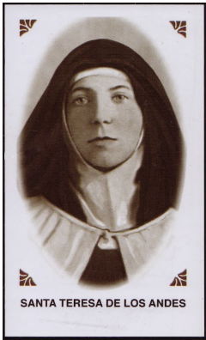
Her life was tragically cut short when she contracted a fatal illness, likely typhus or the Spanish flu. As her condition deteriorated rapidly on Good Friday in 1920, the young novice was permitted to profess her religious vows early while facing imminent death (in articulo mortis). Sister Teresa peacefully passed away on April 12, 1920, leaving behind a lasting legacy of joyful devotion.
To read more about our hermits click the link​​ in the send out

Slide 5
Invitation
Leader: As we come into worship let’s take a few deep breaths,
Let go of anything that isn’t serving us,
And become aware of God’s presence here with us.
Opening Music: https://www.youtube.com/watch?v=-BaYEaCoGAw

Slide 6
Leader and Cantor unmute
The Greeting
Leader: The grace of the Lord Jesus Christ,
and the love of God,
and the fellowship of the Holy Spirit,
be with you all.
All: And also with you.

Slide 7
Gathering Prayer
Leader:
Jesus calls us to meet with him today,
to recognise his resurrection life
and to hear again our commission:
To go and make disciples of all nations.
Let us come and worship him,
Our Lord and our King.
Notes:
Use Call to Worship Prayer

Slide 8
Gathering Prayer
All: Risen Jesus, you are alive and you are here.
Speak to us again, and equip us to do your will
and speak your Word
that we might continue the mission
you gave your first disciples.
Amen.
Notes:
Use gathering prayer

Slide 9
Sentence
Leader: I invite our Cantor to proclaim the sentence for today.
Cantor: Proclaim the Name: ‘The Lord, the Lord, a God who is merciful and gracious, slow to anger and abounding in steadfast love and faithfulness.’
Exodus 34.6

Slide 10
Prayer of Approach
Leader: We pray the prayer of approach together
All: Jesus told his disciples to go up the mountain.
A beautiful but lonely place.
Lord God, our lives can be very lonely.
Even in the middle of a crowd, we can feel alone.
Thank you, Lord, that you are always with us,
wherever we are and however we feel.
We pause to acknowledge your presence with us today.
We bless you for all you will reveal to us. Amen.

Slide 11
Leader unmutes
Our first Hymn
Blessed Angel Spirits
https://www.youtube.com/watch?v=-n42dr-NA1g&t=6s
We stay on mute
Leader mutes

Slide 12
The Introduction to Confession​
God is steadfast in love and infinite in mercy, welcoming sinners and inviting them to the Lord's table.
Silence may be kept.​
Let us confess our sins in penitence and faith, with a sincere and a true heart.

Slide 13
All: ​Merciful God, our maker and our judge, ​
we have sinned against you ​in thought, word, and deed, ​
and in what we have failed to do: ​
we have not loved you with our whole heart; ​
we have not loved our neighbours as ourselves; ​
we repent, and are sorry for all our sins.​
Father, forgive us. Strengthen us to love and obey you
in newness of life; ​through Jesus Christ our Lord. ​
Amen.​

Slide 14
Words of Assurance offered by the Deacon or LA
These words of assurance from the First Letter of John declare that:
If anyone sins, we have an advocate with the Father, Jesus Christ the righteous. He is the perfect offering for our sin, and not for ours only, but for the sins of the whole world.
(1 John 2: 1-2)
In this is love, not that we loved God, but that he loved us and sent his Son to be the perfect offering for our sins.
(1 John 4:10)

Slide 15
Collect
Leader: Almighty and everlasting God,
you have given to us your servants grace
by the confession of a true faith
to acknowledge the glory of the eternal Trinity,
and in the power of the divine majesty
to worship the Unity:
keep us steadfast in this faith,
and evermore defend us from all adversities,
for you live and reign, one God, for ever and ever. Amen.

Slide 16
The 1st reader unmutes
Leader: I invite the 1st reader to unmute and offer the 1st lesson when ready.
Reader 1: The 1st Reading is from Exodus 34.1-8
¹ The Lord said to Moses, ‘Cut two tablets of stone like the former ones, and I will write on the tablets the words that were on the former tablets, which you broke. ² Be ready in the morning, and come up in the morning to Mount Sinai and present yourself there to me, on the top of the mountain. ³ No one shall come up with you, and do not let anyone be seen throughout all the mountain;
Continue…

Slide 17
and do not let flocks or herds graze in front of that mountain.’ ⁴ So Moses cut two tablets of stone like the former ones; and he rose early in the morning and went up on Mount Sinai, as the Lord had commanded him, and took in his hand the two tablets of stone. ⁵ The Lord descended in the cloud and stood with him there, and proclaimed the name, ‘The Lord .’
⁶ The Lord passed before him, and proclaimed, ‘The Lord , the Lord , a God merciful and gracious, slow to anger, and abounding in steadfast love and faithfulness,
Continue…

Slide 18
⁷ keeping steadfast love for the thousandth generation, forgiving iniquity and transgression and sin, yet by no means clearing the guilty, but visiting the iniquity of the parents upon the children
and the children’s children, to the third and the fourth generation.’
⁸ And Moses quickly bowed his head towards the earth, and worshipped.
For the word of the Lord. Thanks be to God.​

Slide 19
Leader: We now say the psalm antiphonally, I invite the first
reader to lead, and we will all respond with our cantor as our voice.
Psalm
Song of the Three Young Men 29-34
Blessed are you, the God of our forebears:
worthy to be praised and exalted for ever.
Blessed is your holy and glorious name:
worthy to be praised and exalted for ever.
Blessed are you, glorious in your holy temple:
worthy to be praised and exalted for ever.
Continue…

Slide 20
Blessed are you who behold the depths:
worthy to be praised and exalted for ever.
Blessed are you on the throne of your kingdom:
worthy to be praised and exalted for ever.
Blessed are you in the heights of heaven:
worthy to be praised and exalted for ever.

Slide 21
The 2nd reader unmutes
Leader: I invite the 2nd reader to unmute and offer the 2nd lesson when ready.
Reader 2: The 2nd Reading is from 2 Corinthians 13.11-14
¹¹ Finally, brothers and sisters, farewell. Put things in order, listen to my appeal, agree with one another, live in peace; and the God of love and peace will be with you. ¹² Greet one another with a holy kiss. All the saints greet you. ¹³ The grace of the Lord Jesus Christ, the love of God, and the communion of the Holy Spirit be with all of you.
For the word of the Lord. Thanks be to God.​

Slide 22

We pause before
​the Gospel ​​

Slide 23
Deacon: The Gospel of our Lord Jesus Christ according to St Matthew Chapter 28 beginning at the 16th verse
All: Glory to you Lord Jesus Christ.
¹⁶ Now the eleven disciples went to Galilee, to the mountain to which Jesus had directed them. ¹⁷ When they saw him, they worshipped him; but some doubted. ¹⁸ And Jesus came and said to them, ‘All authority in heaven and on earth has been given to me. ¹⁹ Go therefore and make disciples of all nations,
Continue…

Slide 24
baptising them in the name of the Father and of the Son and of the Holy Spirit, ²⁰ and teaching them to obey everything that I have commanded you. And remember, I am with you always, to the end of the age.’
This is the Gospel of the Lord. Praise to you Lord Jesus Christ.

Slide 25
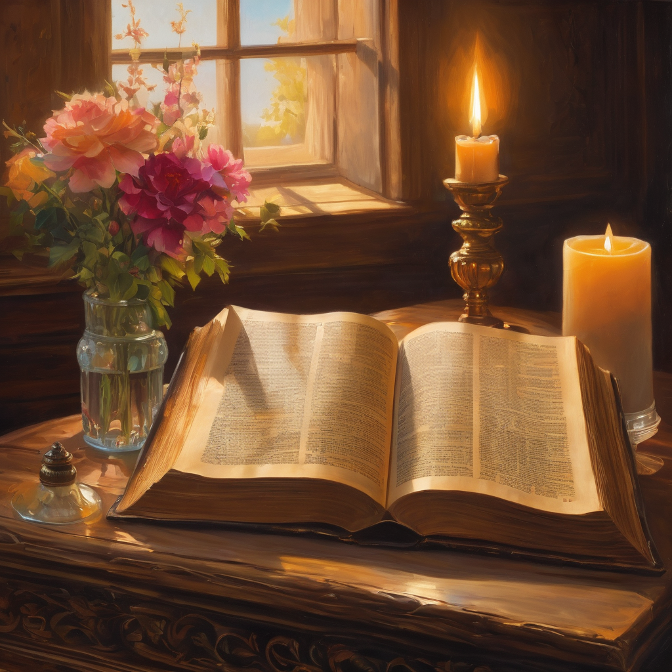
We pause
after ​the Gospel ​​

Slide 26
Leader: .
Leader and Cantor mute
Broadcaster exits screenshare
Flashback Sermon:
The Trinity Community
The Rev'd John Dougherty
https://youtu.be/ojdI_ES-OW8

Slide 27
Leader unmutes
Our next Hymn
Holy, Holy, Holy!
https://www.youtube.com/watch?v=VR-c7MSsbqs&t=2s
We stay on mute
Leader mutes

Slide 28
The Leader and Cantor unmute
The Greeting of Peace
Leader: We are the body of Christ
All: God’s Spirit is with us
Leader: The peace of the Lord be always with you.
All: And also with you.
Leader: A sign of peace may be exchanged
You may like to type 'Peace' into the chat, use the 'raise hand’ or other reaction buttons, or just simply wave via the screen with your video turned on
(Broadcaster exits shared screen for a few moments for the exchange of peace)

Slide 29
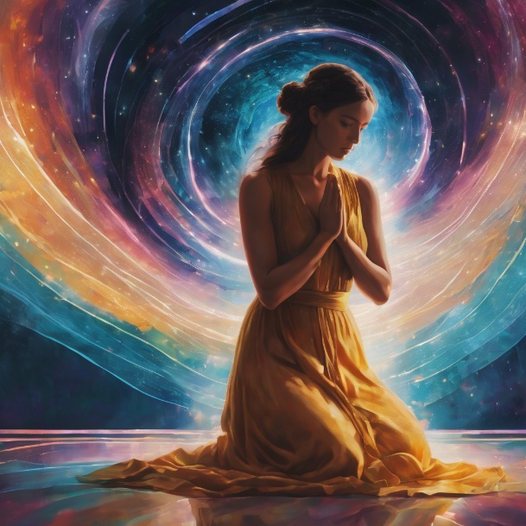
Prayer of Thanksgiving before Intercessions
Leader: As we enter prayer, I invite the second reader to unmute to lead our intercessions following the prayer of thanksgiving on the next slide. Please feel free to change your body position as you need.
Continue…

Slide 30
Leader: Thank you, Lord, that you are with us always,
to the very end of the age.
You gave all your disciples authority to spread your word.
Thank you that we are your disciples also,
and you do the same for us.
May we praise you with our words and actions,
as we seek first your kingdom in our lives.
Thank you, Lord.
Amen.
Notes:
Prayer of praise and thanksgiving

Slide 31
Intercessions
Reader 2: We pray for creation and communities we share our lives with. We pause for a few moments to name either in our hearts, or out loud, or in the chat, those environments and communities we bring to the Lord in prayer.
PAUSE…
Continue…

Slide 32
Intercessions
Reader 2: We entrust to you the community of Holy Hermits Online and our ministry partners:
Prosper the work of our hands and show us the way to your new creation.
Creator God, Hear our prayer.
St John's Cathedral Brisbane The Anglican Diocese of Southern Queensland St Gabriel’s, Carindale Benedictus Contemplative Church, Canberra Anglican Focus and Tithe.ly

Slide 33
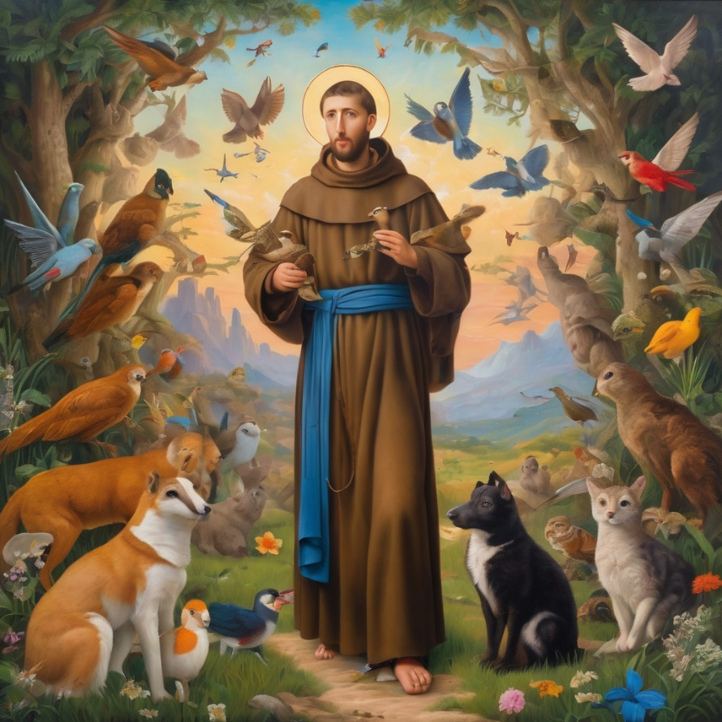
Reader 2: Loving Creator, we entrust to you all animals, especially those who are sick, anxious, ageing, lost, at risk, lonely, sad, hungry, in pain, homeless, abused, living in fear, encountering violence of any kind, in need of comfort, rehabilitation or transformation.
Continue…

Slide 34
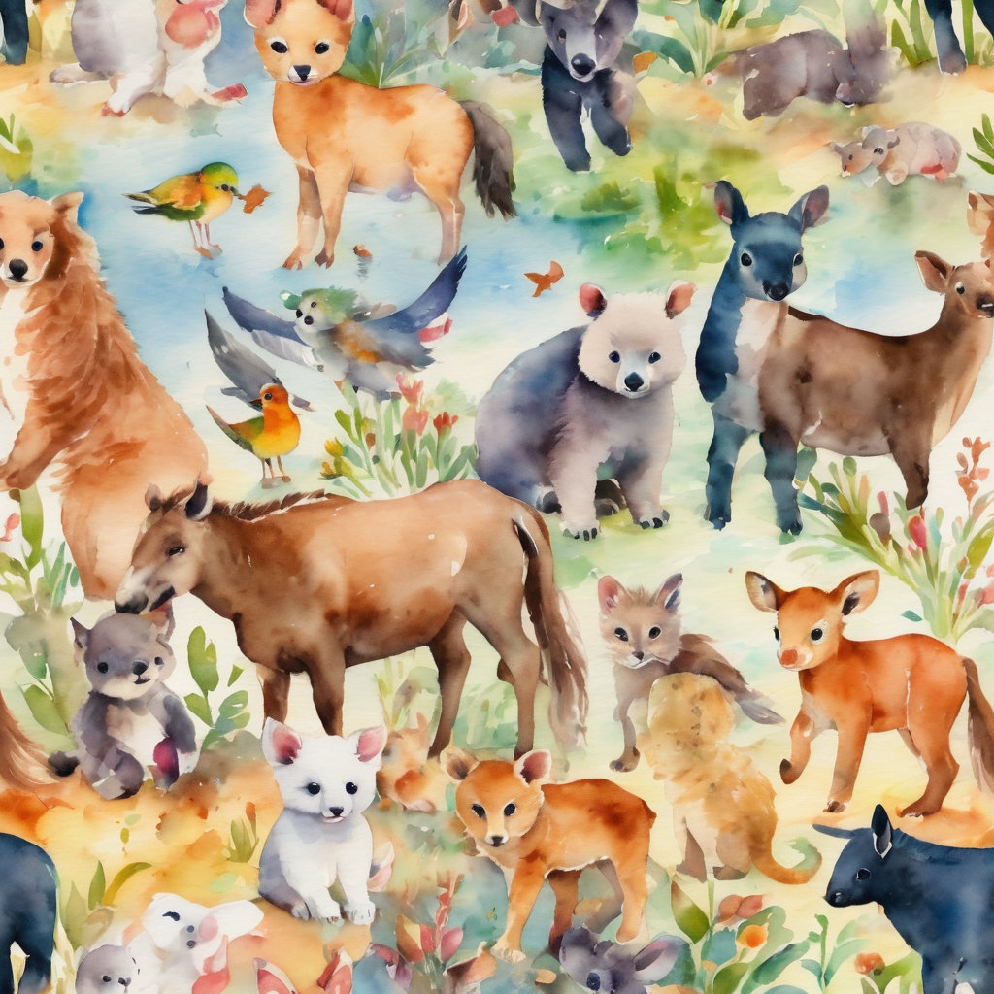
Reader 2: We invite your loving compassion for:
We name in our hearts, out loud or in the chat,
the animals we bring to the Lord in prayer. PAUSE…
Jasmine, ​
Leese(y), ​
Sid, Toots & Lulu​
Polly and Suki​
Fred, George & Percy​
Koshka ​
Jax
Lambert ​​
Kala, Nigel & Little One ​​
Toby​​
Taco​​
Paddy ​​
Rosie​

Slide 35
Reader 2: Eternal Trinity of Love, we uphold to you the people we love and carry cares for:
Kerry, Les & Jake Julie, Ray, Tracey & Shane Mark, Desley & Bob ​​ Rachel, Mervyn & Gillian ​​Rev'd Shane & Janette​​ Alecia, Martin & Aidan​​ Kirsten, Greg, Daphne & Beau Bill & Marjorie​​ Aaron & Andrea Liz’s Godchildren | Barry​​ Dr Julie ​​ Ruth​​ Phil​ May Susan Tanya​ Neva Kathy ​Gayanne Tina | ​​ | Alan & Gaylene​ Jess & Leah ​​ Barry & Gwen Matthew & Nicholas​ Bob & Di​ Pat & Julie Dilys & Tony, Paul & Darhon Judy & Mary Miriam
Continue…

Slide 36
Reader 2:
We name in our hearts, out loud or in the chat, those we bring to the Lord in prayer.
PAUSE…
We entrust to you those who have died, those who have died peacefully and those who have died tragically, The old and the young. Receive them into your Kingdom. Lord in your mercy, Hear our prayers. Amen.

Slide 37
Pray Daily Cycle of Prayer
Leader: Loving God, joining with the Church in our cycle of prayer, we ask your blessings on:
Eglise Anglicane du Rwanda
The Parish of Ipswich: Mpole, Simon, Elizabeth, Dianne, Brenda, Rachael, Allana
Anglican Men’s Society

Slide 38
Commitment prayer for the week
Leader: Our commitment prayer for the week is for Lay Roles
God of love, pour out your Holy Spirit on our lay ministry at Holy Hermits Online.​​
​Bless those who offer their ministry gifts as cantors, readers, prayer writers, Liturgical Assistants, lay leaders, service prep team members, broadcasters, proof-readers, welcomers, tech supporters and helpers in any way. We pray each one feels encouraged to continue serving you.​​​
Continue…
Notes:
Link to prayer group ministry page for weekly commitment prayer https://holyhermits.com.au/ministries/prayer-group

Slide 39
​​Give courage to those who hear your voice and offer their ministry gifts so that they too can serve you in the future.​​
Thank you for your rich blessings on our community.​​
​​In Jesus' name we pray. ​ Amen.
Notes:
Link to prayer group ministry page for weekly commitment prayer https://holyhermits.com.au/ministries/prayer-group

Slide 40
Leader: Let us pray together the prayer which Jesus gave us saying:
All: Our Father in heaven, hallowed be your name,
your kingdom come, your will be done, on earth as in heaven.
Give us today our daily bread.
Forgive us our sins
as we forgive those who sin against us.
Save us from the time of trial and deliver us from evil.
For the kingdom, the power, and the glory are yours
now and for ever.
Amen.

Slide 41
Devotions

Slide 42
Holy Hermit
Sister Teresa of Jesus of Los Andes

Slide 43
Hermit Wisdom
“Remember that the Heart of Jesus is your spiritual cradle. There is your nest. There Jesus sings lullabies of peace and love to you.“
"I feel full of God. There is no separation between us. Wherever I go, He is with me, within me. I live with Him. And despite being on the walks, we both talk without anyone surprising us or interrupting us. The will of God is a spiritual food that fortifies the soul that surrenders to Him gladly."

Slide 44
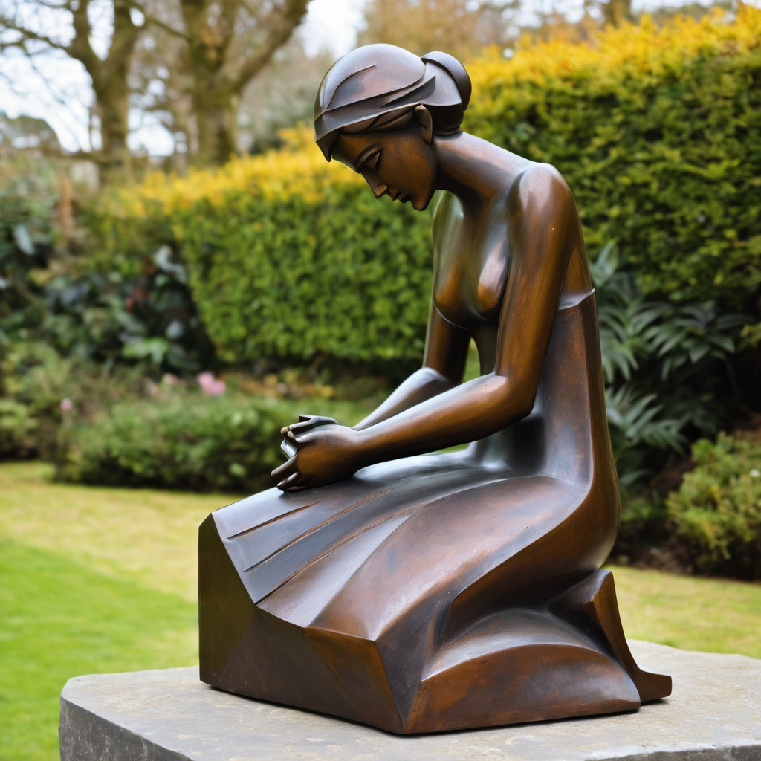
​
Leader: ​As we enter a few minutes of silence together, you are invited to pray the prayer of adoration on the next slide and/or spend this time in contemplation. ​
The Spiritual Communion prayer follows on the slide after that.
Let us be still.
Leader and Cantor Mute.
Continue…

Slide 45
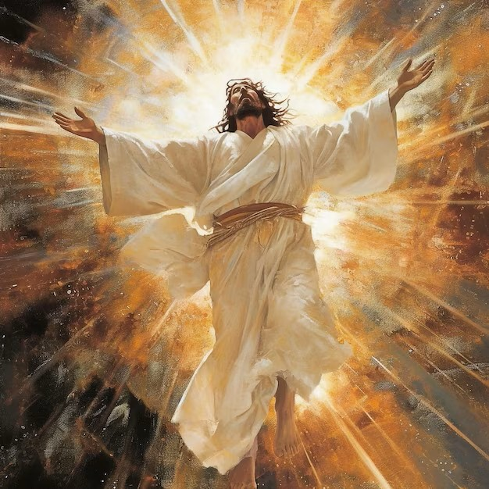
Lord God, some of the disciples doubted when they saw you.
But you didn’t leave them in their darkness, you came to them.
Come to us now, Lord, as we worship you.
Lord, where you are there is love.
May we never doubt your love for us.
May we be transfixed as we look upon your face.
Come to us here, Lord, as we worship you.
Amen.
​

Slide 46

Oh, my Lord Jesus I turn to you present at the Altar and in the Tabernacle. I believe that you are present in the Holy Sacrament of your most Sacred Body and Blood. I love you above all things and I desire to receive you into my Soul. I cannot at this moment receive you Sacramentally in Holy Communion. Come spiritually into my heart. Purify it, Sanctify it. Render my heart like your own heart. I embrace you as if you were already there and unite myself wholly with you. Never permit me to be separated from you. Lord, I am not worthy to receive you, but only say the word and I shall be healed. Amen
Making a
Spiritual Communion
(Prayed in silence)

Slide 47
Leader unmutes
Our final song is
Father In My Life I See
https://www.youtube.com/watch?v=V6zYEkIjpIc
​We stay on mute
Leader and Cantor mute

Slide 48
Leader and cantor unmute
Sending Prayer
Leader: We pray our sending prayer together.
All: Jesus, thank you for trusting us to go out with your message.
Thank you that as we go we are filled with your Holy Spirit
and can know you with us, strengthening and helping us.
Lead us to those who are open to becoming learners of you
and give us the words to share.
Amen.

Slide 49
The Benediction
Leader: Let us all invite God’s blessings together,
All: As we leave, leave with us, Lord,
walk with us always.
Be there as we share bread
and help us to share with others in need.
Amen.

Slide 50
Notices
3D Dialogue: Surprised by Joy in an ordinary life this afternoon @ 5pm. All are welcome to come along.
If anyone is interested in sharing some information on a Saint, or Holy Hermit for our 2nd Sunday Saint Spotlight in June please contact Rev’d Lauren.
Wednesday night we continue with out study on the Trinity; Embracing The Divine Flow @6pm. All are welcome to join.
See HHO Events page for further upcoming events HHO Events

Slide 51

Leader: Thank you for your regular gifts to this ministry. Offerings are most welcome via:
The HHO App
Direct Debit
International Direct Debit
Please consider a one-off donation
or leaving a legacy in your Will
For further information go to HHO give page
https://holyhermits.com.au/give

Slide 52
Serving next week
7th June 2026
9:00 am AEST
Service Prep: Lauren | Chat Host: Rachel | First Reader: Viki
Music: Wiggles | Welcomer: Julie | Second Reader: Bob
Proof-reader: Viki | Priest: N/A | Preacher: Lauren
Broadcaster: Barry | Deacon: Lauren | Fellowship: Lauren
Backup Broadcaster: Lauren | Leader: Jeremy | Safety Officer: Julie
Zoom Buttons: Rachel | Cantor: Kieron | Attendance: Rachel
Thank you for your ministry gifts
New Servers always welcome!
Please email Rev’d Lauren to get involved
holyhermits@anglicanchurchsq.org.au

Slide 53
The Dismissal
Leader: I invite everyone to unmute for the Dismissal
Leader: Go in peace to love and serve the Lord.
All: In the name of Christ, Amen.

Slide 54
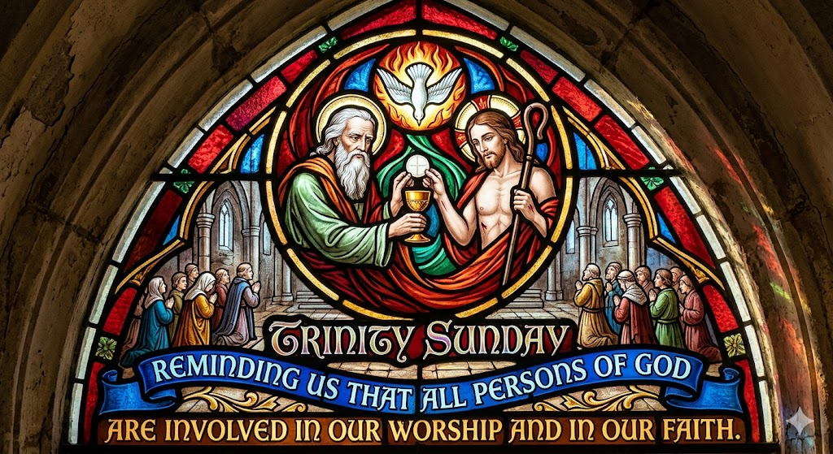
Fellowship time
Thank you, Julie for leading Fellowship
Please feel welcome to linger or pop a message in the chat and head off when you are ready.​
Extra resources developed
by Roots on the Web

