Slide 1
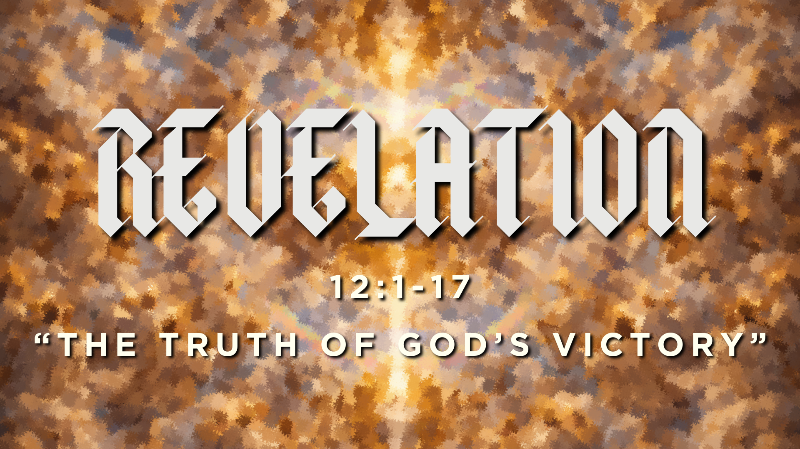

Slide 2
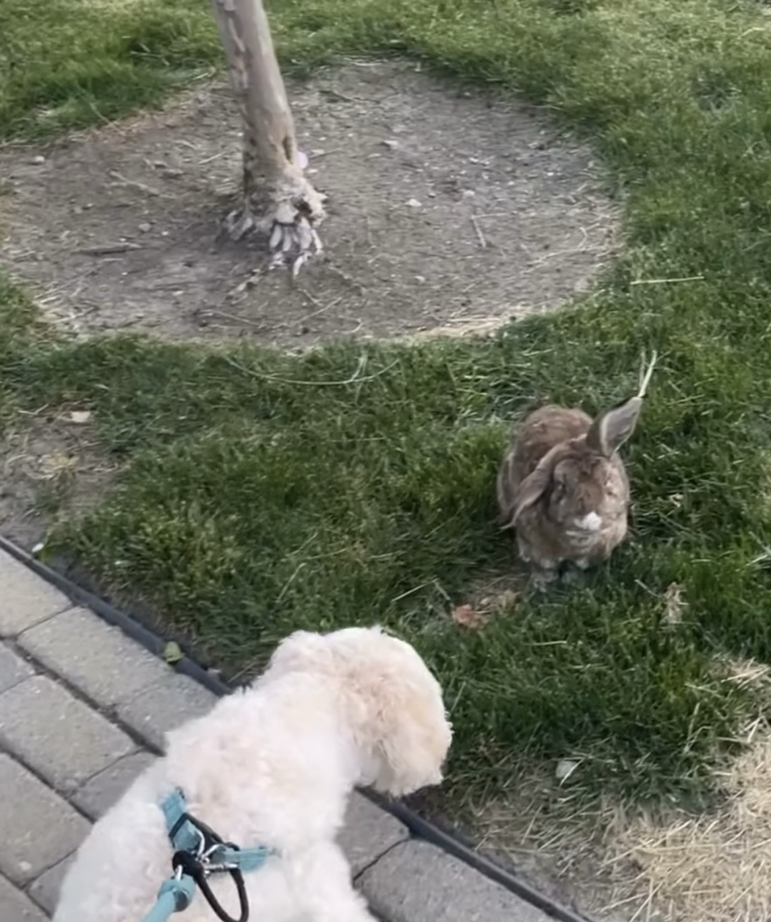

Slide 3
Be watchful, stand firm in the faith (1 Cor. 16:13)
…that you are standing firm in one spirit…and not frightened in anything by your opponents. (Phil. 1:27)
…that you may be able to withstand in the evil day, and having done all, to stand firm. (Eph. 6:13)

Slide 4
But thanks be to God, who gives us the victory through our Lord Jesus Christ. Therefore, my beloved brothers, be steadfast, immovable, always abounding in the work of the Lord, knowing that in the Lord your labor is not in vain.
1 Corinthians 15:57-58

Slide 5
Q: What spiritual truths help us stand firm when we doubt?

Slide 6
“We come now to what commentators universally agree is the central and pivotal chapter in the book.”
Thomas Schreiner

Slide 7
1 And a great sign appeared in heaven: a woman clothed with the sun, with the moon under her feet, and on her head a crown of twelve stars. 2 She was pregnant and was crying out in birth pains and the agony of giving birth.
Revelation 12:1-2
Isaiah 66:7–9 talks about “Zion giving birth.”

Slide 8
GOD’s PEOPLE
1 And a great sign appeared in heaven: a woman clothed with the sun, with the moon under her feet, and on her head a crown of twelve stars. 2 She was pregnant and was crying out in birth pains and the agony of giving birth.
Revelation 12:1-2
Isaiah 66:7–9 talks about “Zion giving birth.”

Slide 9
3 And another sign appeared in heaven: behold, a great red dragon, with seven heads and ten horns, and on his heads seven diadems. 4 His tail swept down a third of the stars of heaven and cast them to the earth.
Revelation 12:3-4

Slide 10
Dragons were known in history to be scary monsters.
The dragon has seven heads and wears seven crowns. The dragon wants to take God’s authority for himself.
The sweeping of the stars represents the dragon persecuting the church.

Slide 11
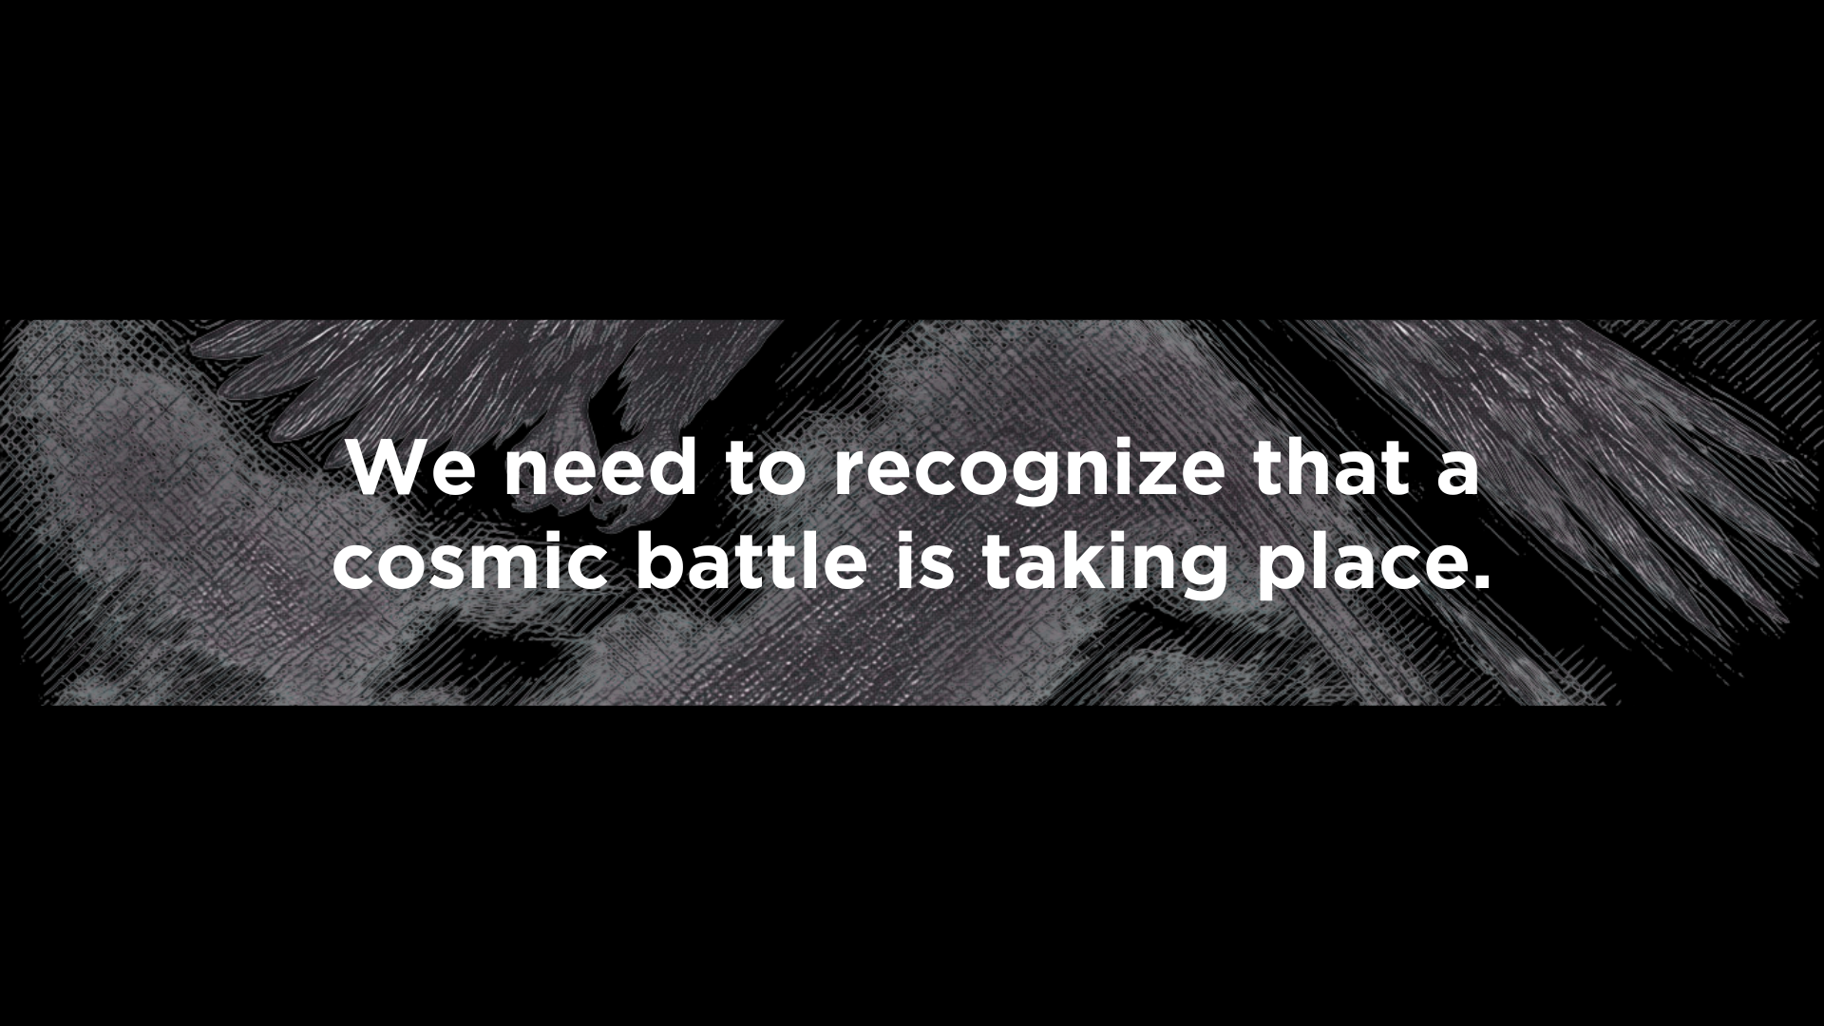
1

Slide 12
12 For we do not wrestle against flesh and blood, but against the rulers, against the authorities, against the cosmic powers over this present darkness, against the spiritual forces of evil in the heavenly places.
Ephesians 6:12

Slide 13
9 And the great dragon…that ancient serpent, who is called the devil and Satan, the deceiver of the whole world…
Revelation 12:9
Sah-TAHN = Accuser

Slide 14
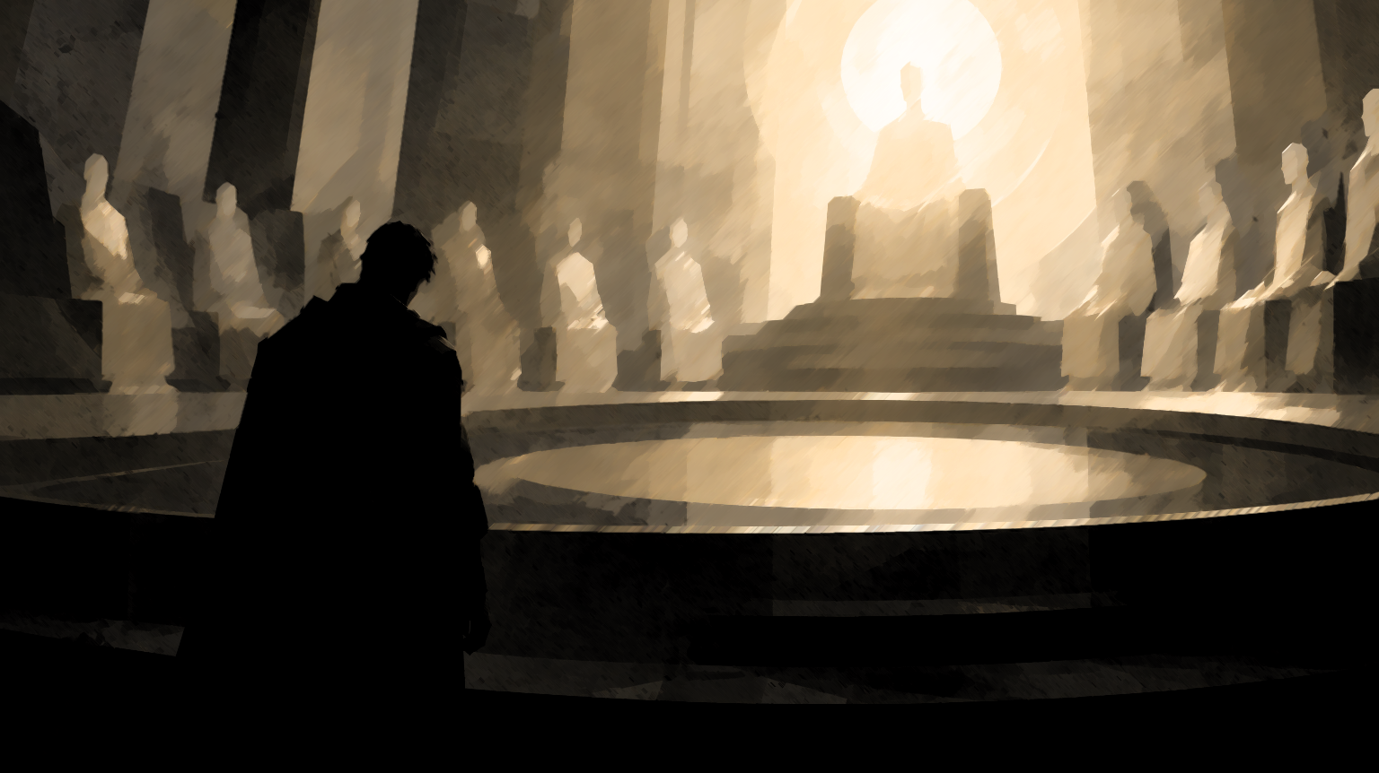

Slide 15
9 And the great dragon…that ancient serpent, who is called the devil and Satan, the deceiver of the whole world…
Revelation 12:9

Slide 16
7 Now war arose in heaven, Michael and his angels fighting against the dragon. And the dragon and his angels fought back,
Revelation 12:7

Slide 17
8 but he was defeated, and there was no longer any place for them in heaven.
Revelation 12:8

Slide 18
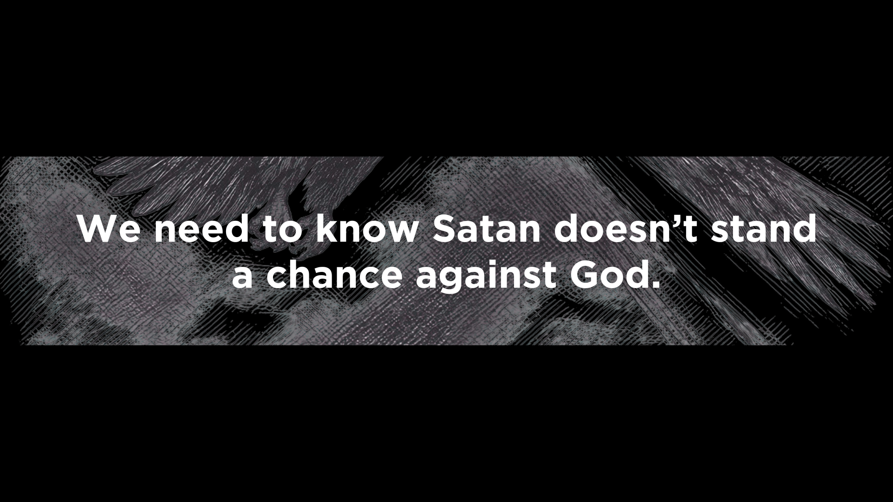
2

Slide 19
he was defeated and removed from heaven (12:8)
he was thrown down to the earth (12:9)
“The great monster no longer has any access to heaven; the courts have declared that he has no right to entrance.”
Thomas Schreiner

Slide 20
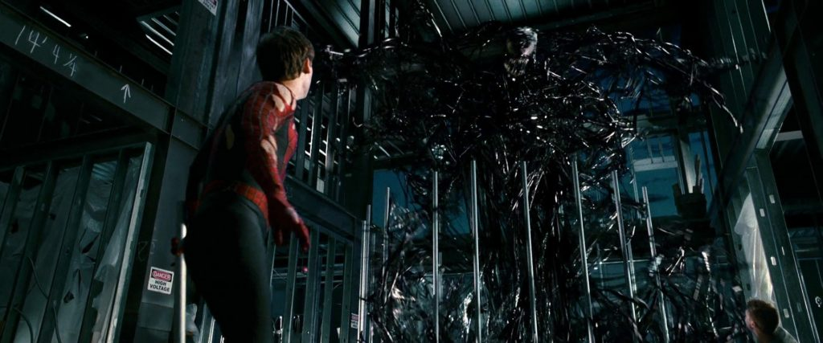

Slide 21
But woe to you, O earth and sea, for the devil has come down to you in great wrath, because he knows that his time is short!
Revelation 12:12

Slide 22
17 Then the dragon became furious with the woman and went off to make war on the rest of her offspring, on those who keep the commandments of God and hold to the testimony of Jesus.
Revelation 12:17

Slide 23
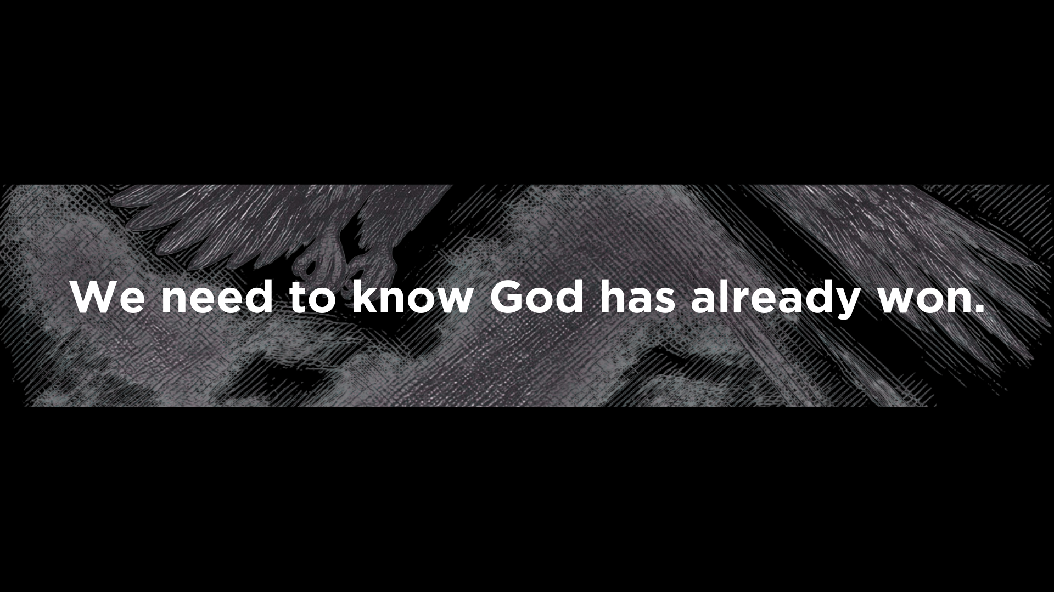
3

Slide 24
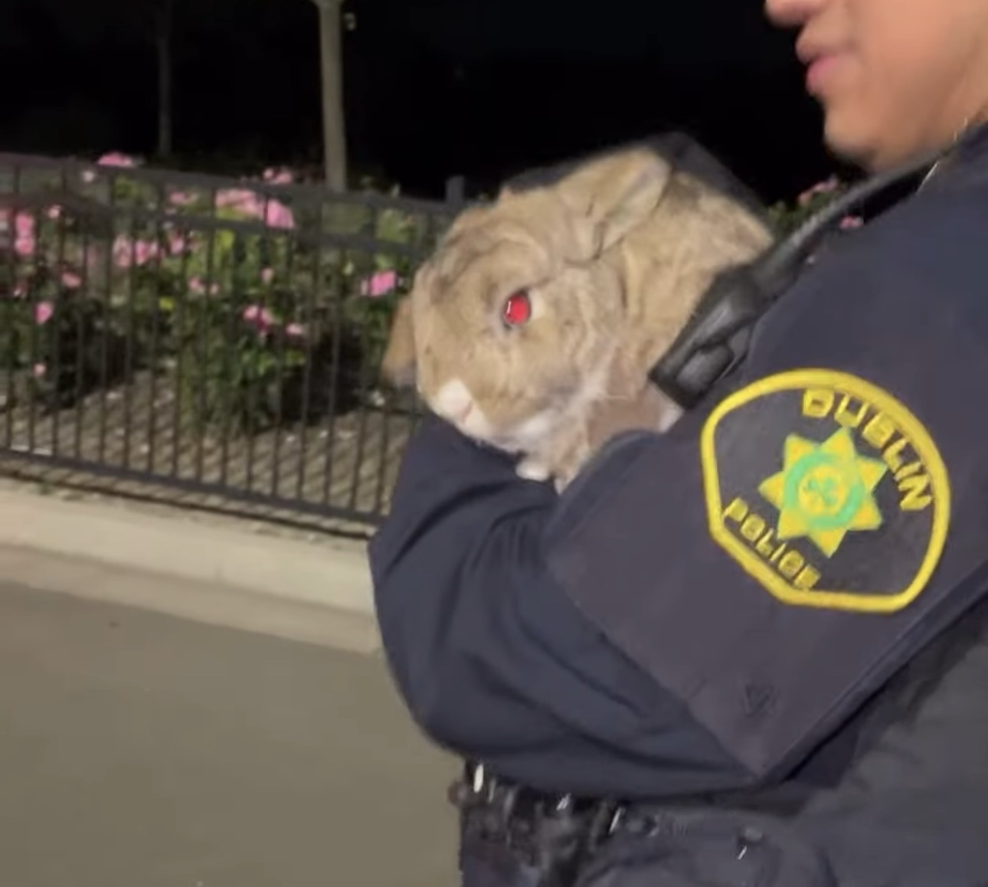

Slide 25
God nourishes the church (12:6)
God is our shepherd in the wilderness (12:14)
God protects us from Satan when he tries to overwhelm us (12:15)

Slide 26
