Slide 1
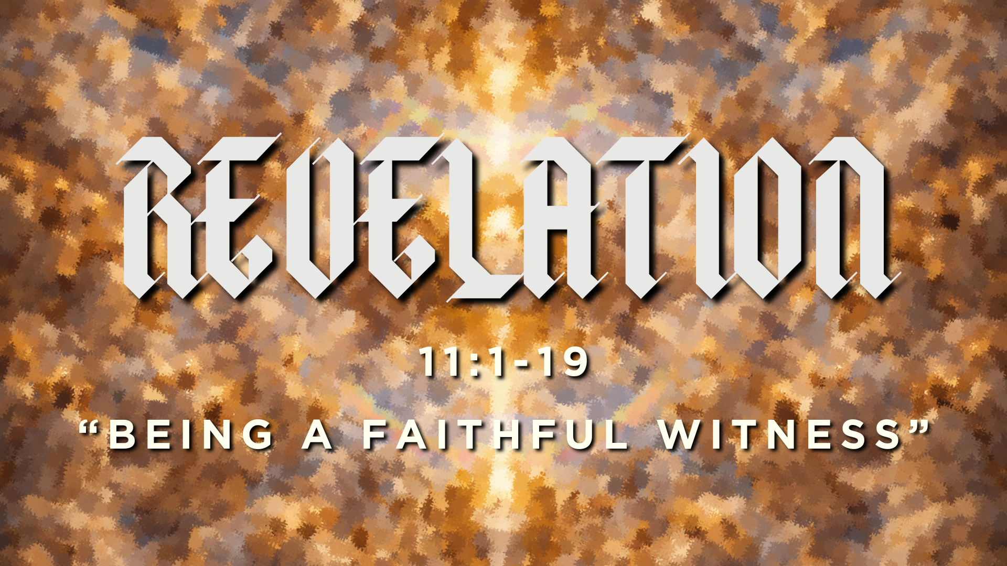

Slide 2

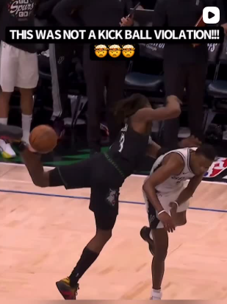
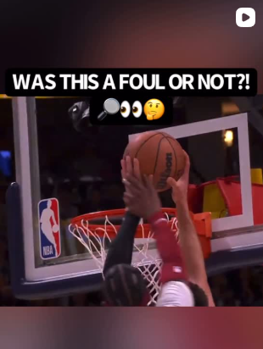
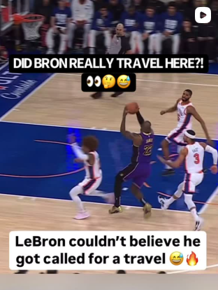

Slide 3


Slide 4
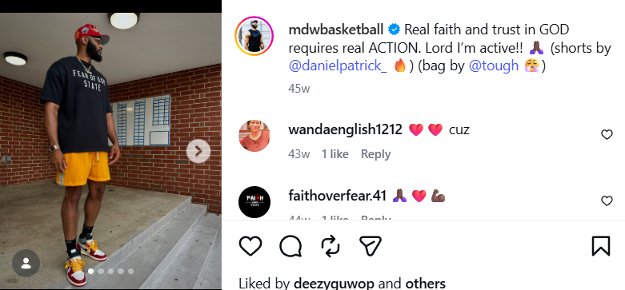

Slide 5
Trust in the authority of God’s word
Trust that God’s word will be fulfilled
Trust in His commands

Slide 6
Q: What does a faithful witness look like?
Q: How do I keep sharing God’s word faithfully?

Slide 7
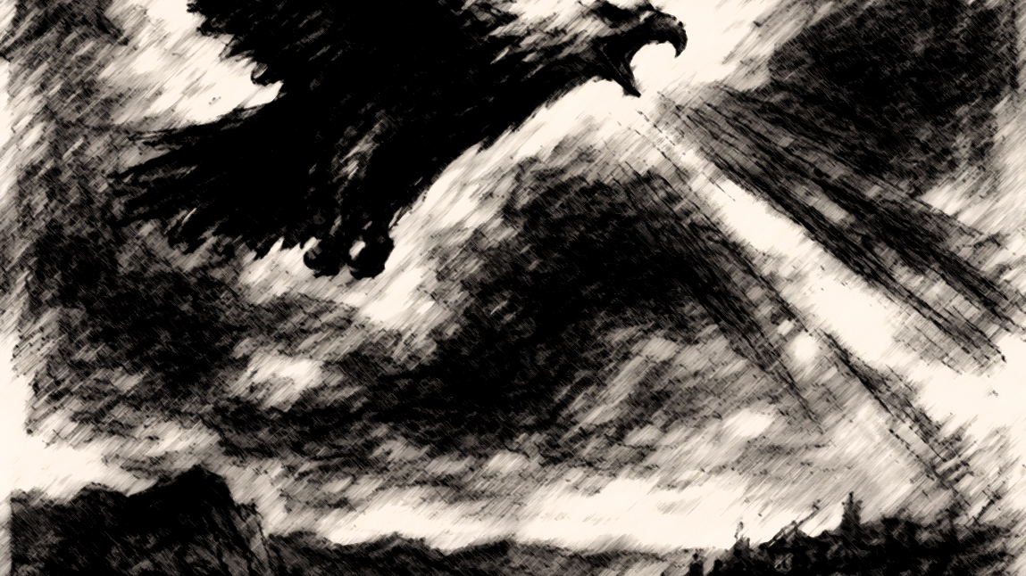

Slide 8
18 Whoever believes in him is not condemned, but whoever does not believe is condemned already, because he has not believed in the name of the only Son of God. 19 And this is the judgment: the light has come into the world, and people loved the darkness rather than the light because their works were evil.
John 3:18

Slide 9
“You must again prophesy about many peoples and nations and languages and kings.”
Revelation 10:11

Slide 10
Chapter 11
The persecution of the church (11:1-2)
The two witnesses and their death (11:3-10)
The witnesses are vindicated (11:11-13)
The Kingdom of God arrives (11:14-19)

Slide 11
Then I was given a measuring rod like a staff, and I was told, “Rise and measure the temple of God and the altar and those who worship there, 2 but do not measure the court outside the temple; leave that out, for it is given over to the nations, and they will trample the holy city for forty-two months.
Revelation 11:1-2

Slide 12
Then I was given a measuring rod like a staff, and I was told, “Rise and measure the temple of God and the altar and those who worship there, 2 but do not measure the court outside the temple; leave that out, for it is given over to the nations, and they will trample the holy city for forty-two months.
Revelation 11:1-2

Slide 13
Then I was given a measuring rod like a staff, and I was told, “Rise and measure the temple of God and the altar and those who worship there, 2 but do not measure the court outside the temple; leave that out, for it is given over to the nations, and they will trample the holy city for forty-two months.
Revelation 11:1-2

Slide 14
And I will grant authority to my two witnesses, and they will prophesy for 1,260 days, clothed in sackcloth.
Revelation 11:3

Slide 15
And I will grant authority to my two witnesses, and they will prophesy for 1,260 days, clothed in sackcloth.
Revelation 11:3

Slide 16
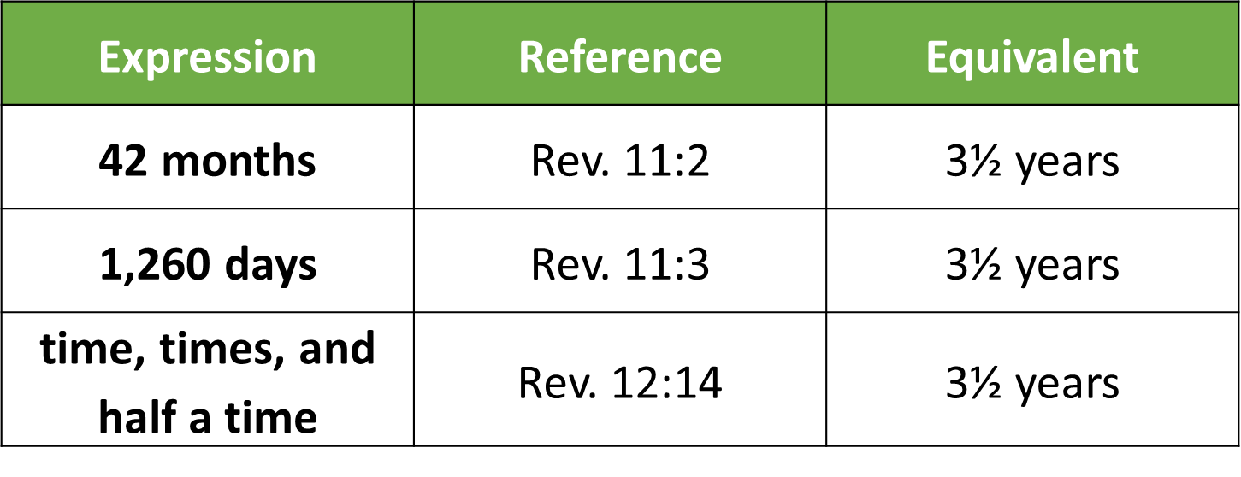

Slide 18
Refers to the period between the ascension of Jesus and His return.

Slide 19
4 These are the two olive trees and the two lampstands that stand before the Lord of the earth. 5 And if anyone would harm them, fire pours from their mouth and consumes their foes. If anyone would harm them, this is how he is doomed to be killed. 6 They have the power to shut the sky, that no rain may fall during the days of their prophesying, and they have power over the waters to turn them into blood and to strike the earth with every kind of plague, as often as they desire.
Revelation 11:4-6

Slide 20
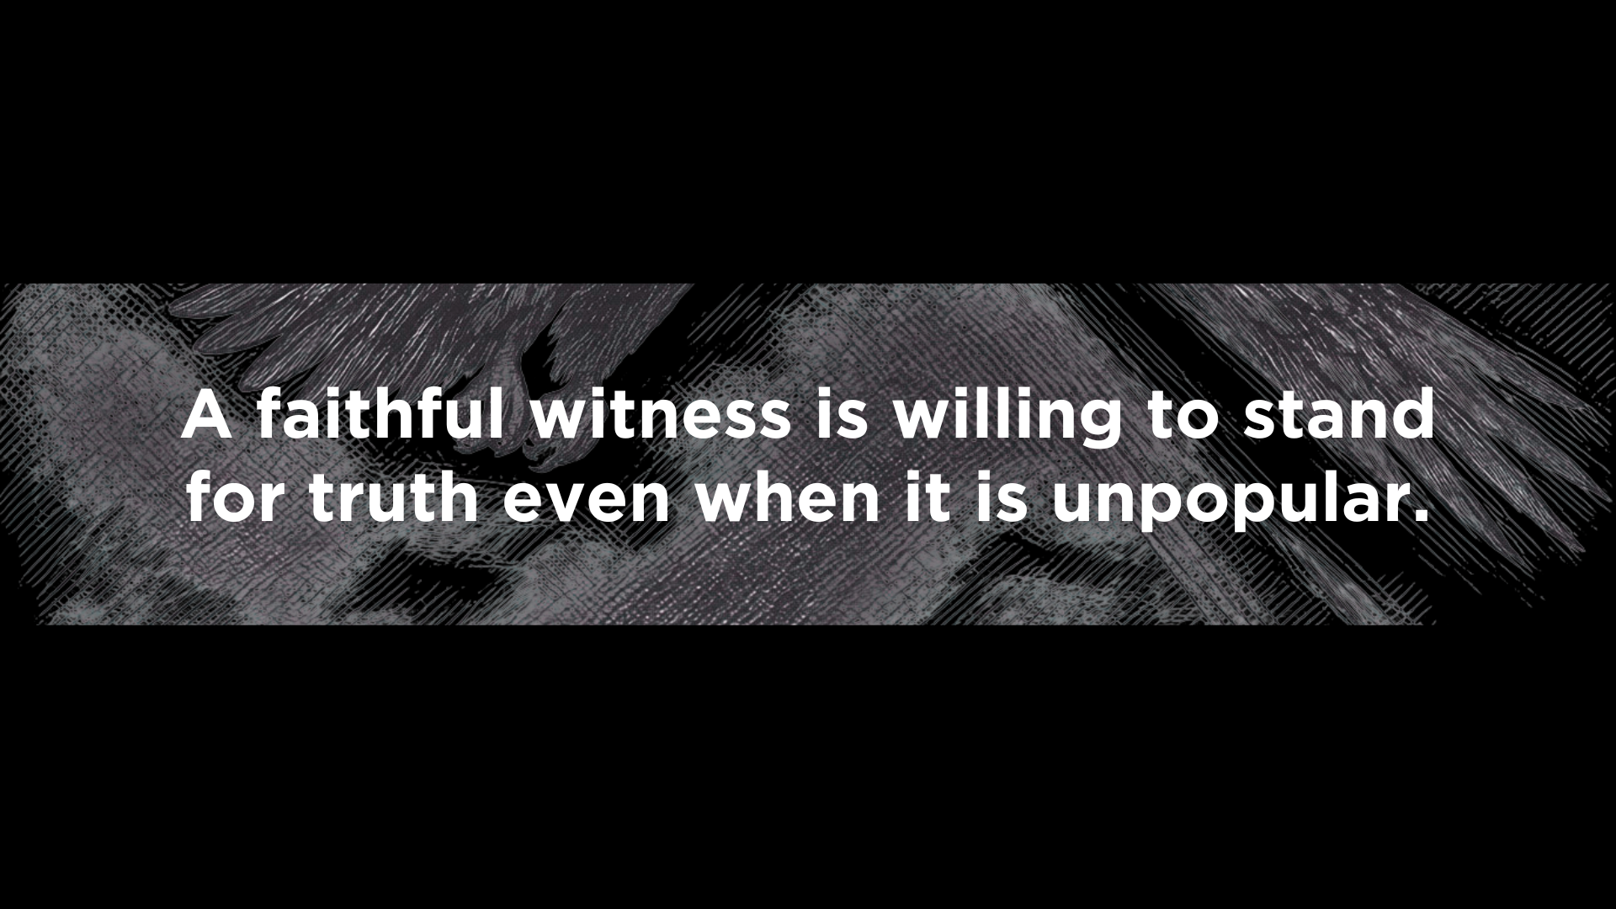
1

Slide 21
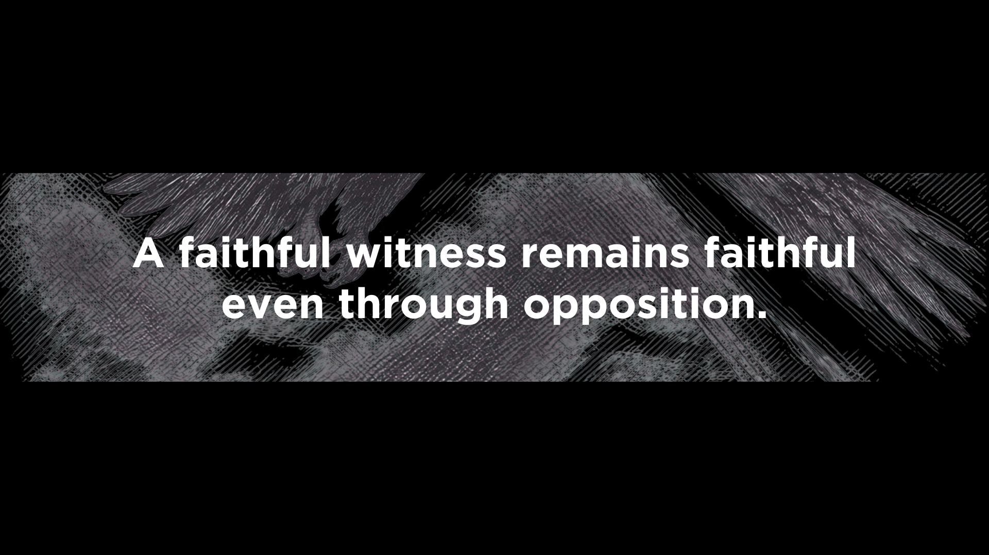
2

Slide 22
7 And when they have finished their testimony, the beast that rises from the bottomless pit will make war on them and conquer them and kill them, 8 and their dead bodies will lie in the street of the great city that symbolically is called Sodom and Egypt, where their Lord was crucified. 9 For three and a half days some from the peoples and tribes and languages and nations will gaze at their dead bodies and refuse to let them be placed in a tomb, 10 and those who dwell on the earth will rejoice over them and make merry and exchange presents, because these two prophets had been a torment to those who dwell on the earth.
Revelation 11:7-10

Slide 23
If the world hates you, know that it has hated me before it hated you.
John 15:18-19
Indeed, all who desire to live a godly life in Christ Jesus will be persecuted.
2 Timothy 3:12

Slide 24
7 And when they have finished their testimony, the beast that rises from the bottomless pit will make war on them and conquer them and kill them, 8 and their dead bodies will lie in the street of the great city that symbolically is called Sodom and Egypt, where their Lord was crucified. 9 For three and a half days some from the peoples and tribes and languages and nations will gaze at their dead bodies and refuse to let them be placed in a tomb, 10 and those who dwell on the earth will rejoice over them and make merry and exchange presents, because these two prophets had been a torment to those who dwell on the earth.
Revelation 11:7-10

Slide 25
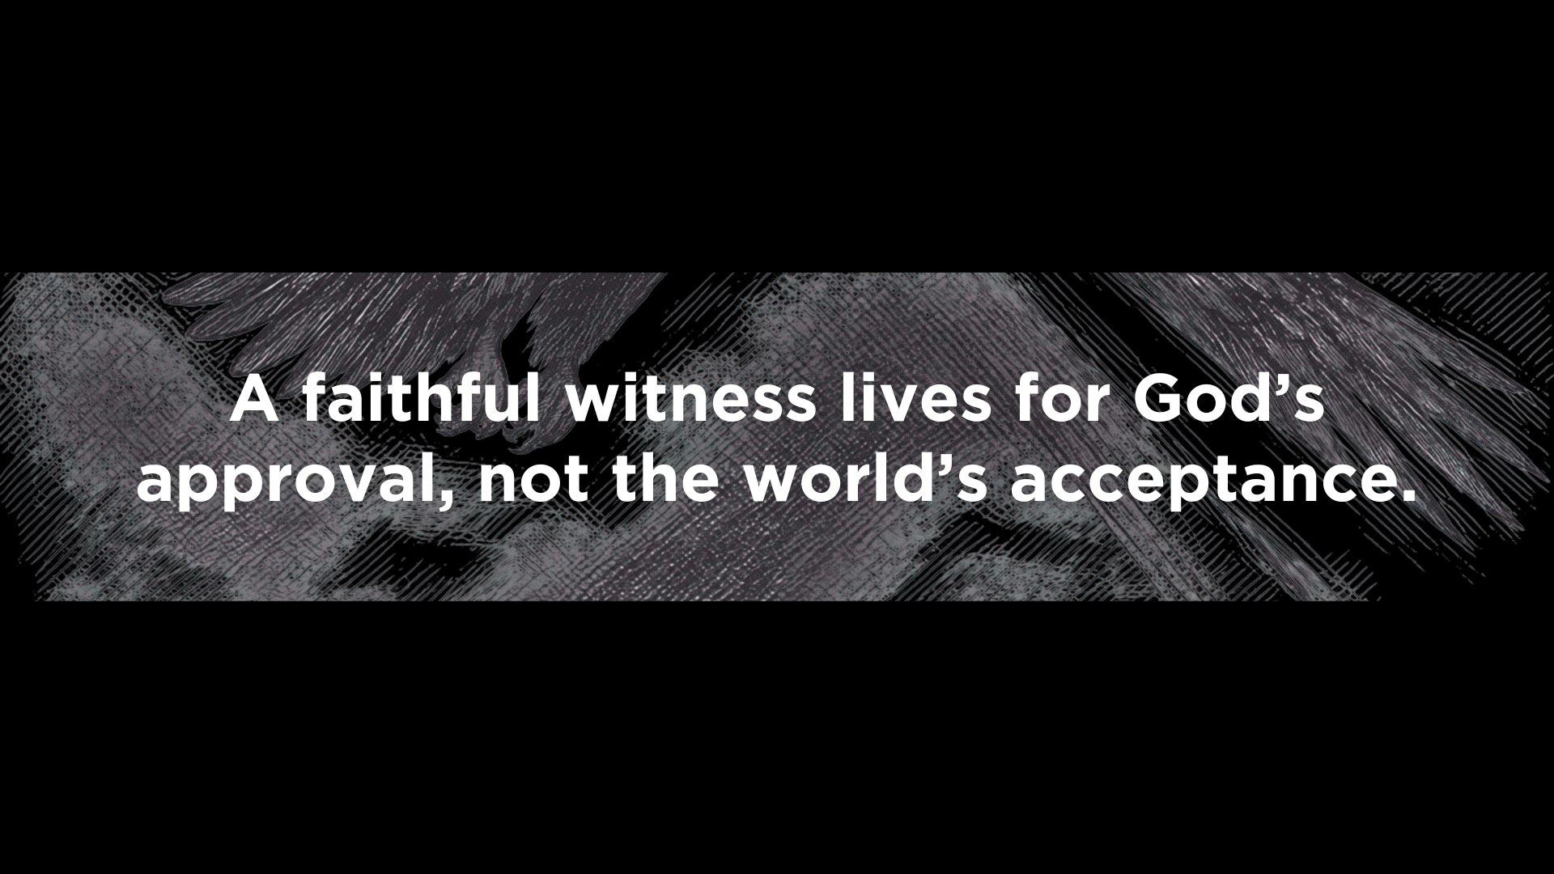
3

Slide 26
11 But after the three and a half days a breath of life from God entered them, and they stood up on their feet, and great fear fell on those who saw them. 12 Then they heard a loud voice from heaven saying to them, “Come up here!” And they went up to heaven in a cloud, and their enemies watched them.
Revelation 11:11-12

Slide 27
