Slide 1



Best of the Church Press 2025
Associated
Church
Press
1A - EDITORIAL

Slide 2



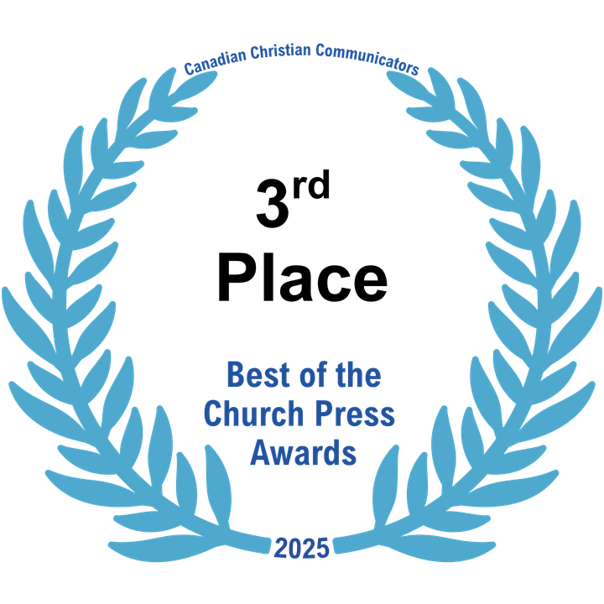
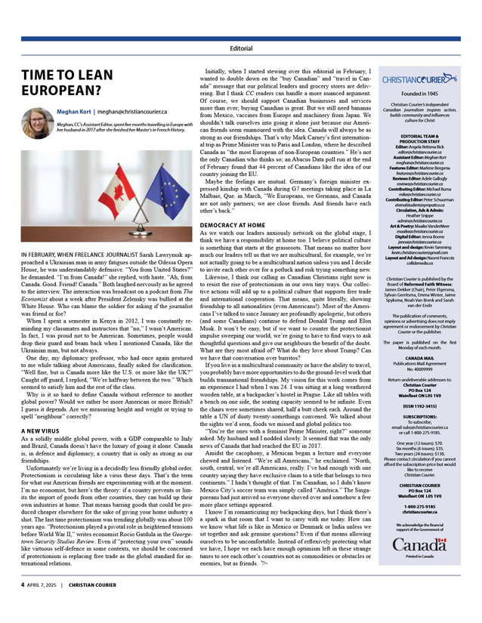
1A. EDITORIAL
Author: Rebecca Roman
Author: Meghan Kort
The Messenger
(Evangelical Mennonite Conference)
Christian Courier
“Time to Lean European?”
“Are Canadian religious charities at risk?”

Slide 3

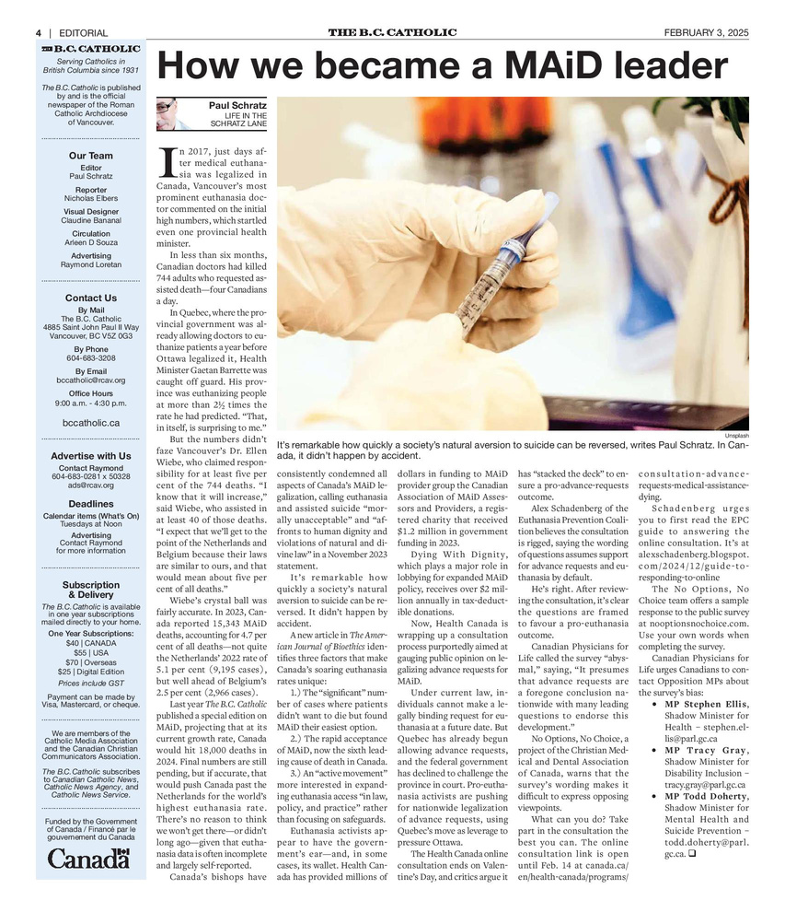
1A - EDITORIAL
FROM THE JUDGE:
Current, lots of takeaway for readers, relevant to your audience, well-written/organized, plenty of examples/data, well-sourced.
Editor: Paul Schratz
The B.C. Catholic
“How we became a MAiD Leader”

Slide 4
Best of the Church Press 2025
Associated
Church
Press
1B - FROM THE EDITOR

Slide 5
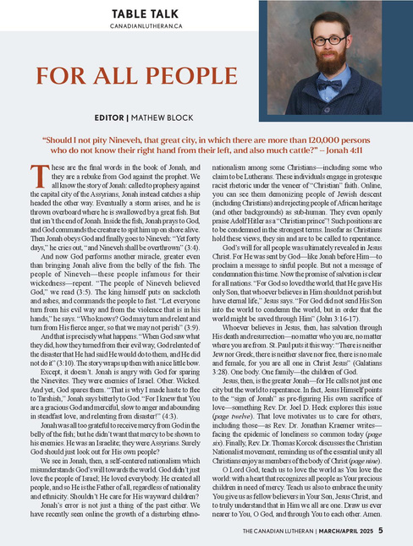
1B - FROM THE EDITOR
Author: Ken Ramstead
Author: Mathew Block
Faith & Friends
(September/October 2025)
The Canadian Lutheran
“For All People”
“Teachable Moment”

Slide 6
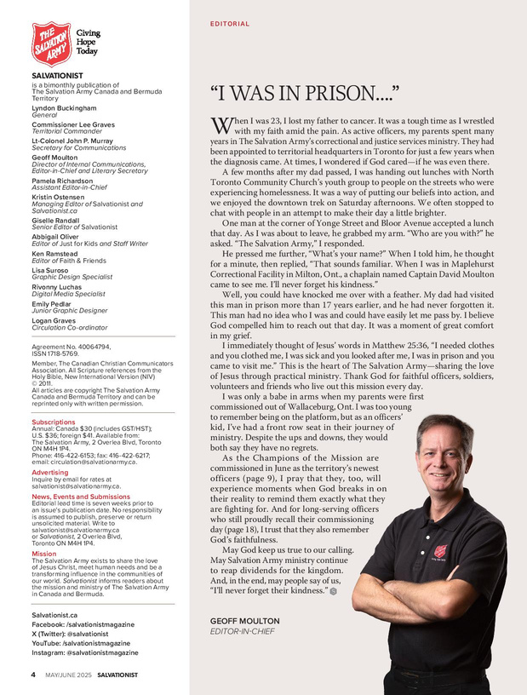
1B - FROM THE EDITOR
FROM THE JUDGE:
Poignant personal anecdote and introduces well the two stories in the issue. I think it works as a real reminder to the readership what they're here for.
Author: Geoff Moulton
Salvationist
“I was in Prison..”

Slide 7
Best of the Church Press 2025
Associated
Church
Press
2 - NEWS STORY

Slide 8
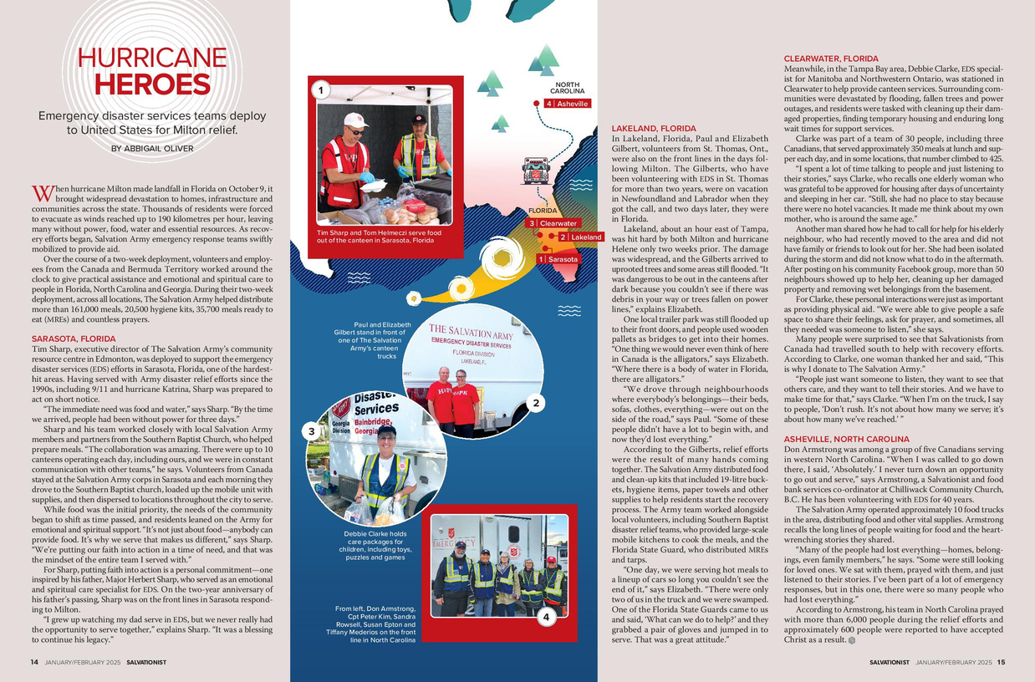
2 - NEWS STORY
Author: Gisele McKnight
Author: Abbigail Oliver
New Brunswick Anglican
Salvationist
“Hurricane Heroes”
“Alongside’s Hope’s diocesan rep hospitalized in Kenya”

Slide 9
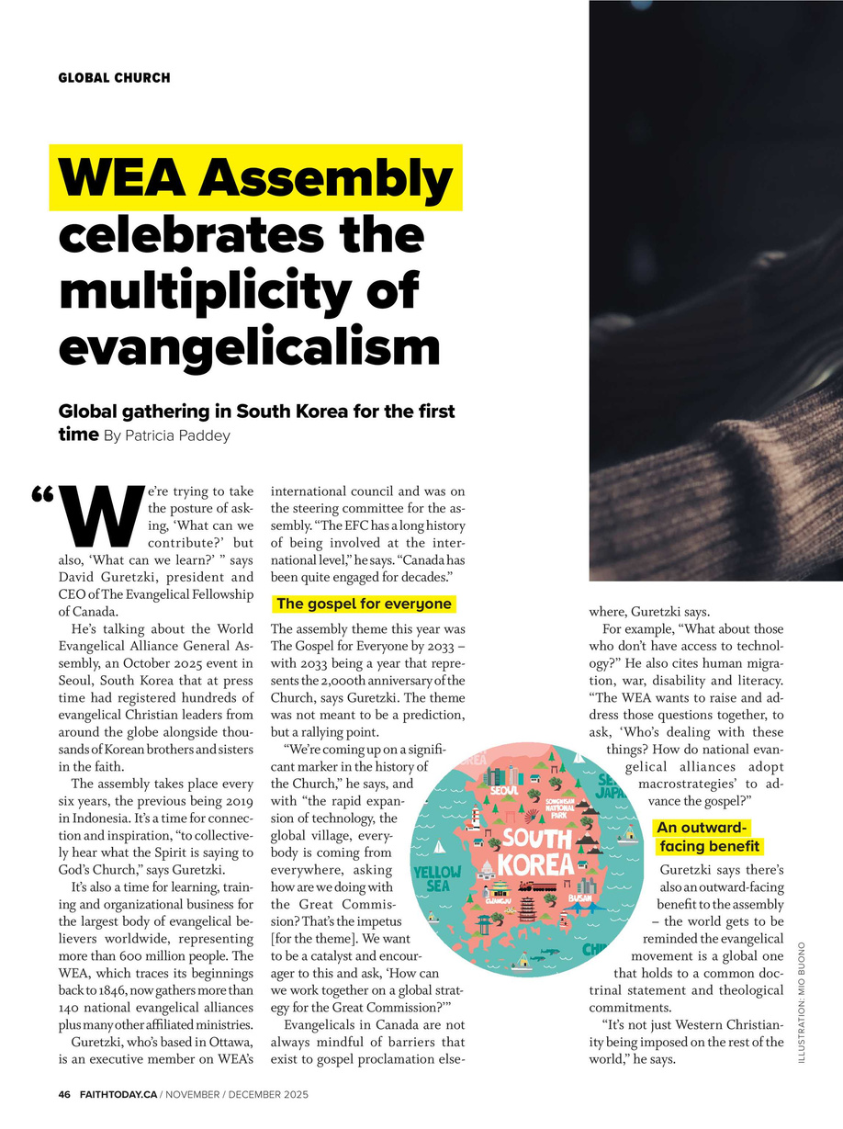
2 - NEWS STORY
FROM THE JUDGE:
Excellent scene-setting detailing the size and scope of the event.. This is a well-balanced news story.
Author: Patricia Paddey
Faith Today
“WEA Assembly celebrates the multiplicity of evangelism”

Slide 10
Best of the Church Press 2025
Associated
Church
Press
3A - FEATURE

Slide 11
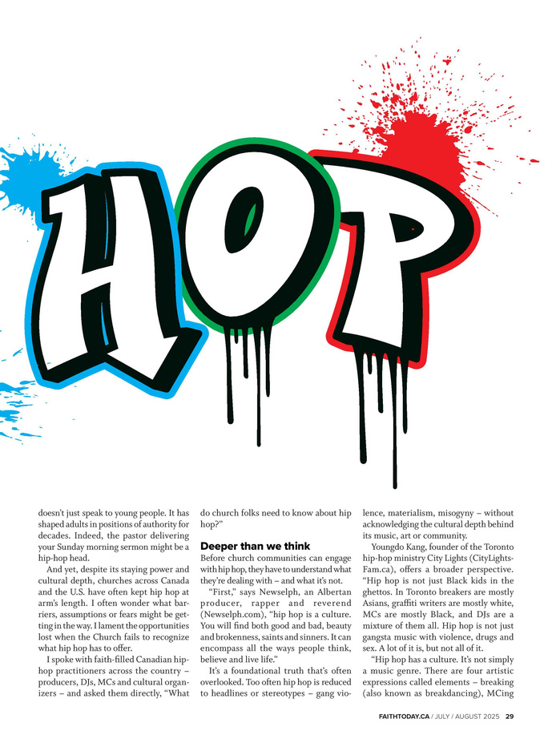
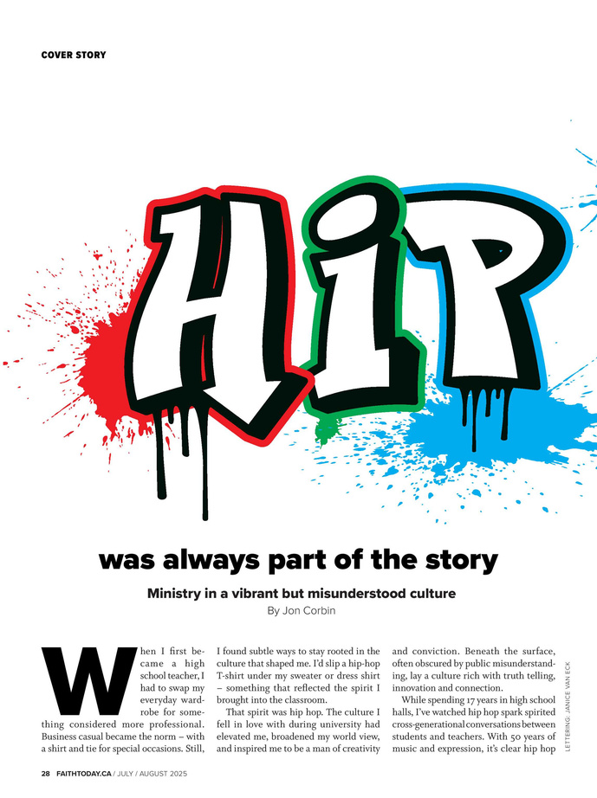
3A - FEATURE
Author: Meagan Gillmore
Author: Jon Corbin
Faith Today
Broadview
“Hip Hop was always part of the story: Ministry in a vibrant but misunderstood culture”
“The Remedy”

Slide 12
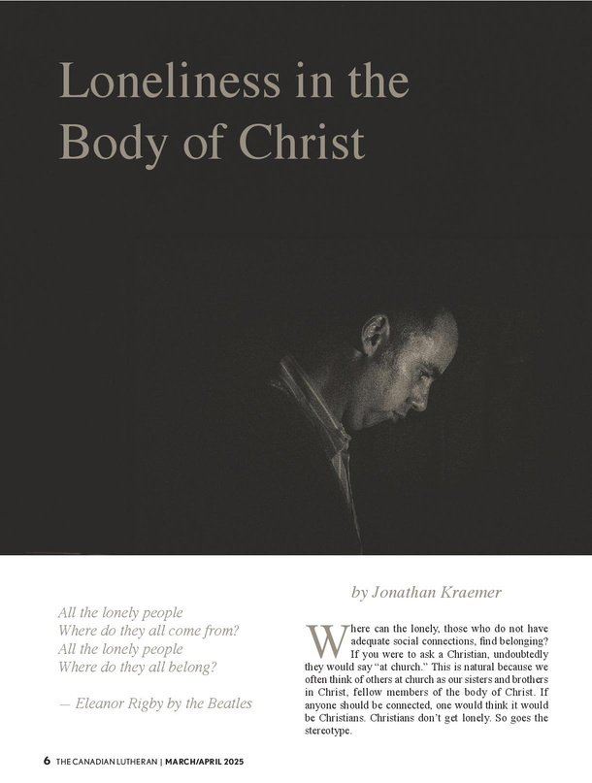
3A - FEATURE
FROM THE JUDGE:
ORIGINAL. Unique approach to a common problem.
Really well-written, well-thought-out piece.
Author: The Reverend
Jonathan Kraemer
The Canadian Lutheran
“Loneliness in the Body of Christ”

Slide 13
Best of the Church Press 2025
Associated
Church
Press
3B - FEATURE SERIES

Slide 14


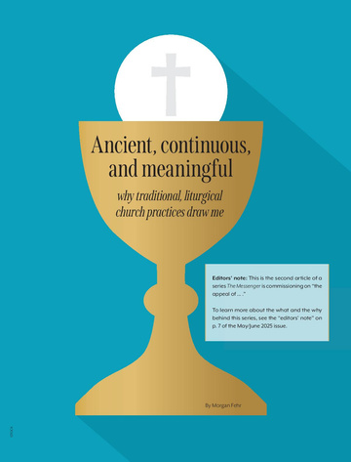

3B - FEATURE SERIES
Authors: James Driedger,
Morgan Fehr,
Steven Warthe,
Ruth Friesen
Author: Lee Purcell
Canadian Catholic News
The Messenger (Evangelical Mennonite Conference)
“Pigment, prayer and grace: a bridge across traditions” and “Icons and skylines”
“The appeal of…”

Slide 15

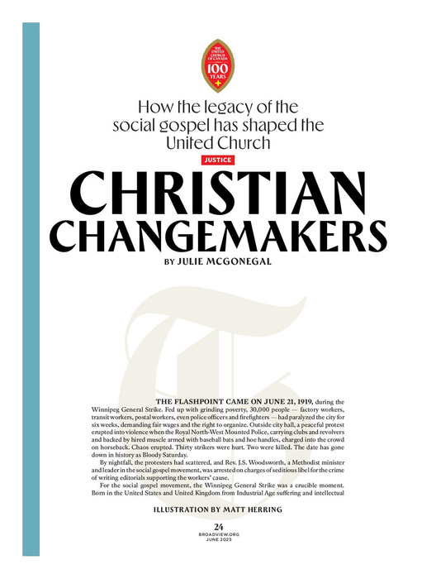

3B - FEATURE SERIES
FROM THE JUDGE:
This is an ambitious, thoughtful and well-crafted series that turns complex pieces of history into a clear and engaging story.
Authors: Julie McGonegal,
Josiah Neufeld,
Jonathan Dyck,
Teresa Burnett-Cole,
Pieta Woolley
Broadview
“100 Years of the United Church of Canada”

Slide 16
Best of the Church Press 2025
Associated
Church
Press
4 - OPINION PIECE

Slide 17
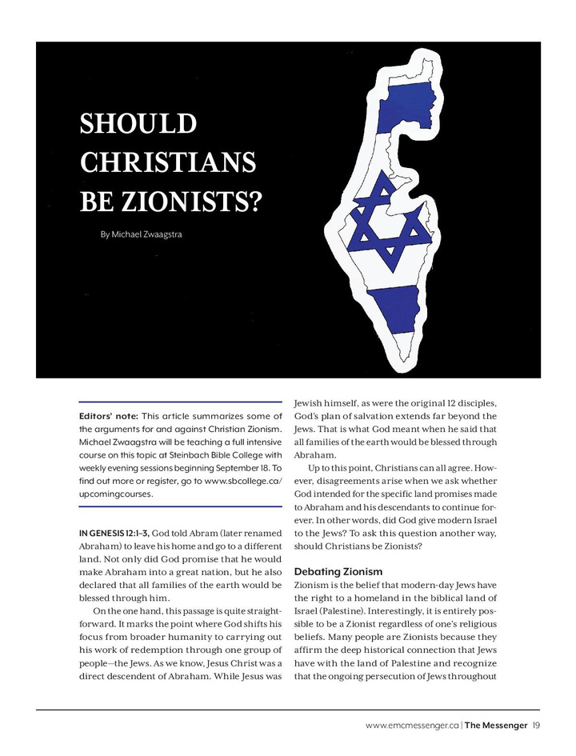
4 - OPINION PIECE
Author: Michael Zwaagstra
Author: Terry O’Neill
The Messenger (Evangelical Mennonite Conference)
The B.C. Catholic
“Companionship is Answer to MAID”
“Should Christians be Zionists?”

Slide 18
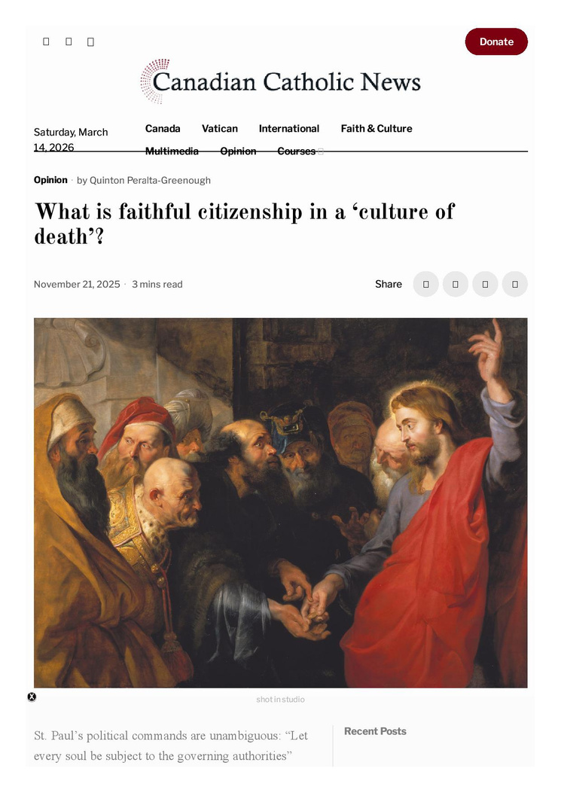
4 - OPINION PIECE
FROM THE JUDGE:
Clear, concise, and well-written. Great use of scriptures that are often seen as conflicting.
Excellent ending.
Author:
Quinton Peralta-Greenough
Canadian Catholic News
“What is faithful citizenship in a ‘culture of death’”

Slide 19
Best of the Church Press 2025
Associated
Church
Press
5 - COLUMN

Slide 20
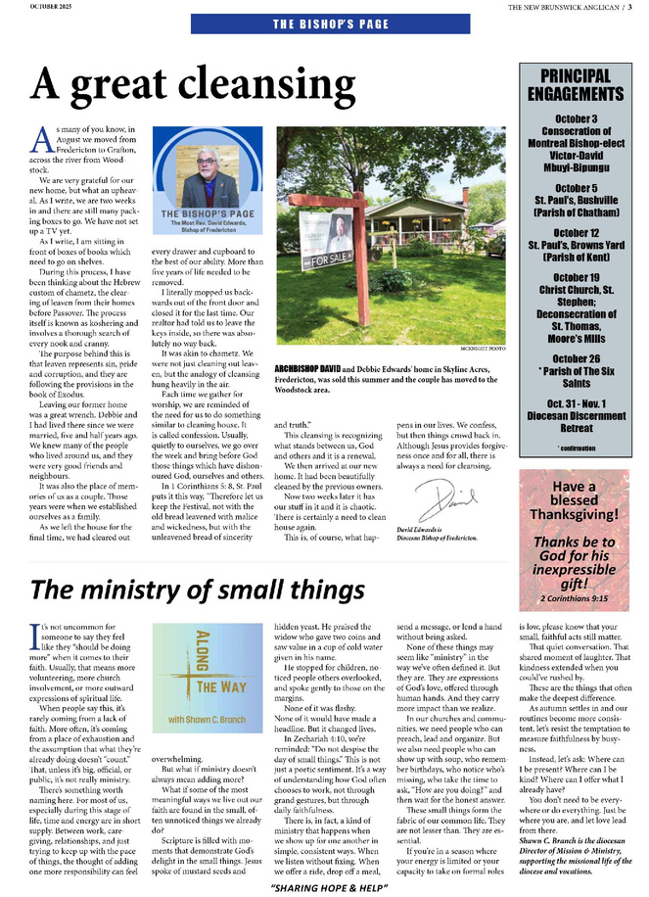
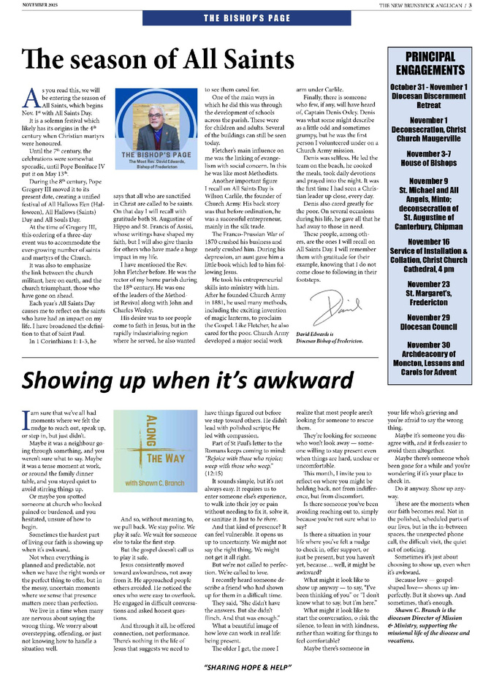
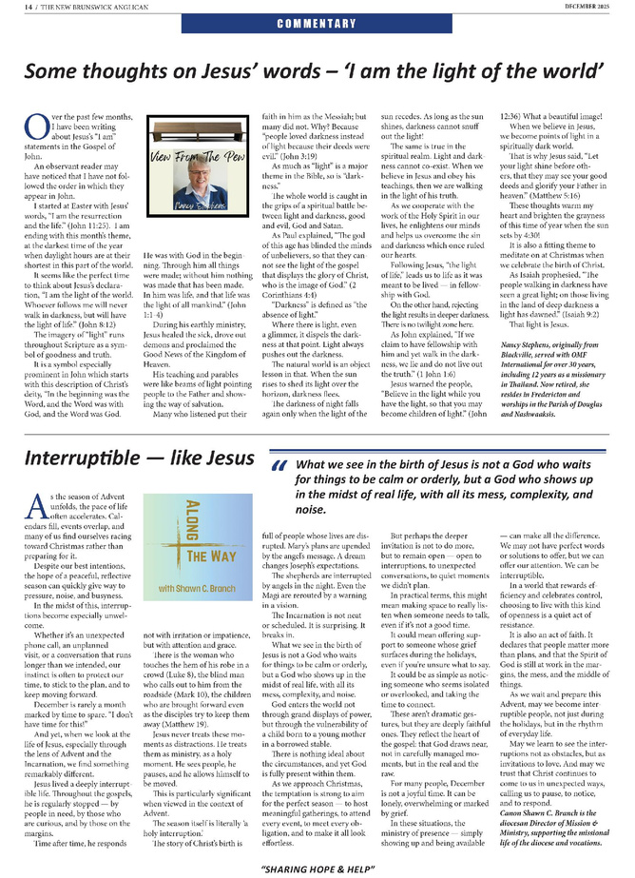
5 - COLUMN
Author:
Captain Laura Van Schaick
Author:
Canon Shawn C. Branch
Salvationist
New Brunswick Anglican
Grace Notes ”How Long, O Lord”, “Untamed”, When Women Weep”
“Along the Way”
October, November, December 2025

Slide 21
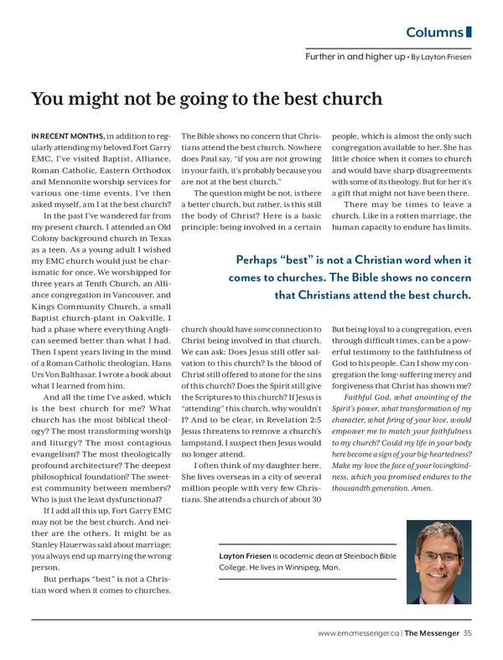
5 - COLUMN
FROM THE JUDGE:
These are very well written articles and are incredibly relatable.
They’re more reflection than information, which I believe can be helpful in the context of magazines.
Author: Layton Friesen
The Messenger
(Evangelical Mennonite Conference)
“Further In and Higher Up”

Slide 22
Best of the Church Press 2025
Associated
Church
Press
6 - SERVICE JOURNALISM

Slide 23
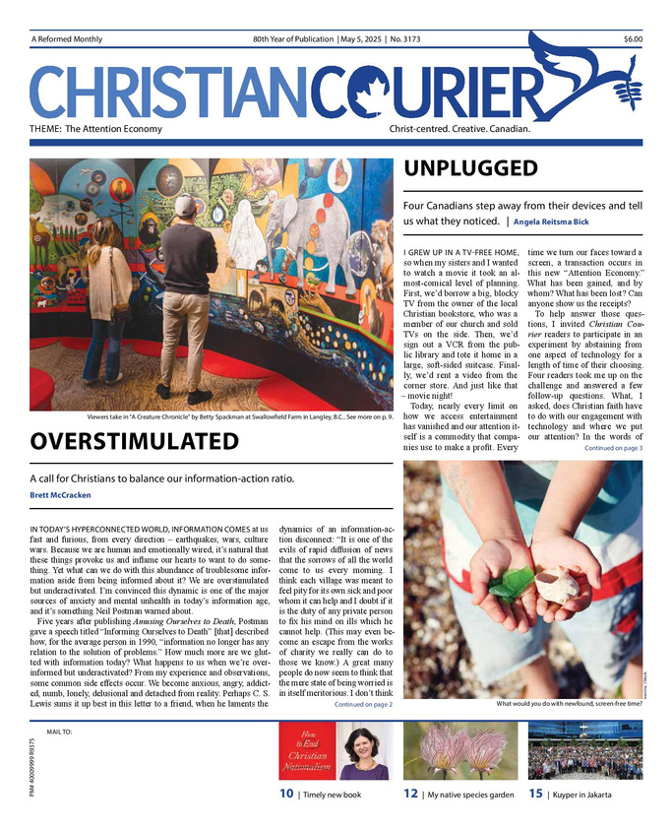
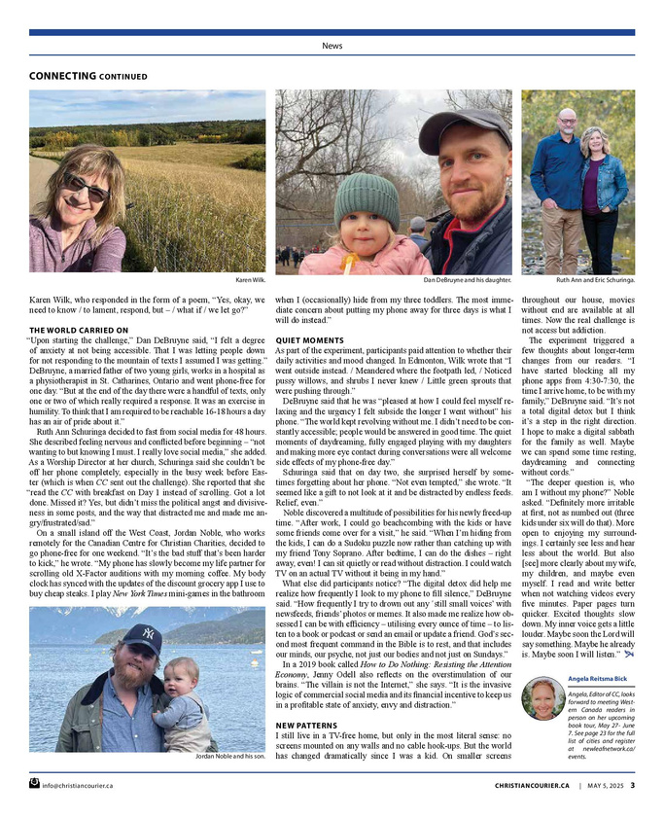
6 - SERVICE JOURNALISM
Author: Angela Reitsma Bick
Author: Emily Lowen
Canada Lutheran
Christian Courier
”Saskatchewan farmer donates crops to help alleviate global hunger”
“Unplugged: Four Canadians step away from their devices”

Slide 24
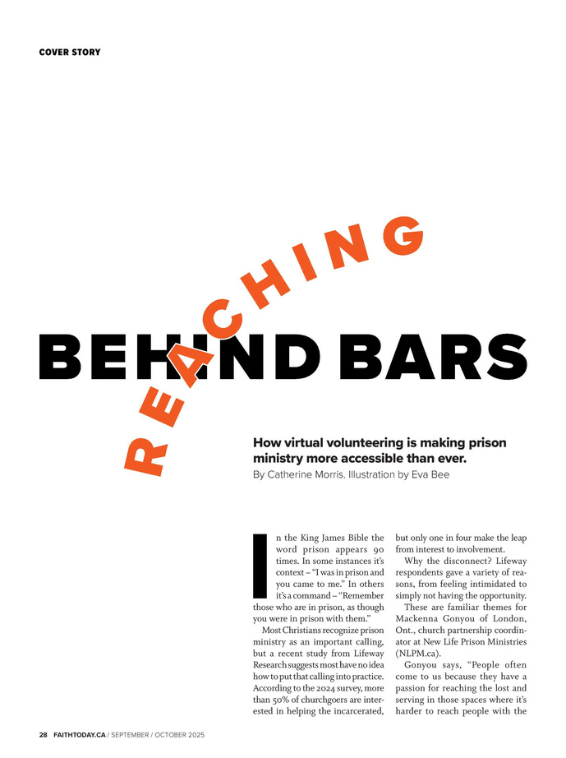
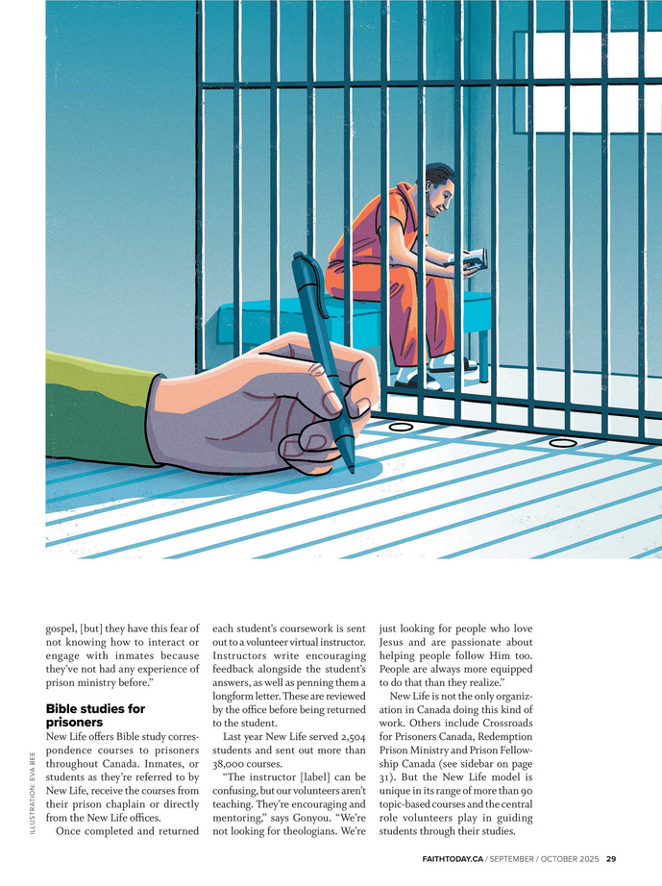
6 - SERVICE JOURNALISM
FROM THE JUDGE:
This is a very inspirational article that makes Christians realize that “I’m too busy to serve the Lord” is not a good excuse.
It shines a bright light on very important and rewarding volunteerism for which everyone can find time, no matter their schedule.
Author: Catherine Morris
Faith Today
“Reaching behind bars: How virtual volunteering is making prison ministry more accessible than ever”

Slide 25
Best of the Church Press 2025
Associated
Church
Press
7 - MEDIA REVIEW

Slide 26
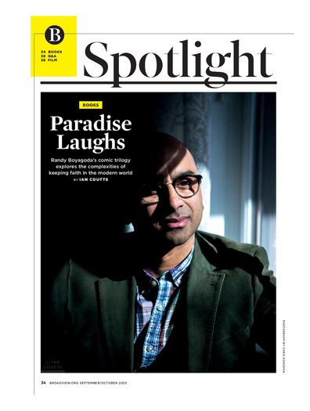
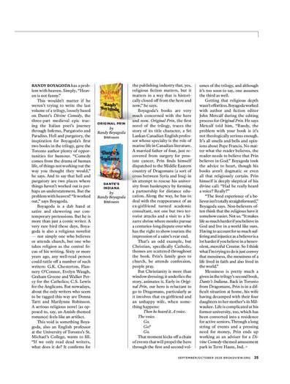
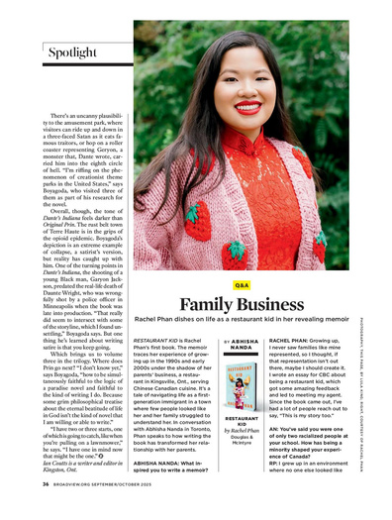
7 - MEDIA REVIEW
Author: Ian Coutts
Broadview
“Paradise Laughs”

Slide 27
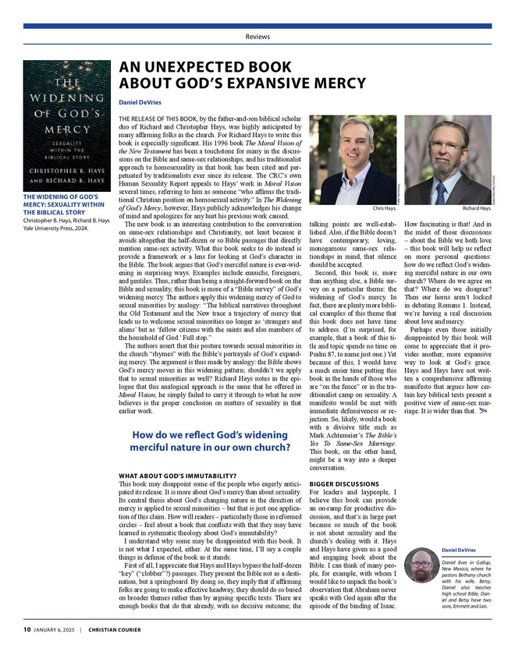
7 - MEDIA REIEW
FROM THE JUDGE:
An unexpected book about God’s expansive mercy” is a concise, well-written review.
The background was very helpful and the summary concise but thorough
Author: Daniel DeVries
Christian Courier
“An unexpected book about God’s expansive mercy”

Slide 28
Best of the Church Press 2025
Associated
Church
Press
8 - BIBLICAL/THEOLOGICAL REFLECTION

Slide 29
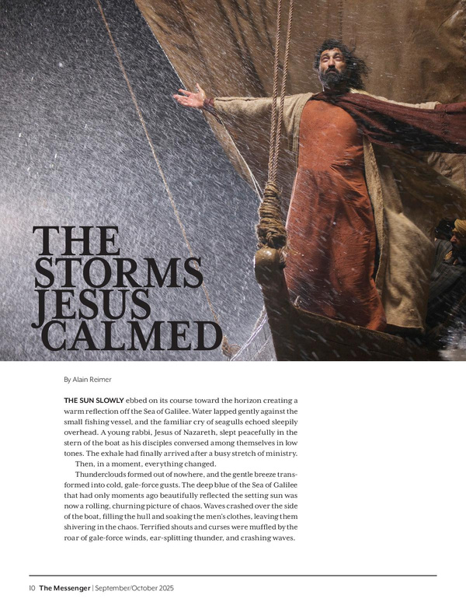
8 - BIBLICAL/THEOLOGICAL REFLECTION
Author:
Ms. Kirsten Pinto-Gfroerer
Author: Alain Reimer
The Messenger (Evangelical Mennonite Conference)
Rupert’s Land News
“Light”
“The storms Jesus calmed”

Slide 30
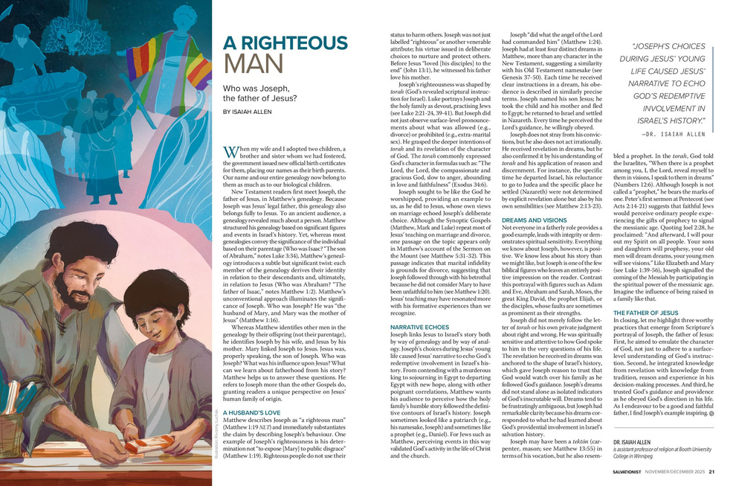
8 - BIBLICAL/THEOLOGICAL REFLECTION
FROM THE JUDGE:
This article does a really good job of liking St Joseph to the story around him (the Old Testament and Jesus).
Author: Isaiah Allen
Salvationist
“A Righteous Man”

Slide 31
Best of the Church Press 2025
Associated
Church
Press
9 - FIRST PERSON ACCOUNT

Slide 32
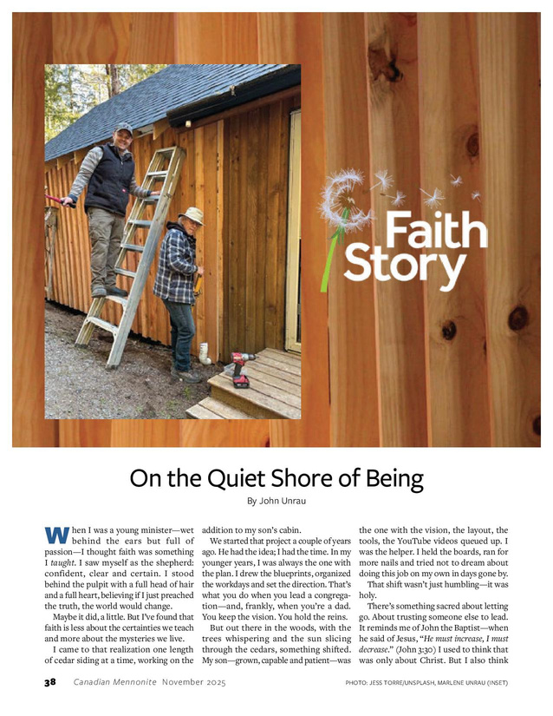
9 - FIRST PERSON ACCOUNT
Author: Pieta Woolley
Author: John Unrau
Broadview
Canadian Mennonite
“A Hitchhiker’s Guide to the Future of the United Church”
“On the Quiet Side of Being”

Slide 33
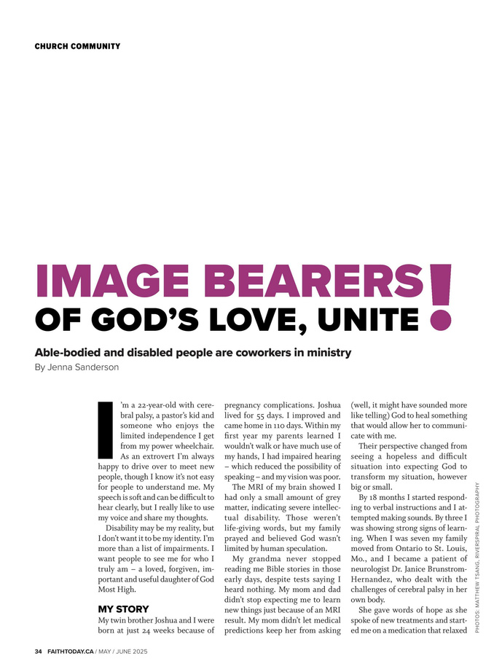
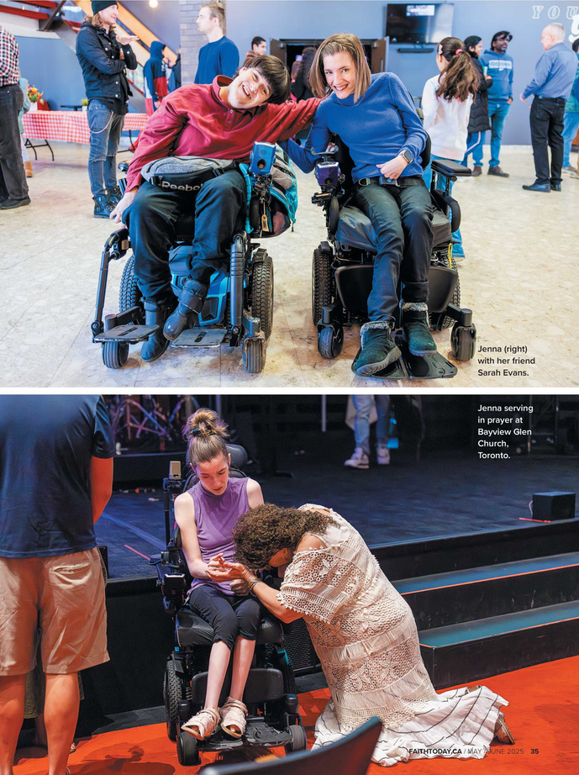
9 - FIRST PERSON ACCOUNT
FROM THE JUDGE:
This is a strong story, with the writer showing what it is like to live with a disability in a church setting. She tests easy claims about welcome and service.
Author: Jenna Sanderson
Faith Today
“Image Bearer’s of God’s Love, Unite: Able-bodied and disabled people are coworkers in ministry”

Slide 34
Best of the Church Press 2025
Associated
Church
Press
10 - BIOGRAPHICAL PROFILE

Slide 35
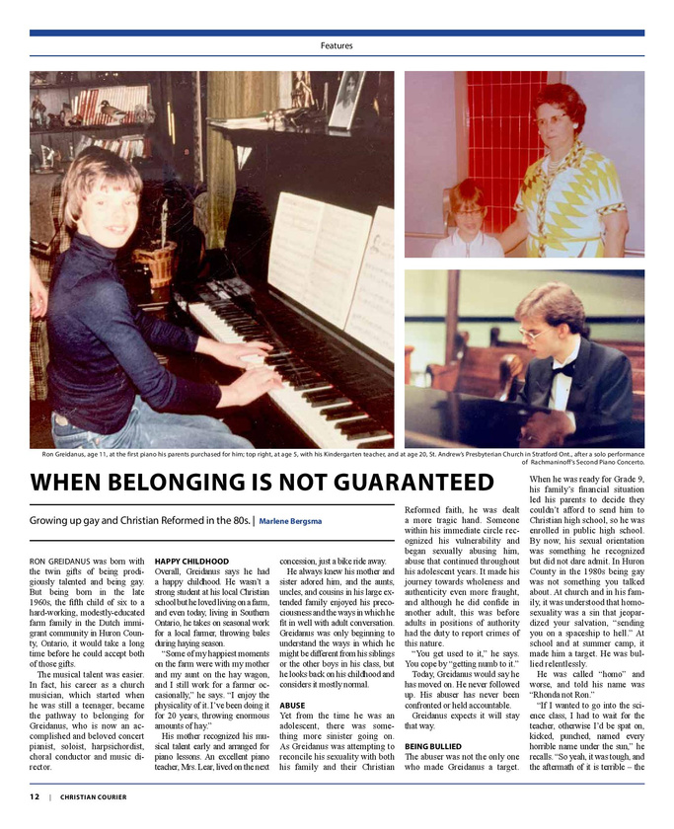
10 - BIOGRAPHICAL PROFILE
Author: Ken Ramstead
Author: Marlene Bergsma
Faith & Friends
(November/December 2025)
Christian Courier
“When belonging is not guaranteed”
“The Kodakid”

Slide 36

10 - BIOGRAPHICAL PROFILE
FROM THE JUDGE:
This is a strong story, with the writer showing what it is like to live with a disability in a church setting. She tests easy claims about welcome and service.
Author and Editor:
Sarah Malina
Canada Lutheran
“Leading with courage and faith”

Slide 37
Best of the Church Press 2025
Associated
Church
Press
11 - INTERVIEW

Slide 38
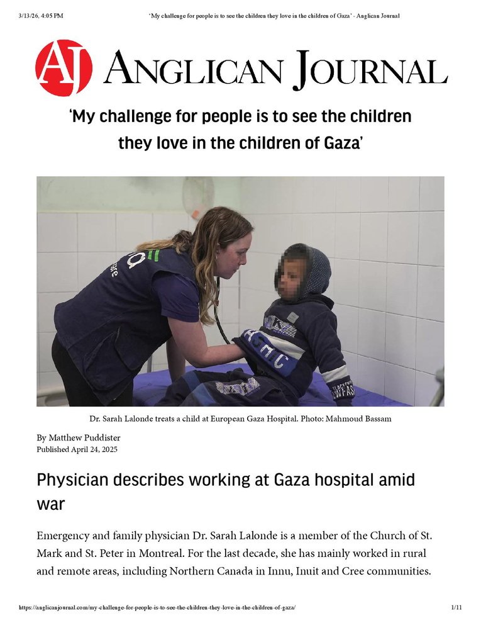
11 - INTERVIEW
Interviewer and Editor:
Bill Fledderus
Editor: Matthew Puddister
Faith Today
Angelican Journal
“The FT Interview with Jennifer Bowen”
My challenge for people to see the children they love in the children of Gaza”

Slide 39
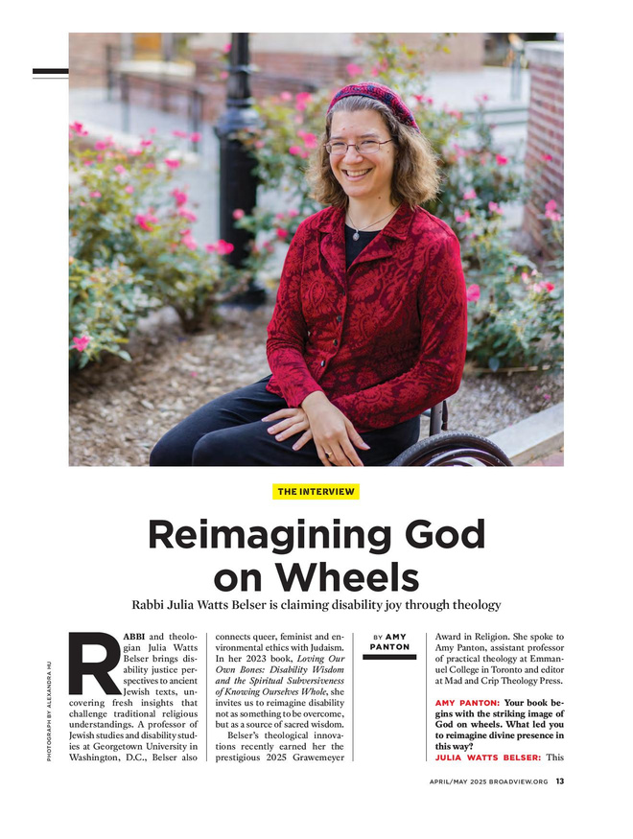
11 - INTERVIEW
FROM THE JUDGE:
The writer curated and asked excellent questions! They provide both context and direction for the interview, but do not limit answers
Author: Amy Panton
Broadview
“Reimagining God on Wheels”

Slide 40
Best of the Church Press 2025
Associated
Church
Press
12 - HEADLINE AND DECK

Slide 41
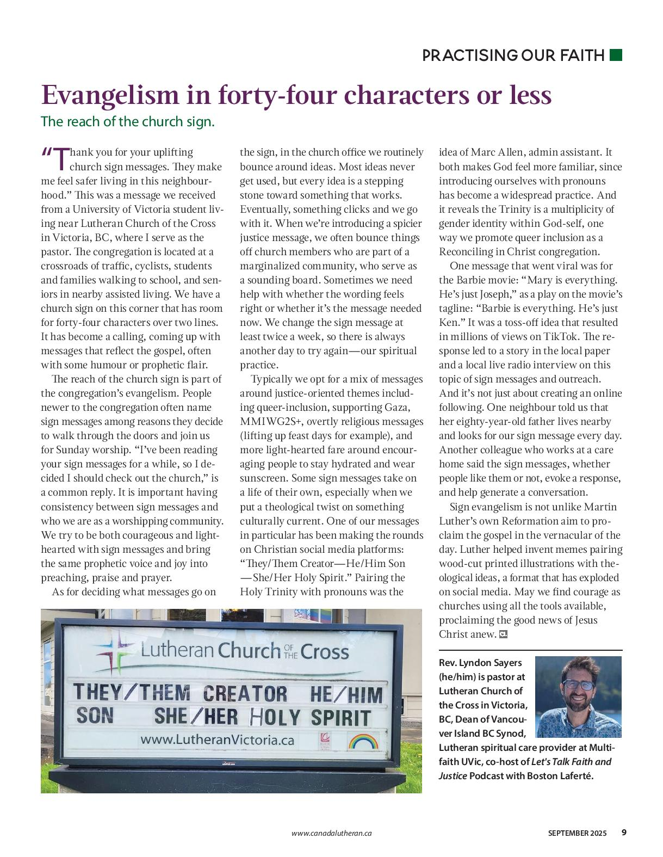
12 - HEADLINE AND DECK
Author: The Reverend Lyndon Sayers
Author: Jake Benjamins
Christian Courier
Canada Lutheran
”Children are a gift, not benchmarks of your success”
“Evangelism in forty-four characters or less”

Slide 42
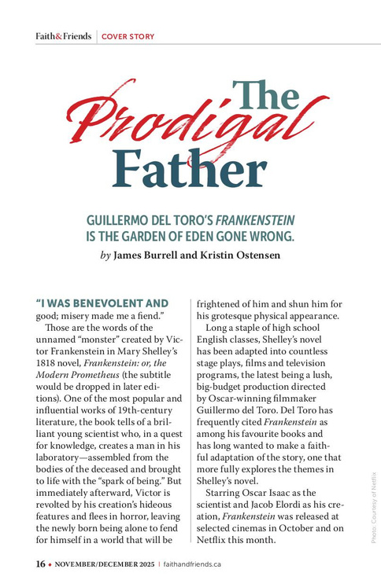
12 - HEADLINE AND DECK
FROM THE JUDGE:
The headline's promise of a comparison of the pop culture classic with the Biblical narrative is intriguing and delivered on in the story that follows. Both the main deck and the subhead draw the reader in.
Authors: James Burrell,
Kristin Ostensen
Faith & Friends
(November/December 2025)
“The Prodigal Father”

Slide 43
Best of the Church Press 2025
Associated
Church
Press
13 - ORIGINAL SONG

Slide 44
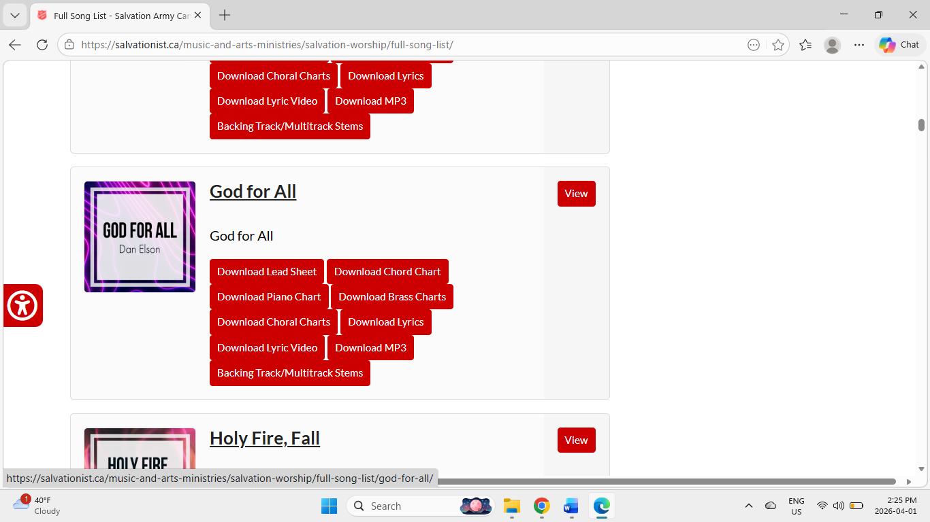
13 - ORIGINAL SONG
FROM THE JUDGE:
This is a well-written song, with clear musical structure that is easy to follow. The music is catchy and energetic and engaging with a great message. Harmonic and melodic choices are very effective.
Writer: Dan Elson
Salvationist
“God for All”

Slide 45
Best of the Church Press 2025
Associated
Church
Press
14 - POETRY

Slide 46
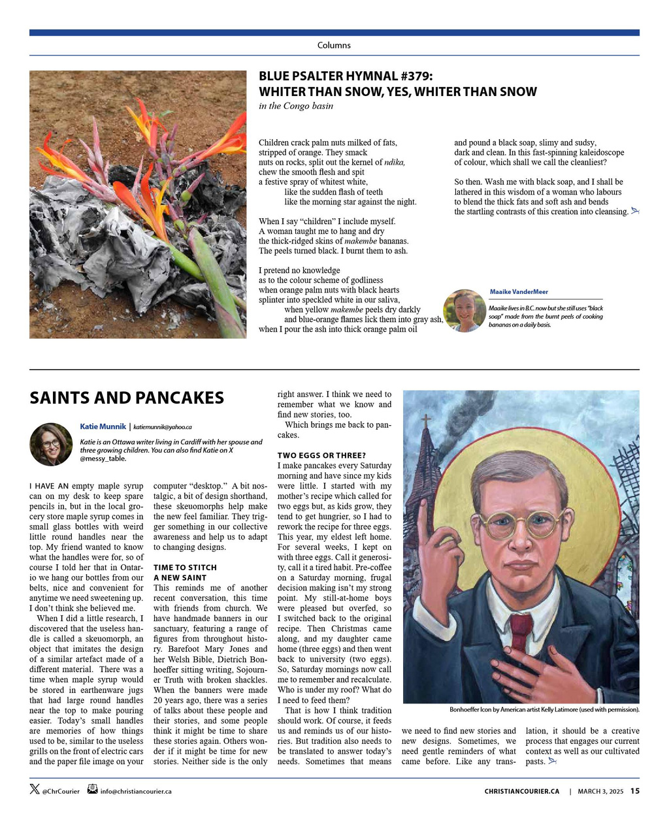
14 - POETRY
Poet:
Ms Angeline Schellenberg
Author: Maaike VanderMeer
Rupert’s Land News
Christian Courier
”Water Above and Below”
“Blue Psalter Hymnal #379: Whiter than snow, yes. whiter than snow”

Slide 47
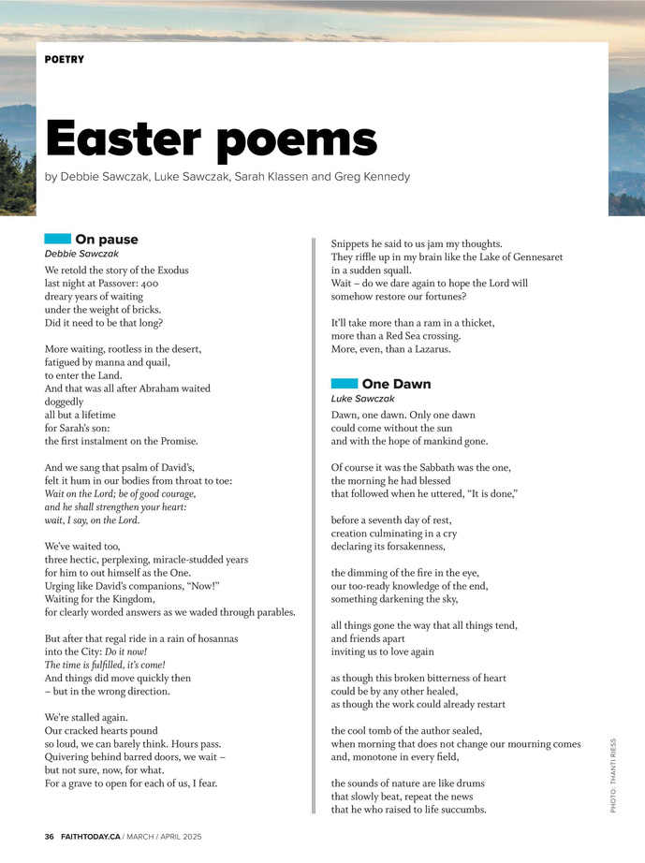
14 - POETRY
FROM THE JUDGE:
This piece uses captivating descriptive language. It’s a beautiful narrative that employs compelling emotion & imagery.
Author: Debbie Sawczak
Faith Today
“On Pause”

Slide 48
Best of the Church Press 2025
Associated
Church
Press
15 - PHOTO

Slide 49
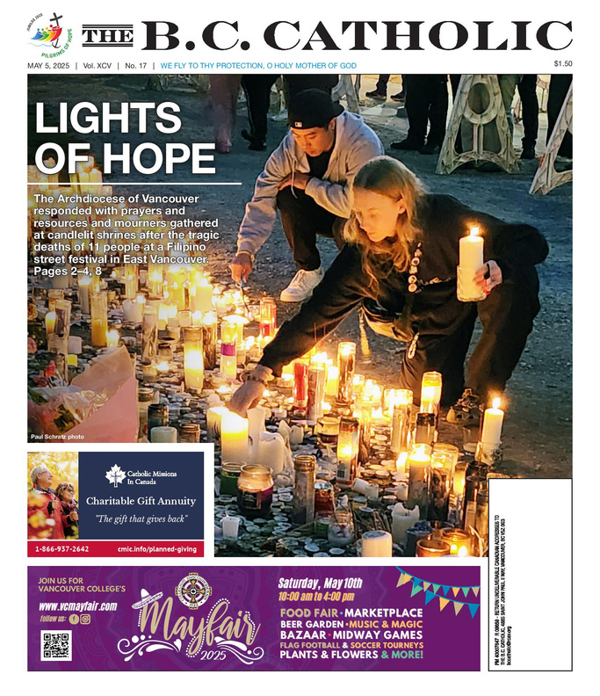
15 - PHOTO
Photographer:
Caroline Ryan
Photographer: Paul Schratz
Faith Today
The B.C. Catholic
”Angie Peters of Yonge Street Mission”
“Lights of Hope”

Slide 50
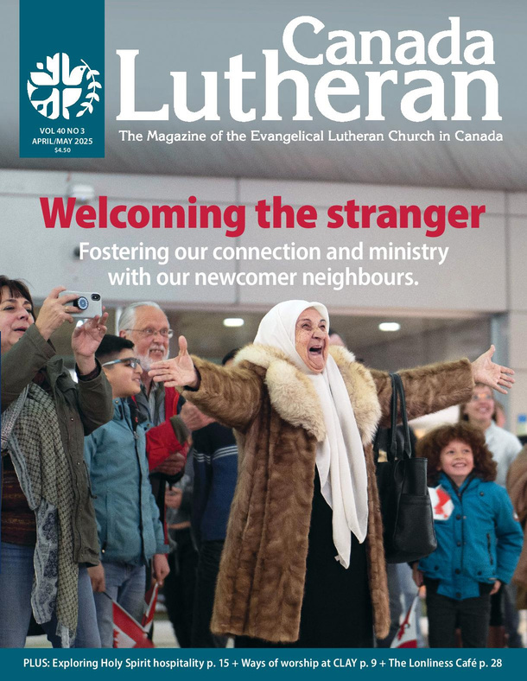
15 - PHOTO
FROM THE JUDGE:
The look of utter joy on the face of the woman with her arm’s wide-open shows how clearly the photographer captured the decisive moment in this shot.
Photographer: Noel Wendt
Canada Lutheran
“Welcoming the Stranger” (Cover April/May 2025)

Slide 51
Best of the Church Press 2025
Associated
Church
Press
16A - PHOTO ESSAY MAGAZINE

Slide 52
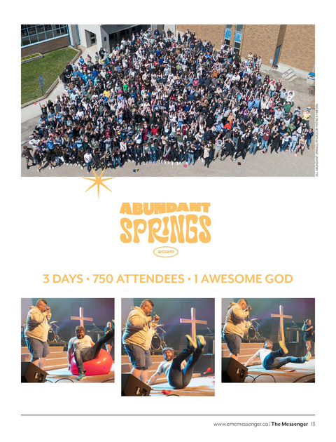
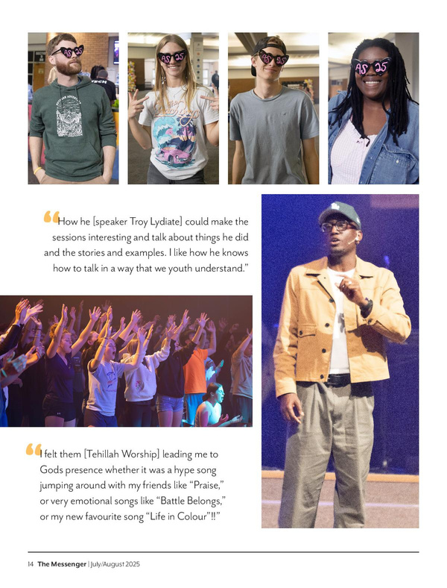
16A - PHOTO ESSAY MAGAZINE
Photos by: Patrick Friesen,
Layout/design by:
Rebecca Roman
The Messenger (Evangelical Mennonite Conference)
“Abundant Springs”

Slide 53
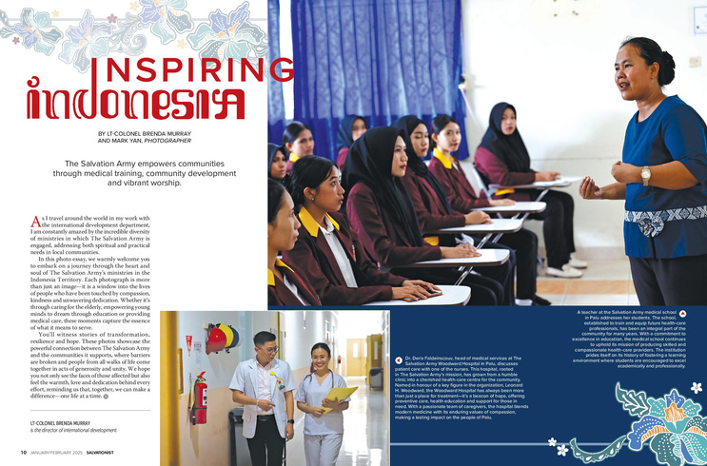
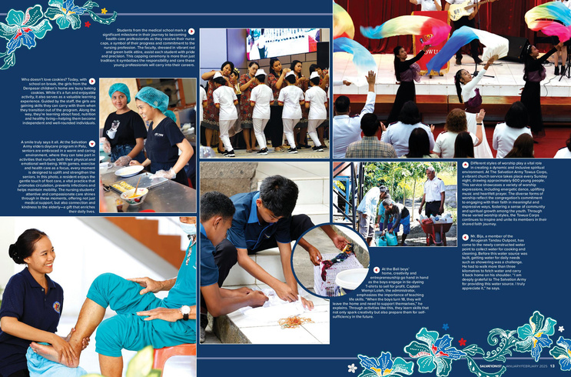
16A - PHOTO ESSAY MAGAZINE
FROM THE JUDGE:
A great range of photographs showing the work in Palu in a dynamic way. The photographs range from close up detail shots to wide shots with many people clearly visible.
Photographer: Mark Yan,
Designer: Lisa Suroso
Salvationist
“Inspiring Indonesia”

Slide 54
Best of the Church Press 2025
Associated
Church
Press
16B - PHOTO ESSAY NEWSPAPER

Slide 55
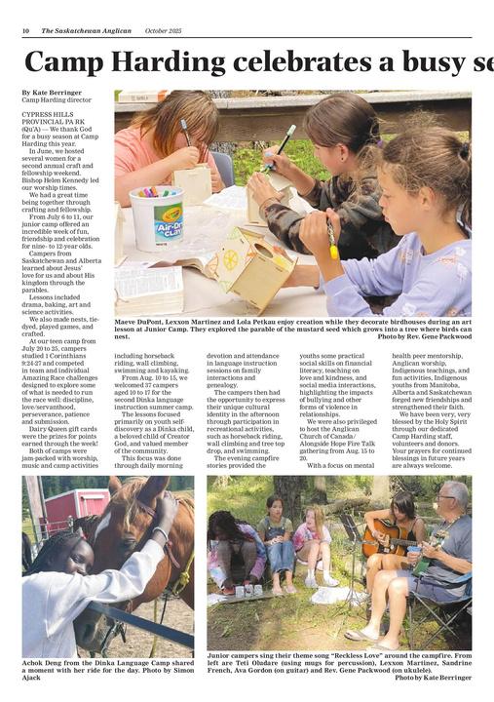
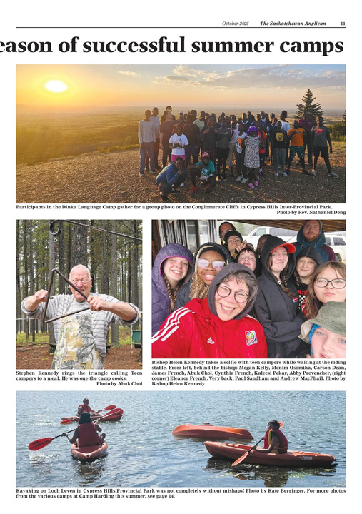
16B - PHOTO ESSAY NEWSPAPER
Artist, Designer and Photographer:
Gisele McKnight
Designer: Jason G. Antonio
The Saskatchewan Anglican
New Brunswick Anglican
“Family Camp”
“Camp Harding celebrates a busy season of successful summer camps ”

Slide 56
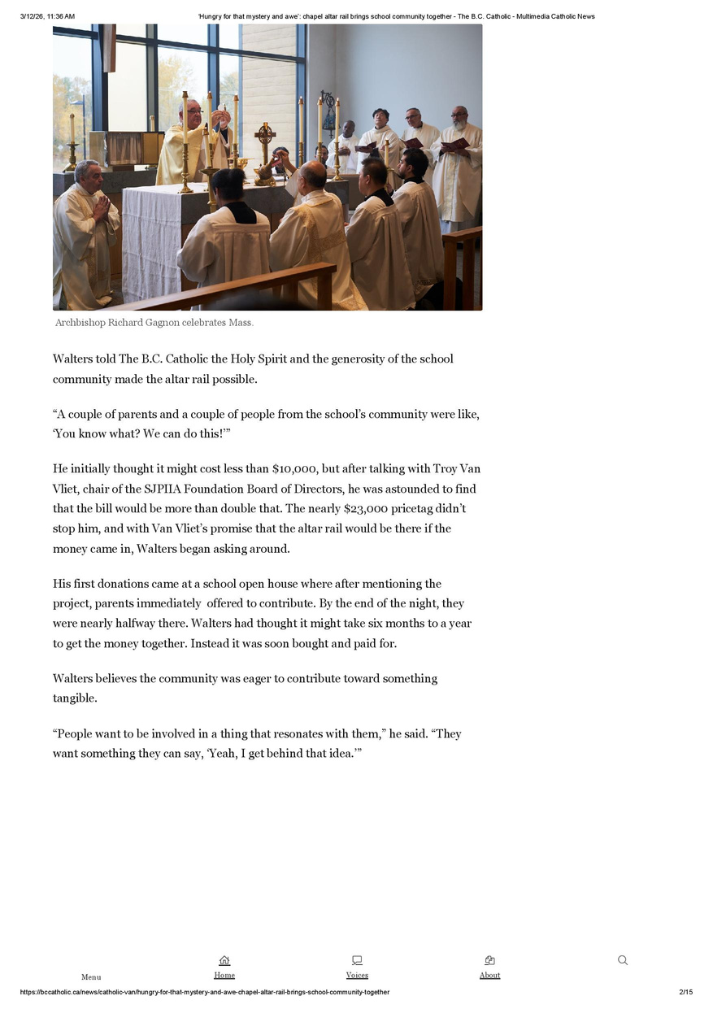
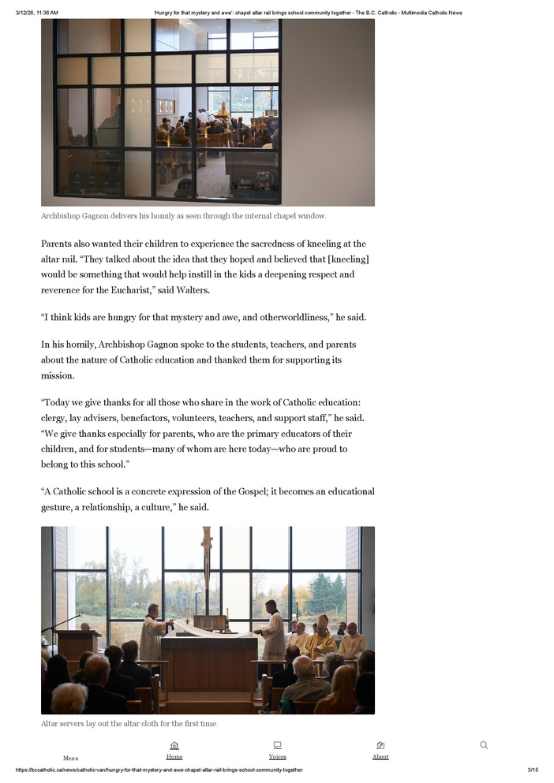
16B - PHOTO ESSAY NEWSPAPER
FROM THE JUDGE:
A strong range of photographs keeps the photo essay interesting for the viewer as the essay works through a breadth of subjects and shot styles, from close up detail pieces to wider group shots.
Photographer:
Nicolas Elbers
The B.C. Catholic
“Hungry for that mystery and awe: Chapel altar rail brings school community together”

Slide 57
Best of the Church Press 2025
Associated
Church
Press
17 - ORIGINAL ARTWORK

Slide 58
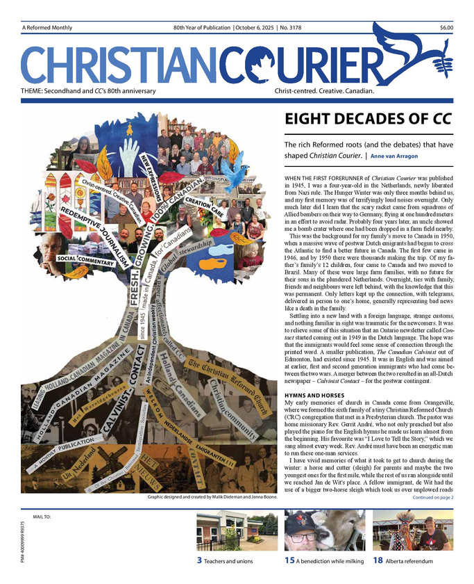
17 - ORIGINAL ARTWORK
Artist and Illustrator: Rivonny Luchas
Artist: Malik Dieleman
Salvationist
Christian Courier
“A Righteous Man”
“Secondhand”

Slide 59

17 - ORIGINAL ARTWORK
FROM THE JUDGE:
Really excellent; bold, eye catching and fun . Really draws one in.
Easy to relate to the activity.
Artist: Dona Park
Canadian Mennonite
“Intergenerational Household of Faith”

Slide 60
Best of the Church Press 2025
Associated
Church
Press
18A - FRONT COVER MAGAZINE -
CIRCULATION UNDER 10,000

Slide 61

18A - FRONT COVER MAGAZINE -
CIRCULATION UNDER 10,000
Original Painting by:
Jen Kornelsen,
Layout/Design by:
Rebecca Roman
Designer: Lisa Suroso
Salvationist
The Messenger (Evangelical Mennonite Conference)
”Play It Again Lam”
(July/August 2025)
“May/June 2025 Issue Cover”

Slide 62

18A - FRONT COVER MAGAZINE -
CIRCULATION UNDER 10,000
FROM THE JUDGE:
Very nice and clean treatment with nice colours – feels warm and inviting.
Nicole Lapierre Photography,
Berdene Owen, Alivelihood Branding & Design
Acadia Divinity College
“More than Welcome”
(ADC Today Winter Issue)

Slide 63
Best of the Church Press 2025
Associated
Church
Press
18B - FRONT COVER MAGAZINE -
CIRCULATION OVER 10,000

Slide 64

18B - FRONT COVER MAGAZINE -
CIRCULATION OVER 10,000
Designer: Lisa Suroso,
Photographer:
Nathan Regamey
Faith & Friends
(Christmas 2025)
“Toy Story”

Slide 65

18B - FRONT COVER MAGAZINE -
CIRCULATION OVER 10,000
FROM THE JUDGE:
Stark, attention-grabbing image and text that stands out from the typical photographic magazine style.
Designer: Janice Van Eck
Faith Today
“Wath the Lamb”
(Cover Image, March/April 2025)

Slide 66
Best of the Church Press 2025
Associated
Church
Press
18C - FRONT PAGE NEWSPAPER

Slide 67

18C - FRONT PAGE NEWSPAPER
Artist, Designer, Photographer and Editor: Gisele McKnight
Designer: Jason G. Antonio
The Saskatchewan Anglican
New Brunswick Anglican
“Summer Fun” - Spetember 2025 Front Page
October 2025 Front Page

Slide 68

18C - FRONT PAGE NEWSPAPER
FROM THE JUDGE:
Front page is engaging & visually appealing; it has a strong human-interest angle (“Comedy Ministry”) that stands out.
Designer: Inca Siojo-Das,
Photographer: Nicholas Elbers
The B.C. Catholic
“A Time to Laugh”
June 5, 2025, Front Page

Slide 69
Best of the Church Press 2025
Associated
Church
Press
19A - FEATURE LAYOUT & DESIGN MAGAZINE

Slide 70
19A - FEATURE LAYOUT & DESIGN MAGAZINE
Designer: Lisa Suroso
Designer: Carol Moskot
Faith & Friends
(November/December 2025)
Broadview
“The Kodakid”
“Christmas Keepsakes”

Slide 71



19A - FEATURE LAYOUT & DESIGN MAGAZINE
Designer:
Janice Van Eck
Faith Today
“Watch the Lamb”

Slide 72


19A - FEATURE LAYOUT & DESIGN MAGAZINE
FROM THE JUDGE:
Great graphics and use of white space! I love the colours and the interesting images and graphics used throughout the article. Great use of complimenting fonts.
Graphic Designer:
Anne Boese
Canadian Mennonite
“Transformed on the Inside:
Prison ministry”

Slide 73
Best of the Church Press 2025
Associated
Church
Press
19B - FEATURE LAYOUT & DESIGN NEWSPAPER

Slide 74


19B - FEATURE LAYOUT & DESIGN NEWSPAPER
Designer and Editor:
Geore Cribbs
Artist and Designer:
Gisele McKnight
New Brunswick Anglican
The Northland
“Advent Activities”
“Oh, What A Day”

Slide 75


19B - FEATURE LAYOUT & DESIGN NEWSPAPER
FROM THE JUDGE:
This layout makes strong use of photography. The large, high-impact images on both pages create clear entry points and give the spread a sense of scale and presence.
Designer: Jason G. Antonio
The Saskatchewan Anglican
“Learning about Alongside Hope’s activities in the ‘breathtaking’ country of Kenya”

Slide 76
Best of the Church Press 2025
Associated
Church
Press
20 – ORIGINAL ALBUM, CD, BOOK OR BOOKLET COVER

Slide 77

20 – ORIGINAL ALBUM, CD, BOOK OR BOOKLET COVER
FROM THE JUDGE:
The front cover is simple yet full of
light. The viewer is led into the centre
towards the source of the light. Symbolic
composition.
Designer: Rivonny Luchas
Salvationist
“His Light In US”

Slide 78
Best of the Church Press 2025
Associated
Church
Press
21 – ADVERTISEMENT

Slide 79


21 – ADVERTISEMENT
FROM THE JUDGE:
This ad features outstanding shots of people taking materials to donate at Salvation Army locations. Video production is top notch, storyboarding and composing are excellent, and editing is seamless and the video just flows.
Producer: Rui Feliz
Salvationist
:”Clutter-Free February - Join the Movement, Donate Today”

Slide 80
Best of the Church Press 2025
Associated
Church
Press
22A – MARKETING CAMPAIGN

Slide 81

22A – MARKETING CAMPAIGN
Director and Videographer: Rui Feliz
Citizens for Justice Staff
Rui Feliz The Salvation Army World Missions
Citizens for Public Justice
“Self-Denial Partners In Mission 2025 – Indonesia”
“No More Coal In Canada!”

Slide 82

22A – MARKETING CAMPAIGN
FROM THE JUDGE:
Your results show the value of hard work, a strong team and consistent messaging. The whole campaign was well thought through and well executed. Great work!
Staff: Trisha Elliott, Sarah Watt, Sharon Doran, Michelle Kay, Anne Brooks, Julie Sherve
Broadview
“United Church of Canada 100th Anniversary Special Issue Campaign”

Slide 83
Best of the Church Press 2025
Associated
Church
Press
22B - SOCIAL MEDIA CAMPAIGN

Slide 84

22B – SOCIAL MEDIA CAMPAIGN
Video Producer and Video Editor: Brian Lopez
Social Media Coordinator: Sammy Kyereme
Faith Today
Promotional reel for podcast episode on pastoral shortages with guest Rick Hiemstra

Slide 85
Best of the Church Press 2025
Associated
Church
Press
23 - AUDIO OR VIDEO INTERVIEW

Slide 86

23 - AUDIO OR VIDEO INTERVIEW
FROM THE JUDGE:
Bowen has a lovely, calm voice, making a podcast the right choice for this interview; the medium fits the message!
Fledderus has a naturally warm and conversational tone. This podcast sounds like a chat between wise friends – nicely done!
Interviwer: Bill Fledderus
Faith Today
“Coping with stress in an increasingly unstable world:
The FT Interview with Jennifer Bowen”

Slide 87
Best of the Church Press 2025
Associated
Church
Press
24 - SOCIAL MEDIA POST

Slide 88

24 - SOCIAL MEDIA POST
Authors: Citizens for Public Justice Staff
Citizens for Public Justice
“Climate Migration”
Instagram Reel

Slide 89

24 - SOCIAL MEDIA POST
FROM THE JUDGE:
Strong headline, and three simple slides. Doesn’t ask the reader to flip through too many pages to get to the heart of the story.
Author: Nicole Schmidt
Broadview
“The vast hidden workforce of Canada’s prisons”

Slide 90
Best of the Church Press 2025
Associated
Church
Press
25 - BLOG SERIES

Slide 91

25 - BLOG SERIES
Authors: Paul Edward Hughes, Matthew R.S. Todd, Gordon T. Smith
Faith Today
“Five men learning to love well”
“Handing on faith to the next generation”
“Rethinking Canada’s congregational leadership crisis”

Slide 92

25 - BLOG SERIES
FROM THE JUDGE:
The writing in the individual posts is clear, thoughtful, and follows a recognizable argument.
Author: Major April McNeilly
Salvationist
Series on Gen Z
“The World of Generation Z”
“Generation Z in the Church”
“The Open Generation”

Slide 93
Best of the Church Press 2025
Associated
Church
Press
26 - VIDEO PRODUCTION

Slide 94
26 - VIDEO PRODUCTION
Producer: Aaron Bowes
Salvationist
Partners in Mission 2025 | Denpasar's Girls Home

Slide 95

26 - VIDEO PRODUCTION
FROM THE JUDGE:
Excellent work and a truly memorable interview.
Producers:
Emma Prestwich and
Everett Bumstead
Broadview
Death-Row Inmate Ramiro Gonzales Fell Through ‘Every Single Crack There Was’: Minister

Slide 96

26 - VIDEO PRODUCTION
FROM THE JUDGE:
This production is beautifully conceived, recorded, and edited. It is short, and yet profound.
Script: Carley Lee
Acadia Divinity College
Shape Your Future
Filming and Production: Mark Moore, Red Lama Media

Slide 97
Best of the Church Press 2025
Associated
Church
Press
27 - PODCAST

Slide 98

27 - PODCAST
FROM THE JUDGE:
A very crisp opening that offers a topic and interview preview. The music bed is well-timed in relation to the spoken word elements, giving a real sense of coherence. Music bed fades naturally as the interview begins.
Host: Kristin Ostensen
Producer: Lisa Suroso
Salvationist
“John Lam, Bandmaster of the Canadian Staff Band”
“Gen Z and Jesus,” with Major April and Rebekah McNeilly
Conception Bay South’s Live-Stream Ministry”

Slide 99
Best of the Church Press 2025
Associated
Church
Press
28 - E-NEWSLETTER

Slide 100

28 - E-NEWSLETTER
Designer:
Maaike VanderMeer
Editor: Meghan Kort
Christian Courier
“Landmark Alberta church leaves Christian Reformed Denomination”
“Hey God how about a miracle?”
“CC editor planning Western Canada book tour”

Slide 101

28 - E-NEWSLETTER
FROM THE JUDGE:
This is laid out well for both web and mobile.Strong photo lead and good balance of editorial and stories.
Author: Nicole Schmidt
Broadview
“Best of the Week”

Slide 102
Best of the Church Press 2025
Associated
Church
Press
29 - GENERAL EXCELLENCE WEBSITE

Slide 103

29 - GENERAL EXCELLENCE WEBSITE
Authors: Emma Prestwich, Christina Jung,
Nicole Schmidt,
Michelle Kay and
Pixel Studioz
Broadview
https://broadview.org

Slide 104

29 - GENERAL EXCELLENCE WEBSITE
FROM THE JUDGE:
One area where Salvationist.ca really excels is accessibility. The inclusion of a robust accessibility pop-up menu is a strong and commendable feature, signaling a genuine commitment to inclusive design and user support.
Editors: Geoff Moulton; Abbigail Oliver; Kristin Ostensen; Ken Ramstead;
Giselle Randall;
Pamela Richardson
Designers:
Rivonny Luchas; Emily Pedlar; Lisa Suroso
Salvationist
https://salvationist.ca/

Slide 105
Best of the Church Press 2025
Associated
Church
Press
30 - GENERAL EXCELLENCE MAGAZINE

Slide 106

30 - GENERAL EXCELLENCE MAGAZINE
Editor: Bill Fledderus
Designer: Janice Van Eck
Designer: Catherine Crivici Editor: Sarah Malina
Faith Today
Canada Lutheran
March/April, July/August and September/October 2025
January/February, March and December 2025

Slide 107

30 - GENERAL EXCELLENCE MAGAZINE
FROM THE JUDGE:
This is a gorgeous magazine. It’s fresh, ultra-modern, with bold and beautiful type treatments.
Authors, Designer and Editor:
Broadview staff and contributors
Broadview
April/May, June and November/December 2025

Slide 108
Best of the Church Press 2025
Associated
Church
Press
31 - GENERAL EXCELLENCE NEWSPAPER

Slide 109

31 - GENERAL EXCELLENCE NEWSPAPER
Editor:
Leigh Anne Williams
Designer: Jason G. Antonio
Perspective (formerly Crosstalk)
The Saskatchewan Anglican
May, September, October 2025 Issues
April, May, September 2025 Issues

Slide 110

31 - GENERAL EXCELLENCE NEWSPAPER
FROM THE JUDGE:
Good eye for design – the editor recognizes the value of a good pic. Never underestimate the value of a compelling pic to stop a scanning reader and entice them to read the “grey stuff” surrounding the art. 😊
Artist, Designer and Editor:
Gisele McKnight
New Brunswick Anglican
April, June, October 2025 Issues

Slide 111
Best of the Church Press 2025
Associated
Church
Press
32- GENERAL EXCELLENCE INSTITUTIONAL PUBLICATION

Slide 112

32 – GENERAL EXCELLENCE INSTITUTIONAL PUBLICATION
FROM THE JUDGE:
Well designed, well written and well thought out publication. It not only provides the basics – news, faculty updates, alumni updates, information that alumni and supporters want to know – but also interesting articles that resource readers.
Editor: Shawna Peverill
Acadia Divinity College
ADC Today

Slide 113
Best of the Church Press 2025
Associated
Church
Press
STUDENT AWARD
SPONSORED BY FAITH TODAY

Slide 114

STUDENT AWARD
SPONSORED BY FAITH TODAY
FROM THE JUDGE:
A beautiful piece, sensitively written. I feel as if I have visited the school through this read.
Author: Derek Hiemstra
Christian Courier
”Indigenous studies in East Van”

Slide 115
Best of the Church Press 2025
Associated
Church
Press
A.C. FORREST MEMORIAL AWARD – CIRCULATION UNDER 10,000

Slide 116



A.C. FORREST MEMORIAL AWARD – CIRCULATION UNDER 10,000
Author: Shannon Brink
Author: Gisele McKnight
Christian Courier
New Brunswick Anglican
“Vital and vanished!”
“Kids Lead at Stone”

Slide 117

A.C. FORREST MEMORIAL AWARD – CIRCULATION UNDER 10,000
FROM THE JUDGE:
Like many times throughout history, we are experiencing a transitional time as AI reshapes and redefines almost every aspect of life. This article provides a map to follow as we step out in faith with confidence.
Author: Aiden Kallionen
Canada Lutheran
“Artificial Intelligence: Tackling new technology through a lens of faith”

Slide 118
Best of the Church Press 2025
Associated
Church
Press
A.C. FORREST MEMORIAL AWARD – CIRCULATION OVER 10,000

Slide 119

A.C. FORREST MEMORIAL AWARD – CIRCULATION OVER 10,000
FROM THE JUDGE:
The article paints a mural of these conditions – prisoners working for daily pittance, either to finance internal prison budgets or to produce products for international companies, at a fraction of what other employees are paid - both within Canada and in other countries.
Author: Leslie Sinclair
Broadview
“Sentenced to Labour”

Slide 120
Best of the Church Press 2025
Associated
Church
Press
SPECIAL AWARDS

Slide 121

SPECIAL AWARDS FOR OVERALL ACHIEVEMENT IN CHRISTIAN COMMUNICATIONS

