Slide 1


Slide 2
22 Soon the servant said, ‘Your order has been carried out, sir, but there is room for more.’ 23 So the master said to the servant, ‘Go out to the country roads and lanes and make people come in, so that my house will be full.
Luke 14:22-23 GNT

Slide 3

Problem:
We’ve Filled Our Lives With Everything Except People

Slide 4
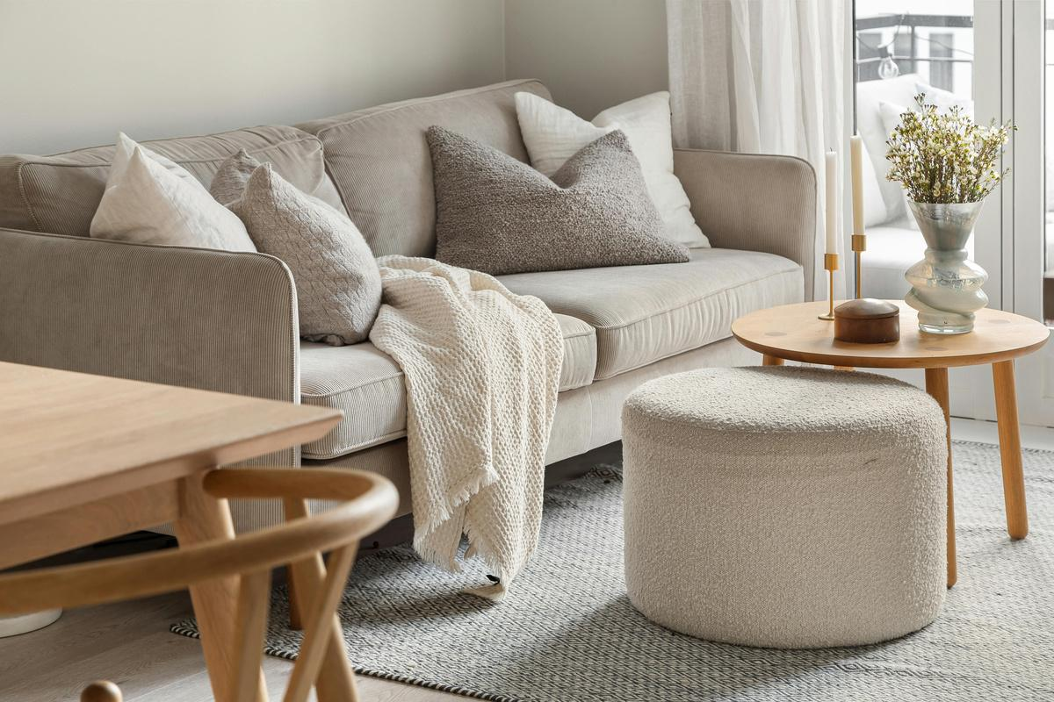
No Space
The reality is—there is room. But most of us live like there isn’t.
Our lives are full:
Full schedules
Full minds
Full priorities
Full of ourselves sometimes

Slide 5
What happens when we don’t make room?
The next generation lacks guides
Wisdom stops with us
Testimonies don’t get passed down
We miss divine interruptions
God sends people—but we’re too busy
We ignore promptings
We rush past moments that matter

Slide 6

Discipleship Requires What We Don’t Want to Give

Slide 7
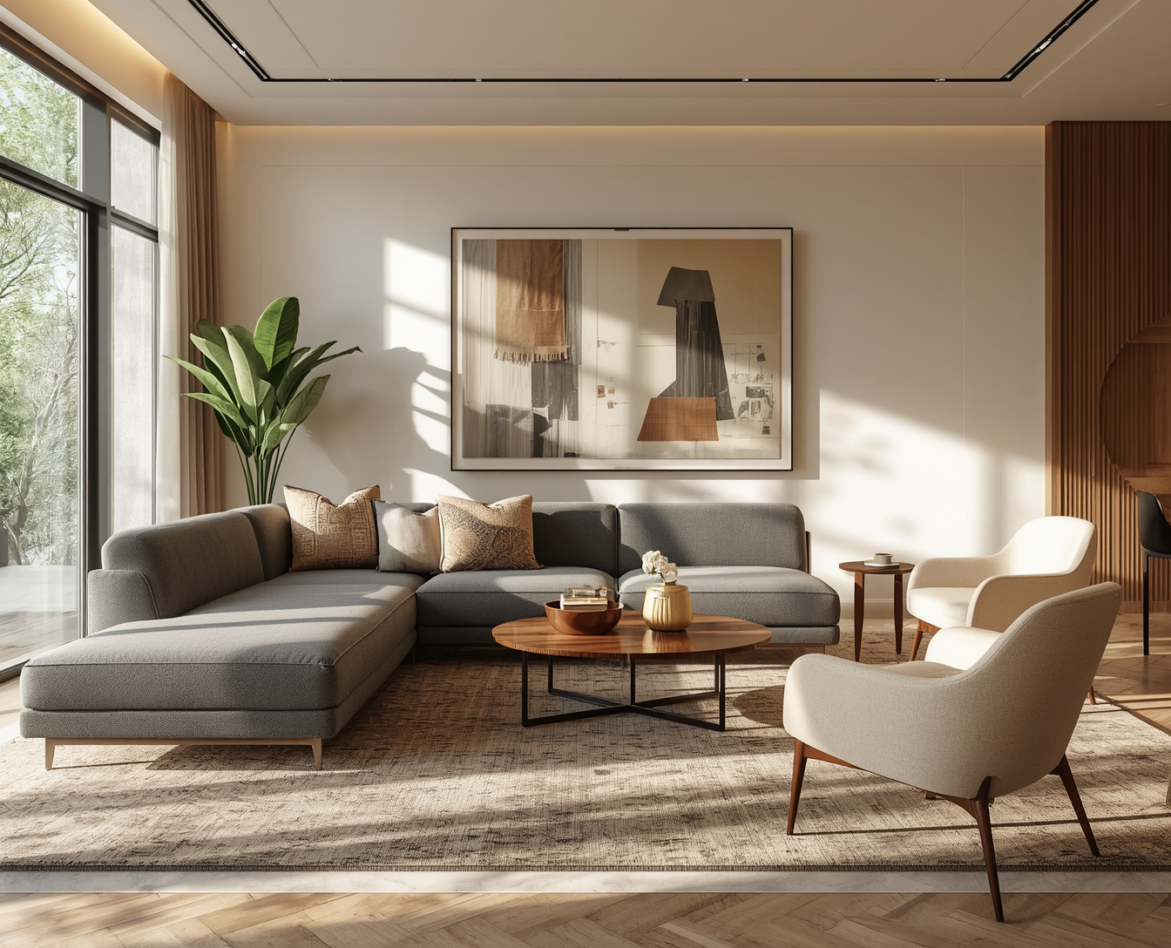
Making room isn’t convenient...
it’s costly

Slide 8
Discipleship isn’t duplication through downloads

Slide 9

That means - You Need to:
Make Room in Your TIME
Discipleship costs time.
Interruptible schedules
Slow conversations
Showing up consistently
Proverbs 13:20 NIV Walk with the wise and become wise

Slide 10
That means - You Need to:
Make Room in Your HEART
Patience for people who aren’t “there yet”
Grace for those who may not “get it” yet
Compassion instead of judging
Romans 15:7 GNT Accept one another, then, for the glory of God, as Christ has accepted you.

Slide 11
That means - You Need to:
Make Room in Your PRIDE
Be someone people can approach/talk to
Be willing to learn
Be willing to admit that you are not perfect
Pride crowds people out. Humility invites them in.
Philippians 2:3-4 NIV 3 Do nothing out of selfish ambition or vain conceit. Rather, in humility value others above yourselves, 4 not looking to your own interests but each of you to the interests of the others.

Slide 12
That means - You Need to:
Make Room in Your CIRCLE
Jesus discipled few, not crowds.
Who are you intentionally letting close?
Who are you opening your life to?
Discipleship doesn’t happen accidentally — it happens on purpose, for a purpose

Slide 13
Think about Paul and Timothy (2 Timothy 2:2)
This only worked because:
Paul made space in his life
Walked with him
Trusted him

Slide 14
Or Moses and Joshua - Making Room for What’s Next
Joshua was brought close (Exodus 24:13)
He observed before he led
He was eventually commissioned

Slide 15
Or Elijah and Elisha - Making Room for Who’s Next
Elisha followed closely
Elijah didn’t push him away
Transfer happened through proximity

Slide 16

Jesus Made Room for Us First

Slide 17
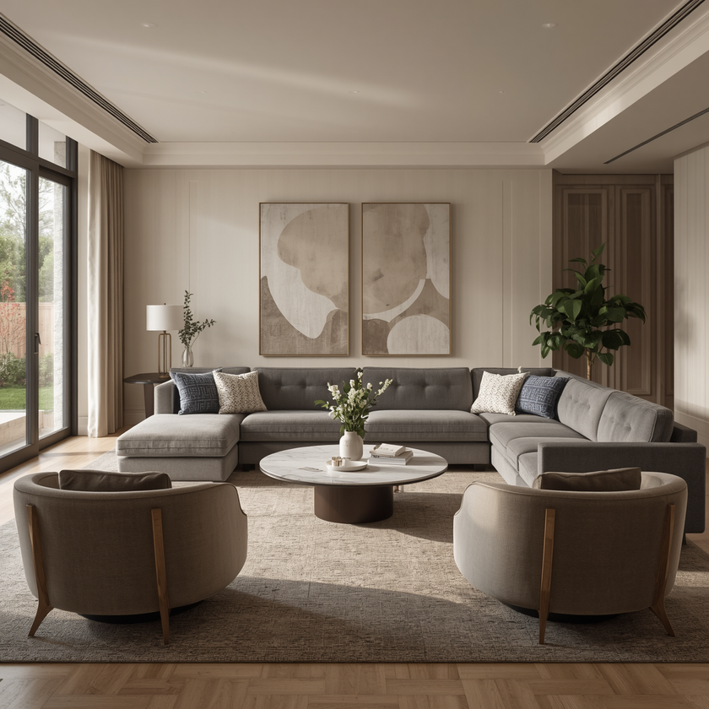
Before we ever make room for others, Jesus made room for us.
He had time for the overlooked
He welcomed the unqualified
He walked closely with a few

Slide 18
You weren’t discipled because someone was perfect....
You were discipled because someone was available.

Slide 19
Jesus didn’t wait for perfect people....
He created space for them to become transformed.

Slide 20

Making Room for the Unlikely
Paul & Barnabas

Slide 21
HOW IT STARTED (Acts 9:26–27)
Paul had just encountered Jesus and was radically changed
But nobody trusted him.
He had a reputation for persecuting Christians
The disciples were afraid
His past disqualified him in people’s eyes

Slide 22
How Barnabas Made Room For Paul

Slide 23
He Made Relational Room
Barnabas closed the distance others created.
While others kept Paul at arm’s length
Barnabas brought him into proximity

Slide 24
He Made Reputation Room
Barnabas put his own credibility on the line.
He vouched for Paul
Risked his own standing with the apostles
Sometimes making room costs your reputation and comfort

Slide 25
He Made Ministry Room
Later in Acts 11:25–26:
Barnabas goes to find Paul in Tarsus
Brings him to Antioch
Ministers alongside him for a year

Slide 26
He Made Leadership Room
It starts as Barnabas & Saul
Then becomes Paul & Barnabas
Barnabas was willing to step back as Paul stepped forward

Slide 27

WHAT THIS MEANS FOR US?

Slide 28
We Make Room for People With PASTS
We Make Room for People Who DON’T FIT YET
We Make Room for People Who FAIL
We Make Room Even When It’s INCONVENIENT

Slide 29
Three Keys to Move Forward:
Living Lives That Make Room

Slide 30
People Encounter Jesus Through Access, Not Perfection

Slide 31
God doesn’t need you to be flawless — He needs you to be available.
This means:
You don’t have to have all the answers to disciple someone
Your honesty, time, and presence create space for God to work
When people feel welcomed, they become teachable
You don’t need to be perfect, you need to be present

Slide 32
Room Is Often Created Through Sacrifice

Slide 33
Something usually has to move for someone else to fit
This could mean:
Saying no things that are comfortable
Letting go of control
Giving up what seems easy
You can’t make room without rearranging something

Slide 34
Room Today Becomes Fruit Tomorrow

Slide 35
Discipleship is slow, but it’s never wasted
What feels small now:
One conversation
One invite
One walk alongside someone

