Slide 1
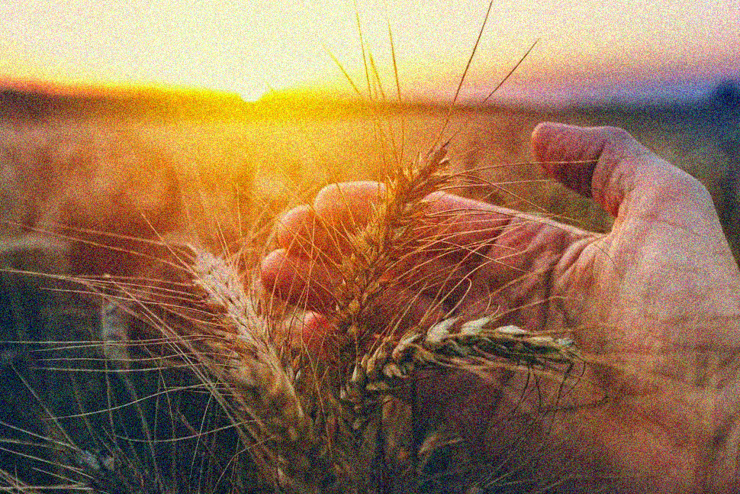
Shavuot – Part 1
The Homecoming – Shavuot, Torah & The Yovel
Notes:
To some, much of this message will be a review of what you already know. To others this will be totally new. But to everyone, I pray that you allow God to speak to your hearts and let Him transform you however He wants to.

Slide 2
Shavuot – The Fourth & Final Spring Feast
Three designations IN SCRIPTURE:
The Feast of Weeks
Seven “weeks” to be counted from the day after the Unleavened Bread Sabbath - Feast of First-fruits
The Feast of the Harvest
The end of the barley season and the beginning of the most important harvest season, the summer wheat harvest
The Day of First Fruits
Another first fruits marking the beginning of the great summer harvest
Notes:
The second of the 3 pilgrim feasts– shalosh regalim…at the Temple in Jerusalem.

Slide 3
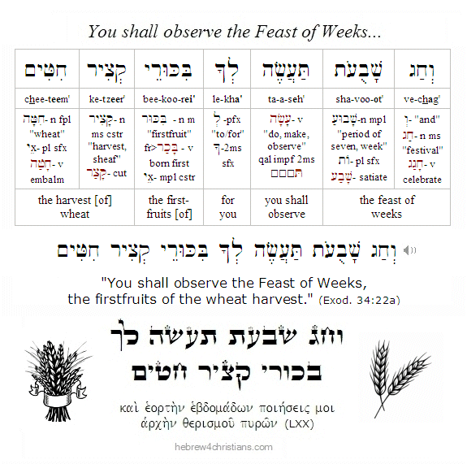
Shavuot

Slide 4
Leviticus 23
“¹ And the LORD spoke to Moses, saying,
² ‘Speak to the children of Israel and say to them: The feasts of the Lord, which you shall proclaim to be holy convocations, these are My feasts.” [NASB]
Notes:
Whose Feasts?

Slide 5
Leviticus 23
¹ Adonai said to Moshe, ² “Tell the people of Isra’el: ‘The designated [appointed] times of Adonai which you are to proclaim as holy convocations are My designated [appointed] times. [CJB]
Notes:
Whose Feasts?

Slide 6
“Feasts of the Lord”
Hebrew: יהוה מועדי
mo-eh-day Adonai
A time designated or appointed by Adonai
…from the root word of mo-eh-day…
An APPOINTMENT with Adonai!!
Notes:
The term “feasts of the Lord” is made up of two Hebrew words – moedai Adonai – which means Adonai’s appointed time…
To the spiritually minded Jew, this is not only a time appointed by God, it more precisely means an actual appointment with Adonai!

Slide 7
God’s Appointed Times
SPRING FEASTS
FALL FEASTS
COUNTING THE OMER
Days of Awe
PASSOVER
[PESACH]
FIRST FRUITS
[CHAG HABIKURIM]
FEAST OF WEEKS
[SHAVUOT]
FEAST OF TRUMPETS
[YOM T’RUAH]
TABERNACLES
[SUKKOT]
DAY OF ATONEMENT
[YOM KIPPUR]
UNLEAVENED
BREAD
[CHAG HAMATZOT]
Notes:
So, in Lev 23, God commands 6/7 sacred assemblies: which can be divided by time of year into the spring feasts and fall feasts. There are 3/4 Spring feasts and 3 fall feasts. If you have studied the Feasts, you will understand that the feasts of the Lord are the very foundation of understanding Prophecy, both Prophecy fulfilled and Prophecy yet to be fulfilled…hence the importance of understanding them as not only appointments with God, but sacred rehearsals of future events.

Slide 8
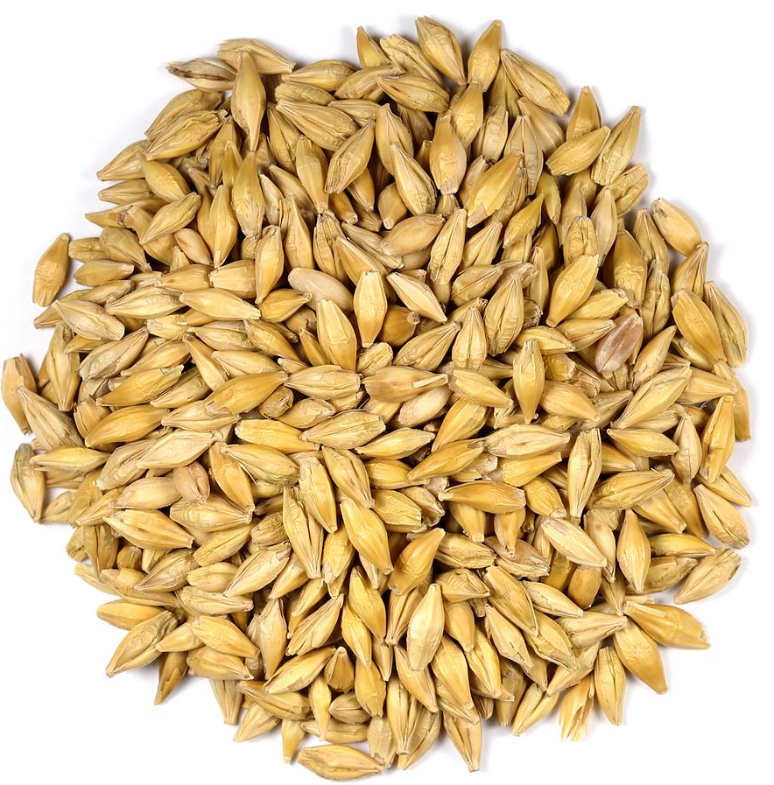
Shavuot – Leviticus 23:15-22
¹⁵ “‘From the day after the day of rest — that is, from the day you bring the sheaf for waving — you are to count seven full weeks…
SPRING FEASTS
COUNTING 7 FULL WEEKS
PESACH
[PASSOVER]
HAG HABIKURIM
[FIRST FRUITS]
HAG HAMATZOT
[UNLEAVENED BREAD]
Notes:
When God presents to Israel, the Moedai Adonai – the Feasts of the Lord in Leviticus 23, he forever connects two of the spring Feasts. They are both harvest feasts. The first, Chag Habikkurim, is the firstfruits of the Barley harvest. Barley is what establishes the beginning of Spring. In fact, the name for spring in Hebrew, Aviv, means sweet. Why? It was only when the barley farmers would taste the barley grain, and it would taste sweet, that they knew Spring had begun. That the barley was ready to begin the early Spring harvest. On day 3 of the Spring Feasts, they would offer the Barley as a first fruits. Another fascinating bit of information: Chag habikkurim – the beginning of the barley harvest: barley is the first grain in recorded history that was farmed and cultivated by mankind!! What else do we know about Barley – it grows naturally and grows best almost exclusively in the Middle East…and it is self-pollinating, diploid species with 14 chromosomes…

Slide 9
Shavuot – Leviticus 23:15-22
¹⁶ …until the day after the seventh week; you are to count FIFTY DAYS; and then you are to present a NEW grain offering to Adonai.
SPRING FEASTS
50 DAYS
PESACH
[PASSOVER]
14TH OF NISAN
CHAG HABIKKURIM
[First Fruits]
16th of Nisan
SHAVUOT
[WEEKS]
Gr: PENTECOST
6th of Sivan
HAG HAMATZOT
[UNLEAVENED BREAD]
15TH OF NISAN
SHABBAT DAY OF REST
Notes:
Where else in scripture do we see the number 50? The Yovel…the Jubilee year. What happens on the Jubilee Year? Slaves wait for the 50th year to be made free. They don’t have to redeem themselves. It is by God’s unmerited grace, embedded into His Torah command that frees them – the perfect blend of grace and truth!!! Families are allowed to go back to their original land and live there without having to redeem it themselves. It’s redeemed for them by the Grace of God embedded into His Torah command. Again, the perfect blend of grace and truth.

Slide 10
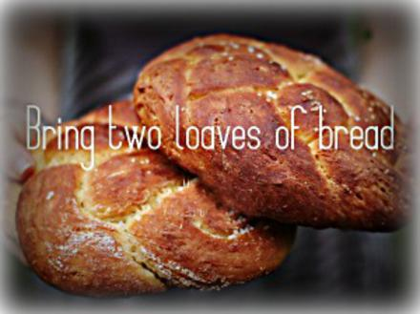
Shavuot – Leviticus 23:15-22
¹⁷ You must bring bread from your homes for waving — two loaves made with one gallon of fine flour, BAKED WITH LEAVEN — as firstfruits for Adonai.
Notes:
2 loaves…with leaven – this is the only time in the Torah where a sacrifice would include leaven. What is leaven symbolic of? Sin, of course. Why 2 loaves? Many theories…but the bottom line is that whatever the two loaves symbolize, they are brought as gifts to the Lord by the people as a faith offering for the coming harvest. I am convinced that this is prophetic pattern symbolizing Jew and Gentile brought to the Lord and waved to Him as a faith offering as the great summer harvest begins.

Slide 11
Shavuot – Leviticus 23:15-22
¹⁸ Along with the bread, present SEVEN lambs without defect one year old, one young bull and two rams; these will be a burnt offering for Adonai, with their grain and drink offerings, an offering made by fire as a fragrant aroma for Adonai.
Notes:
Burnt offerings are offerings of submission and surrender – brought in worship to God giving thanks because it’s only by His grace and mercy that we are alive, let alone that our harvest is plenty…the entire offering is burnt up – nothing left of the offering. Scripture says we are a living sacrifice…the Holy Spirit baptizes us in fire. What does that mean? Not what you think it means. It doesn’t mean now we got the power we’re on fire, no folks. When the HS baptizes us in fire, that means that everything that is about us goes up in flames. From that point on, we are dead to our selves. Our goals, our purposes, our needs, our wants…done. It’s all about God from that point on. Which is why we need to continuously be filled, continuously be baptized with fire. Because we are a selfish, stiff-necked people. We even make the prophetic fulfillment of Shavuot…the great day of Pentecost…about us. “We got the Power!!” No…the Ruach has the power, and the Ruach is given to us for one singular purpose!! The Hebrew word for burnt offering is the noun olah עֹלָה occurs 289 times in the Masoretic Text of the Hebrew Bible. It means "that which goes up". It is formed from the active participle of the verb alah עָלָה “to cause to ascend.“ Our lives, our wants, our needs go up in smoke to God. We give up all rights to be the directors of the world – to be a God to ourselves.

Slide 12
Shavuot – Leviticus 23:15-22
19 Offer one male goat as a sin offering and two male lambs one year old as a sacrifice of peace offerings. 20 The cohen will wave them with the bread of the firstfruits as a wave offering before Adonai, with the two lambs; these will be holy for Adonai for the cohen.
Notes:
What do we know so far? That the Resurrection day of Yeshua is tied eternally with Shavuot…that Shavuot only occurs in connection with Chag Habikkuim. That Shavuot is the beginning of the greatest of all Harvests…the summer Harvest and it is commemorated by the Nation bringing offerings for the High Priest to sacrifice before God…

Slide 13
Shavuot – Leviticus 23:15-22
21 On the same day, you are to call a holy convocation; do not do any kind of ordinary work; this is a permanent regulation through all your generations, NO MATTER WHERE YOU LIVE.

Slide 14
Shavuot – Leviticus 23:15-22
²² “‘When you harvest the ripe crops produced in your land, don’t harvest all the way to the corners of your field, and don’t gather the ears of grain left by the harvesters; leave them for THE POOR AND THE FOREIGNER;
I AM ADONAI YOUR GOD.’”
Notes:
Be merciful…in the midst of commemorating, celebrating and sacrificing according to the regulations and laws of God…always focus on mercy and grace. Your Harvest is bounded on every corner by a giving heart. To remind you, that it’s not about you. That it all belongs to God. Because you are not the end all, be all!!!! Be merciful to those outside your group and the poor. Fast forward 1500 years…

Slide 15
Deuteronomy 16
9 “You are to count seven weeks; you are to begin counting seven weeks from the time you first put your sickle to the standing grain. 10 You are to observe the festival of Shavu‘ot [weeks] for Adonai your God with a voluntary offering, which you are to give in accordance with the degree to which ADONAI YOUR GOD HAS PROSPERED YOU.
Notes:
The offering is tied to gratefulness – to recognizing God as the source of all prosperity, the source of our sustenance. He created all and we have the no ability to create – only to utilize what He has already created to benefit ourselves and our world.

Slide 16
Deuteronomy 16
11 You are to rejoice IN THE PRESENCE of Adonai your God —
YOU, YOUR SONS AND DAUGHTERS, YOUR MALE AND FEMALE SLAVES, THE L’VI’IM LIVING IN YOUR TOWNS, AND THE FOREIGNERS, ORPHANS AND WIDOWS LIVING AMONG YOU

Slide 17
Deuteronomy 16
— IN THE PLACE where Adonai your God will choose to HAVE HIS NAME LIVE.
12 REMEMBER THAT YOU WERE A SLAVE IN EGYPT; THEN YOU WILL KEEP AND OBEY THESE LAWS.

Slide 18
Shavuot
Celebrating the land producing a harvest – the end of the spring harvest and the freedom to begin the great summer harvest
Bring an offering of praise to God in thanksgiving with the first fruits and the two loaves
Bring a purification offering to cleanse you and free you to draw closer to the Lord
Bring an offering of fire (an olah) in submission to the God of creation – the source of all blessings
Allow the poor and needy to eat of your land
It is a Sabbath day of complete rest for everyone in the land
Commanded again to remember your redemption from slavery in Egypt

Slide 19
Shavuot
Proclaim to the children of Israel – slave or free, rich or poor, widow or orphan – that they are free to partake in the great summer wheat harvest, with the foreigners invited as well.
While we pause to remember yearly Whose land it is, Who provides the nutrients and water for the crops to grow, Who brings life to the land and ensures the harvest…and Who is our covering, our nurturer, our provider.

Slide 20
Fifty, Seven Sevens, Harvest, Sabbath, Slave, The Dispossessed, Freedom
Which Other Event Does Scripture Command Israel To Keep That Has The Same Themes as Shavuot?

Slide 21
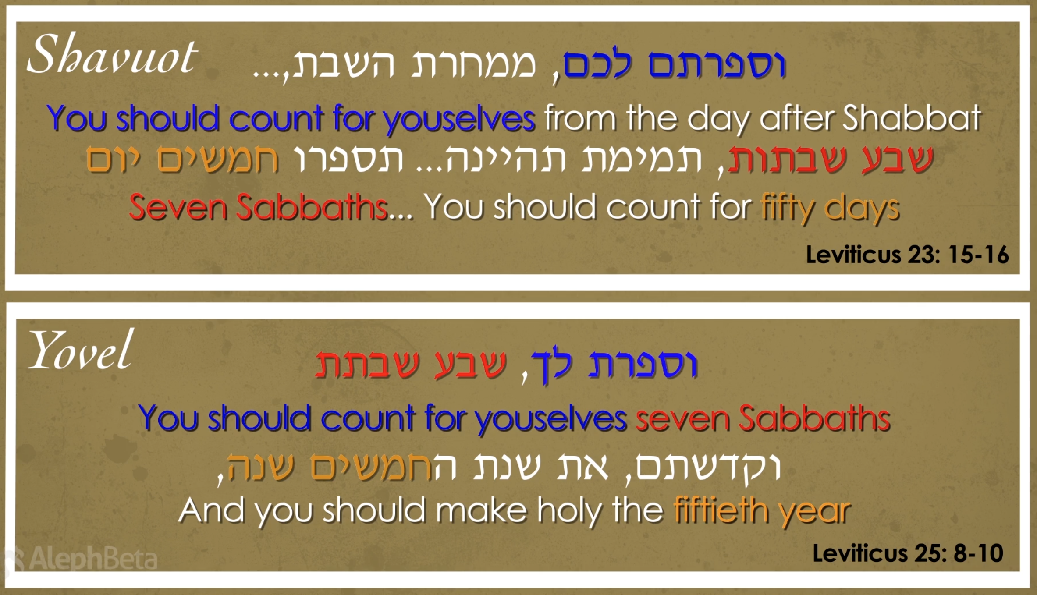

Slide 22
Yovel - יוֹבֵל
Yovel comes from a root that means “ram’s horn” or “trumpet,” because it was with the blast of the shofar that the Jubilee year was announced.
The sound of Yovel also signaled freedom for slaves to return to their ancestral family, and the return of land to their ancestral owner, along with the freedom from all debts.

Slide 23
Yovel - יוֹבֵל
Leviticus 25
8 “‘You are to count SEVEN SHABBATS OF YEARS, SEVEN TIMES SEVEN YEARS, that is, forty-nine years. 9 Then, on the tenth day of the SEVENTH MONTH, on Yom-Kippur, you are to SOUND A BLAST ON THE SHOFAR; you are to sound THE SHOFAR all through YOUR LAND;

Slide 24
Yovel - יוֹבֵל
Leviticus 25
10 and you are to consecrate the FIFTIETH year, PROCLAIMING FREEDOM THROUGHOUT THE LAND TO ALL ITS INHABITANTS.
It will be a yovel for you;

Slide 25
Yovel - יוֹבֵל
Leviticus 25
10 and you are to consecrate the fiftieth year, PROCLAIMING FREEDOM THROUGHOUT THE LAND TO ALL ITS INHABITANTS.
It will be a yovel for you;
you will RETURN EVERYONE TO THE LAND he owns,
and everyone is to RETURN TO HIS FAMILY.
Notes:
What’s the difference between the Yovel and the Sh’mitah? Sh’mitah frees people from debt and allows them to eat from the corners of anyone’s land, but does not return them to their ancestral land or free them totally from slavery!

Slide 26
Yovel - יוֹבֵל
Leviticus 25
11 That fiftieth year WILL BE A YOVEL FOR YOU; in that year you are not to sow, harvest what grows by itself or gather the grapes of untended vines; 12 because it is a YOVEL. It will be holy for you; whatever the fields produce will be food for all of you. 13 In this year of YOVEL, every one of you is to RETURN TO THE LAND he owns.

Slide 27
Yovel - יוֹבֵל
Leviticus 25
23 “‘The land is not to be sold in perpetuity, BECAUSE THE LAND BELONGS TO ME כִּי־לִ֖י הָאָ֑רֶץ
YOU ARE ONLY FOREIGNERS AND TEMPORARY RESIDENTS WITH ME.

Slide 28
Shavuot & Yovel
Shavuot reminds us that the land belongs to God, the harvest is His doing, and we are to draw close to Him as a family
But what if you are dispossessed from your land?
What if you are dispossessed from your family?

Slide 29
Yovel
The Yovel frees you to be reunited again with your ancestral land and to your ancestral family.
FREEDOM
RETURNS YOU TO WHERE YOU BELONG [FAMILY & ANCESTRAL LAND]

Slide 30
How Do Both Shavuot & Yovel Point Us To The Marriage Covenant & The Giving of The Torah?

Slide 31
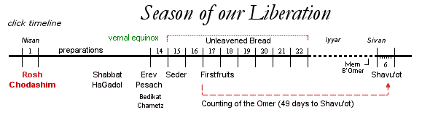
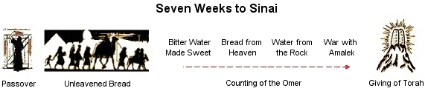

Slide 32
Giving of The Torah
Exodus 19
1 IN THE THIRD MONTH after the people of Isra’el had left the land of Egypt, the same day they came to the Sinai Desert. 2 After setting out from Refidim and arriving at the Sinai Desert, they set up camp in the desert; there in front of the mountain, Isra’el set up camp. 3 Moshe went up to God, and Adonai called to him from the mountain: “Here is what you are to say to the household of Ya‘akov, to tell the people of Isra’el:

Slide 33
Giving of The Torah
Exodus 19
4 ‘You have seen what I did to the Egyptians, and how I carried you on eagles’ wings and BROUGHT YOU TO MYSELF.
Notes:
The whole purpose of the Passover – the redemption out of slavery was for God to bring His family back to Himself and to prepare them to receive His truth – His Torah.

Slide 34
Giving of The Torah
Exodus 19
5 Now if you will pay careful attention to what I say and keep my covenant, then you will be MY OWN TREASURE from among all the peoples…

Slide 35
Giving of The Torah
Exodus 19
…FOR ALL THE EARTH IS MINE; [כִּי־לִ֖י כׇּל־הָאָֽרֶץ]

Slide 36
Giving of The Torah
Exodus 19
6 and YOU WILL BE A KINGDOM OF COHANIM FOR ME, A NATION SET APART.’ These are the words you are to speak to the people of Isra’el.”

Slide 37
Giving of The Torah
Exodus 19
16 On the morning of the third day, there was thunder, lightning and a thick cloud on the mountain. THEN A SHOFAR BLAST SOUNDED SO LOUDLY THAT ALL THE PEOPLE IN THE CAMP TREMBLED.

Slide 38
Giving of The Torah
Exodus 19
17 Moshe brought the people out of the camp TO MEET GOD; they stood near the base of the mountain. 18 Mount Sinai was enveloped in smoke, because Adonai descended onto it in fire — its smoke went up like the smoke from a furnace, and the whole mountain shook violently.

Slide 39
Giving of The Torah
Exodus 19
19 As THE SOUND OF THE SHOFAR grew louder and louder, Moshe spoke; and God answered him with a voice.
20 Adonai came down onto Mount Sinai, to the top of the mountain…

Slide 40
Shavuot, Yovel, & The Giving of Torah
Shavuot
Yearly, as a result of our redemption from slavery, we are free to celebrate the land God gave us in the annual harvest, regardless of where we are…acknowledging the sovereignty of God, through the keeping of Shavuot.

Slide 41
Shavuot, Yovel, & The Giving of Torah
Shavuot
And no matter our circumstance, even if we are separated from our land or from our family by slavery, by poverty, by widowhood, by orphanhood, we keep Torah, God brought us close to Him, and we remain part of God’s family through the covenant He made with us at Sinai.

Slide 42
Shavuot, Yovel, & The Giving of Torah
Shavuot
And those who have must share with those who are less fortunate, reminding them that they are part of a larger family, and have access to the blessings of God.

Slide 43
Shavuot, Yovel, & The Giving of Torah
Yovel
And every 50 years, we are reminded even more deeply of the covenant, if we remain separated from our ancestral family through slavery, or separated from our ancestral land, we are provided actual freedom to return home.

Slide 44
Matthew 22
36 “Rabbi, which of the mitzvot in the Torah is the most important?” 37 He told him, “‘You are to love Adonai your God with all your heart and with all your soul and with all your strength.’ 38 This is the greatest and most important mitzvah. 39 And a second is similar to it, ‘You are to love your neighbor as yourself.’ 40 All of the Torah and the Prophets are dependent on these two mitzvot.”

Slide 45
“Holy Convocations”
Hebrew: קדשׁ מקראי
mik’rei Kodesh
A sacred or holy calling together (assembly)
…from the root of mik’rei…
A sacred REHEARSAL
Rehearsal: The act of practicing in preparation for an actual performance
Notes:
The term micrey kodesh: it’s primary meaning is as a calling together of God’s people. The secondary meaning that comes from the root of the word Micrey is – REHEARSAL; NOW, IF WE THINK ABOUT THE MEANING OF THE WORD REHEARSAL, IT PROVIDES US WITH A FASCINATING PERSPECTIVE OF THE LORD’S HOLY CONVOCATIONS/THE FEASTS AS A REHEARSAL FOR SOME FUTURE EVENT – ONE THAT DEFINES THEM AS INDEED PROPHETIC. More than prophetic…God moves in patterns. He sets the pattern in the Torah and then repeats that pattern throughout time. One of the many reasons that you need to study the Torah, the prophets, the writings of the Tanakh is to understand those patterns. Your will never understand the plans and purposes of God without knowing the Tanakh…what many call the Old Testament.

Slide 46
SPRING FEASTS
MESSIAH BECAME
OUR SACRIFICIAL PASSOVER LAMB
MESSIAH RAISED AS THE FIRST FRUITS
OF OUR RESURRECTION
COUNTING THE OMER
PESACH
[PASSOVER]
HAG HABIKURIM
[FIRST FRUITS]
SHAVUOT
[WEEKS]
(Gr: PENTECOST)
6th Sivan
PROPHETICALLY FULFILLED 50 DAYS AFTER THE RESURRECTION
HAG HAMATZOT
[UNLEAVENED BREAD]
MESSIAH THE PERFECTLY SINLESS UNLEAVENED BREAD
BECAME LEAVEN ON OUR BEHALF
Notes:
All 4 of the Spring feasts are prophetic – sacred rehearsals – that have already been fulfilled. These were rehearsals set forth by Adonai 1500+ years prior to Yeshuah’s coming, all of which were clearly, overtly and specifically fulfilled during and immediately after Mashiach’s first coming almost 2000 years ago.
Describe the first 3…It is critical that we understand the purpose, both in their celebration and their prophetic meaning and only then can we fully grasp what Shavuot means. Everything with God is orderly, perfectly timed with absolute purpose and intent and God creates repeated patterns in scripture. Once we understand that, all that He does fits together like the perfect jigsaw puzzle that paints a picture of His redemptive love for us. What is fascinating is that, not only are these holy convocations a foreshadowing of the first coming of our Lord. But, the Lord fulfilled these holy convocations ON THE EXACT DAY OF THE ACTUAL FEAST!!!!! Since today is Shavuot

