Slide 1


Slide 2
The Portion We Can’t Proclaim
Exodus 32: 1-9
Why Our Yes Fails and Jesus is Our Only “Amen”

Slide 3
When the people saw that Moses was so long in coming down from the mountain, they gathered around Aaron and said, “Come, make us gods who will go before us. As for this fellow Moses who brought us up out of Egypt, we don’t know what has happened to him.”
Exodus 32:1-9 NIV

Slide 4
² Aaron answered them,
“Take off the gold earrings that your wives, your sons and your daughters are wearing, and bring them to me.” ³ So all the people took off their earrings and brought them to Aaron.
Exodus 32:1-9 NIV

Slide 5
⁴ He took what they handed him and made it into an idol cast in the shape of a calf, fashioning it with a tool. Then they said, “These are your gods, Israel, who brought you up out of Egypt.”
Exodus 32:1-9 NIV

Slide 6
⁵ When Aaron saw this, he built an altar in front of the calf and announced, “Tomorrow there will be a festival to the Lord.” ⁶ So the next day the people rose early and sacrificed burnt offerings and presented fellowship offerings. Afterward they sat down to eat and drink and got up to indulge in revelry.
Exodus 32:1-9 NIV

Slide 7
⁷ Then the Lord said to Moses,
“Go down, because your people,
whom you brought up out of Egypt,
have become corrupt.
Exodus 32:1-9 NIV

Slide 8
⁸ They have been quick to turn away from what I commanded them and have made themselves an idol
cast in the shape of a calf. They have bowed down to it and sacrificed to it and have said, ‘These are your gods, Israel,
who brought you up out of Egypt.’
Exodus 32:1-9 NIV

Slide 9
⁹ “I have seen these people,”
the Lord said to Moses,
“and they are a stiff-necked people.”
Exodus 32:1-9 NIV

Slide 10
The Fragility of the
"Amen"

Slide 11
⁸ The people all responded together,
“We will do everything
the Lord has said.”
Exodus 19:8 NIV

Slide 12
⁷ Then he took the Book of the Covenant and read it to the people. They responded,
“We will do everything the Lord has said; we will obey.”
⁸ Moses then took the blood, sprinkled it on the people and said, “This is the blood of the covenant that the Lord has made with you in accordance with all these words.”
Exodus 24:7-8 NIV

Slide 13
When the people saw that Moses was so long in coming down from the mountain, they gathered around Aaron and said, “Come, make us gods who will go before us. As for this fellow Moses who brought us up out of Egypt, we don’t know what has happened to him.”
Exodus 32:1 NIV

Slide 14
The Golden Calf:
Making God "Manageable"

Slide 15
⁴ He took what they handed him and made it into an idol cast in the shape of a calf, fashioning it with a tool. Then they said, “These are your gods, Israel, who brought you up out of Egypt.”
Exodus 32:4 NIV

Slide 16
⁵ When Aaron saw this, he built an altar in front of the calf and announced, “Tomorrow there will be a festival to the Lord.”
⁶ So the next day the people rose early and sacrificed burnt offerings and presented fellowship offerings. Afterward they sat down to eat and drink and got up to indulge in revelry.
Exodus 32:5-6 NIV

Slide 17
³ For the revelation awaits
an appointed time; it speaks of the end and will not prove false. Though it linger, wait for it; it will certainly come and will not delay.
Habakkuk 2:3 NIV

Slide 18
The Mediator in the Gap

Slide 19
¹¹ But Moses sought the favor of the Lord his God.
“Lord,” he said, “why should your anger burn against your people, whom you brought out of Egypt with great power and a mighty hand?
Exodus 32:11 NIV

Slide 20
¹³ Remember your servants Abraham, Isaac and Israel,
to whom you swore by your own self:
‘I will make your descendants as numerous as the stars in the sky and I will give your descendants all this land I promised them, and it will be their inheritance forever.’
Exodus 32:13-14 NIV

Slide 21
We all, like sheep, have gone astray, each of us has turned to our own way; and the Lord has laid on him the iniquity of us all.
Isaiah 53:6 NIV

Slide 22
⁵ For there is one God
and one mediator
between God and mankind,
the man Christ Jesus,
⁶ who gave himself as a ransom for all people.
1 Timothy 2:5-6 NIV

Slide 23
Conclusion:
The story of the Golden Calf ends with a broken covenant. But the story of the Gospel ends with a New Covenant and an invited people. While Israel stood in the valley trying to fashion a god out of gold,
God was looking ahead
to a hill called Calvary,
where He would provide
a Savior out of grace.

Slide 24


Slide 25
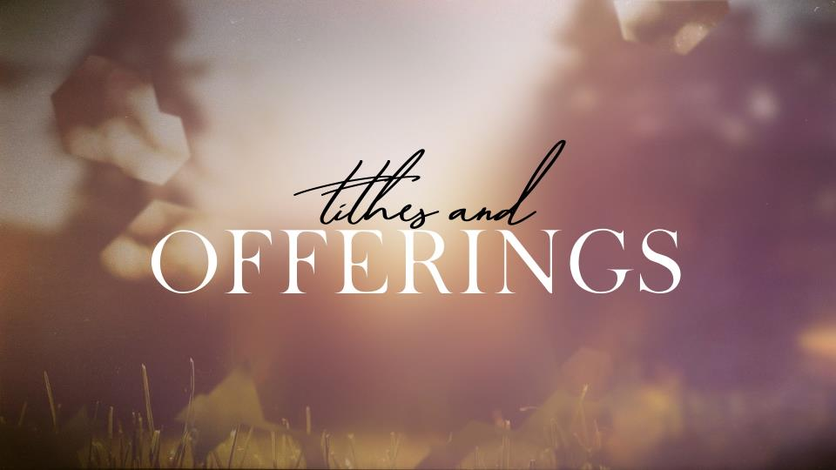

Slide 26


