Slide 1
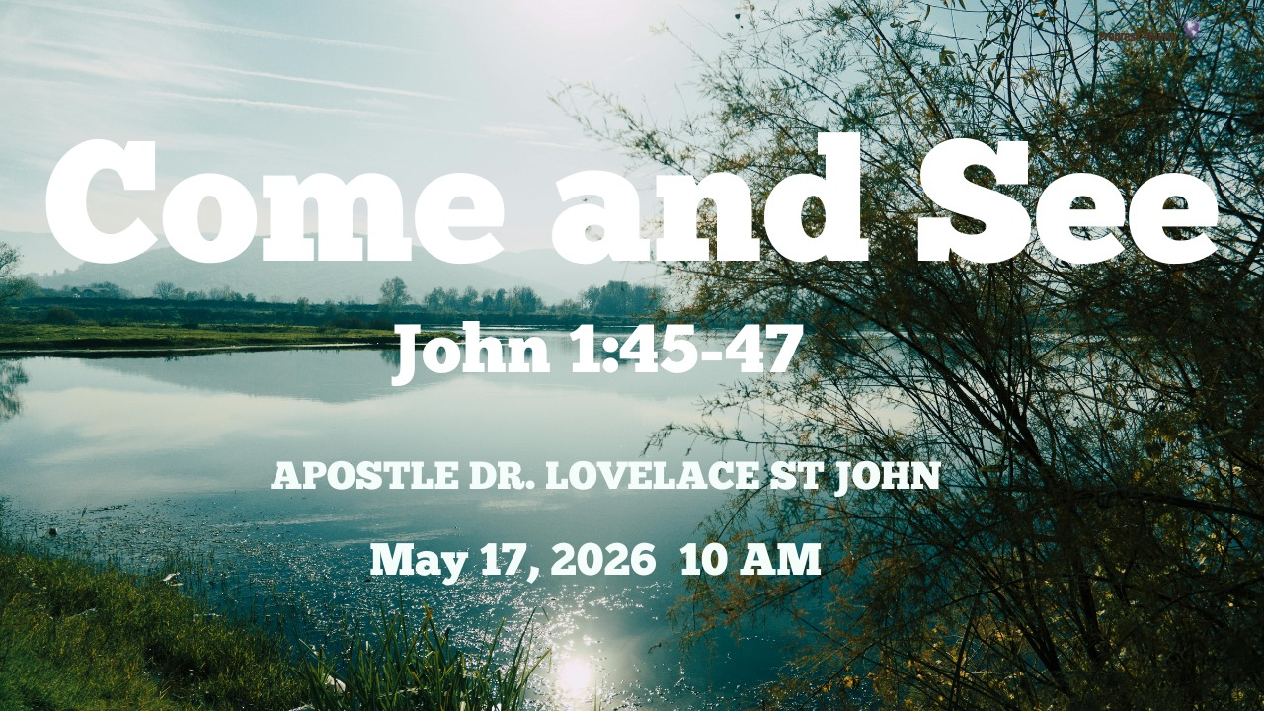

Slide 2



Scripture:
ST JOHN 1: 45 – 47

Slide 3
INTRODUCTION
Sometimes the greatest transformation does not begin with a sermon; it begins with an invitation.
The early scenes of John’s Gospel unveil a chain of encounters:
John the Baptist points to Jesus: “Behold, the Lamb of God.”
Andrew and another disciple follow Him.
Andrew finds Peter and says, “We have found the Messiah.”
Now Philip finds Nathanael and says the same.

Slide 4
INTRODUCTION cont.
Every great work of God begins with one obedient person saying, “Come and see.”
Andrew invited Peter.
Philip invited Nathanael.
The Samaritan woman invited a city.
Matthew invited sinners into his house to meet Jesus.

Slide 5
INTRODUCTION cont.
The Gospel travels through invitation.
Many people are one invitation away from a breakthrough.
One invitation away from healing.
One invitation away from deliverance.
One invitation away from discovering purpose.
One invitation away from salvation.

Slide 6
1. THE SKEPTIC’S QUESTION: CAN ANYTHING GOOD COME OUT OF NAZARETH?
Nathanael’s Doubt
Nazareth wasn’t an elite city. It was despised and obscure. Nazareth had a poor reputation. It was overlooked. Insignificant.
Many people today are like Nathanael, they say:
“Church is fake.”
“Christians are hypocrites.”
“Religion hurt me.”
“Nothing good can come from there.”

Slide 7
2. THE POWER OF SIMPLE WITNESS: PHILIP SAID TO HIM, COME AND SEE.
Philip first experienced Jesus before he invited someone else.
Before Philip became an inviter, Philip first became a follower.
You cannot authentically invite people into something you have never experienced yourself.

Slide 8
2. THE POWER OF SIMPLE WITNESS: PHILIP SAID TO HIM, COME AND SEE cont.
Philip encountered Christ personally.
There is a difference between:
Knowing church culture and knowing Jesus
Knowing religion and knowing Christ
Knowing information and knowing transformation

Slide 9
3. ONE INVITATION CAN CHANGE EVERYTHING: THE RIPPLE EFFECT OF FAITHFUL WITNESS
From cynic to confessor in one encounter; that’s what one invitation can do.
Let’s trace it:
John the Baptist points to Andrew.
Andrew brings Peter.
Philip brings Nathanael.
Nathanael later follows Jesus and bears witness.
Salvation flows like a chain of divine connections; each link built through relationships.

Slide 10
4. COME AND SEE IS THE LANGUAGE OF INVITATION
Experience can accomplish what arguments cannot.
If you can encounter Him for yourself, everything will change.
The invitation.
Not: Come and understand everything. Not: Come and become perfect first. Not: Come and fix your whole life. Just come and see.
The Gospel invitation.
Come and see His grace. Come and see His mercy. Come and see His power. Come and see His love. Come and see His forgiveness.

Slide 11
5. THE LITTLE MAID OF ISRAEL - 2 Kings 5:1–3
One of the most overlooked evangelistic figures in Scripture is the unnamed servant girl in Naaman’s story.
She was: unnamed, enslaved, overlooked, taken captive:
If only my master were with the prophet who is in Samaria! For he would heal him of his leprosy.
She essentially said: “Come and see.”
This little servant girl understood: There is a prophet connected to the power of God.
And her invitation led Naaman toward healing.

Slide 12
6. EVERY GREAT MOVE OF GOD SPREADS THROUGH INVITATION
The early Church grew relationally. Andrew invited Peter.
Philip invited Nathanael.
Cornelius invited relatives and friends.
The Samaritan woman invited a city.
The Gospel moves through relationships.

Slide 13
6. EVERY GREAT MOVE OF GOD SPREADS THROUGH INVITATION cont.
Statistics may change over time, but one truth remains:
Most people come to faith because someone personally invited them.
Invitation is a Kingdom strategy.

Slide 14
CONCLUSION
God’s Invitations Are Always Redemptive; God never invites to condemn; He invites to transform.
Every “Come” of God is preceded by grace and followed by glory.
“Come now, let us reason together,” says the Lord (Isaiah 1:18).
“Come to Me, all who labor and are heavy laden…” (Matthew 11:28).

Slide 15
CONCLUSION cont.
“Let the one who is thirsty come” (Revelation 22:17).
The Bible begins with “Come” (Genesis 7:1—Noah’s ark) and ends with “Come” (Revelation 22:17). From beginning to end, God is a God of invitation.

