Slide 1
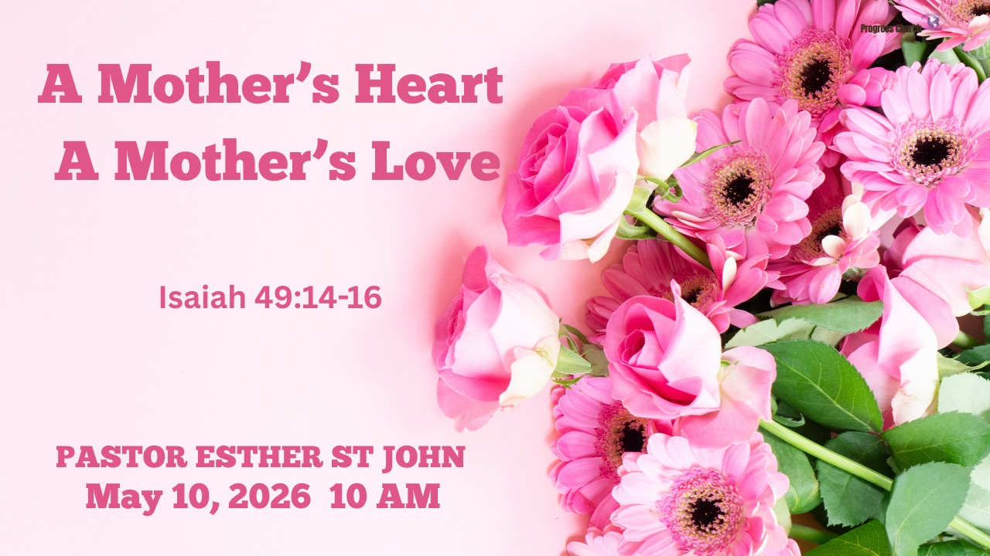

Slide 2



SCRIPTURE
1 CORINTHIANS 16: 12 – 14

Slide 3
INTRODUCTION
A Mother’s Heart, A Mother's love. What Does It Mean and Why Does It Matter?
A Picture Examples
When God wants to give us a picture of something concerning his relationship towards us so we can know his thoughts for us, He shows it from the things he already made.
Infinite Measure of God’s Love
If we want to know the measure of his love-Psalm 103:11- states: "For as high as the heavens are above the earth, so great is his steadfast love toward those who fear him" (ESV).

Slide 4
INTRODUCTION (cont)
Christ and His Church
If we want to visualize the type of relationship the Church and Jesus have, we see the picture in Ephesians 5:31-32(Niv).
“For this reason a man will leave his father and mother and be united to his wife, and the two will become one flesh.” 32)This is a profound mystery—but I am talking about Christ and the church.

Slide 5
1. Created As A Reflection Of God
The creation of mankind in the book of Genesis, give us insight into the nature of God and of human beings, “God created humankind in his own image, in the image of God he created them, male and female he created them” (Gen. 1:27).
Humans are designed by God to be his representatives to rule over creation, reflecting His character mentally, morally, and socially. This image imparts inherent characteristics meaning, it was built in.
Men and women were created equal in value but created with distinct, complementary natures that, together, reflect the nature of God.

Slide 6
2. God’s Testimony Of A Mother
Isa. 49:15 says, "Can a woman forget her sucking child, that she should not have compassion on the son of her womb? yes, they may forget, yet will I not forget you."
God was responding to the Israelites' feelings of abandonment while in exile.
(mentioned in verse 14).
God uses the powerful image of a mother’s love for her nursing child to illustrate that His commitment to His people is even stronger and more unwavering than that bond, assuring them that He cannot forget them. (radical.net)

Slide 7
3. Scenario Of A Mother Forgetting Her Child
A mother's bond with her child is considered one of the strongest human connections, but this Word in Isaiah 49:15, poses the scenario that even if a mother could forget her nursing child, God will never forget His people.

Slide 8
4. The Heart of A Mother
What is the Heart ?
The heart refers to the core of a person’s inner moral, spiritual, and intellectual life encompassing emotions, thoughts, desires, and the will.
Proverbs 4:23 commands, "Above all else, guard your heart, for everything you do flows from it," recognizing it as the source of actions.
A mother's heart is the capacity, source, and nurturing nature—the internal, spiritual, or emotional reservoir that makes love possible, often reflecting God's divine care.

Slide 9
5. A Mother's Pondering Heart
Scripture: St. Luke 2:19
..."And Mary ponder these things in her heart...
In Luke 2:19, "pondered" comes from the Greek word sumballo (sumballousa), which literally means to "throw together," "piece together," or "bring together in one's mind".
For Mary, it was putting all the pieces together. What she had seen and heard-like the angelic announcement and shepherd report of their angelic and heavenly host visitation and the 3 wise men who traveled a long time and a long way, just to present gifts that was more fitting for a king but it was given to her child Jesus. She wanted to form a coherent understanding in her heart of what was happening.
□A mother's heart will never stop carrying or caring for her children and sometimes with much pain and anxiety.

Slide 10
6. Piercing The Soul
St. Luke 2:35-reading from verse 34
Then Simeon blessed them and said to Mary, his mother:
“This child is destined to cause the falling and rising of many in Israel, and to be a sign that will be spoken against, 35) so that the thoughts of many hearts will be revealed. And a sword will pierce your own soul too.”

Slide 11
6. Piercing The Soul (con’t)
Simeon prophesies that Mary's soul would be pierced by a great sword because of the destiny of her child.
The piercing heart speaks to the trouble you will face being a mothers.
Motherhood was never meant for you to carry on your own. Christ in you is your hope for over coming ever obstacles and experience the joy.

Slide 12
7. A Mother's Selfless Love
A mother’s heart is characterized by unwavering love, self-sacrificial action, and the profound responsibility of shaping the next generation's faith.
The Story of two Prostitute-1 Kings 3:16-26
Verse 26 "Then the woman whose son was alive spoke to the king because she yearned with compassion for her son. “Please, my lord,” she said, “give her the living baby. Do not kill him!” But the other woman said, “He will be neither mine nor yours. Cut him in two!”

Slide 13
7. A Mother's Selfless Love (cont’d)
We learn from this story, that a true mother's heart will not stand around to see her children be destroyed.
The heart of a true mother is protective toward her child.
The heart of a true mother will not take pleasure in killing her child or participating in destroying others.
Her heart is marked by Strength and sacrificial love-the mother of the living baby said, "Give her the living baby" verse 26.

Slide 14
Conclusion
A mother's heart was given to us to display our heavenly Father's heart and to remind us how much he loves us, cherish us, nurture us, protect us and wants the best for us as his children.
It is a Source of Wisdom and Instruction, passing on Faith: As Eunice and Lois did to Timothy
(2 Timothy 1:5).
It Discipline with kindness: A godly mother teaches her children with wisdom and kindness, not mere anger (Proverbs 31:26).

Slide 15
Conclusion (con’t)
It is Resilient and wise: Proverbs 31:25-28 describes the ideal mother as "clothed with strength and dignity," allowing her to approach the future without fear.
A Mother Deserves Honor and Recognition because Motherhood is ordained by God, beginning with Eve as "the mother of all the living" (Genesis 3:20).

