Slide 1

Fiery Faith
Michael Christie

Slide 2

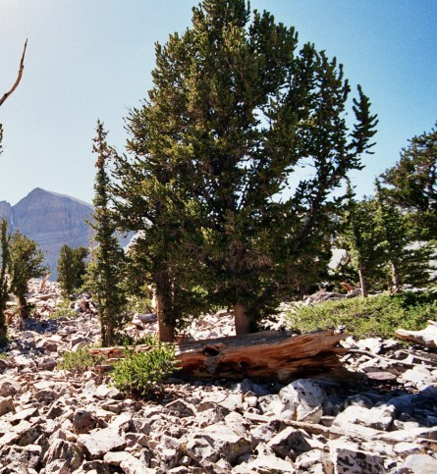

Slide 3
DANIEL 3:13-27
¹³ Furious with rage, Nebuchadnezzar summoned Shadrach, Meshach and Abednego. So these men were brought before the king, ¹⁴ and Nebuchadnezzar said to them, “Is it true, Shadrach, Meshach and Abednego, that you do not serve my gods or worship the image of gold I have set up?

Slide 4
¹⁵ Now when you hear the sound of the horn, flute, zither, lyre, harp, pipe and all kinds of music, if you are ready to fall down and worship the image I made, very good.
But if you do not worship it, you will be thrown immediately into a blazing furnace. Then what god will be able to rescue you from my hand?”

Slide 5
¹⁶ Shadrach, Meshach and Abednego replied to him, “King Nebuchadnezzar, we do not need to defend ourselves before you in this matter. ¹⁷ If we are thrown into the blazing furnace, the God we serve is able to deliver us from it, and he will deliver us from Your Majesty’s hand.
¹⁸ But even if he does not, we want you to know, Your Majesty, that we will not serve your gods or worship the image of gold you have set up.”

Slide 6
¹⁹ Then Nebuchadnezzar was furious … and his attitude toward them changed. He ordered the furnace heated seven times hotter than usual ²⁰ and commanded some of the strongest soldiers in his army to tie up Shadrach, Meshach and Abednego and throw them into the blazing furnace. ²¹ So these men, wearing their robes, trousers, turbans and other clothes, were bound and thrown into the blazing furnace.

Slide 7
²² The king’s command was so urgent and the furnace so hot that the flames of the fire killed the soldiers who took up Shadrach, Meshach and Abednego, ²³ and these three men, firmly tied, fell into the blazing furnace.
²⁴ Then King Nebuchadnezzar leaped to his feet in amazement and asked his advisers, “Weren’t there three men that we tied up and threw into the fire?” They replied, “Certainly, Your Majesty.”

Slide 8
²⁵ He said, “Look! I see four men walking around in the fire, unbound and unharmed, and the fourth looks like a son of the gods.”
²⁶ Nebuchadnezzar then approached the opening of the blazing furnace and shouted, “Shadrach, Meshach and Abednego, servants of the Most High God, come out! Come here!”

Slide 9
So Shadrach, Meshach and Abednego came out of the fire, ²⁷ and the satraps, prefects, governors and royal advisers crowded around them.
They saw that the fire had not harmed their bodies, nor was a hair of their heads singed; their robes were not scorched, and there was no smell of fire on them.

Slide 10
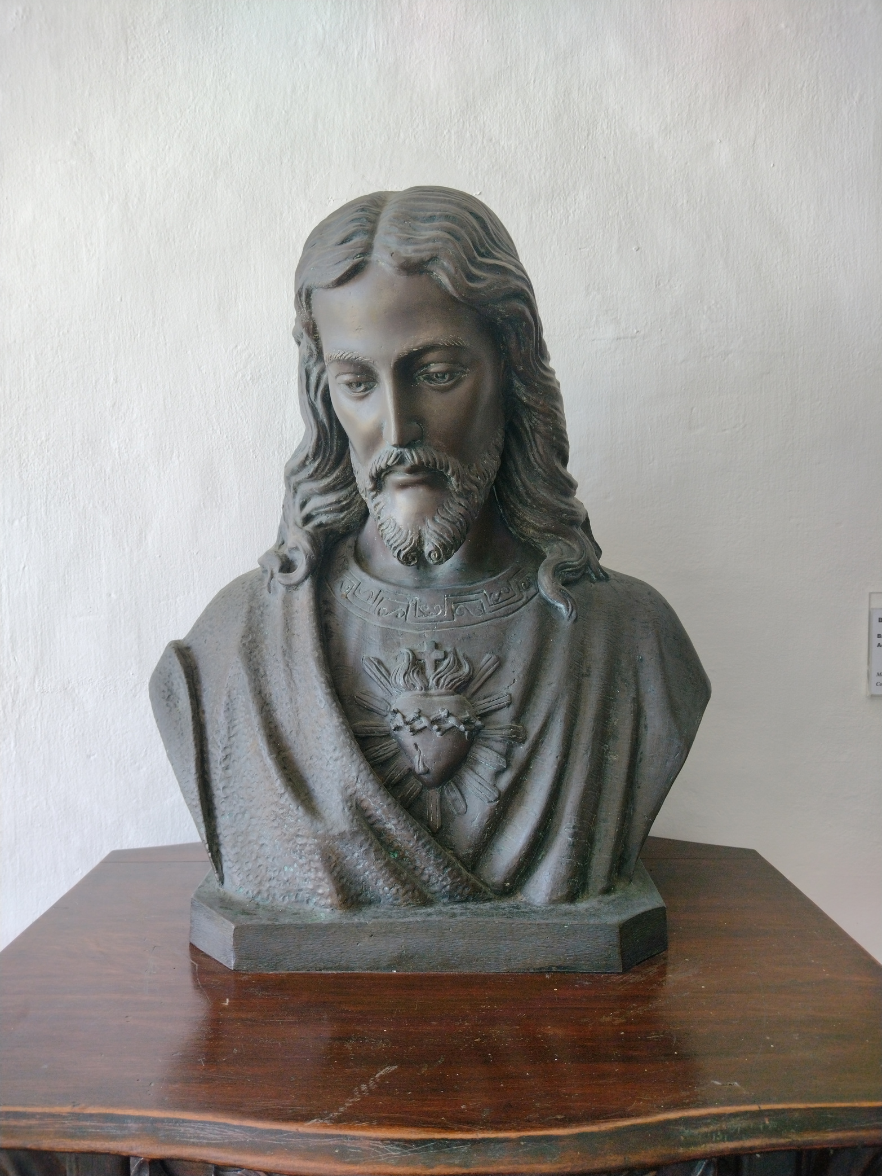

Slide 11
Pressure to Conform
Nebuchadnezzar said to them, “Is it true, Shadrach, Meshach and Abednego, that you do not serve my gods or worship the image of gold I have set up? Now when you hear the sound of the horn, flute, zither, lyre, harp, pipe and all kinds of music, if you are ready to fall down and worship the image I made, very good. But if you do not worship it, you will be thrown immediately into a blazing furnace. Then what god will be able to rescue you from my hand?
- DANIEL 3:14-15

Slide 12
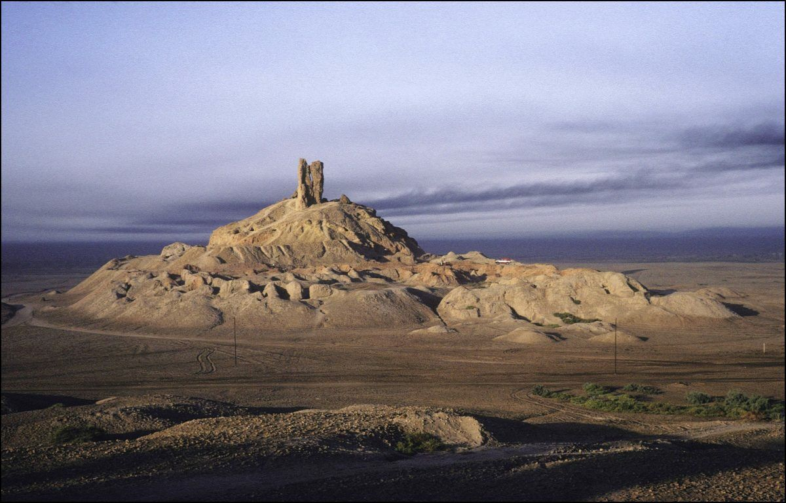
https://armstronginstitute.org/enlarge_image?data=eyJpZCI6IjIxMiIsImNhcHRpb24iOiJCb3JzaXBwYSBaaWdndXJhdCwgYSBw%0Ab3NzaWJsZSBsb2NhdGlvbiBvZiB0aGUgVG93ZXIgb2YgQmFiZWwiLCJjcmVk%0AaXQiOiJZdmVzIEdFTExJRS9HYW1tYS1SYXBoby8gR2V0dHkgSW1hZ2VzIn0%3D%0A

Slide 13
Dear friends, do not be surprised at the fiery ordeal that has come on you to test you, as though something strange were happening to you.
- 1 PETER 4:12

Slide 14
When Man ceases to worship God, he does not worship nothing but worships everything.
- GK CHESTERTON

Slide 15
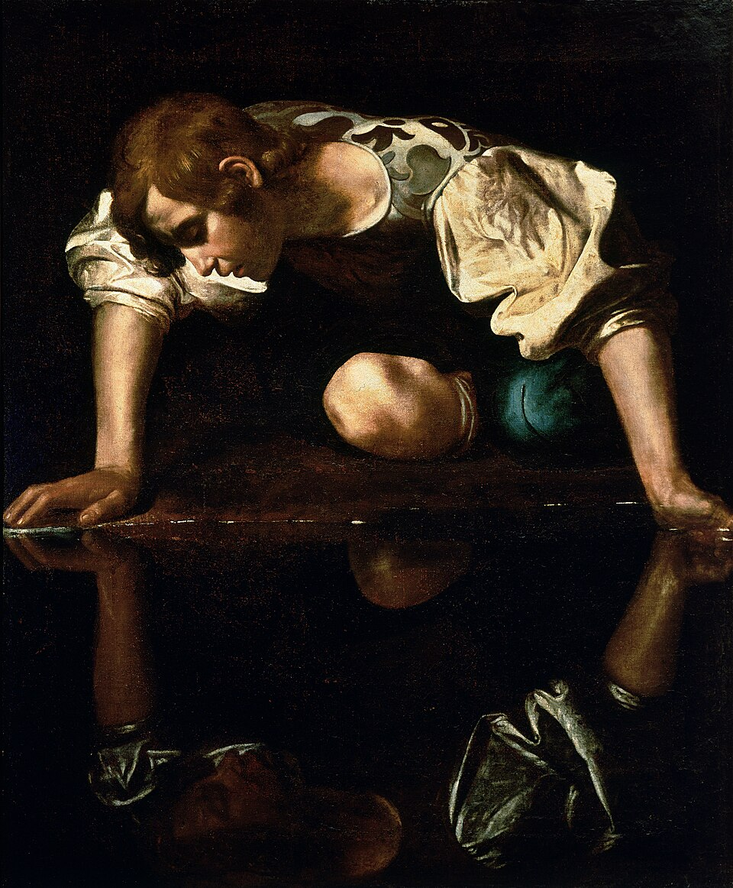
Narcissus
by Caravaggio

Slide 16
They pour out drink offerings to other gods to arouse my anger. But am I the one they are provoking? declares the Lord. Are they not rather harming themselves, to their own shame?
- JEREMIAH 7:18-19

Slide 17
Positioned in Trust
Shadrach, Meshach and Abednego replied to him, “King Nebuchadnezzar, we do not need to defend ourselves before you in this matter. If we are thrown into the blazing furnace, the God we serve is able to deliver us from it, and he will deliver us from Your Majesty’s hand. But even if he does not, we want you to know, Your Majesty, that we will not serve your gods or worship the image of gold you have set up.
- DANIEL 3:16-18

Slide 18
FOUNDATION OF FAITH
God is ABLE
God is WILLING
God is BETTER

Slide 19
I am the Lord your God, who brought you out of Egypt, out of the land of slavery. “You shall have no other gods before me. “You shall not make for yourself an image in the form of anything in heaven above or on the earth beneath or in the waters below. You shall not bow down to them or worship them.
- EXODUS 20:3-5

Slide 20
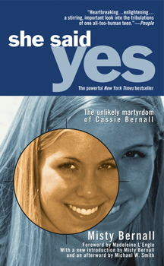

Slide 21
When God doesn’t want me to do something, I definitely know it. When he wants me to do something, even if it means going outside my comfort zone, I know that too. I feel pushed in the direction I need to go... I try to stand up for my faith at school... It can be discouraging, but it can also be rewarding… I will die for my God. I will die for my faith. It’s the least I can do for Christ dying for me.
- CASSIE BERNALL
She Said Yes: The Unlikely Martyrdom

Slide 22
Preservation through Presence
[The] three men, firmly tied, fell into the blazing furnace. Then King Nebuchadnezzar leaped to his feet in amazement and asked his advisers, “Weren’t there three men that we tied up and threw into the fire?” They replied, “Certainly, Your Majesty.” He said, “Look! I see four men walking around in the fire, unbound and unharmed, and the fourth looks like a son of the gods.”
- DANIEL 3:23-25

Slide 23
In times of affliction, we commonly meet with the sweetest experiences of the love of God.
- JOHN BUNYAN

Slide 24
When you pass through the waters, I will be with you; and when you pass through the rivers, they will not sweep over you. When you walk through the fire, you will not be burned; the flames will not set you ablaze. For I am the Lord your God.
- ISAIAH 43:2-3

Slide 25
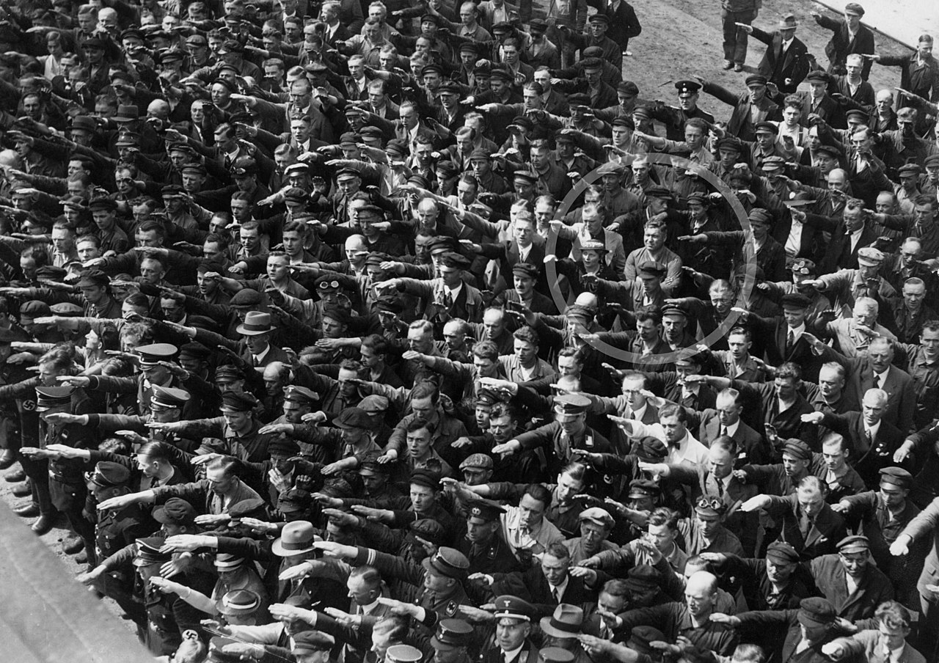

Slide 26

Whoever does not carry their cross (Gk. σταυρός) and follow me cannot be my disciple.
– LUKE 14:27
τ (tau)
ρ (rho)

