Slide 1

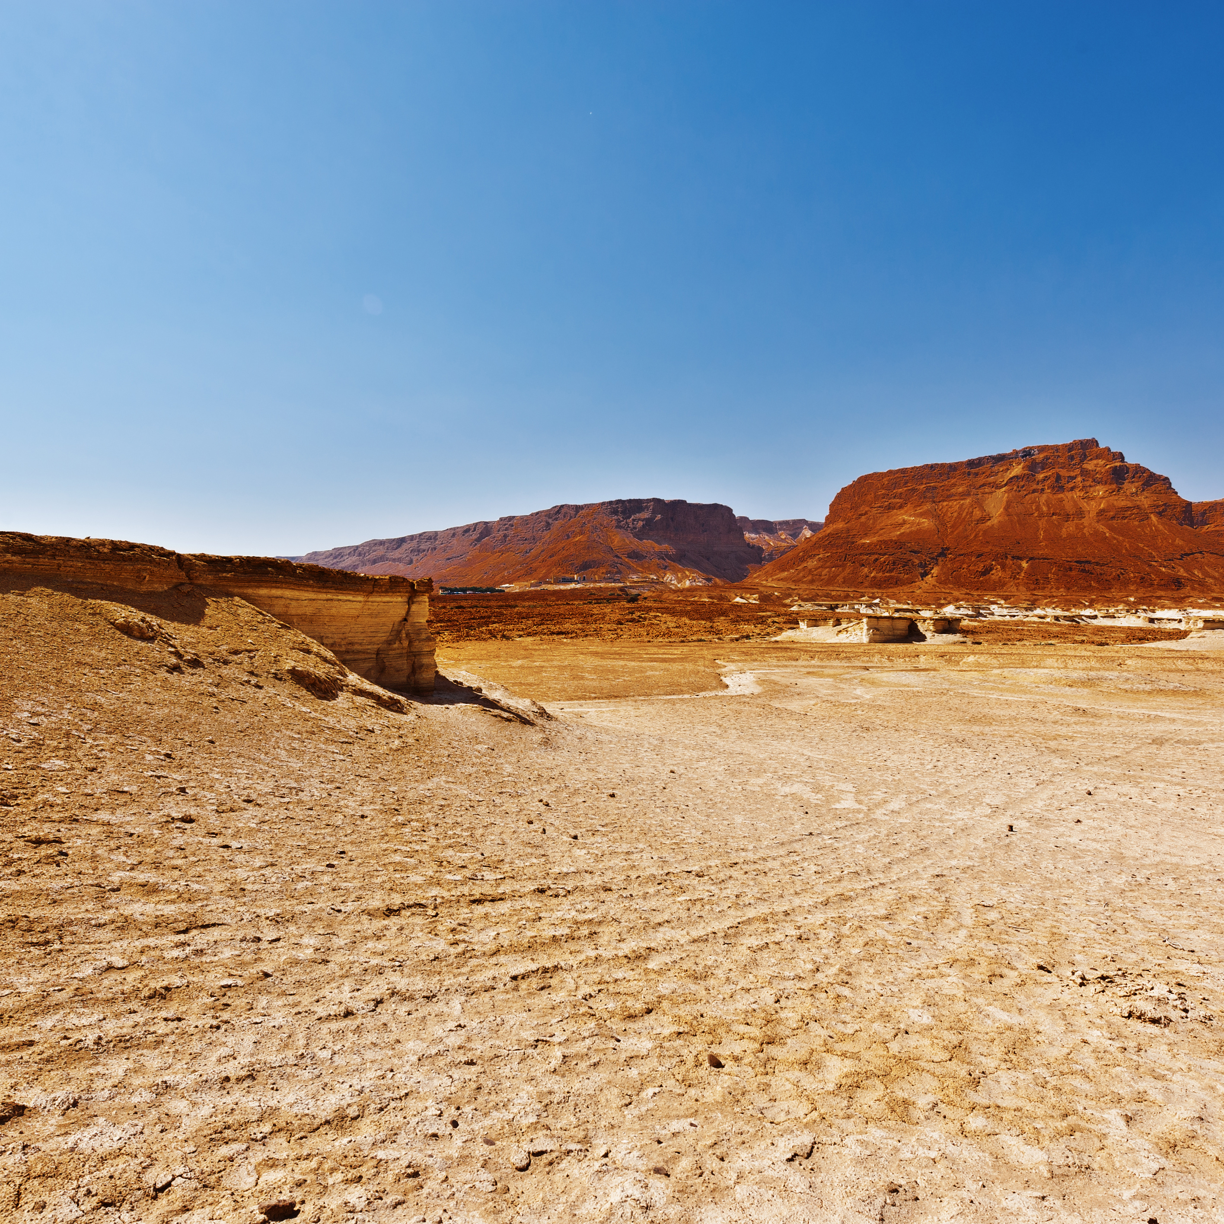

THE GOD
WHO SEES
10 MAY 2026

Slide 2
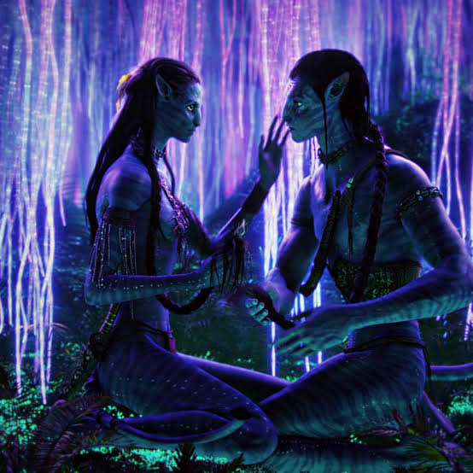

Slide 3


The One No One Sees

Slide 4

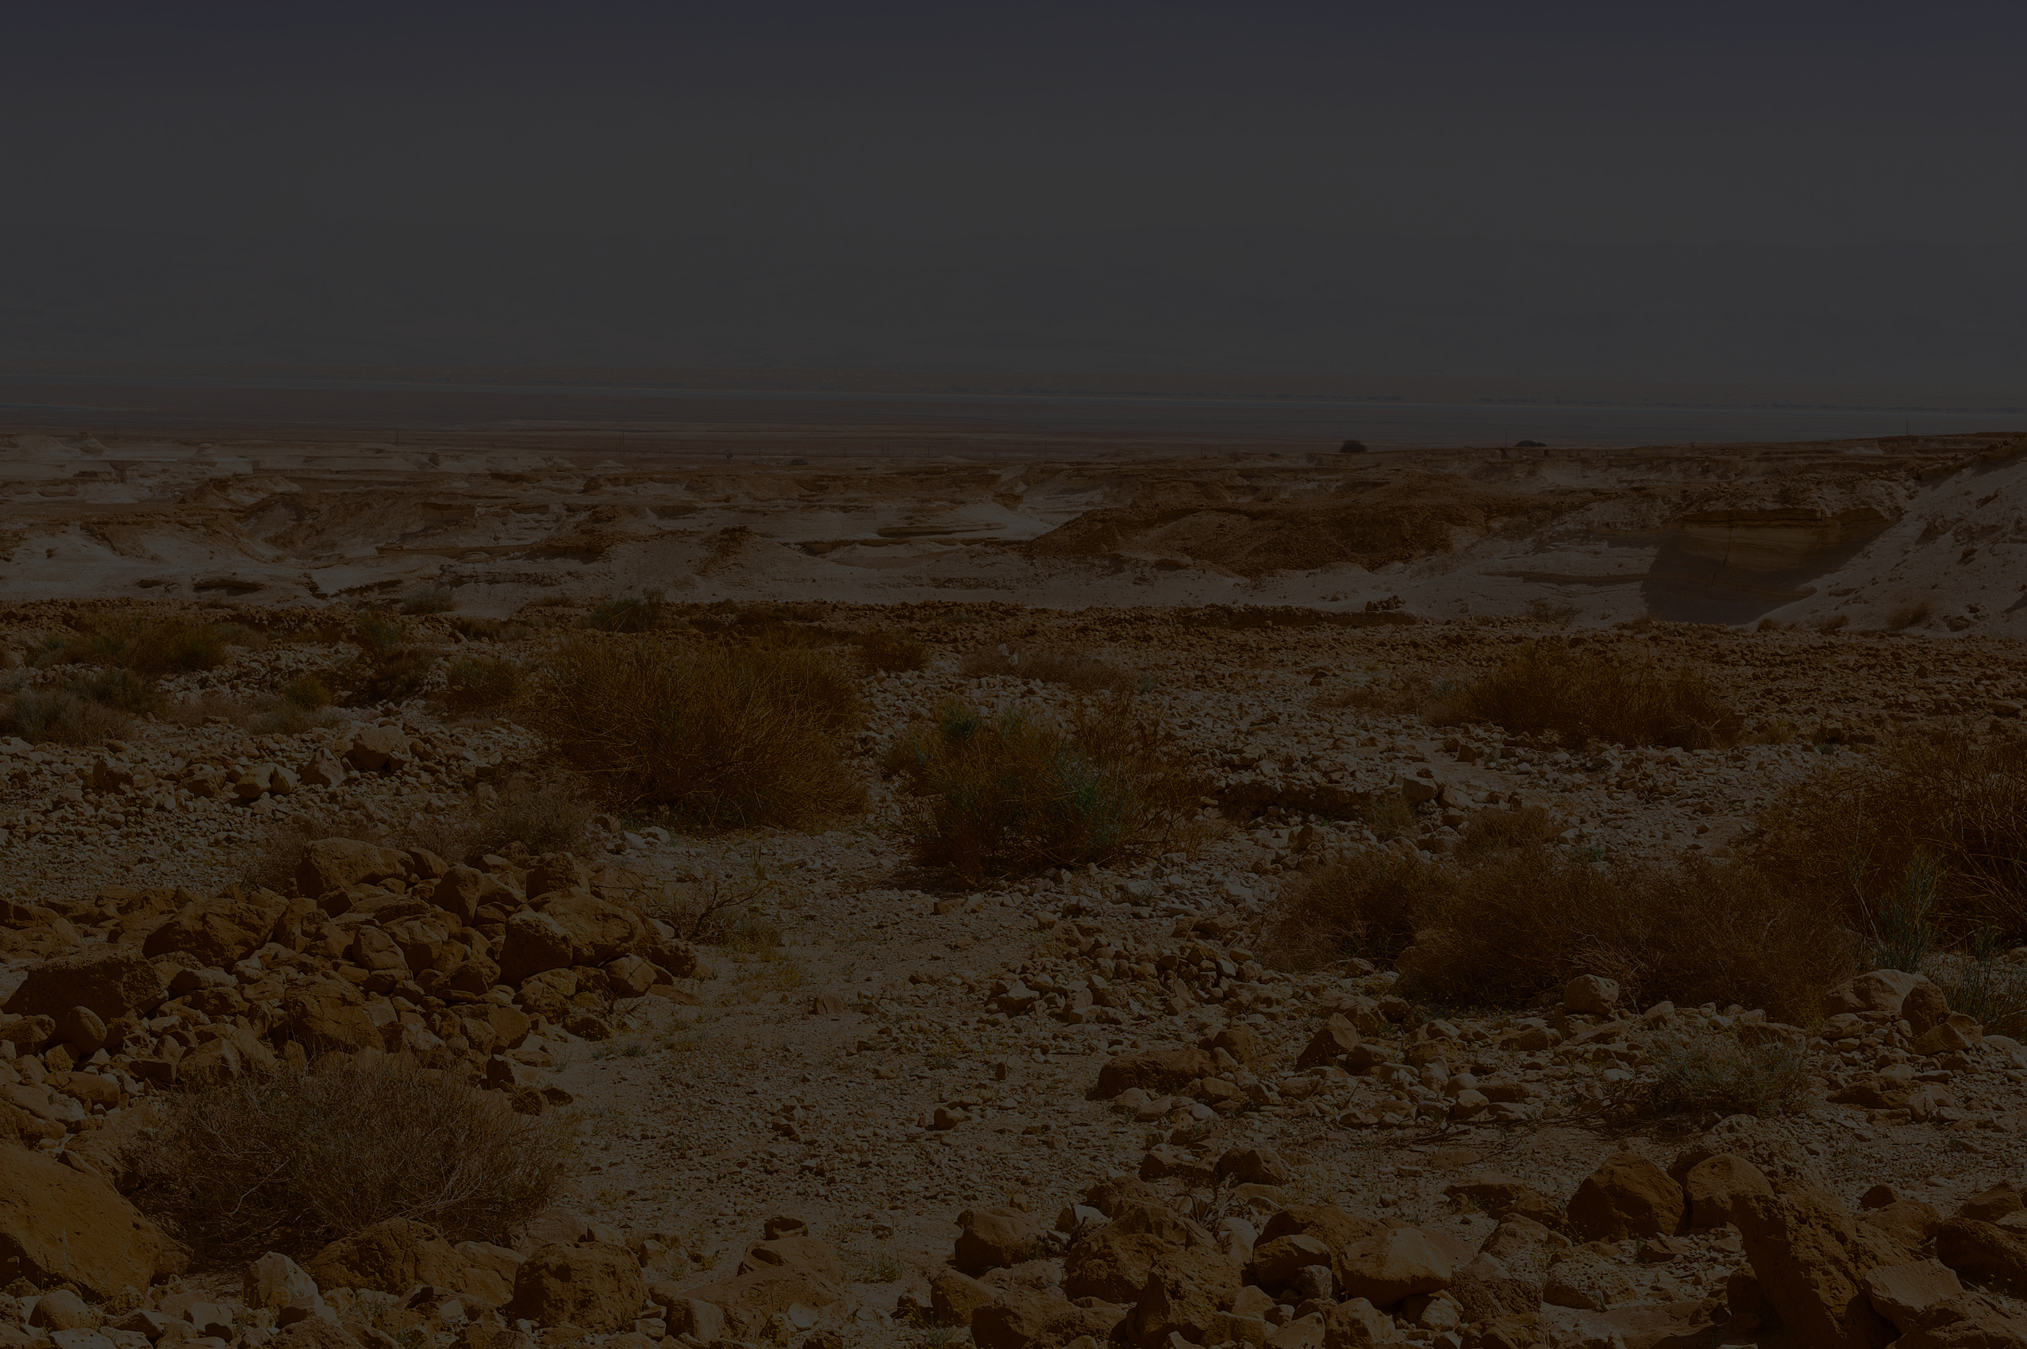
1 Now Sarai, Abram’s wife, had borne him no children. But she had an Egyptian slave named Hagar; 2 so she said to Abram, “The Lord has kept me from having children. Go, sleep with my slave; perhaps I can build a family through her.”
Genesis 16:1-8

Slide 5
Abram agreed to what Sarai said. 3 So after Abram had been living in Canaan ten years, Sarai his wife took her Egyptian slave Hagar and gave her to her husband to be his wife. 4 He slept with Hagar, and she conceived.
Genesis 16:1-8

Slide 6
When she knew she was pregnant, she began to despise her mistress. 5 Then Sarai said to Abram, “You are responsible for the wrong I am suffering. I put my slave in your arms, and now that she knows she is pregnant, she despises me. May the Lord judge between you and me.”
Genesis 16:1-8

Slide 7
6 “Your slave is in your hands,” Abram said. “Do with her whatever you think best.” Then Sarai mistreated Hagar; so she fled from her. 7The angel of the LORD found Hagar near a spring in the desert; it was the spring that is beside the road to Shur.
Genesis 16:1-8

Slide 8
8And he said, “Hagar, slave of Sarai, where have you come from, and where are you going?” “I’m running away from my mistress Sarai,” she answered.
Genesis 16:1-8

Slide 9
13 She gave this name to the Lord who spoke to her: “You are the God who sees me,” for she said, “I have now seen the One who sees me.” 14 That is why the well was called Beer Lahai Roi it is still there, between Kadesh and Bered.
Genesis 16:13-14

Slide 10
The One No One Sees
(Know Who You Are)

Slide 11
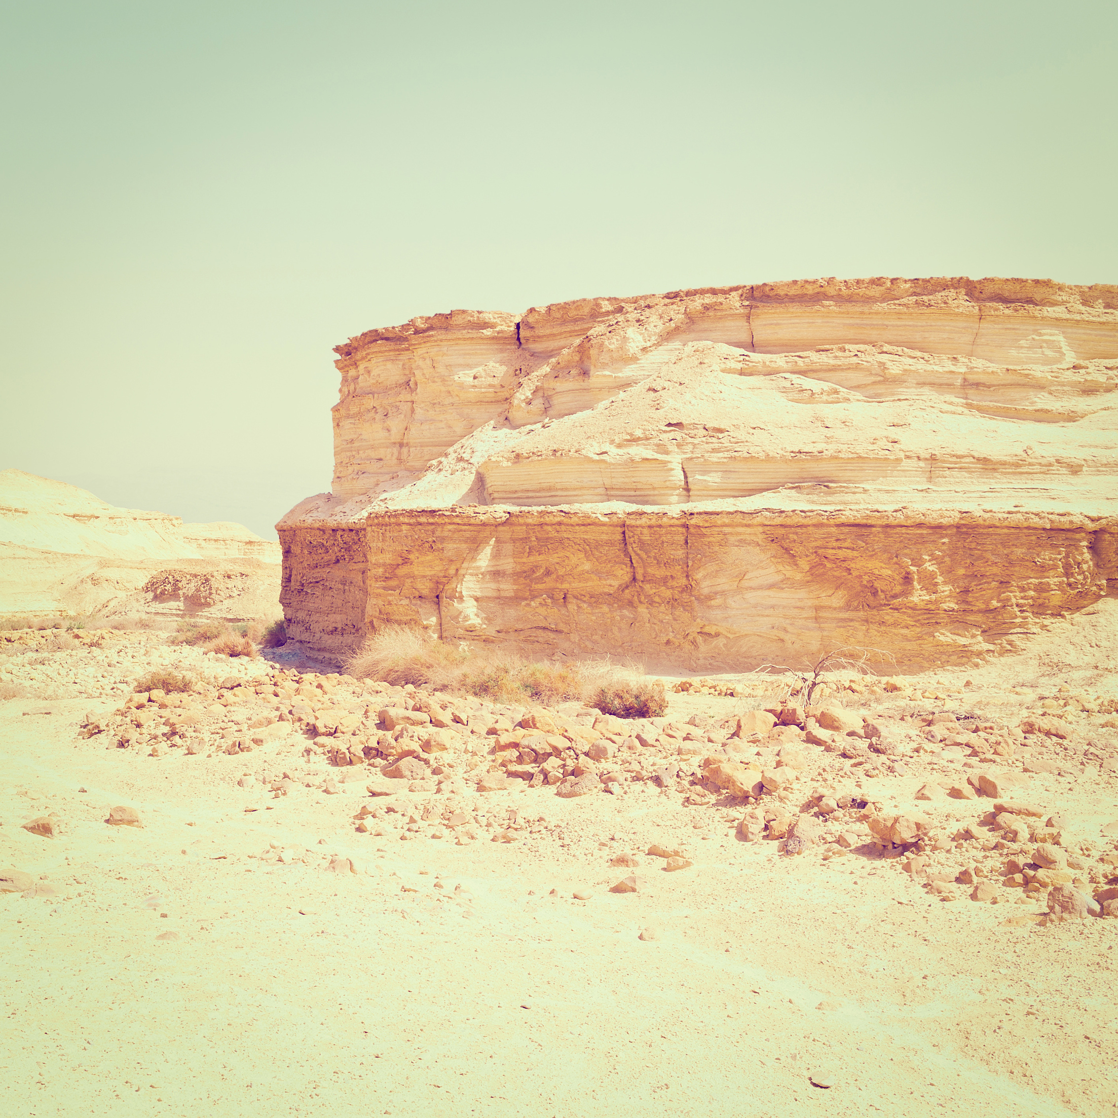
Your identity is not something your situation gives you...it’s something God speaks over you.
For even the Son of Man did not come to be served, but to serve, and to give his life as a ransom for many.

Slide 12


The God Who Draws Near
(Know Who Is With You)

Slide 13
i. The Angel of the LORD
For even the Son of Man did not come to be served, but to serve, and to give his life as a ransom for many.

Slide 14
For the Son of Man came to seek and to save the lost.
luke 19:10

Slide 15
ii. The Name - El Ro’i
For even the Son of Man did not come to be served, but to serve, and to give his life as a ransom for many.

Slide 16
The Lord is my shepherd.
YHWH Ro’i
For even the Son of Man did not come to be served, but to serve, and to give his life as a ransom for many.

Slide 17
14 “I am the good shepherd; I know my sheep and my sheep know me— 15 just as the Father knows me and I know the Father—and I lay down my life for the sheep.
John 10:14-15

Slide 18
iii. The Well
For even the Son of Man did not come to be served, but to serve, and to give his life as a ransom for many.

Slide 19
13 Jesus answered, “Everyone who drinks this water will be thirsty again, 14 but whoever drinks the water I give them will never thirst. Indeed, the water I give them will become in them a spring of water welling up to eternal life.”
john 4:13-14

Slide 20


The Way Through the Wilderness
(Know Where He Is Leading You)

Slide 21


Where have you come from...
Where are you going?

Slide 22
Jesus answered, “I am the way and the truth and the life...”
john 14:6

Slide 23
The destination was never a place you arrive at, but a Presence you abide in.
For even the Son of Man did not come to be served, but to serve, and to give his life as a ransom for many.

