Slide 1
Welcome to Holy Hermits Online Worship
Sixth Sunday in Easter
Today we are remembering
Holy Hermit St. Gregory the Illuminator
Service Prep: Kristine | Chat Host: Rachel | First Reader: Helen
Music: Wiggles 🐶 | Welcomer: Julie | Second Reader: Kieron
Proof-reader: Chris | Priest: N/A | Preacher: Lauren
Broadcaster: Barry | Deacon: Lauren | Fellowship: Julie
Backup Broadcaster: Kieron | Leader: Julie | Safety Officer: Rachel
Zoom Buttons: Rachel | Cantor: Roselyn | Attendance: Rachel

Slide 2






Hospitality
Leader:
Please mute for the service unless invited to offer your voice as part of the service ministry
Have the video camera on or off and turn the volume and brightness up or down on your device if things are too loud 🔉🔊or too bright🔅🔆
Our Cantor acts as our voice, offering the responses, in Bold Text, which we say together
Feel welcome to use the chat and reaction emojis 👍
🙏 Please take care of yourself in this space. 🙏 Come and go as you need
😴 It is great to take rest in this space, so falling asleep is also OK 😴
👂️ Remember, pastoral care is available to all in the community, if you'd like to speak to someone about anything spiritual. ❤️ Visit the help page at the website to reach out 🌐
Our Being Together ethos and safeguarding practices can also be accessed on the website 🫶​
🙌 Come as you are – we are all here together! 🙌

Slide 3
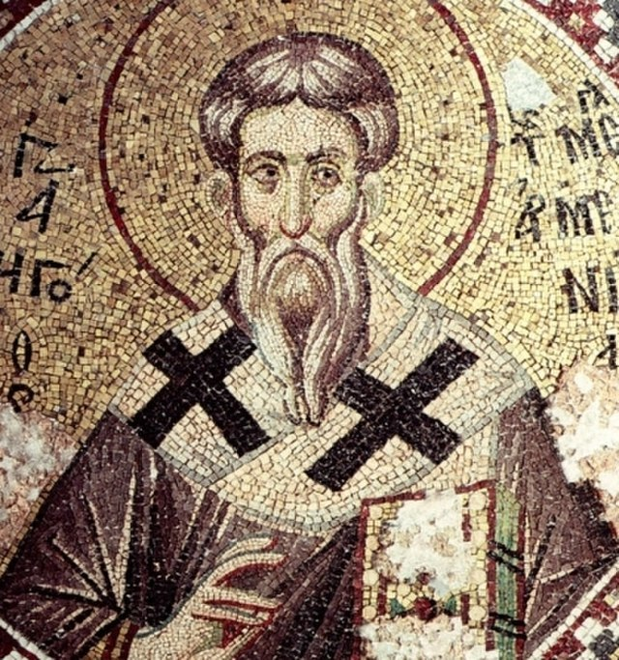
Leader: Our Holy Hermit today is St. Gregory the Illuminator
Gregory the Illuminator (c. 257 – c. 331) is the patron saint and first official head of the Armenian Church. He was a religious leader who converted Armenia from paganism to Christianity in 301. Equal of the Apostles and Enlightener of Armenia, was the religious leader credited with forging the Christian identity of Armenia.

Slide 4
Armenia became the first country to establish itself as a Christian nation, an event traditionally dated to 301, now believed by most scholars to have occurred somewhat later, though before 314.
To read more about our hermits click the link​​ in the send out

Slide 5
Invitation
Leader: As we come into worship let’s take a few deep breaths,
Let go of anything that isn’t serving us,
And become aware of God’s presence here with us.
Opening Music: https://www.youtube.com/watch?v=OqgEH2CjNNg

Slide 6
Leader and Cantor unmute
The Greeting
Leader: Christ has risen, Alleluia!
All: Christ is risen indeed, Alleluia!

Slide 7
Gathering Prayer
Leader: Shape us, Spirit of God, with your hope.
Faithful witnesses to God’s love.
Shape us, Spirit of God, with your hope.
Bold to proclaim God’s peace.
Shape us, Spirit of God, with your hope.
Ready to share your joy.
Notes:
Gathering prayer = Leader says the call to worship. Cantor says the gathering prayer from Roots.

Slide 8
Gathering Prayer
All: ​God of hope,
thank you for the hope given in Jesus.
Thank you for the hope inspired by the Spirit.
Thank you for the hope shared when your people gather.
Amen.
Notes:
Gathering prayer = Leader says the call to worship. Cantor says the gathering prayer from Roots.

Slide 9
Sentence
Leader: I invite our Cantor to proclaim the sentence for today.
Cantor: ‘Those who love me will keep my word,’ Jesus promises, ‘and my Father will love them, and we will come to them and make our home with them.’
John 14.23

Slide 10
Prayer of Approach
Leader: We pray the prayer of approach together
All: Lord God, in our daily lives,
we see so many people hurting and living in fear.
We gather here now, not in a spirit of fear
but ready to revere you as our Lord.
Mighty God, may we be always open
to your marvellous hope,
ready to share it wherever we go.
May our lives imitate you,
always aware of your life-changing power.
Amen.

Slide 11
The Gloria​
(to be sung every Sunday during the Season of Easter)
Leader: We now sing the Gloria together
https://www.youtube.com/watch?v=vexqIzvkMT4
Leader Mutes

Slide 12
Collect
Leader: O God, you have prepared for those who love you
joys beyond our understanding:
pour into our hearts such love for you,
that, loving you above all else,
we may obtain your promises that exceed all we can desire;
through Jesus Christ our Lord,
who is alive and reigns with you and the Holy Spirit,
one God, for ever and ever. Amen.

Slide 13
The 1st reader unmutes
Leader: I invite the 1st reader to unmute and offer the 1st lesson when ready.
Reader 1: The 1st Reading is from Acts 17.22-33
²² Then Paul stood in front of the Areopagus and said, ‘Athenians, I see how extremely religious you are in every way. ²³ For as I went through the city and looked carefully at the objects of your worship, I found among them an altar with the inscription, “To an unknown god.” What therefore you worship as unknown, this I proclaim to you. ²⁴ The God who made the world and everything in it,
Continue…

Slide 14
he who is Lord of heaven and earth, does not live in shrines made by human hands, ²⁵ nor is he served by human hands, as though he needed anything, since he himself gives to all mortals life and breath and all things. ²⁶ From one ancestor he made all nations to inhabit the whole earth, and he allotted the times of their existence and the boundaries of the places where they would live,
²⁷ so that they would search for God and perhaps grope for him and find him—though indeed he is not far from each one of us. ²⁸ For “In him we live and move and have our being”; as even some of your own poets have said, “For we too are his offspring.”
Continue…

Slide 15
²⁹ Since we are God’s offspring, we ought not to think that the deity is like gold, or silver, or stone, an image formed by the art and imagination of mortals.
³⁰ While God has overlooked the times of human ignorance, now he commands all people everywhere to repent, ³¹ because he has fixed a day on which he will have the world judged in righteousness by a man whom he has appointed, and of this he has given assurance to all by raising him from the dead.’
For the word of the Lord. Thanks be to God.​

Slide 16
Leader: We now say the psalm antiphonally, I invite the first reader to lead, and we will all respond with our cantor as our voice.
Psalm 66:
7-19
⁷ O bless our God, you peoples:
and cause his praises to resound,
⁸ Who has held our souls in life:
who has not suffered our feet to slip.
⁹ For you have proved us, O God:
you have tried us as silver is tried.
Continue…

Slide 17
¹⁰ You brought us into the net:
you laid sharp torment on our loins.
¹¹ You let our enemies ride over our heads,
we went through fire and water:
but you brought us out into a place of liberty.
¹² I will come into your house with burnt-offerings:
and I will pay you my vows,
¹³ The vows that opened my lips:
that my mouth uttered when I was in trouble.
Continue…

Slide 18
¹⁴ I will offer you burnt-offerings of fattened beasts,
with the sweet smoke of rams:
I will sacrifice a bull and the flesh of goats.
¹⁵ Come then and hear, all you that fear God:
and I will tell what he has done for me.
¹⁶ I called to him with my mouth:
and his praise was on my tongue.
¹⁷ If I had cherished wickedness in my heart:
the Lord would not have heard me.
Continue…

Slide 19
¹⁸ But God has heard me:
he has heeded the voice of my prayer.
¹⁹ Praise be to God:
who has not turned back my prayer,
or his steadfast love from me.

Slide 20
The 2nd reader unmutes
Leader: Thank you, I invite the 2nd reader to unmute and offer the 2nd lesson when ready.
Reader 2: The 2nd Reading is from 1 Peter 3:8
⁸ Finally, all of you, have unity of spirit, sympathy, love for one another, a tender heart, and a humble mind. ⁹ Do not repay evil for evil or abuse for abuse; but, on the contrary, repay with a blessing. It is for this that you were called—that you might inherit a blessing.
Continue…

Slide 21
¹⁰ For
‘Those who desire life
and desire to see good days,
let them keep their tongues from evil
and their lips from speaking deceit;
¹¹ let them turn away from evil and do good;
let them seek peace and pursue it.
¹² For the eyes of the Lord are on the righteous,
and his ears are open to their prayer.
But the face of the Lord is against those who do evil.’
Continue…

Slide 22
¹³ Now who will harm you if you are eager to do what is good?
¹⁴ But even if you do suffer for doing what is right, you are blessed. Do not fear what they fear, and do not be intimidated, ¹⁵ but in your hearts sanctify Christ as Lord. Always be ready to make your defence to anyone who demands from you an account of the hope that is in you; ¹⁶ yet do it with gentleness and reverence. Keep your conscience clear, so that, when you are maligned, those who abuse you for your good conduct in Christ may be put to shame. ¹⁷ For it is better to suffer for doing good, if suffering should be God’s will, than to suffer for doing evil.
Continue…

Slide 23
¹⁸ For Christ also suffered for sins once for all, the righteous for the unrighteous, in order to bring you to God. He was put to death in the flesh, but made alive in the spirit, ¹⁹ in which also he went and made a proclamation to the spirits in prison, ²⁰ who in former times did not obey, when God waited patiently in the days of Noah, during the building of the ark, in which a few, that is, eight people, were saved through water.
Continue…

Slide 24
²¹ And baptism, which this prefigured, now saves you—not as a removal of dirt from the body, but as an appeal to God for a good conscience, through the resurrection of Jesus Christ, ²² who has gone into heaven and is at the right hand of God, with angels, authorities, and powers made subject to him.
For the word of the Lord. Thanks be to God.​

Slide 25
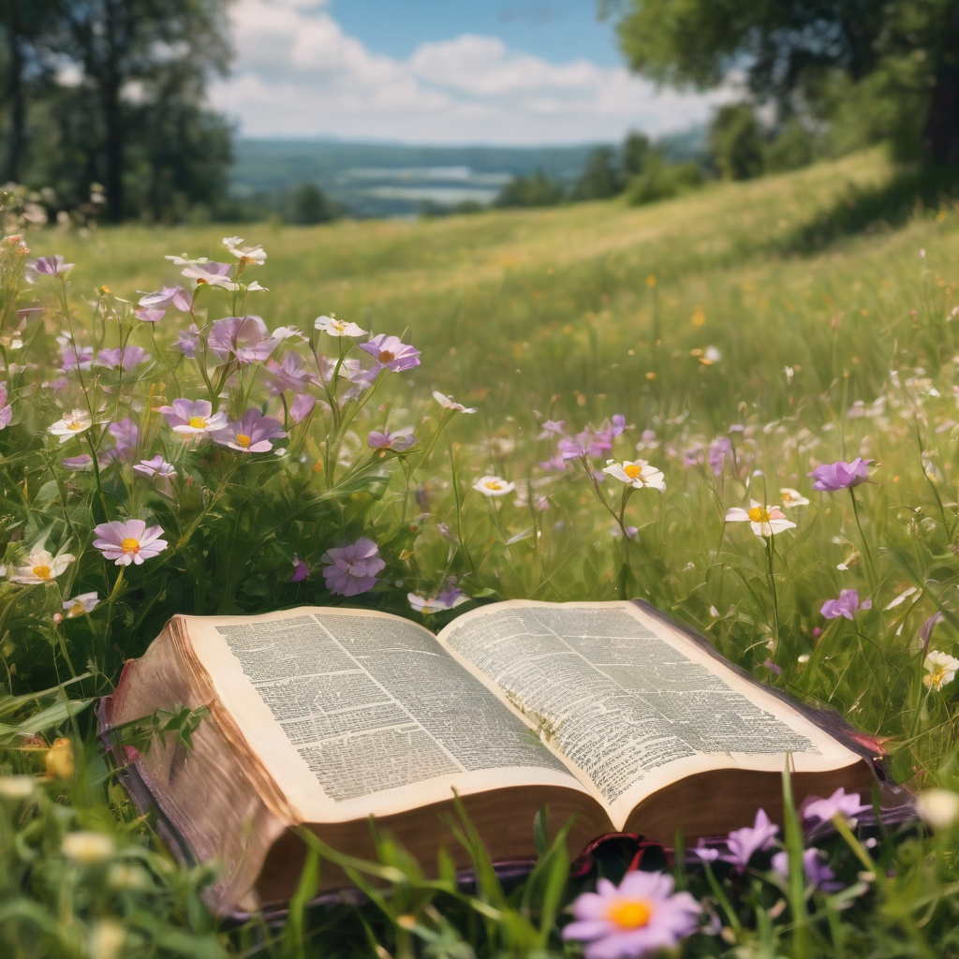
We pause before
​the Gospel ​​

Slide 26
Deacon: The Gospel of our Lord Jesus Christ according to St John Chapter 14 beginning at the 15th verse
All: Glory to you Lord Jesus Christ.
¹⁵ ‘If you love me, you will keep my commandments. ¹⁶ And I will ask the Father, and he will give you another Advocate, to be with you for ever. ¹⁷ This is the Spirit of truth, whom the world cannot receive, because it neither sees him nor knows him. You know him, because he abides with you, and he will be in you. ¹⁸ ‘I will not leave you orphaned; I am coming to you. .’
This is the Gospel of the Lord. Praise to you Lord Jesus Christ.
Continue…

Slide 27
¹⁹ In a little while the world will no longer see me, but you will see me; because I live, you also will live. ²⁰ On that day you will know that I am in my Father, and you in me, and I in you. ²¹ They who have my commandments and keep them are those who love me; and those who love me will be loved by my Father, and I will love them and reveal myself to them.’
This is the Gospel of the Lord. Praise to you Lord Jesus Christ.

Slide 28
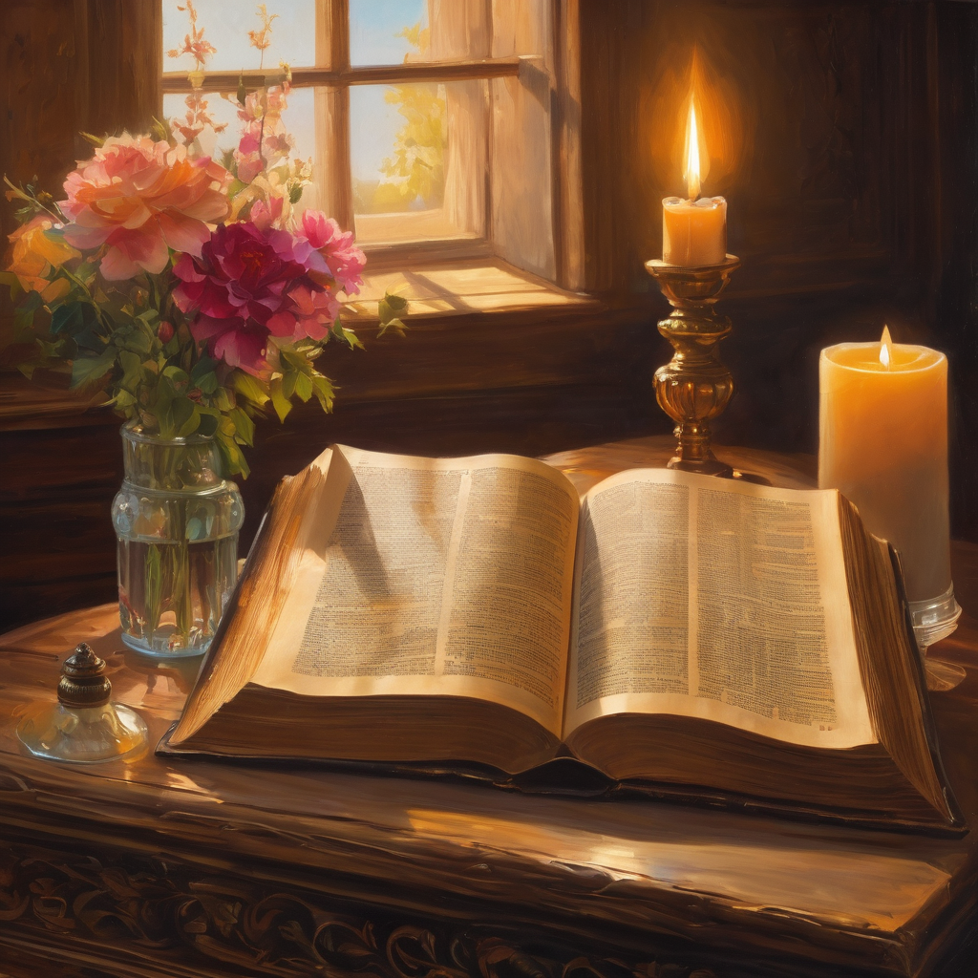
We pause
after ​the Gospel ​​

Slide 29
Leader: The Sermon is recorded to YouTube for sharing later.
Only the preacher's video and audio will be recorded.
The chat and other participants' feeds remain out of sight of the recording.
Leader and Cantor mute
Broadcaster exits screenshare
Preacher unmutes
Zoom buttons ”pins” preacher’s screen + selects “record to the cloud”
Sermon

Slide 30
Leader unmutes
Our next Hymn
The Greatest Commands
https://www.youtube.com/watch?v=TEiTobGdGcI
We stay on mute
Leader mutes

Slide 31
The Leader and Cantor unmute
The Greeting of Peace
Leader: We are the body of Christ
All: God’s Spirit is with us
Leader: The peace of the Lord be always with you.
All: And also with you.
Leader: A sign of peace may be exchanged
You may like to type 'Peace' into the chat, use the 'raise hand’ or other reaction buttons, or just simply wave via the screen with your video turned on
(Broadcaster exits shared screen for a few moments for the exchange of peace)

Slide 32
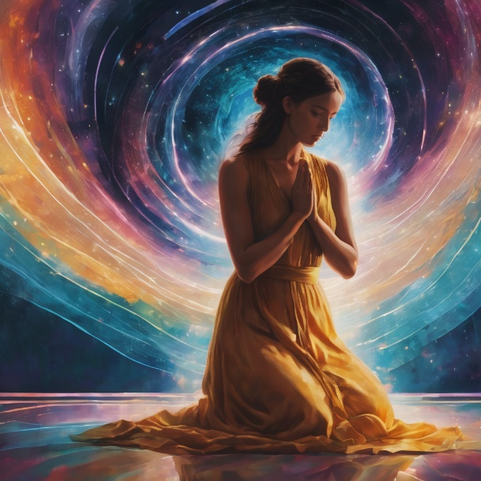
Prayer of Thanksgiving before Intercessions
Leader: As we enter prayer, I invite the second reader to unmute to lead our intercessions following the prayer of thanksgiving on the following slide. Please feel free to change your body position as you need.
Continue…

Slide 33
Prayer of Thanksgiving before Intercessions
Leader:
God of all hope, may we continue to praise you.
We go into a new week with your hope in our hearts.
We praise you for all the chances
there will be to share that hope with others.
We ask you to keep our eyes firmly fixed on you.
Amen.

Slide 34
Intercessions
Reader 2: We pray for creation and communities we share our lives with. We pause for a few moments to name either in our hearts, or out loud, or in the chat, those environments and communities we bring to the Lord in prayer.
PAUSE…
Continue…

Slide 35
Intercessions
Reader 2: We entrust to you the community of Holy Hermits Online and our ministry partners:
Prosper the work of our hands and show us the way to your new creation.
Creator God, Hear our prayer.
St John's Cathedral Brisbane The Anglican Diocese of Southern Queensland St Gabriel’s, Carindale Benedictus Contemplative Church, Canberra Anglican Focus and Tithe.ly

Slide 36
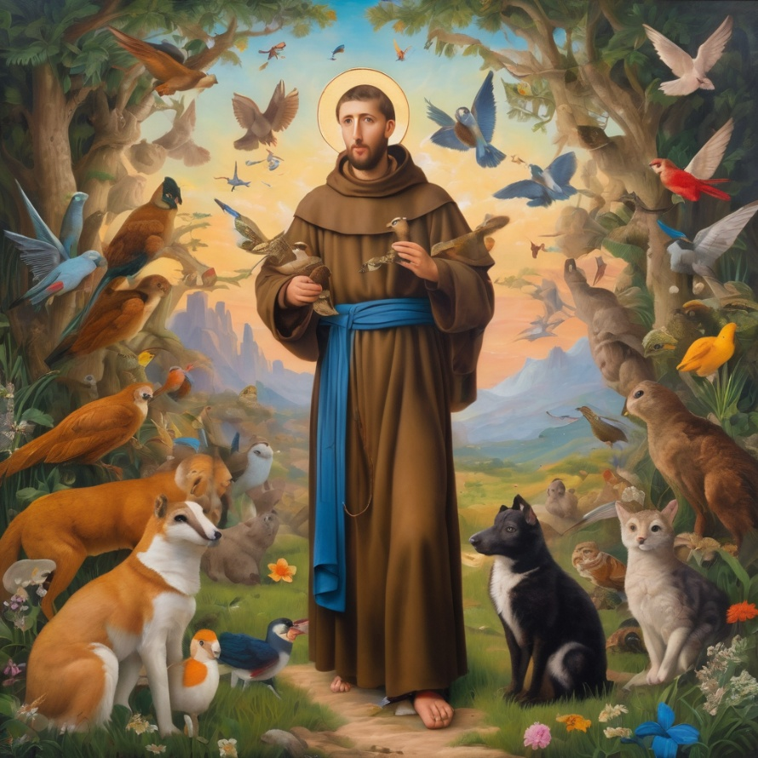
Reader 2: Loving Creator, we entrust to you all animals, especially those who are sick, anxious, ageing, lost, at risk, lonely, sad, hungry, in pain, homeless, abused, living in fear, encountering violence of any kind, in need of comfort, rehabilitation or transformation.
Continue…

Slide 37
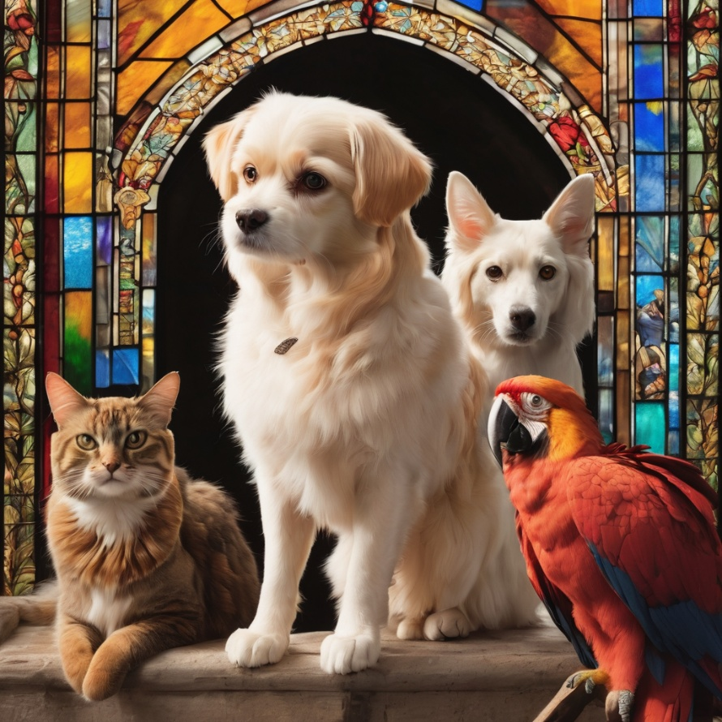
Reader 2: We invite your loving compassion for:
We name in our hearts, out loud or in the chat,
the animals we bring to the Lord in prayer. PAUSE…
Jasmine, ​
Leese(y), ​
Sid, Toots & Lulu​
Polly and Suki​
Fred, George & Percy​
Koshka ​
Jax
Lambert ​​
Kala, Nigel & Little One ​​
Toby​​
Taco​​
Paddy ​​
Rosie​

Slide 38
Reader 2: Eternal Trinity of Love, we uphold to you the people we love and carry cares for:
Kerry, Les & Jake Julie, Ray, Tracey & Shane Mark, Desley & Bob ​​ Rachel, Mervyn & Gillian ​​Rev'd Shane & Janette​​ Alecia, Martin & Aidan​​ Steven & Vanessa Tina | Barry​​ Dr Julie ​​ Ruth​​ Phil​ May Susan Tanya​ Craig Neva​ | Bill & Marjorie​​ Aaron & Andrea Dilys & Tony, Paul & Darhon Judy & Mary​​ Bob & Di​ Pat & Julie Miriam Gayanne | Kirsten, Greg, Daphne & Beau Alan & Gaylene​ Jess & Leah ​​ Bonnie & girls Liz’s Godchildren Barry & Gwen Matthew & Nicholas​ Kathy
Continue…

Slide 39
Reader 2:
We name in our hearts, out loud or in the chat, those we bring to the Lord in prayer.
PAUSE…
We entrust to you those who have died, those who have died peacefully and those who have died tragically, The old and the young. Receive them into your Kingdom. Lord in your mercy, Hear our prayers. Amen.

Slide 40
Pray Daily Cycle of Prayer
Leader: Loving God, joining with the Church in our cycle of prayer, we ask your blessings on:
The Church of Pakistan (United)
Ministry to the Defence Force: †Grant; Chaplains & Members of the Defence Force
The Parish of East Redland: Cameron, Shan, Aubrey, Allan, Bill, George, Peter, Bruce, David, Clive, Neville, David, Susan, Kate
Diocesan Council
St Andrew’s Anglican College, Peregian Springs: Principal – Karen; Chaplain - Gary; Chair of College Council - Rosalyn; members of College Council; staff & students

Slide 41
Commitment prayer for the week: Companion Animal
God, we give thanks for your call to develop a Companion Animal Ministry at Holy Hermits Online.
We ask for your grace to guide us, as we build this ministry together.
Holy Spirit we ask your presence to be with us as we continue to develop resources together in this new season.
Provide us with wisdom and with compassion and with a sense of fun as we celebrate our companion animals and live this mission to outreach.
Alongside Holy Hermit St. Francis, we ask you Lord Jesus Christ, to enliven us in this ministry space.
Amen .
Notes:
Link to prayer group ministry page for weekly commitment prayer https://holyhermits.com.au/ministries/prayer-group

Slide 42
Leader: Let us pray together the prayer which Jesus gave us saying:
All: Our Father in heaven, hallowed be your name,
your kingdom come, your will be done, on earth as in heaven.
Give us today our daily bread.
Forgive us our sins
as we forgive those who sin against us.
Save us from the time of trial and deliver us from evil.
For the kingdom, the power, and the glory are yours
now and for ever.
Amen.

Slide 43
Devotions

Slide 44
Hermit Wisdom
A prayer inspired by St Gregory the Illuminator
Loving God we give you thanks for your servant Gregory, who models for us what it means to pray for our enemies or those who persecute us. Thank you for healing King Tiridates III and giving him the influence of Gregory who had been his prisoner, by which he transformed the nation of Armenia from pagan to Christian. May we too be inspired to rest on you in prayer whenever we face turmoil or opposition in our lives. In the name of Christ, we pray. Amen.

Slide 45
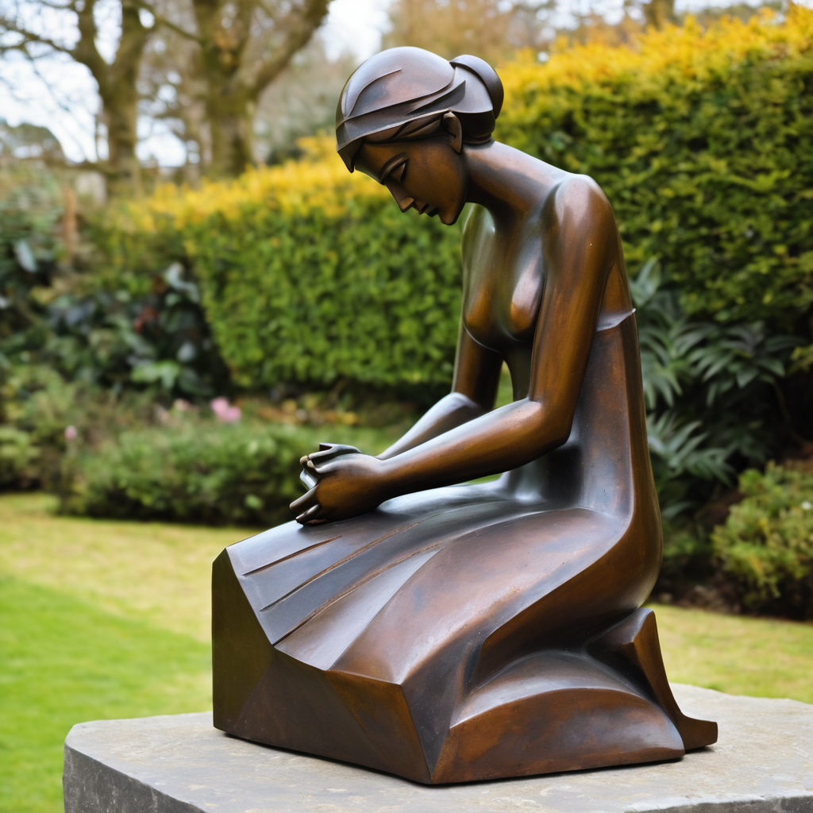
Leader: ​As we enter a few minutes of silence together, you are invited to pray this prayer of adoration on the next slide and/or spend this time in contemplation. ​
This is then followed by the Spiritual Communion prayer.
Let us be still.
Leader and Cantor Mute.
​
Continue…

Slide 46
‘We are saved by the resurrection of our Lord Jesus Christ,
who has gone into heaven and is at God’s right hand –
with angels, authorities and powers in submission to him.’
Amen.
(1 Peter 3:21,22)
​

Slide 47
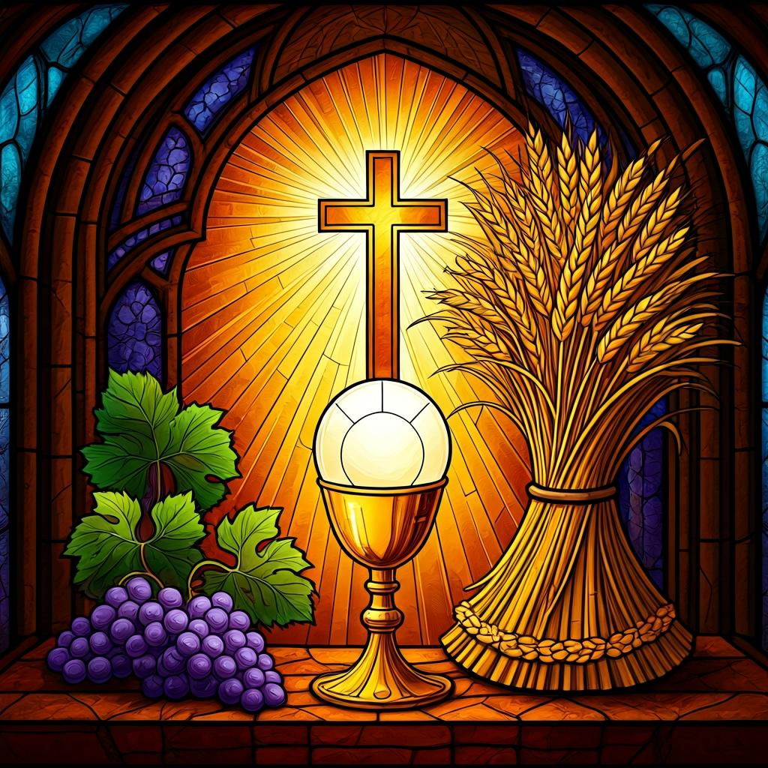
Oh, my Lord Jesus I turn to you present at the Altar and in the Tabernacle. I believe that you are present in the Holy Sacrament of your most Sacred Body and Blood. I love you above all things and I desire to receive you into my Soul. I cannot at this moment receive you Sacramentally in Holy Communion. Come spiritually into my heart. Purify it, Sanctify it. Render my heart like your own heart. I embrace you as if you were already there and unite myself wholly with you. Never permit me to be separated from you. Lord, I am not worthy to receive you, but only say the word and I shall be healed. Amen
Making a
Spiritual Communion
(Prayed in silence)

Slide 48
Leader unmutes
Our final song is
If you love me
https://www.youtube.com/watch?v=pLTIW11ohcA
​We stay on mute
Leader and Cantor mute

Slide 49
Leader and cantor unmute
Sending Prayer
Leader: We pray our sending prayer together.
All: When we are troubled... God is our hope.
When our faith is challenged… God is our hope.
When life is tough… God is our hope.
Let us go share God’s love in the world because…
God is our hope.
Amen.

Slide 50
The Benediction
Leader: Let us all invite God’s blessings together,
All:
As we leave, leave with us, Lord,
walk with us always.
Be there as we share bread
and help us to share with others in need.
Amen.

Slide 51
Notices
Today is our first 2nd Sunday Saint Spotlight. If you would like to volunteer for June please contact Rev’d Lauren.
Today is our Open Space @ 11am – all are welcome.
Companion Animal Service this Thursday @ 6pm
Next Sunday is our Companion Animal Workshop @ 11am
Wednesday night study recommences May 27th with Embracing The Divine Flow. See send out for more information.
See HHO Events page for further upcoming events HHO Events

Slide 52
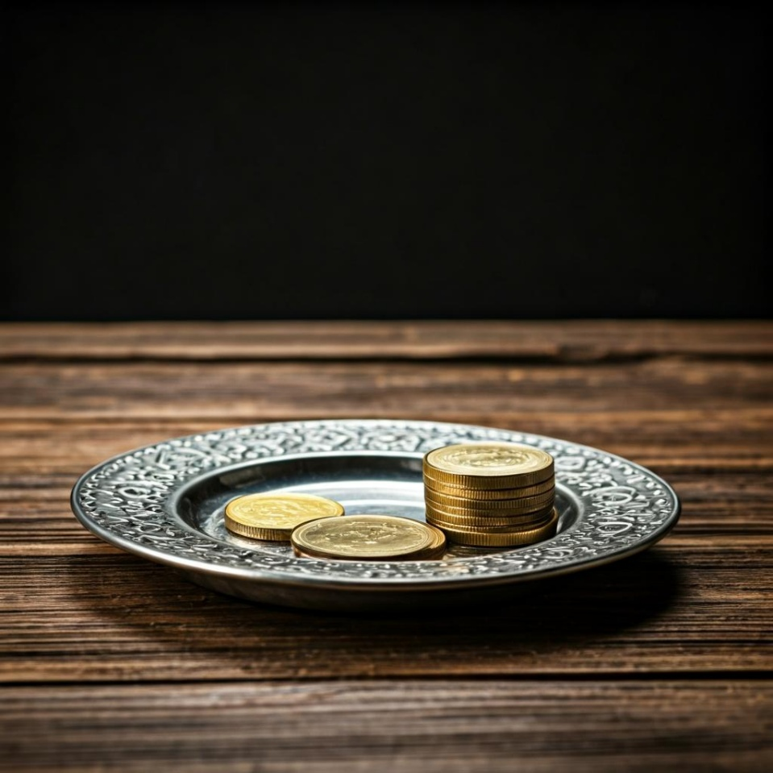
Leader: Thank you for your regular gifts to this ministry. Offerings are most welcome via:
The HHO App
Direct Debit
International Direct Debit
Please consider a one-off donation
or leaving a legacy in your Will
For further information go to HHO give page
https://holyhermits.com.au/give

Slide 53
Serving next week
17 May 2026
7th Sunday of Easter
9:00 am AEST
Service Prep: Paul | Chat Host: Viki | First Reader: Margo
Music: Paul | Welcomer: Chris | Second Reader: Roselyn
Proof-reader: Kris | Priest: N/A | Preacher: Lauren
Broadcaster: Paul | Deacon: Lauren | Fellowship: Rachel
Backup Broadcaster: Lauren | Leader: Jeremy | Safety Officer: Chris
Zoom Buttons: Barry | Cantor: Vanessa | Attendance: Rachel
Thank you for your ministry gifts
New Servers always welcome!
Please email Rev’d Lauren to get involved
holyhermits@anglicanchurchsq.org.au

Slide 54
The Dismissal
Leader: I invite everyone to unmute for the Dismissal
Leader: Go in peace to love and serve the Lord.
All: In the name of Christ, Amen.

Slide 55
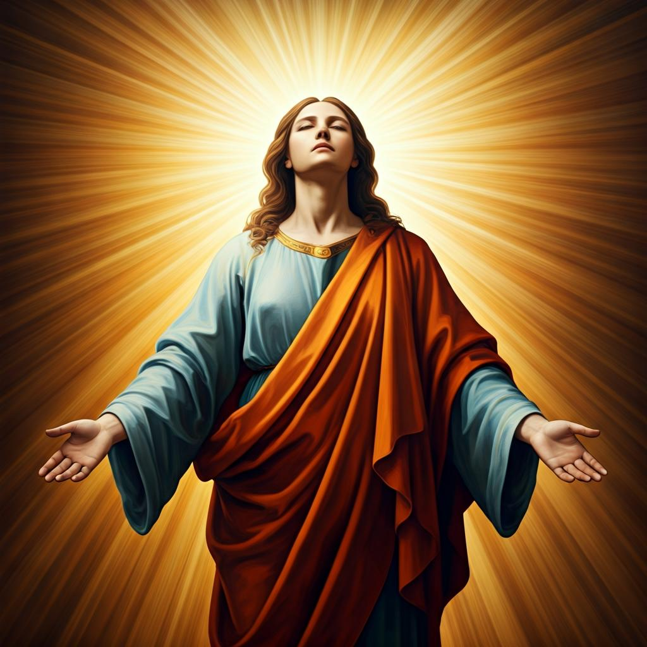
Fellowship time
Thank you, Julie for leading Fellowship and Saint Spotlight
Please feel welcome to linger or pop a message in the chat and head off when you are ready.​
Extra resources developed
by Roots on the Web
Artwork created on Padlet

