Slide 1


Slide 2
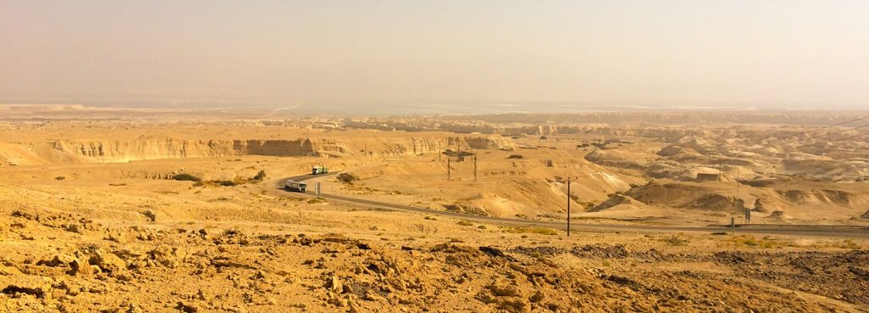
Modern Day
Valley of Siddim

Slide 3
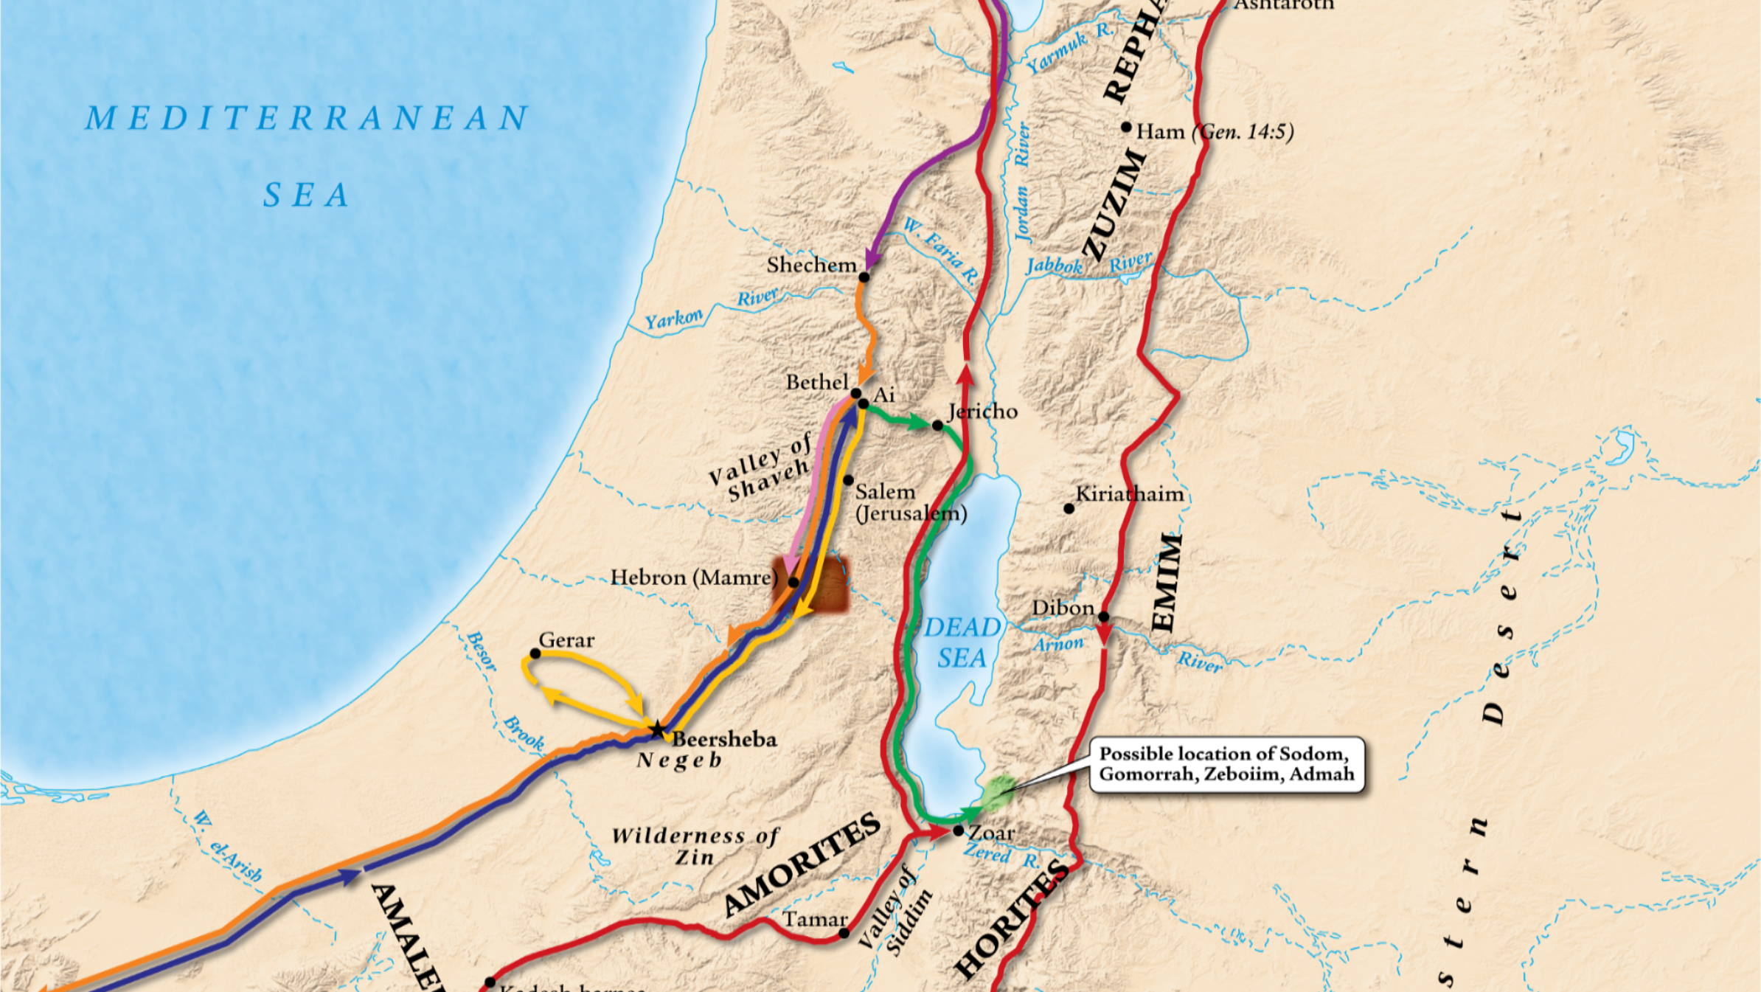

Slide 4
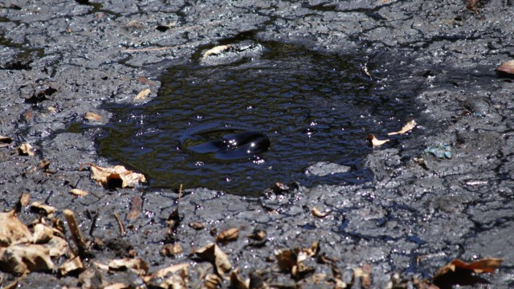
Example of Bitumen Pit

Slide 5
Instead of running towards God, Lot was running after the passions of the world.

Slide 6
We cannot leave the space God has called us to be to satisfy our worldly cravings and still expect to benefits of the faithful.

Slide 7
No matter how far we might wander God’s love for us never changes.

Slide 8
Selfless love for one another is a sign of a mature faith!

Slide 9
Abram’s victory had nothing to with his ability and everything to do the divine will of God.

Slide 10
A tithe is to be given:
Freely
Generously
Cheerfully
As an act of worship

Slide 11
The enemy's mission is to keep God’s people from gaining more people.

Slide 12
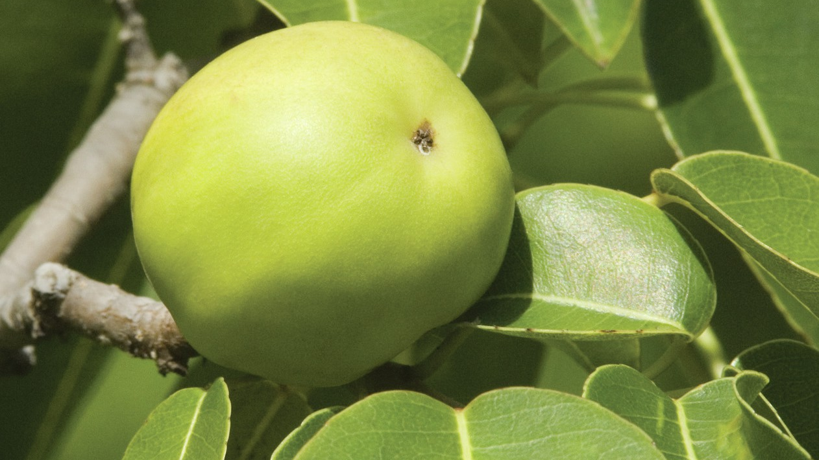
“Death Apple”

Slide 13
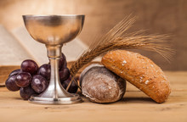
Communion

