Slide 1

A Clash of Kingdoms
Michael Christie

Slide 2




Slide 3
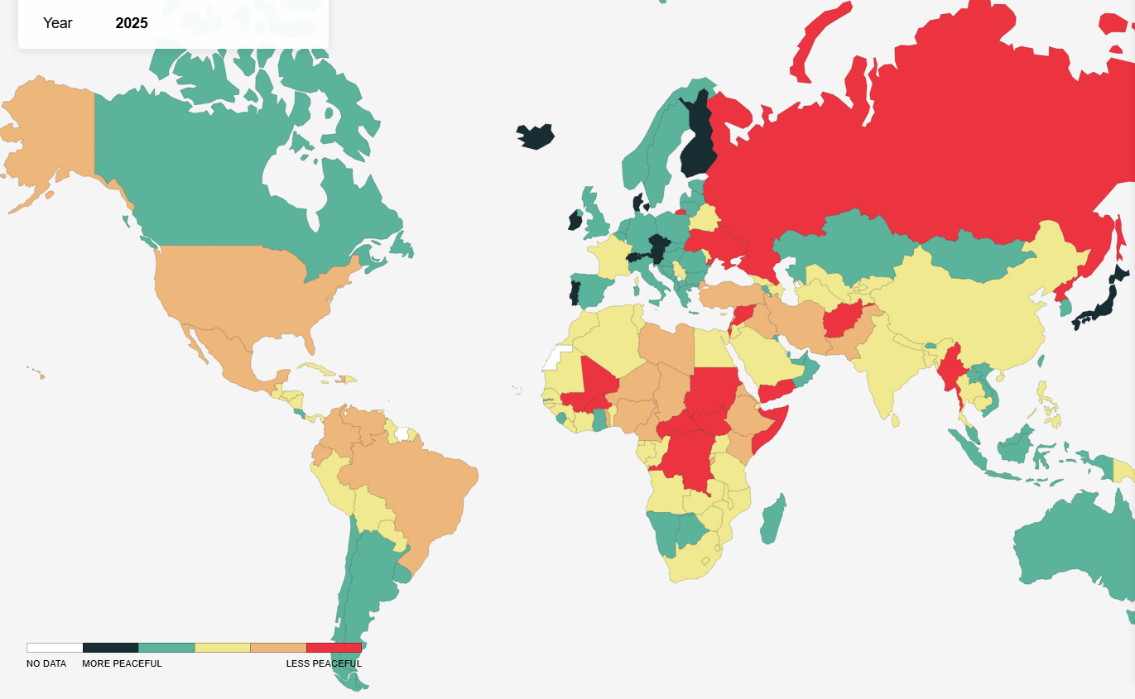
GLOBAL PEACE MAP
https://www.visionofhumanity.org/maps

Slide 4
I could not be more optimistic than I am, because my hope is in Jesus Christ alone. Just think if the apostolic church had pinned its hope on the Roman Empire!
- MALCOM MUGGERIDGE

Slide 5
DANIEL 2:24-49
²⁶ The king asked Daniel (also called Belteshazzar), “Are you able to tell me what I saw in my dream and interpret it?” ²⁷ Daniel replied, “No wise man, enchanter, magician or diviner can explain to the king the mystery he has asked about, ²⁸ but there is a God in heaven who reveals mysteries.

Slide 6
He has shown King Nebuchadnezzar what will happen in days to come. Your dream and the visions that passed through your mind as you were lying in bed are these…
³¹ “Your Majesty looked, and there before you stood a large statue—an enormous, dazzling statue, awesome in appearance.

Slide 7
³² The head of the statue was made of pure gold, its chest and arms of silver, its belly and thighs of bronze, ³³ its legs of iron, its feet partly of iron and partly of baked clay.
³⁴ While you were watching, a rock was cut out, but not by human hands. It struck the statue on its feet of iron and clay and smashed them.

Slide 8
³⁵ Then the iron, the clay, the bronze, the silver and the gold were all broken to pieces and became like chaff on a threshing floor in the summer. The wind swept them away without leaving a trace. But the rock that struck the statue became a huge mountain and filled the whole earth.
³⁶ “This was the dream, and now we will interpret it to the king…

Slide 9
⁴⁴ “In the time of those kings, the God of heaven will set up a kingdom that will never be destroyed, nor will it be left to another people. It will crush all those kingdoms and bring them to an end, but it will itself endure forever.
⁴⁵ This is the meaning of the vision of the rock cut out of a mountain, but not by human hands—a rock that broke the iron, the bronze, the clay, the silver and the gold to pieces.

Slide 10
“The great God has shown the king what will take place in the future. The dream is true and its interpretation is trustworthy.” ⁴⁶ Then King Nebuchadnezzar fell prostrate before Daniel and paid him honour and ordered that an offering and incense be presented to him. ⁴⁷ The king said to Daniel, “Surely your God is the God of gods and the Lord of kings and a revealer of mysteries, for you were able to reveal this mystery.”

Slide 11


Slide 12
Delivery of Good News
The king asked Daniel (also called Belteshazzar), “Are you able to tell me what I saw in my dream and interpret it?” Daniel replied, “No wise man, enchanter, magician or diviner can explain to the king the mystery he has asked about, but there is a God in heaven who reveals mysteries.
- DANIEL 2:26-28

Slide 13
This is what the Lord Almighty, the God of Israel, says to all those I carried into exile from Jerusalem to Babylon: “Build houses and settle down; plant gardens and eat what they produce. Marry and have sons and daughters... Increase in number there; do not decrease. Also, seek the peace and prosperity of the city to which I have carried you into exile. Pray to the Lord for it, because if it prospers, you too will prosper.”
- JEREMIAH 29:4-7

Slide 14
My prayer is not that you take them out of the world but that you protect them from the evil one. They are not of the world, even as I am not of it.
- JOHN 17:15-16

Slide 15
I urge you, as foreigners and exiles, to abstain from sinful desires, which wage war against your soul. Live such good lives among the pagans that, though they accuse you of doing wrong, they may see your good deeds and glorify God…
- 1 PETER 2:11-12

Slide 16
Description of the Problem
… before you stood a large statue—an enormous, dazzling statue, awesome in appearance. The head of the statue was made of pure gold, its chest and arms of silver, its belly and thighs of bronze, its legs of iron, its feet partly of iron and partly of baked clay. While you were watching, a rock was cut out, but not by human hands. It struck the statue on its feet of iron and clay and smashed them.
- DANIEL 2:31-34

Slide 17
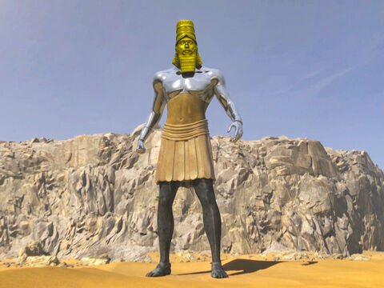
BABYLON (626-539BC)
MEDE-PERSIA (539-331BC)
GREECE (331-168BC)
ROME (168BC-476AD)

Slide 18



Slide 19
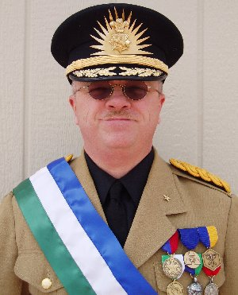
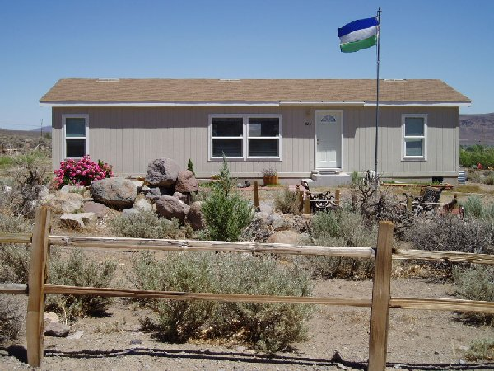

Slide 20
How can you believe since you accept glory from one another but do not seek the glory that comes from the only God?
- JOHN 5:44

Slide 21
Decryption of the Solution
In the time of those kings, the God of heaven will set up a kingdom that will never be destroyed, nor will it be left to another people. It will crush all those kingdoms and bring them to an end, but it will itself endure forever. This is the meaning of the vision of the rock cut out of a mountain, but not by human hands...
- DANIEL 2:44-45

Slide 22
See, I lay a stone in Zion, a chosen and precious cornerstone, and the one who trusts in him will never be put to shame.” Now to you who believe, this stone is precious. But to those who do not believe, “The stone the builders rejected has become the cornerstone,” and, “A stone that causes people to stumble and a rock that makes them fall.
- 1 PETER 2:6-8

Slide 23
Jesus Christ alone founded his empire upon love, and at this hour millions of men would die for him.
- NAPOLEAN BONAPARTE

Slide 24
The kingdom of the world has become the kingdom of our Lord and of his Messiah, and he will reign for ever and ever.
- REVELATION 11:15

Slide 25
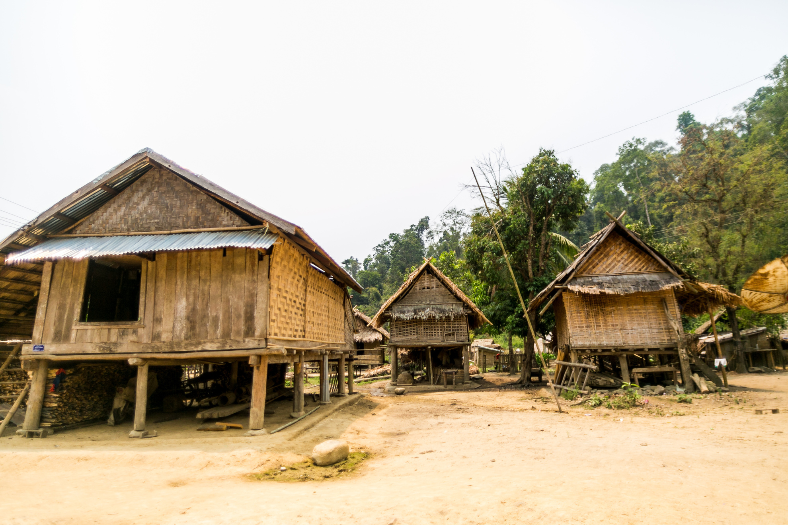

Slide 26
Jesus now has many lovers of his heavenly kingdom, but few bearers of his cross.
THOMAS A KEMPIS
The Imitation of Christ

Slide 27
If we only had eyes to see and ears to hear and wits to understand, we would know that the Kingdom of God in the sense of holiness, goodness, beauty is as close as breathing and is crying out to born both within ourselves and within the world; we would know that the Kingdom of God is what we all of us hunger for above all other things even when we don’t know its name ... The Kingdom of God is where our best dreams come from and our truest prayers. We glimpse it at those moments when we find ourselves being better than we are and wiser than we know. We catch sight of it when at some moment of crisis a strength seems to come to us that is greater than our own strength. The Kingdom of God is where we belong. It is home, and whether we realize it or not, I think we are all of us homesick for it.
- FREDERICK BUECHNER
The Clown in the Belfry

Slide 28
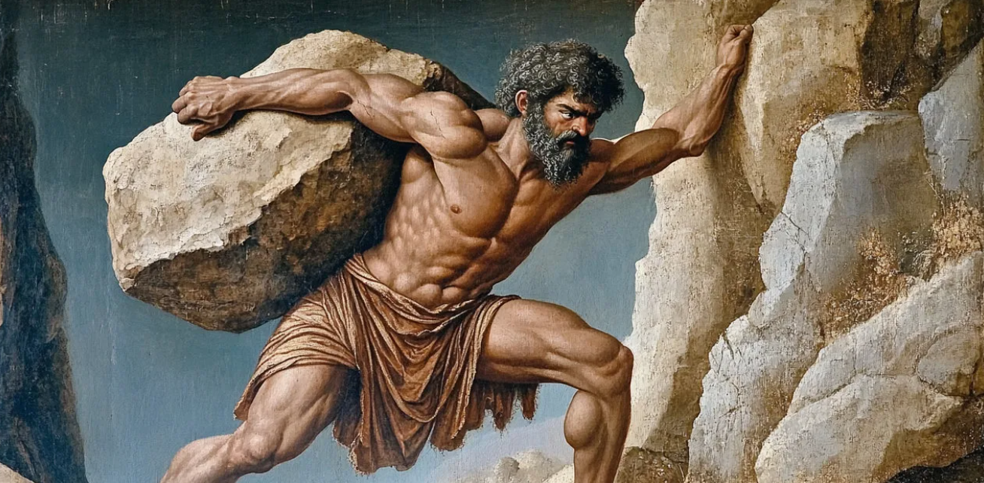
https://www.greekmyths-greekmythology.com/sisyphus/

