Slide 1
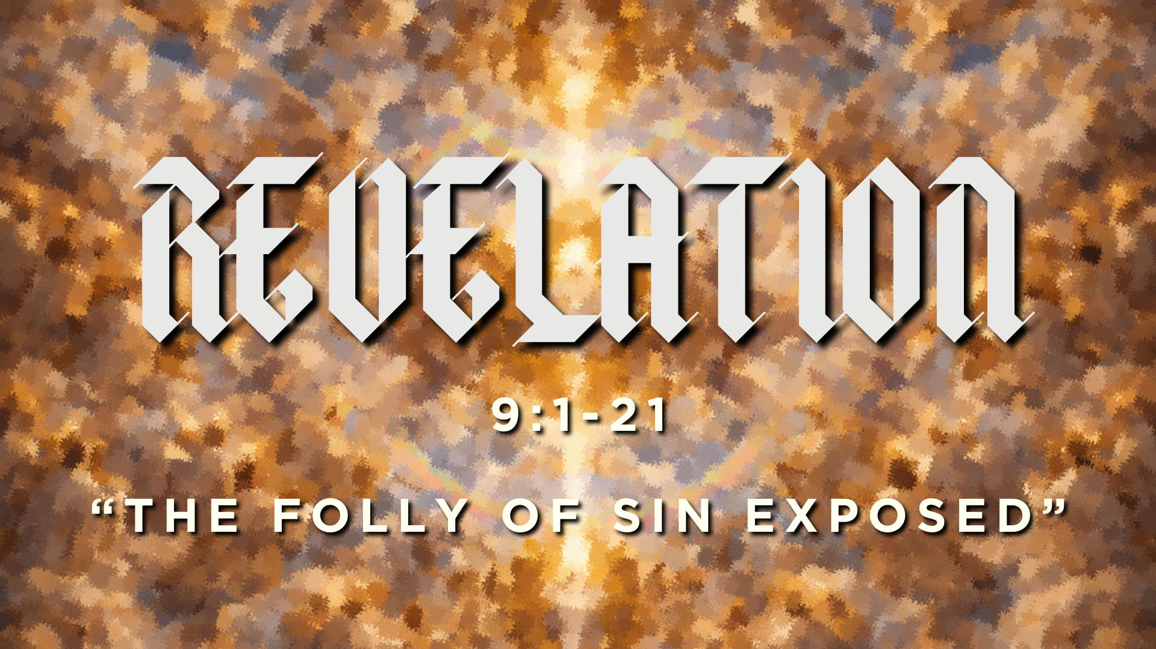

Slide 2
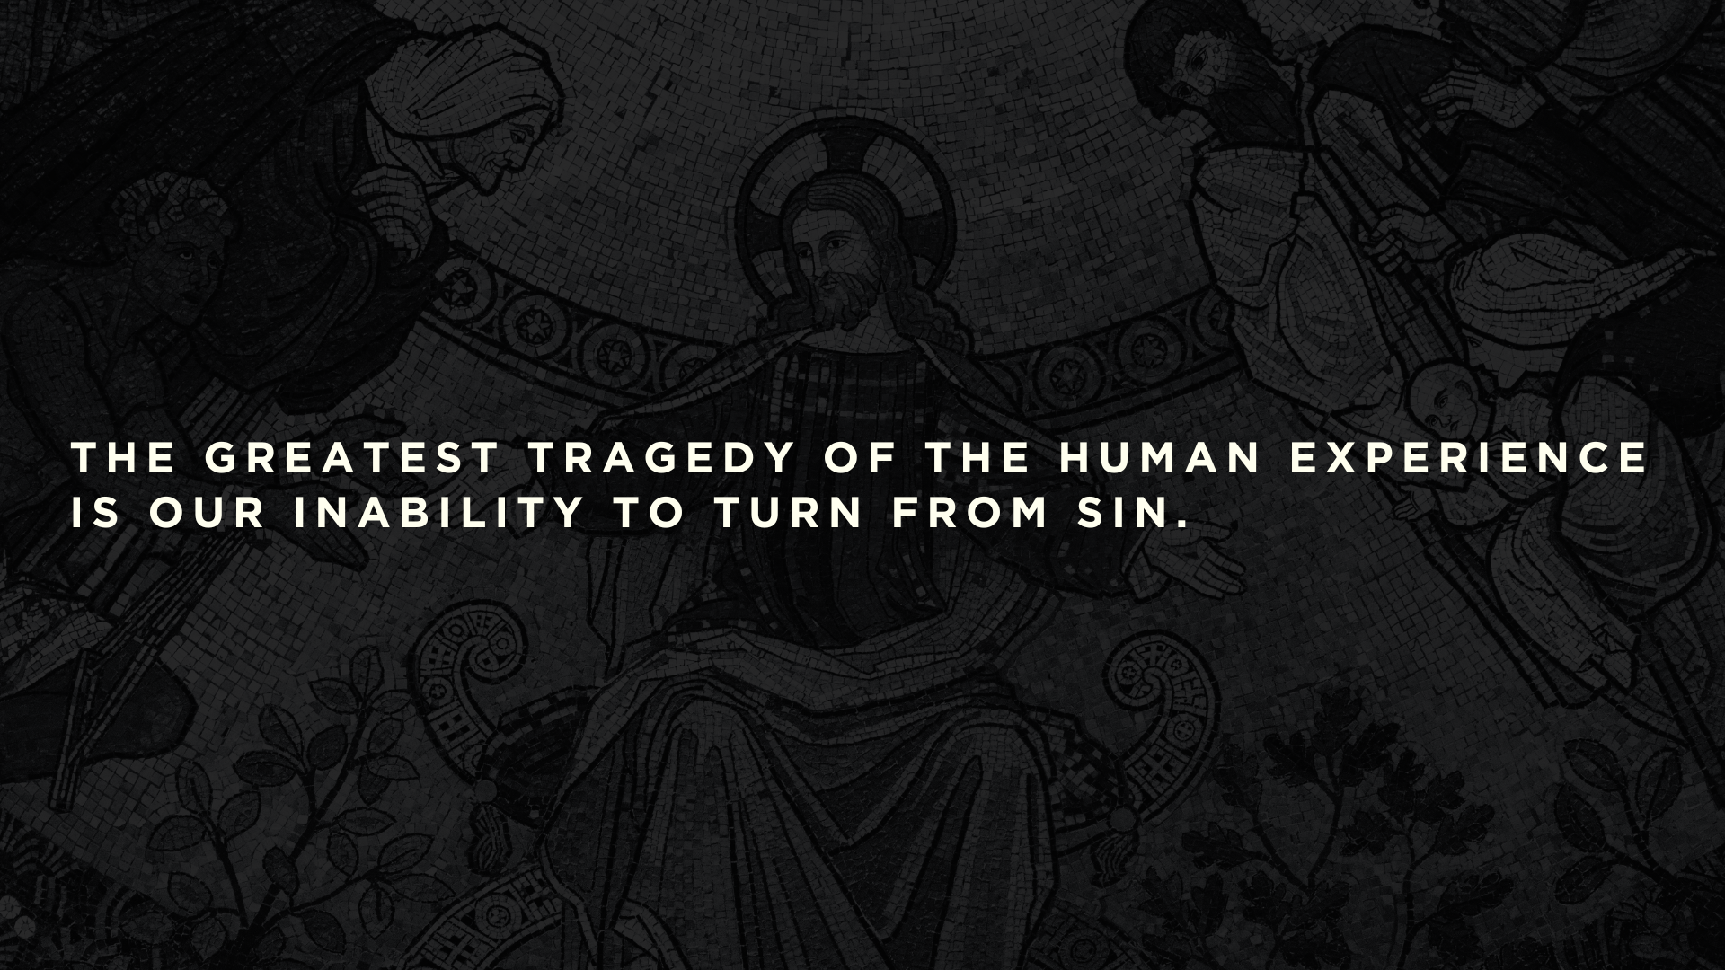
THE GREATEST TRAGEDY OF THE HUMAN EXPERIENCE IS OUR INABILITY TO TURN FROM SIN.

Slide 3
Q: How do we turn from our sin?

Slide 4
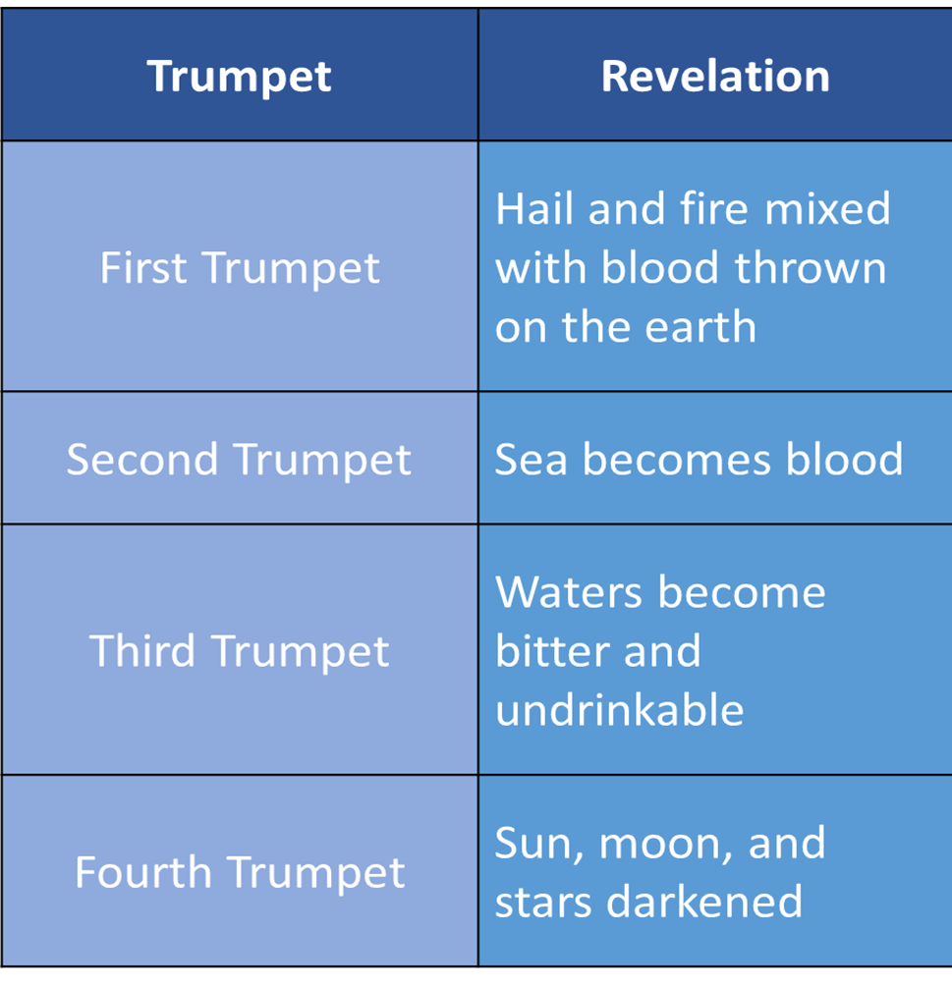

Slide 8
13 Then I looked, and I heard an eagle crying with a loud voice as it flew directly overhead, “Woe, woe, woe to those who dwell on the earth, at the blasts of the other trumpets that the three angels are about to blow!”
Revelation 8:13

Slide 9
13 Then I looked, and I heard an eagle crying with a loud voice as it flew directly overhead, “Woe, woe, woe to those who dwell on the earth, at the blasts of the other trumpets that the three angels are about to blow!”
Revelation 8:13

Slide 10
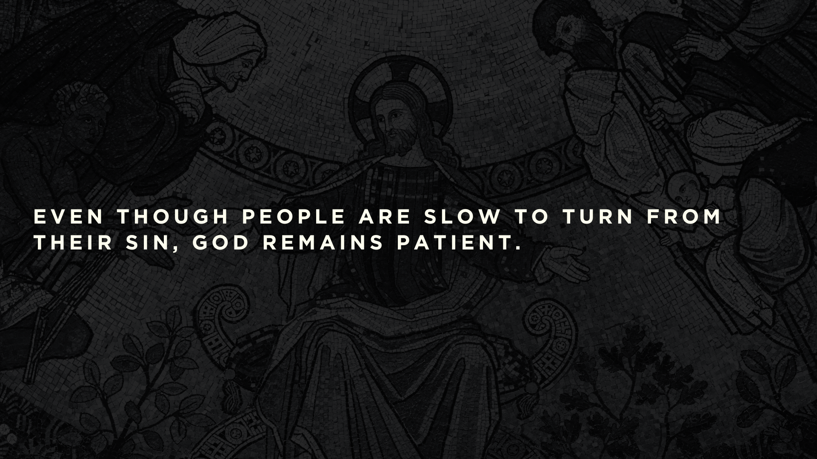

Slide 11
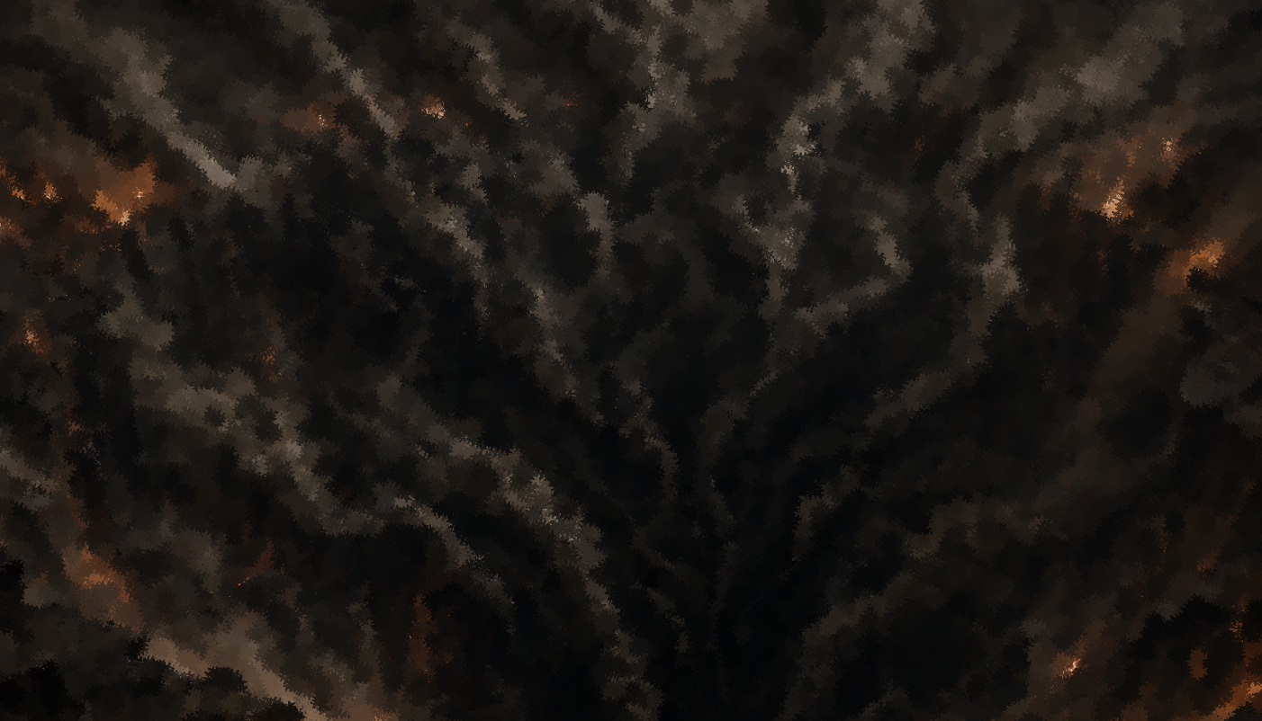
7 In appearance the locusts were like horses prepared for battle: on their heads were what looked like crowns of gold; their faces were like human faces, 8 their hair like women's hair, and their teeth like lions' teeth; 9 they had breastplates like breastplates of iron, and the noise of their wings was like the noise of many chariots with horses rushing into battle. 10 They have tails and stings like scorpions, and their power to hurt people for five months is in their tails.
Revelation 9:7-10

Slide 12
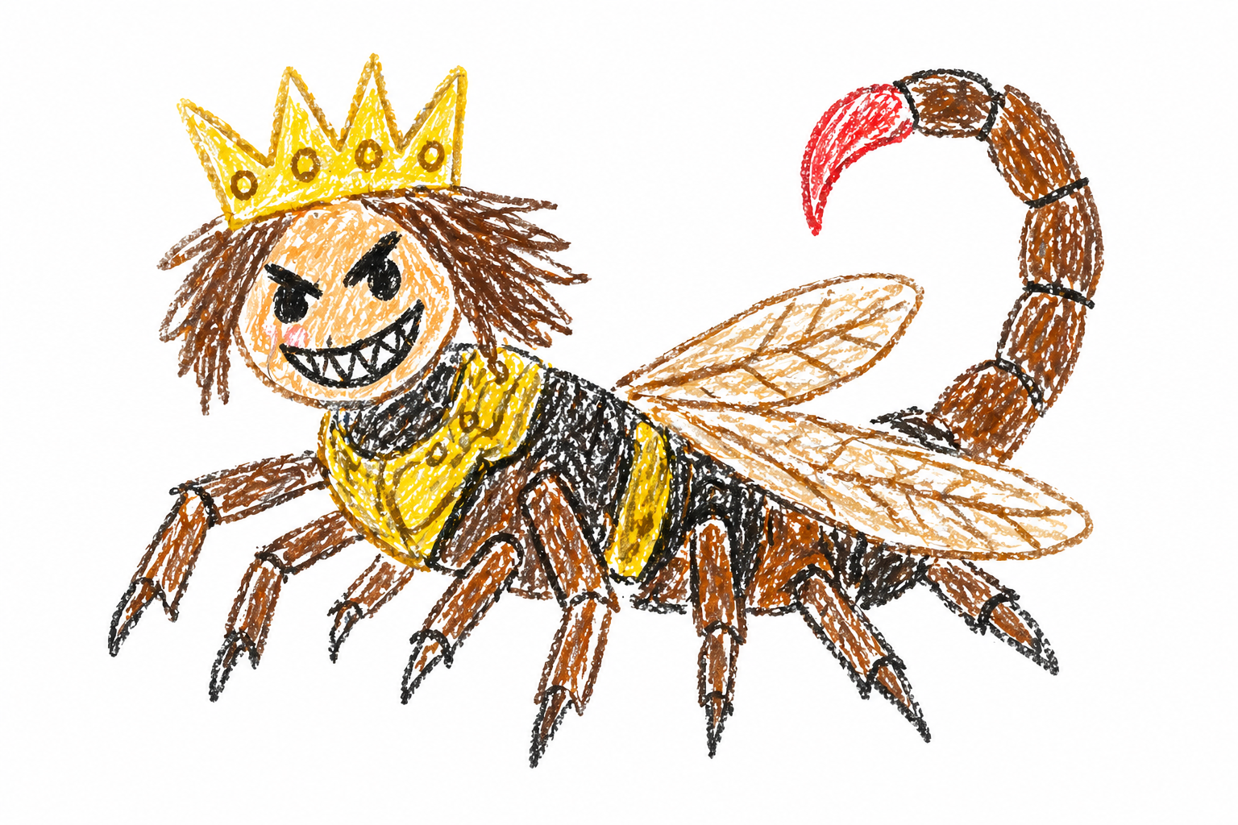

Slide 13
• Even though it is much more intense, it is limited to only five months.
• There is no death involved.

Slide 14
15 So the four angels, who had been prepared for the hour, the day, the month, and the year, were released to kill a third of mankind. 16 The number of mounted troops was twice ten thousand times ten thousand; I heard their number. 17 And this is how I saw the horses in my vision and those who rode them: they wore breastplates the color of fire and of sapphire and of sulfur, and the heads of the horses were like lions' heads, and fire and smoke and sulfur came out of their mouths. 18 By these three plagues a third of mankind was killed, by the fire and smoke and sulfur coming out of their mouths.
Revelation 9:15-18

Slide 15
22 Note then the kindness and the severity of God: severity toward those who have fallen, but God’s kindness to you, provided you continue in his kindness. Otherwise you too will be cut off. 23 And even they, if they do not continue in their unbelief, will be grafted in, for God has the power to graft them in again.
Romans 11:22-23

Slide 16
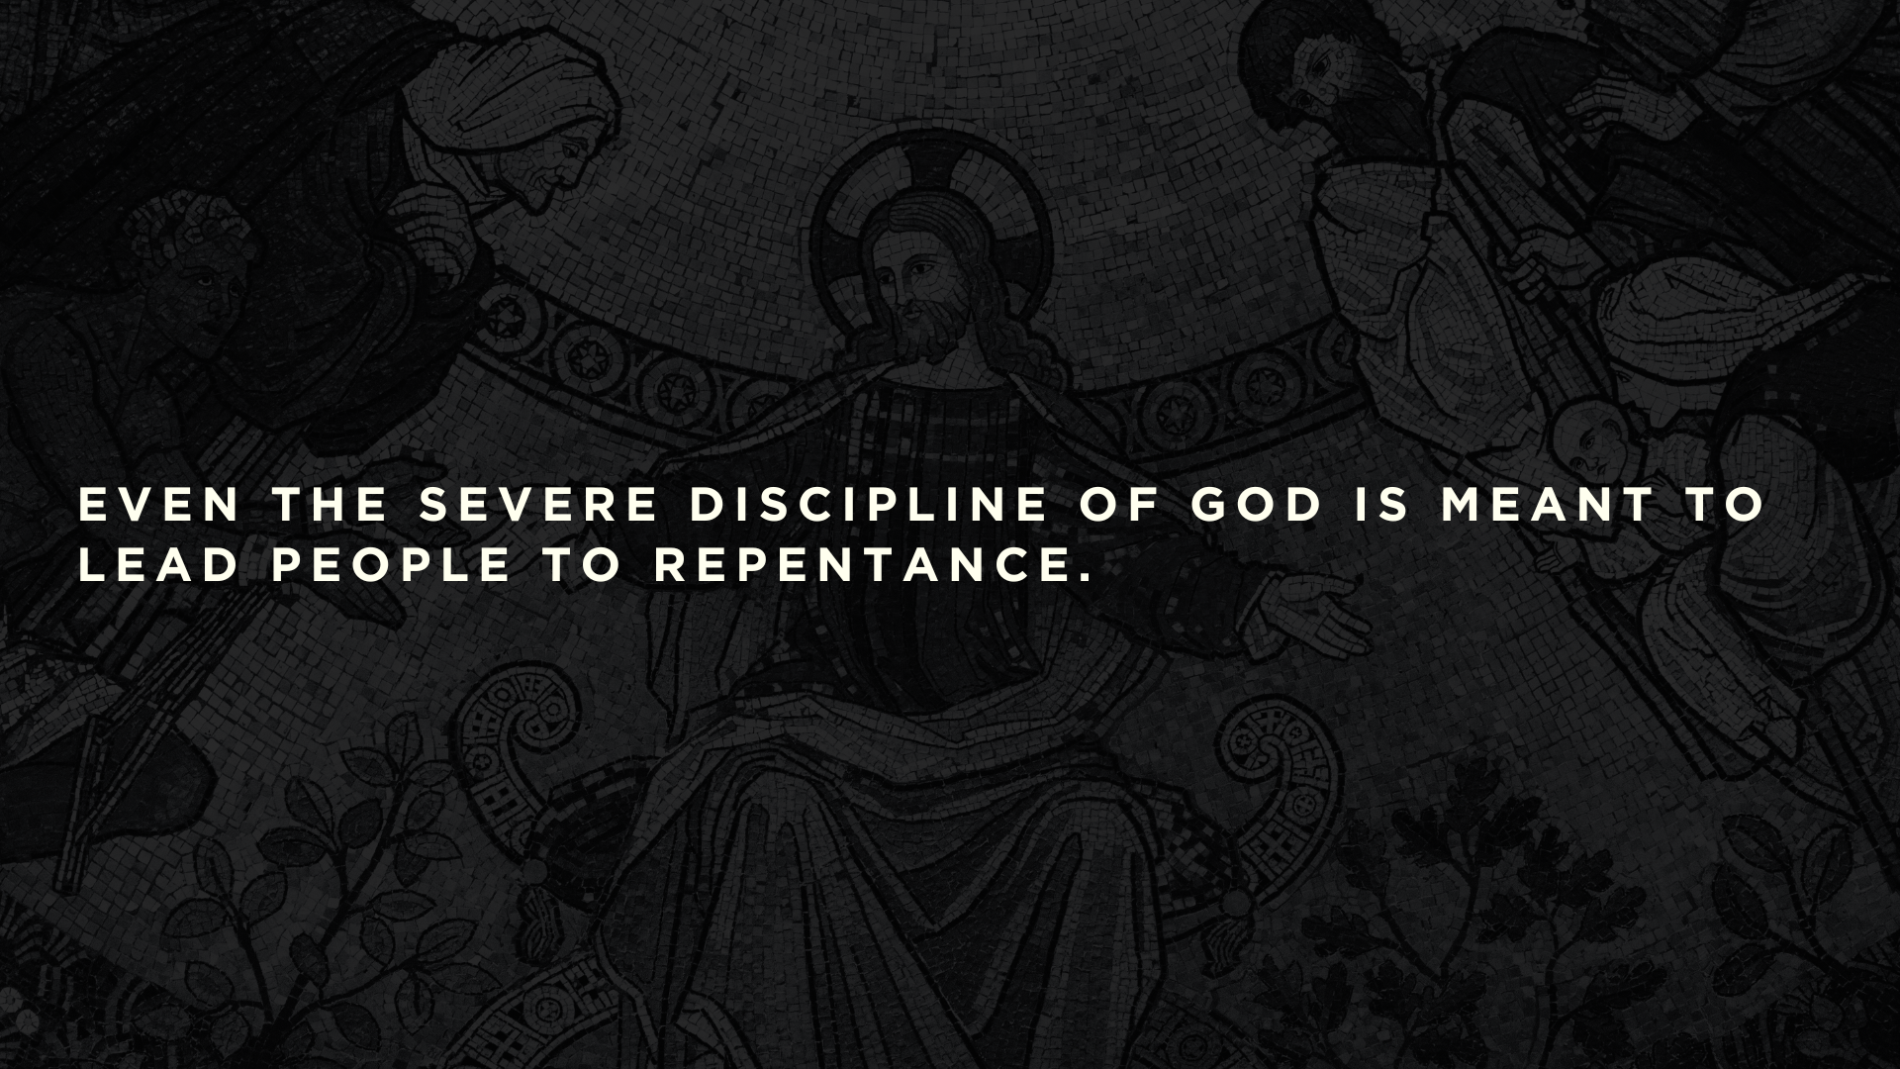

Slide 17
• They experienced the terrifying might of demonic locusts (9:1-11)
• They experienced the rampant loss of life
(9:13-19)

Slide 18
20 The rest of mankind, who were not killed by these plagues, did not repent of the works of their hands nor give up worshiping demons and idols of gold and silver and bronze and stone and wood, which cannot see or hear or walk, 21 nor did they repent of their murders or their sorceries or their sexual immorality or their thefts.
Revelation 9:20-21

Slide 19
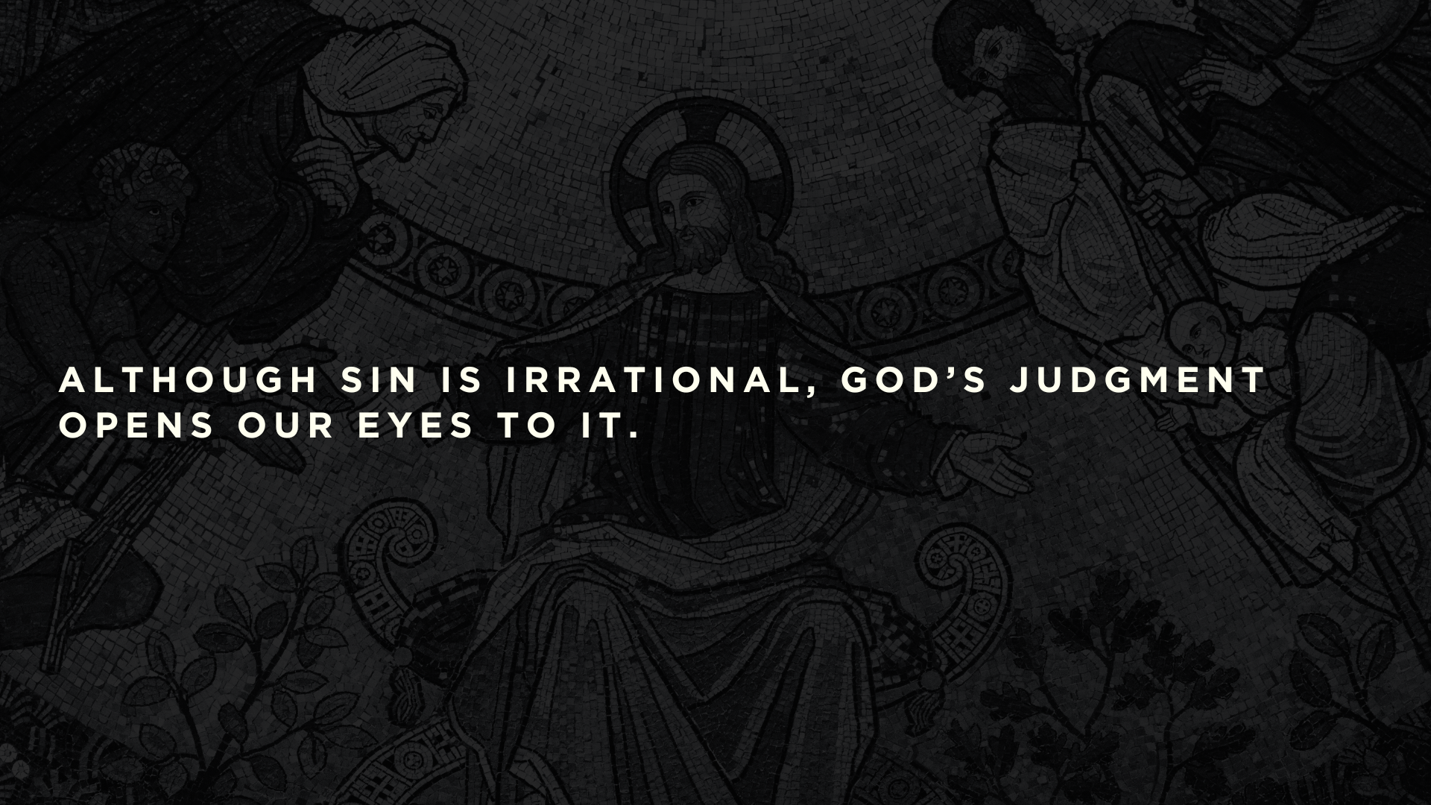

Slide 20
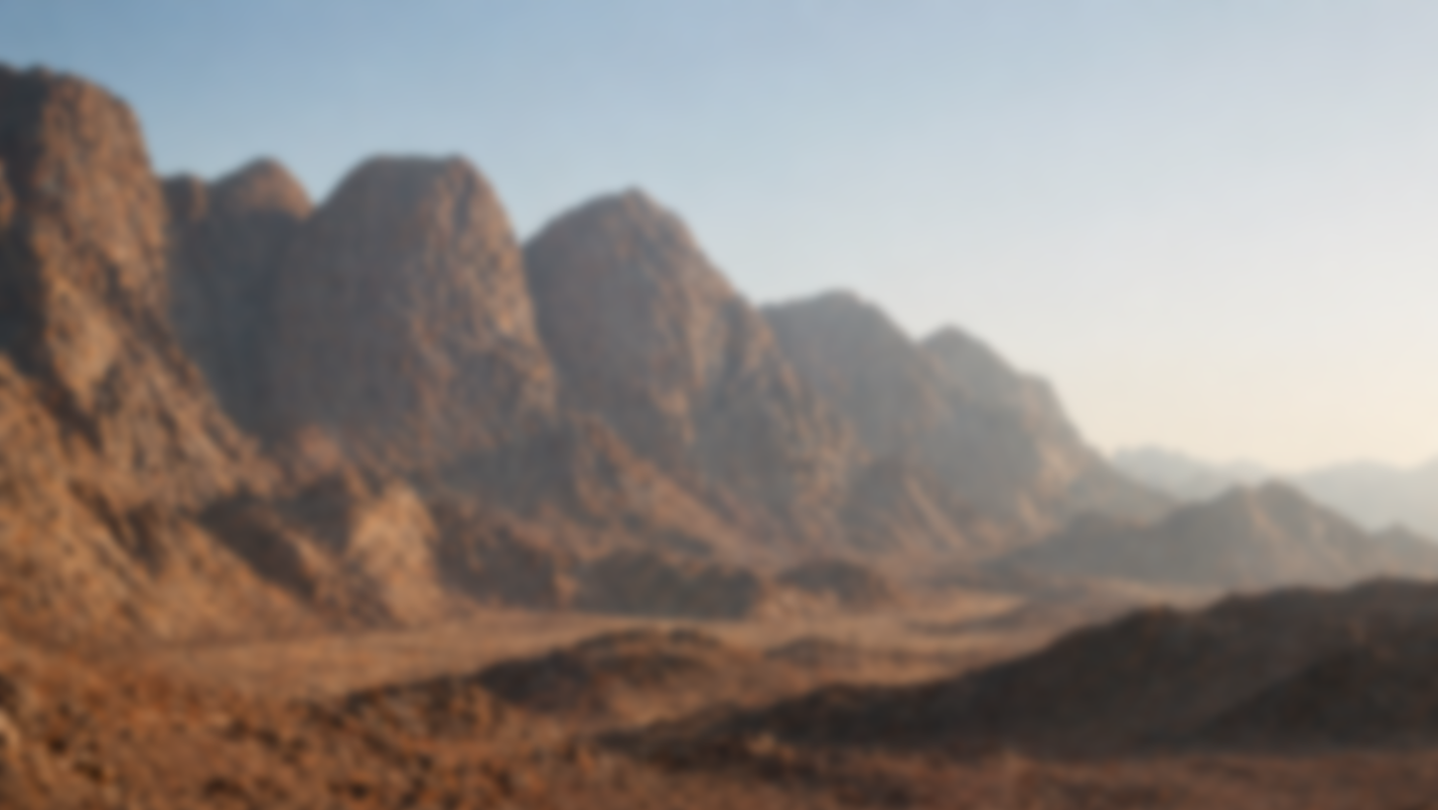
“Who will give us meat to eat?”
“For it was better for us in Egypt.”
Numbers 11:18

Slide 21
“Therefore the Lord will give you meat, and you shall eat. You shall not eat just one day, or two days, or five days, or ten days, or twenty days, but a whole month, until it comes out at your nostrils and becomes loathsome to you, because you have rejected the Lord.”
Number 11:18-20

Slide 22
