Slide 1
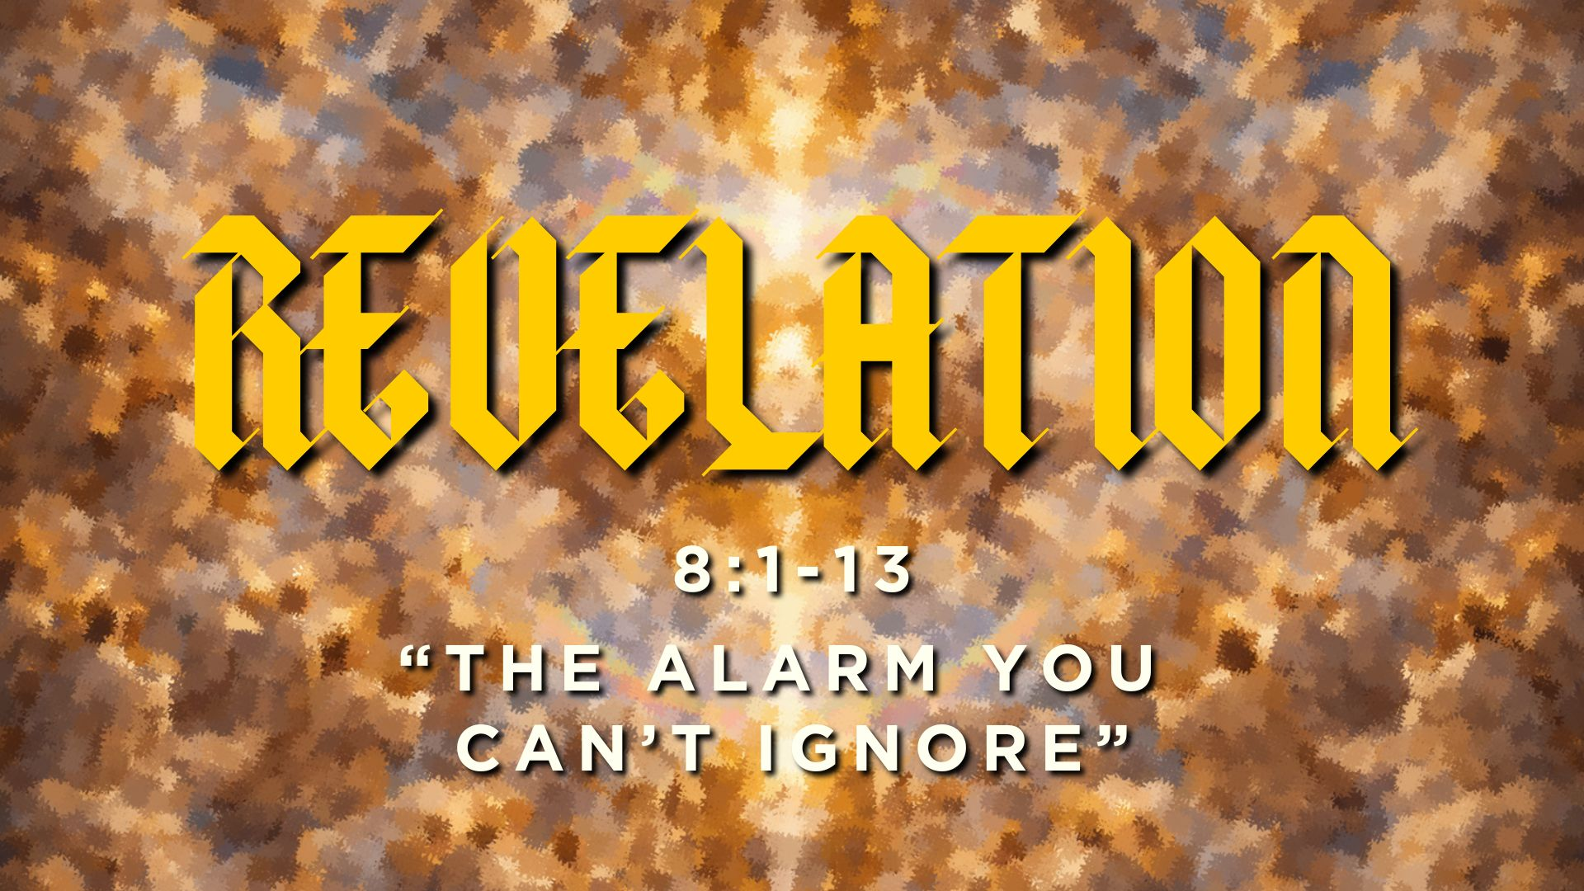

Slide 2
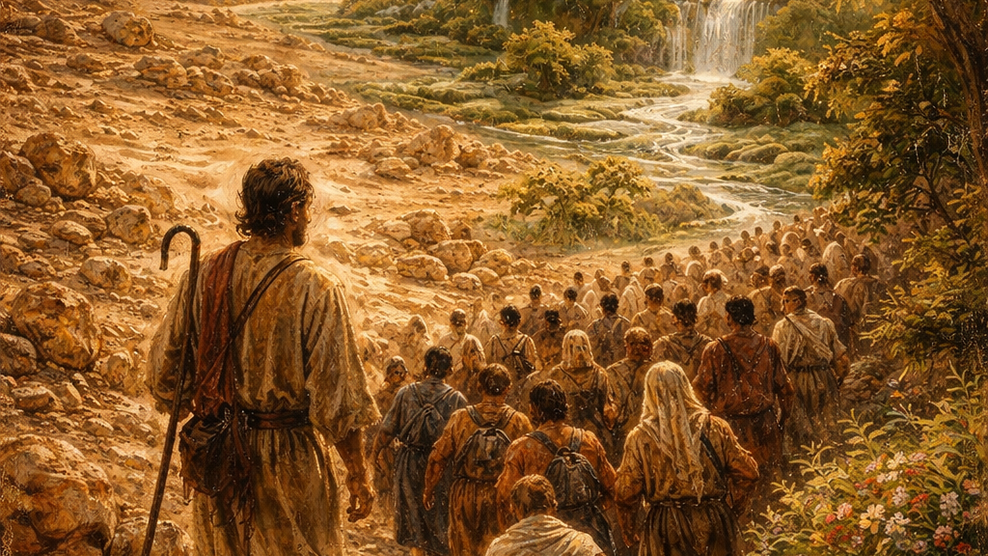

Slide 3
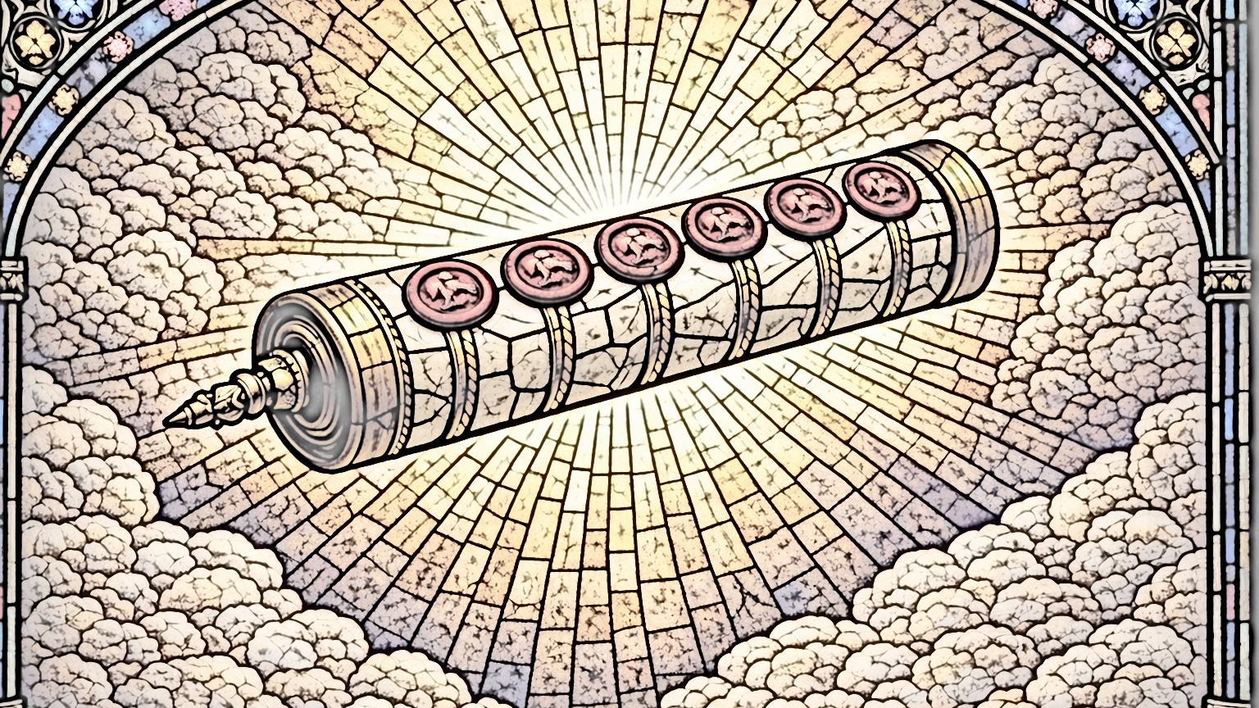
“When the Lamb opened the seventh seal, there was silence in heaven for about half an hour.”
Revelation 8:1

Slide 4
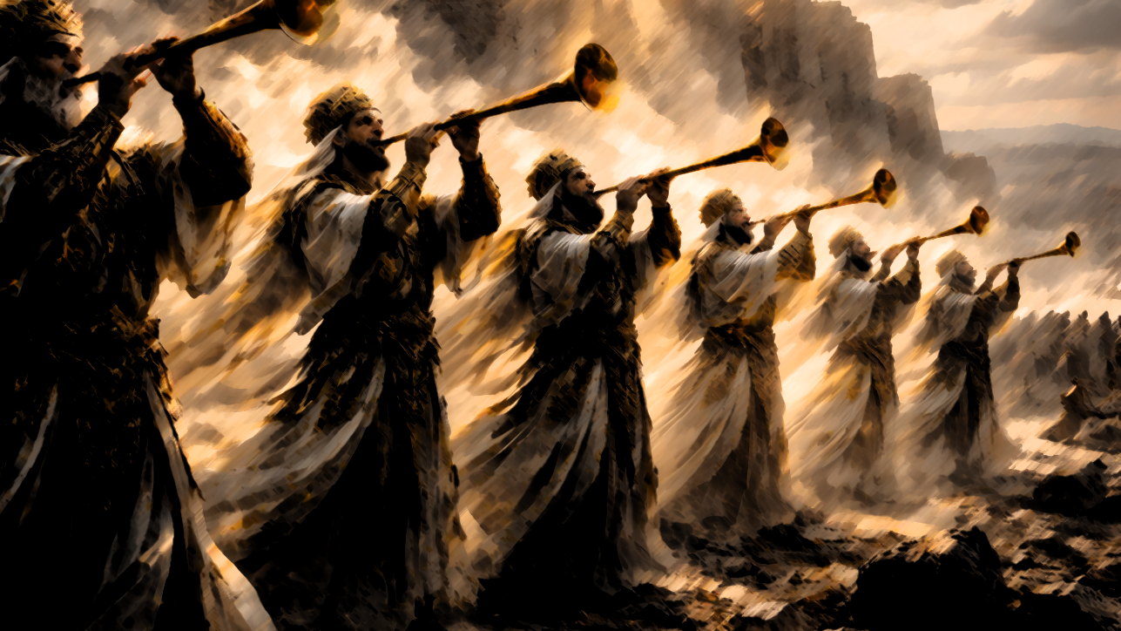
“Here the trumpets represent God’s judgments during this present age, in answer to the prayers of God’s people, summoning the nations to repent before the end arrives. The judgments that span life in this world anticipate the final judgment. Those who have sided with evil should reconsider and return to righteousness before the fatal day of reckoning arrives.”
-Thomas Schreiner

Slide 5
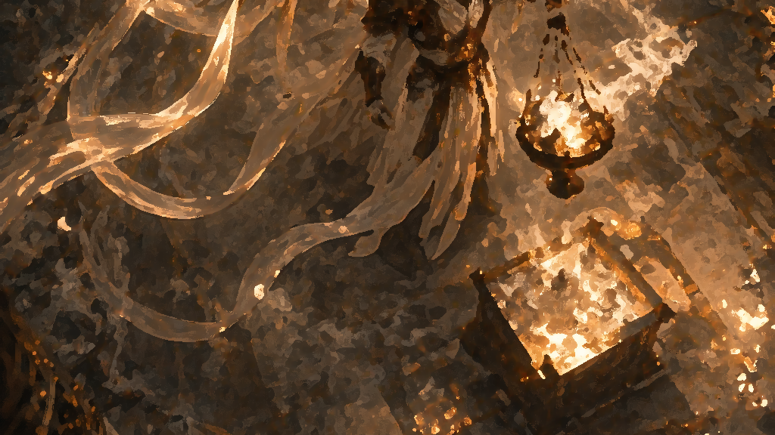

Slide 6
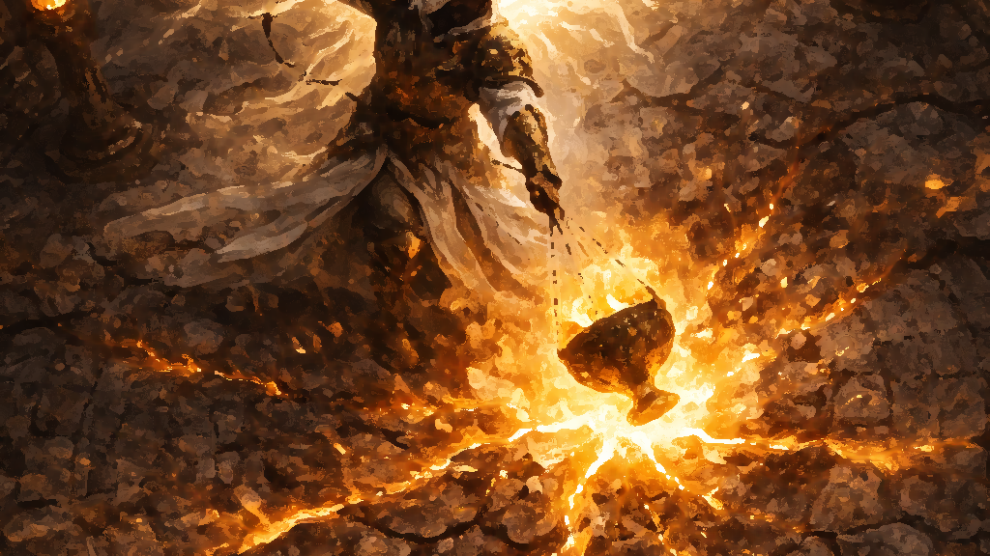
“Then the angel took the censer and filled it with fire from the altar and threw it on the earth, and there were peals of thunder, rumblings, flashes of lightning, and an earthquake.”
Revelation 8:5

Slide 7
“God does not judge like a tyrant, nor is his judgment comparable to a toddler’s irrational tantrum. Rather, God judges precisely to bring justice, to restore what is right and vanquish evil.”
-Thomas Schreiner

Slide 8
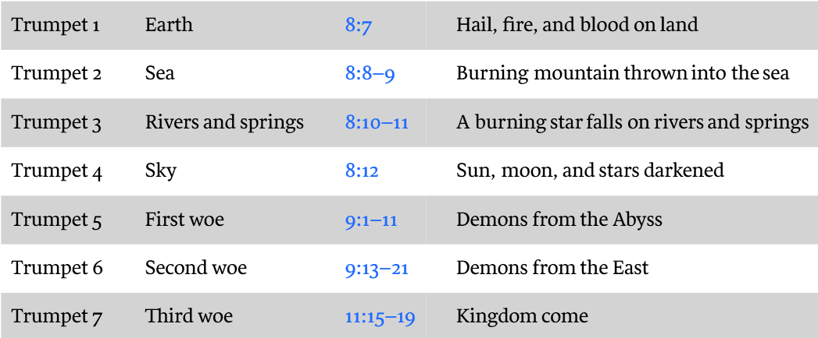
Schreiner, Revelation (2023)

Slide 9
Schreiner, Revelation (2023)

Slide 10
Schreiner, Revelation (2023)

Slide 11
Schreiner, Revelation (2023)

Slide 12
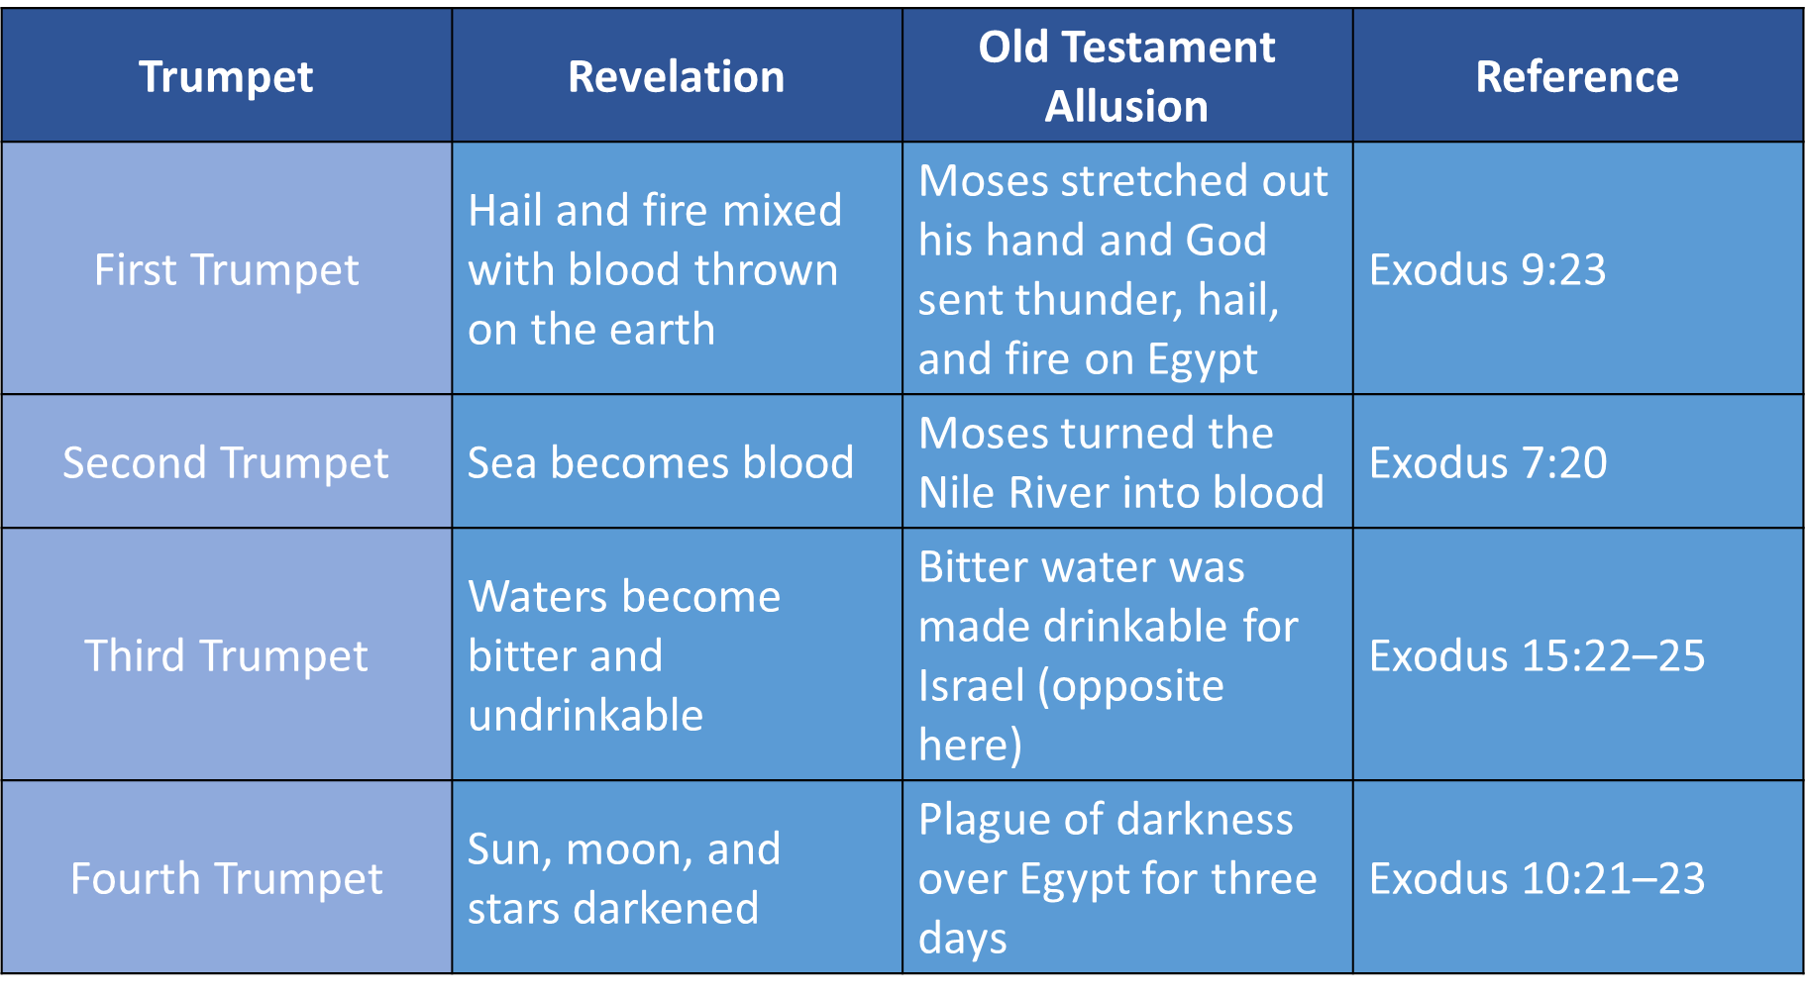

Slide 13
23 I looked on the earth, and behold, it was without form and void;
and to the heavens, and they had no light.
24 I looked on the mountains, and behold, they were quaking,
and all the hills moved to and fro.
25 I looked, and behold, there was no man,
and all the birds of the air had fled.
(Jeremiah 4:23-25)

Slide 14
