Slide 1



Slide 2
Psalm 42:1-2
“¹As a deer pants for flowing streams, so pants my soul for you, O God. ²My soul thirsts for God, for the living God. When shall I come and appear before God?”

Slide 3
God, You are the satisfier of my soul! You are the living God, present and approachable.
Lord, thank you for satisfying my soul when….
God satisfy my soul’s longing for…..
Lord, bring Your hope and salvation to _________

Slide 4
Humility
“... not thinking less of yourself than of other people, nor does it mean having a low opinion of your own gifts. It means freedom from thinking about yourself one way or the other at all.”

Slide 5
Abram’s wealth did not effect his worship.

Slide 6
Followers of Christ should be the ones seeking to deescalate not fueling the flames of bitter disagreements.

Slide 7
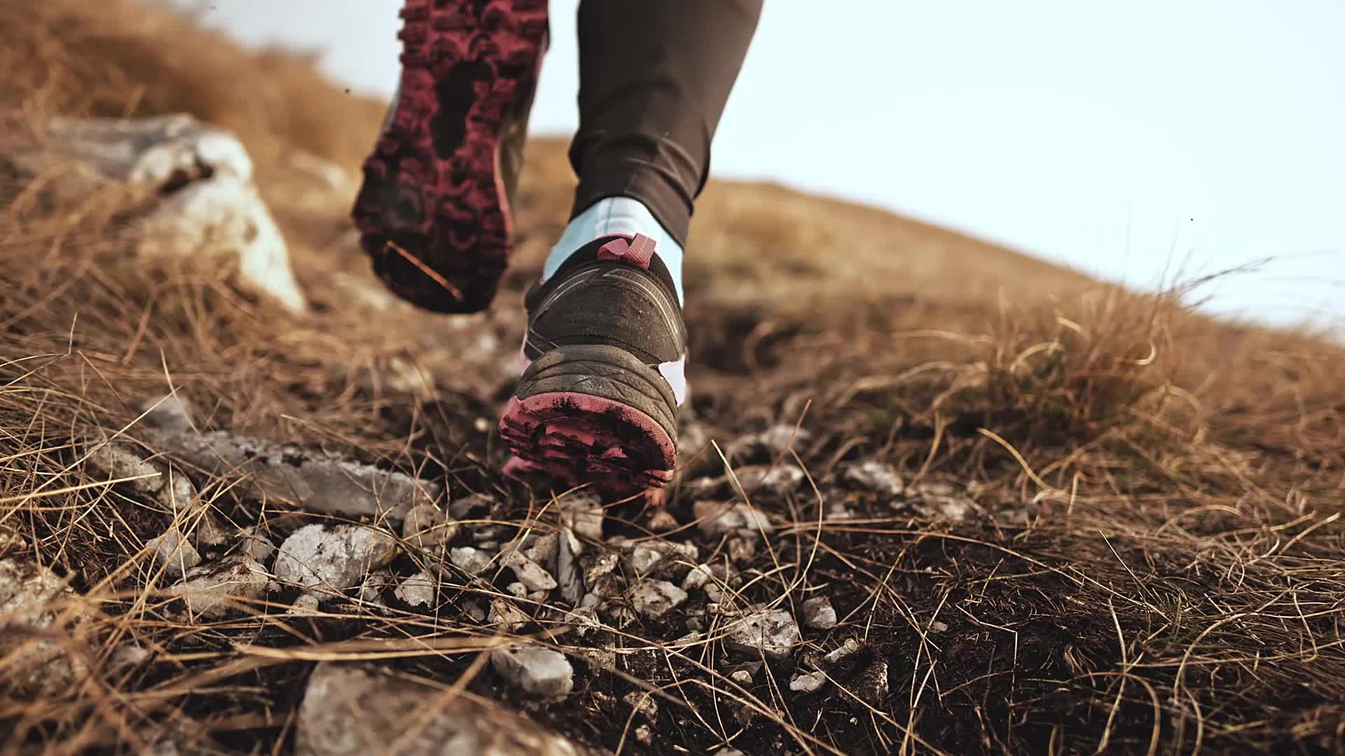
A blameless walk requires humility.

Slide 8
Abram humbles himself so peace can be restored.

Slide 9
Our choices are an overflow of our heart.

Slide 10
What is best for us is what is best for our souls.

Slide 11
God’s people are to be peacemakers.

Slide 12
Abram found his security in the promises of the Father.

Slide 13
Abram’s humble faithfulness led him to a more intimate knowledge of the Father’s will.

Slide 14
The gracious promises of God should always be met with the humble praises of God’s people.

Slide 15
When we surrender our heart and will to God we will experience peace and contentment.

