Slide 1

Navigating Crises: For His Glory and Our Good
Michael Christie

Slide 2



Slide 3


Slide 4
Crises of every kind will find us… [But] these crises enter our lives not just as challenges to us to retain our balance and stability, but as invitations to stretch our hearts and minds.
- RONALD ROLHEISER
Sacred Fire

Slide 5
DANIEL 2:1-20
¹ In the second year of his reign, Nebuchadnezzar had dreams; his mind was troubled and he could not sleep. ² So the king summoned the magicians, enchanters, sorcerers and astrologers to tell him what he had dreamed. When they came in and stood before the king, ³ he said to them, “I have had a dream that troubles me and I want to know what it means.”

Slide 6
⁴ Then the astrologers answered the king, “May the king live forever! Tell your servants the dream, and we will interpret it.”
⁵ The king replied to the astrologers, “This is what I have firmly decided: If you do not tell me what my dream was and interpret it, I will have you cut into pieces and your houses turned into piles of rubble.

Slide 7
⁶ But if you tell me the dream and explain it, you will receive from me gifts and rewards and great honor. So tell me the dream and interpret it for me.”
¹⁰ The astrologers answered the king, “There is no one on earth who can do what the king asks! … ¹¹ What the king asks is too difficult. No one can reveal it to the king except the gods, and they do not live among humans.”

Slide 8
¹² This made the king so angry and furious that he ordered the execution of all the wise men of Babylon...
¹⁶ Daniel went in to the king and asked for time, so that he might interpret the dream for him.
¹⁷ Then Daniel returned to his house and explained the matter to his friends Hananiah, Mishael and Azariah.

Slide 9
¹⁸ He urged them to plead for mercy from the God of heaven concerning this mystery, so that he and his friends might not be executed with the rest of the wise men of Babylon.
¹⁹ During the night the mystery was revealed to Daniel in a vision. Then Daniel praised the God of heaven ²⁰ and said: “Praise be to the name of God for ever and ever; wisdom and power are his.

Slide 10


Slide 11
Confronted by Trouble
In the second year of his reign, Nebuchadnezzar had dreams; his mind [Hb. ruach or spirit] was troubled and he could not sleep.
- DANIEL 2:1

Slide 12
I realised that when I sleep, I am out of control. When I experience insomnia, I am also out of control. [I] cannot make myself go to sleep. Perhaps, insomnia and sleep accomplish the same purpose… We do not control our own lives, let alone the world. God is our Creator and is the one in charge… God is God and I am not. God is in control of my life, my waking and sleeping hours, in loving, creative, grace-filled ways. Apparently, my being out of control is part of God's design.
- ALICE FRYLING
Ageing Faithfully

Slide 13
You have made us for yourself, O Lord, and our hearts are restless until they rest in You.
- AUGUSTINE
Confessions

Slide 14

[Samson] grew and the Lord blessed him, and the Spirit of the Lord began to stir him [agitate/trouble].
- JUDGES 13:25

Slide 15
Consulting Earthly Answers Fails
So the king summoned the magicians, enchanters, sorcerers and astrologers to tell him what he had dreamed. When they came in and stood before the king, he said to them, “I have had a dream that troubles me and I want to know what it means.”
- DANIEL 2:2-3

Slide 16
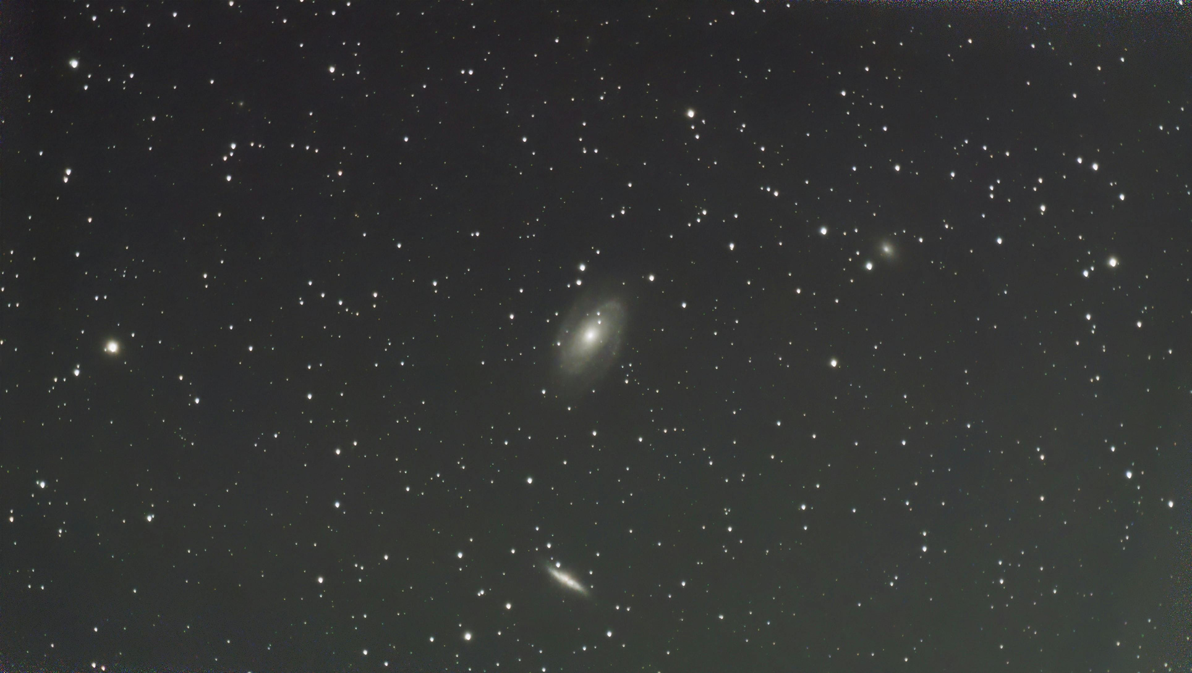

Slide 17
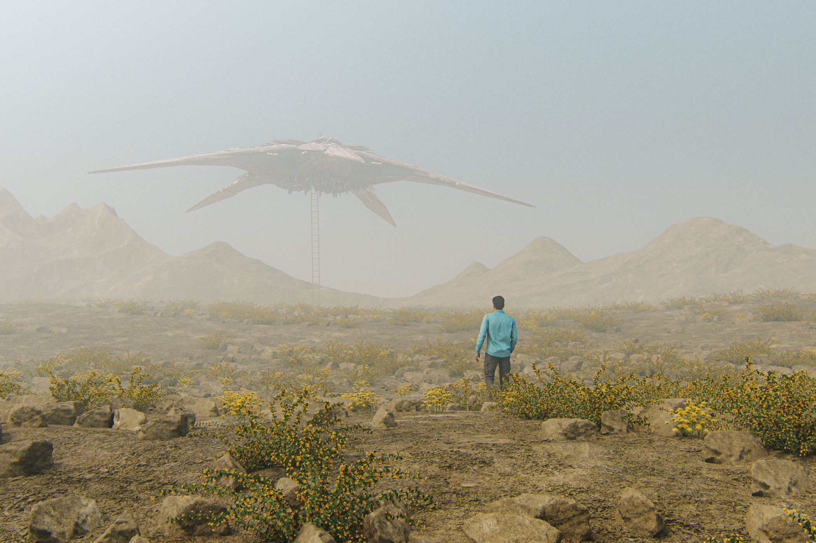
It expresses our secret longings for a wisdom that might come down from the stars in new, improved, easy-to-use packaging, to reveal the secrets of life and tell us, at long last, who we are.
ANNA MERLAN, Republic of Lies

Slide 18


Slide 19
See to it that no one takes you captive through hollow and deceptive philosophy, which depends on human tradition and the elemental spiritual forces of this world rather than on Christ. For in Christ all the fullness of the Deity lives in bodily form, and in Christ you have been brought to fullness. He is the head over every power and authority.
- COLOSSIANS 2:8-10

Slide 20
Create Space for God’s Intervention
Daniel returned to his house and explained the matter to his friends Hananiah, Mishael and Azariah. He urged them to plead for mercy from the God of heaven concerning this mystery, so that he and his friends might not be executed with the rest of the wise men of Babylon. During the night the mystery was revealed to Daniel in a vision. Then Daniel praised the God of heaven and said: “Praise be to the name of God for ever and ever; wisdom and power are his…
- DANIEL 2:17-20

Slide 21
Navigating Crises
Cultivate intimacy with God

Slide 22
What we do in the crisis always depends on whether we see the difficulties in the light of God, or God in the shadow of the difficulties.
- G CAMPBELL MORGAN

Slide 23
Navigating Crises
Cultivate intimacy with God
Commune with other believers
Communicate with God in prayer

Slide 24
Navigating Crises
Cultivate intimacy with God
Commune with other believers
Communicate with God in prayer
Commend him in praise and thanks

Slide 25


Slide 26
God puts sticks and stones of love in our beds to wake us up, to bring us to rely on him, lest the end of history or of life overtake us without the Lord in our heart, and we be turned to stone.
TIM KELLER
The Prodigal Prophet

