Slide 1
Welcome to Holy Hermits Online Worship
Fourth Sunday in Easter
Today we are remembering
Holy Hermit Herbert of Derwent Water
Service Prep: Kristine | Chat Host: Viki | First Reader: Jeremy
Music: Wiggles 🐶 | Welcomer: Julie | Second Reader: Vanessa
Proof-reader: Viki | Priest: N/A | Preacher: Lauren
Broadcaster: Kieron | Deacon: Lauren | Fellowship: Julie
Backup Broadcaster: Barry | Leader: Julie | Safety Officer: Chris
Zoom Buttons: Barry | Cantor: Margo | Attendance: Viki

Slide 2


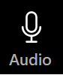



Hospitality
Leader:
Please mute for the service unless invited to offer your voice as part of the service ministry
Have the video camera on or off and turn the volume and brightness up or down on your device if things are too loud 🔉🔊or too bright🔅🔆
Our Cantor acts as our voice, offering the responses, in Bold Text, which we say together
Feel welcome to use the chat and reaction emojis 👍
🙏 Please take care of yourself in this space. 🙏 Come and go as you need
😴 It is great to take rest in this space, so falling asleep is also OK 😴
👂️ Remember, pastoral care is available to all in the community, if you'd like to speak to someone about anything spiritual. ❤️ Visit the help page at the website to reach out 🌐
Our Being Together ethos and safeguarding practices can also be accessed on the website 🫶​
🙌 Come as you are – we are all here together! 🙌
Notes:
Used Lent 2022

Slide 3
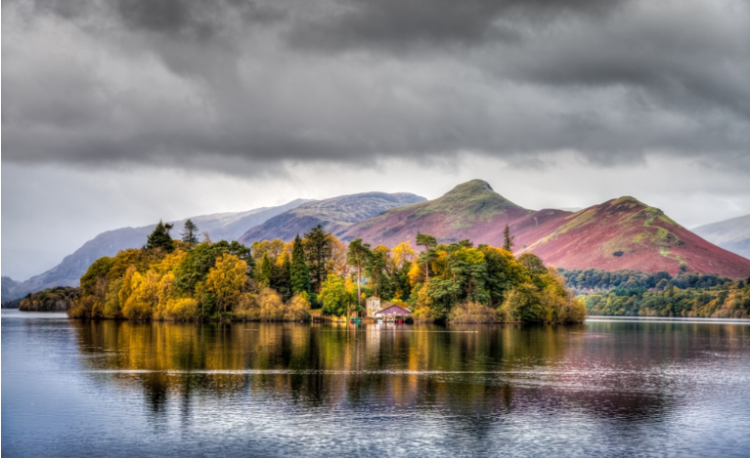
Leader: Our Holy Hermit today is Herbert of Derwent Water
Contemporary of St Cuthbert of Lindisfarne
Little is known of Herbert of Derwent Water, a seventh-century hermit who lived on an island in the middle of the Cumbrian lake. Both Herbert and the island named after him were inspiration for writers as diverse as William Wordsworth and Beatrix Potter.
Image shows an island in a lake Derwent Water with hills in the background.

Slide 4
Herbert lived in prayer and solitude, but once a year would pilgrimage to Lindisfarne to visit his friend, St. Cuthbert.
Herbert was so upset about Cuthbert’s death premonition, that Cuthbert petitioned God to allow them to both die at the same time. Miraculously, after returning to Derwent Water, Herbert died at the very same time as Cuthbert.
To read more about our hermits click the link​​ in the send out

Slide 5
Invitation
Leader: As we come into worship let’s take a few deep breaths,
Let go of anything that isn’t serving us,
And become aware of God’s presence here with us.
Opening Music: Snare Drum March
https://www.youtube.com/watch?v=J8hzw3Lpk9Q

Slide 6
Leader and Cantor unmute
The Greeting
Leader: Christ has risen, Alleluia!
All: Christ is risen indeed, Alleluia!

Slide 7
Gathering Prayer
Leader:
Listen to the voice that is calling you.
Reject the other things calling you away.
Follow where Jesus leads.
Enter the gateway to new life.
Come, live life to the full.

Slide 8
Gathering Prayer
All: ​Heavenly Father, our shepherd,
let us follow your voice
as you lead us to rest and peace
and life everlasting.
Amen.

Slide 9
Sentence
Leader: I invite our Cantor to proclaim the sentence for today.
Cantor: ‘I am the good shepherd,’ says the Lord. ‘The good shepherd lays down his life for the sheep.’
John 10.11

Slide 10
Prayer of Approach
Leader: We pray the prayer of approach together
All: Good Shepherd, we know your voice
and we heed your call to us now
to come into your house and gather before you,
to receive succour for our souls.
Amen.

Slide 11
The Gloria​
(to be sung every Sunday during the Season of Easter)
Leader: We now sing the Gloria together
https://www.youtube.com/watch?v=8AK9zPuyQ2o
Leader Mutes

Slide 12
Collect
Leader: God of all power,
you called from death our Lord Jesus,
the great shepherd of the sheep:
send us as shepherds to rescue the lost,
to heal the injured,
and to feed one another with understanding;
through your Son, Jesus Christ our Lord,
who lives and reigns with you and the Holy Spirit,
one God, now and for ever. Amen.

Slide 13
The 1st reader unmutes
Leader: I invite the 1st reader to unmute and offer the 1st lesson when ready.
Reader 1: The 1st Reading is from Acts 2.42-47
⁴² They devoted themselves to the apostles’ teaching and fellowship, to the breaking of bread and the prayers. ⁴³ Awe came upon everyone, because many wonders and signs were being done by the apostles. ⁴⁴ All who believed were together and had all things in common; ⁴⁵ they would sell their possessions and goods and distribute the proceeds to all, as any had need.
Continue…

Slide 14
⁴⁶ Day by day, as they spent much time together in the temple, they broke bread at home and ate their food with glad and generous hearts, ⁴⁷ praising God and having the goodwill of all the people. And day by day the Lord added to their number those who were being saved.
For the word of the Lord. Thanks be to God.​

Slide 15
Leader: Thank you, the Psalm today is a recitation by Ruth - https://youtu.be/JwrHMYkbjts?si=S10vWJP861LrtZ9f
Psalm 23
¹ The Lord is my shepherd:
therefore can I lack nothing.
² He will make me lie down in green pastures:
and lead me beside still waters.
³ He will refresh my soul:
and guide me in right pathways for his name’s sake.
Continue…

Slide 16
⁴ Though I walk through the valley of the shadow of death,
I will fear no evil:
for you are with me, your rod and your staff comfort me.
⁵ You spread a table before me
in the face of those who trouble me:
you have anointed my head with oil,
and my cup shall be full.
⁶ Surely your goodness and loving-kindness
will follow me all the days of my life:
and I shall dwell in the house of the Lord for ever.

Slide 17
The 2nd reader unmutes
Leader: I invite the 2nd reader to unmute and offer the 2nd lesson when ready.
Reader 2: The 2nd Reading is from 1 Peter 2.1-10
¹ Rid yourselves, therefore, of all malice, and all guile, insincerity, envy, and all slander. ² Like newborn infants, long for the pure, spiritual milk, so that by it you may grow into salvation— ³ if indeed you have tasted that the Lord is good. ⁴ Come to him, a living stone, though rejected by mortals yet chosen and precious in God’s sight, and
Continue…

Slide 18
⁵ like living stones, let yourselves be built into a spiritual house, to be a holy priesthood, to offer spiritual sacrifices acceptable to God through Jesus Christ.
⁶ For it stands in scripture:
‘See, I am laying in Zion a stone, a cornerstone chosen and precious;
and whoever believes in him will not be put to shame.’
Continue…

Slide 19
⁷ To you then who believe, he is precious; but for those who do not believe, ‘The stone that the builders rejected has become the very head of the corner’, ⁸ and ‘A stone that makes them stumble, and a rock that makes them fall.’ They stumble because they disobey the word, as they were destined to do. ⁹ But you are a chosen race, a royal priesthood, a holy nation, God’s own people, in order that you may proclaim the mighty acts of him who called you out of darkness into his marvellous light.
Continue…

Slide 20
⁹ But you are a chosen race, a royal priesthood, a holy nation, God’s own people, in order that you may proclaim the mighty acts of him who called you out of darkness into his marvellous light.
¹⁰ Once you were not a people,
but now you are God’s people;
once you had not received mercy,
but now you have received mercy.
For the word of the Lord. Thanks be to God.​

Slide 21
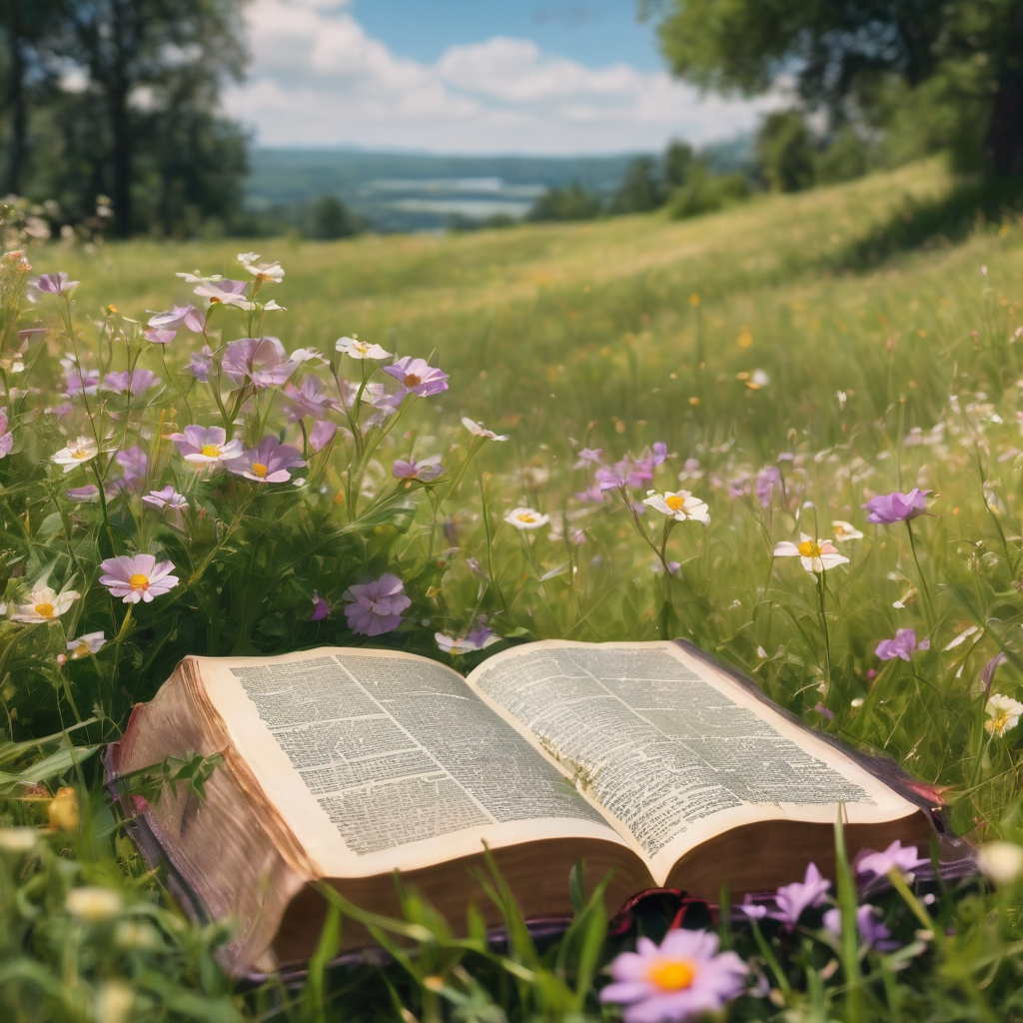
We pause before
​the Gospel ​​

Slide 22
Deacon: The Gospel of our Lord Jesus Christ according to St John Chapter 10 beginning at the 1st verse
All: Glory to you Lord Jesus Christ.
¹ ‘Very truly, I tell you, anyone who does not enter the sheepfold by the gate but climbs in by another way is a thief and a bandit. ² The one who enters by the gate is the shepherd of the sheep. ³ The gatekeeper opens the gate for him, and the sheep hear his voice. He calls his own sheep by name and leads them out. ⁴ When he has brought out all his own, he goes ahead of them, and the sheep follow him because they know his voice.
Continue…

Slide 23
⁵ They will not follow a stranger, but they will run from him because they do not know the voice of strangers.’ ⁶ Jesus used this figure of speech with them, but they did not understand what he was saying to them. ⁷ So again Jesus said to them, ‘Very truly, I tell you, I am the gate for the sheep. ⁸ All who came before me are thieves and bandits; but the sheep did not listen to them. ⁹ I am the gate. Whoever enters by me will be saved, and will come in and go out and find pasture. ¹⁰ The thief comes only to steal and kill and destroy. I came that they may have life, and have it abundantly.
This is the Gospel of the Lord. Praise to you Lord Jesus Christ.

Slide 24
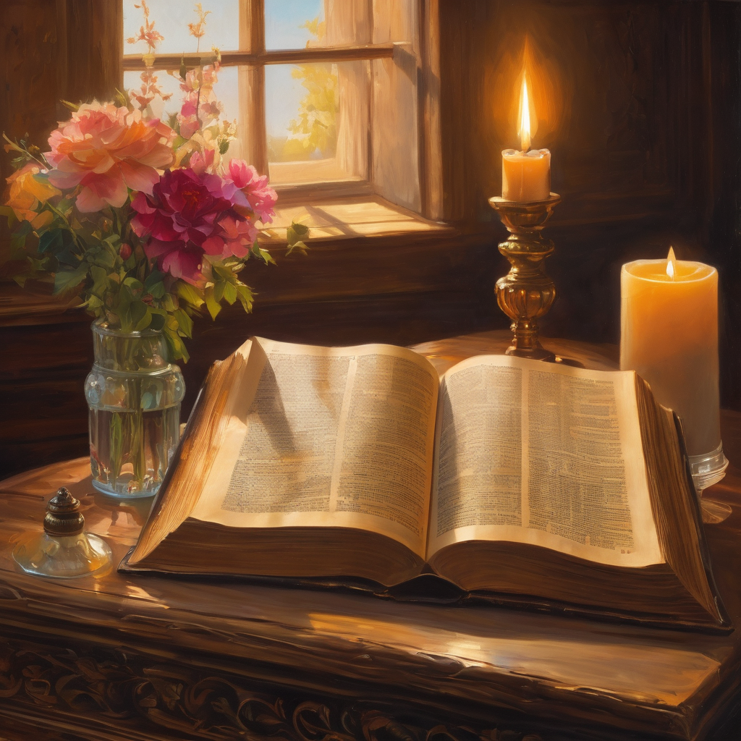
We pause
after ​the Gospel ​​

Slide 25
Leader: .
Leader and Cantor mute
Broadcaster exits screenshare
Flashback Sermon:
Do you know your Shepherd’s voice?
https://www.youtube.com/watch?v=sSwEhl2f8qA

Slide 26
Leader unmutes
Our next Hymn
By Gracious Powers
in honour of Anzac Day yesterday and has been curated by Paul for us
https://www.youtube.com/watch?v=agY9jiBggbI
We stay on mute
Leader mutes

Slide 27
The Leader and Cantor unmute
The Greeting of Peace
Leader: We are the body of Christ
All: God’s Spirit is with us
Leader: The peace of the Lord be always with you.
All: And also with you.
Leader: A sign of peace may be exchanged
You may like to type 'Peace' into the chat, use the 'raise hand’ or other reaction buttons, or just simply wave via the screen with your video turned on
(Broadcaster exits shared screen for a few moments for the exchange of peace)

Slide 28
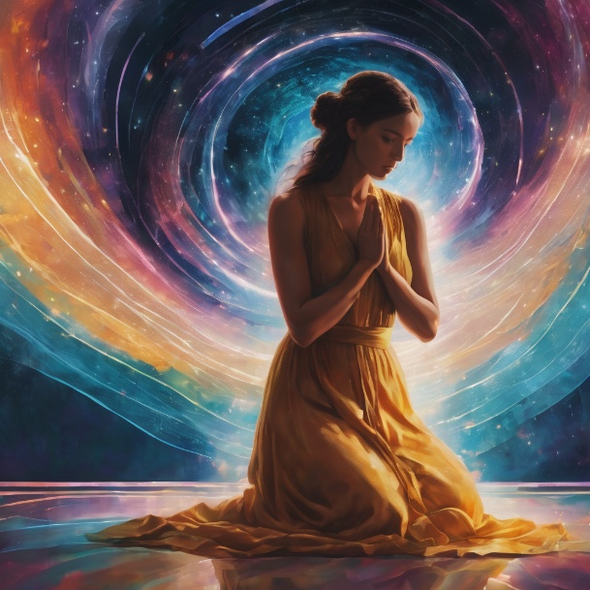
Prayer of Thanksgiving before Intercessions
Leader: As we enter prayer, I invite the second reader to unmute to lead our intercessions following the prayer of thanksgiving on the next slide. Please feel free to change your body position as you need.
Continue…

Slide 29
Leader:Lord, we thank you for calling us here each week,
to this place where we can tune into your voice and drown
out the din of the world’s voices.
We praise you for the deep knowledge we have of you,
the trust of a flock for their Good Shepherd.
Thank you, Lord Jesus, for teaching us to hear your voice in the Gospels
and in the stillness of our personal prayer.
Good Shepherd, may we ever raise our voices in praise,
to the one whose firm, gentle command
is our gateway to life in all its abundant fullness. Amen.

Slide 30
Intercessions
Reader 2: We pray for creation and communities we share our lives with. We pause for a few moments to name either in our hearts, or out loud, or in the chat, those environments and communities we bring to the Lord in prayer.
PAUSE…
Continue…

Slide 31
Intercessions
Reader 2: We entrust to you the community of Holy Hermits Online and our ministry partners:
Prosper the work of our hands and show us the way to your new creation.
Creator God, Hear our prayer.
St John's Cathedral Brisbane The Anglican Diocese of Southern Queensland St Gabriel’s, Carindale Benedictus Contemplative Church, Canberra Anglican Focus and Tithe.ly

Slide 32
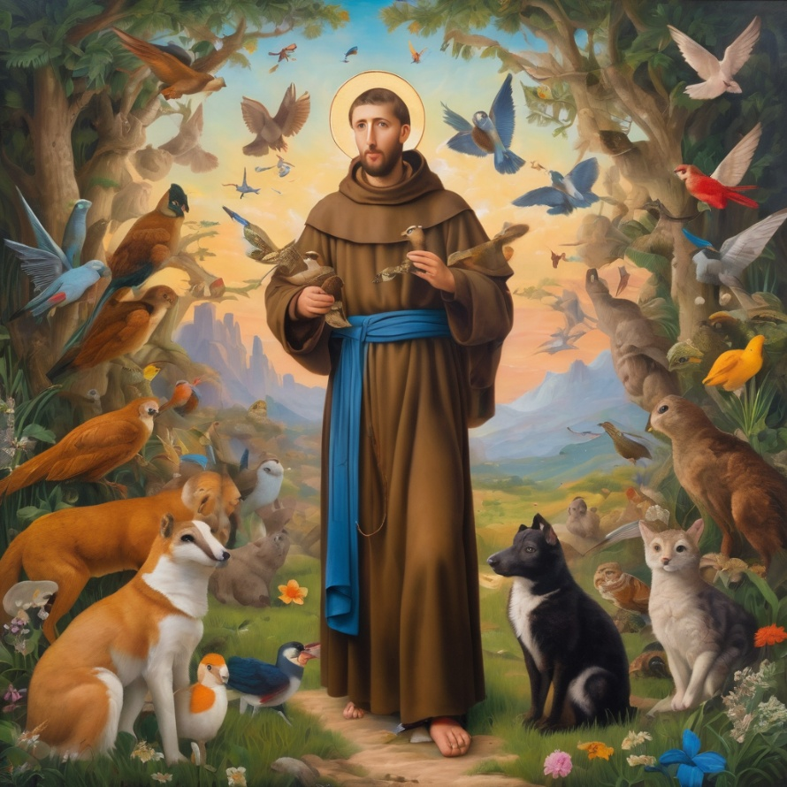
Reader 2: Loving Creator, we entrust to you all animals, especially those who are sick, anxious, ageing, lost, at risk, lonely, sad, hungry, in pain, homeless, abused, living in fear, encountering violence of any kind, in need of comfort, rehabilitation or transformation.
Continue…

Slide 33
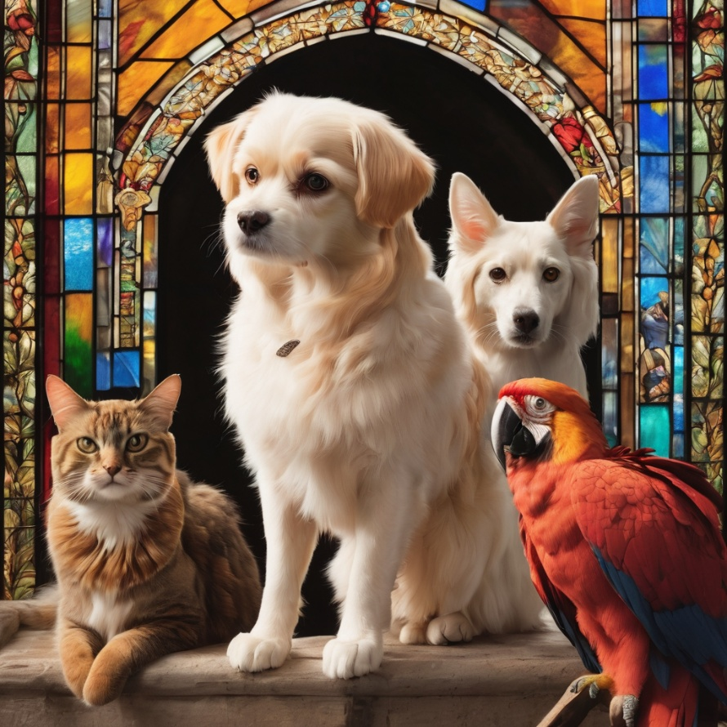
Reader 2: We invite your loving compassion for:
We name in our hearts, out loud or in the chat,
the animals we bring to the Lord in prayer. PAUSE…
Jasmine, ​
Leese(y), ​
Sid, Toots & Lulu​
Polly and Suki​
Fred, George & Percy​
Koshka ​
Jax
Lambert ​​
Kala, Nigel & Little One ​​
Toby​​
Taco​​
Paddy ​​
Rosie​

Slide 34
Reader 2: Eternal Trinity of Love, we uphold to you the people we love and carry cares for:
Kerry, Les & Jake Julie, Ray, Tracey & Shane Mark, Desley & Bob ​​ Rachel, Mervyn & Gillian ​​Rev'd Shane & Janette​​ Alecia, Martin & Aidan​​ Kirsten, Greg, Daphne & Beau Bill & Marjorie​​ Aaron & Andrea Bonnie & girls Liz’s Godchildren | Barry​​ Dr Julie ​​ Ruth​​ Phil​ May Susan Tanya​ Neva Kathy ​Gayanne Tina | ​​ | Alan & Gaylene​ Jess & Leah ​​ Barry & Gwen Matthew & Nicholas​ Bob & Di​ Pat & Julie Dilys & Tony, Paul & Darhon Judy & Mary Miriam
Continue…

Slide 35
Reader 2:
We name in our hearts, out loud or in the chat, those we bring to the Lord in prayer.
PAUSE…
We entrust to you those who have died, those who have died peacefully and those who have died tragically, The old and the young. Receive them into your Kingdom. Lord in your mercy, Hear our prayers. Amen.

Slide 36
Pray Daily Cycle of Prayer
Leader: Loving God, joining with the Church in our cycle of prayer, we ask your blessings on:
The Church of Nigeria (Anglican Communion)
The Diocese of Wangaratta: †Clarence; Clergy and People
The Parish of Carindale: Lynda, Allan, John, Ron
AnglicareSQ Out of Home Care, Central Region – Sunshine Coast Foster & Kinship Care

Slide 37
Commitment prayer for the week: Natural Disasters
All things look to you, O Lord, to give them their food in due season: look in mercy on your people, and hear our prayer for those whose lives and possessions have been affected by natural disaster. ​We ask that all our first responders, volunteers and emergency service workers be given strength and care, rest and recuperation. ​
We uphold the vulnerable ones, children and animals, people living rough and in financial distress; that they be given courage and the appropriate support. ​Please empower community groups and organisations as they step up.
Continue…
Notes:
Link to prayer group ministry page for weekly commitment prayer https://holyhermits.com.au/ministries/prayer-group

Slide 38
Encourage neighbours as they look out for one another. Inspire communities to support and resource animal organisations as they offer sanctuary and care for displaced animals—domestic, farm and wild. ​
Give courage to all who work in ongoing trauma recovery; support workers, doctors, nurses, social workers, psychologists, veterinarians, counselling services, chaplains, clergy and local ministers. May they be enabled to sustain good self-care practices, access resources, find strength and resilience, peace and rest.​
Continue…
Notes:
Link to prayer group ministry page for weekly commitment prayer https://holyhermits.com.au/ministries/prayer-group

Slide 39
May all who suffer survivor guilt, be compassionate towards themselves and find grace in you. Holy Spirit please gently lead their energy into prayer, loving service and gratitude, so they can experience and share peace. ​
We entrust the rebuilding efforts into your care Lord. May the resources needed become available, the trades people offering their skills be honest and diligent. ​
We hold before you Lord, local council and governments especially politicians and leaders as they represent people and places. Give them inspiration, wisdom and discernment. ​
Continue…

Slide 40
In your mercy restore your creation and heal our lands, air and waterways, regenerate all that has been destroyed and inspire people to help with that new growth and restoration. ​
So guide and bless your people, that we may enjoy the fruits of the earth and give you thanks with grateful hearts, through our Lord Jesus Christ.
Amen.

Slide 41
Leader: Let us pray together the prayer which Jesus gave us saying:
All: Our Father in heaven, hallowed be your name,
your kingdom come, your will be done, on earth as in heaven.
Give us today our daily bread.
Forgive us our sins
as we forgive those who sin against us.
Save us from the time of trial and deliver us from evil.
For the kingdom, the power, and the glory are yours
now and for ever.
Amen.

Slide 42
Devotions

Slide 43
Hermit Wisdom
Herbert led a life of quiet contemplation and yet became the inspiration for writers and poets alike. His friendship with St Cuthbert is a beacon for the extraordinary power of connection. This prayer is inspired by the example of friendship shown by Herbert of Derwent Water.
God of friendship and all company. Thank you for St Herbert’s example of friendship with St Cuthbert. May we too be inspired to great friendships, where we journey together in faith and encourage one another by living as your disciples. Amen.

Slide 44
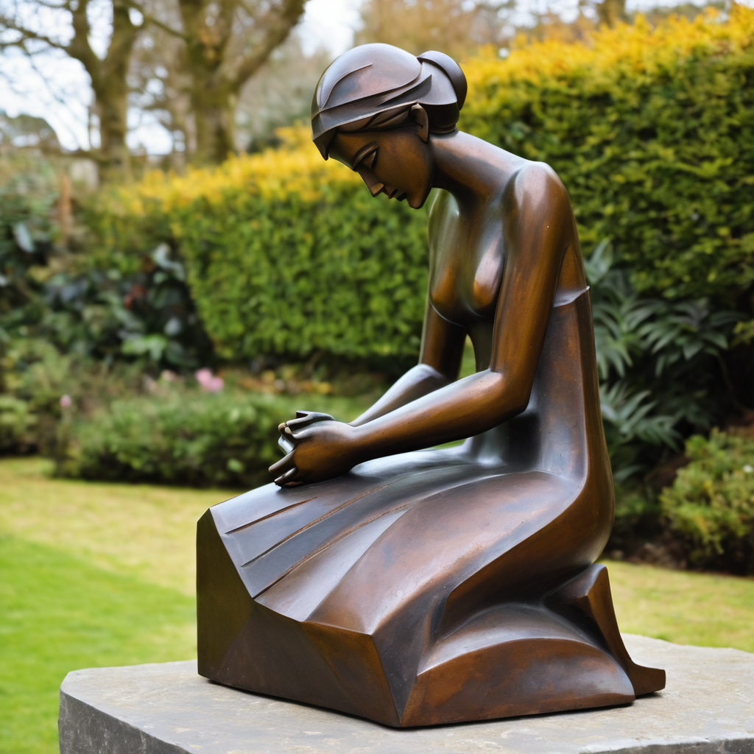
​
Leader: ​As we enter a few minutes of silence together, you are invited to pray the prayer of adoration on the next slide and/or spend this time in contemplation. ​
The Spiritual Communion prayer follows on the slide after that.
Let us be still.
Leader and Cantor Mute.
Continue…

Slide 45
Dear God,
thank you for the gift of faith,
which is more precious than gold.
Thank you for the different ways we have of knowing you.
Help us to leave everything that takes us away from you
at the cross. Amen.
​

Slide 46
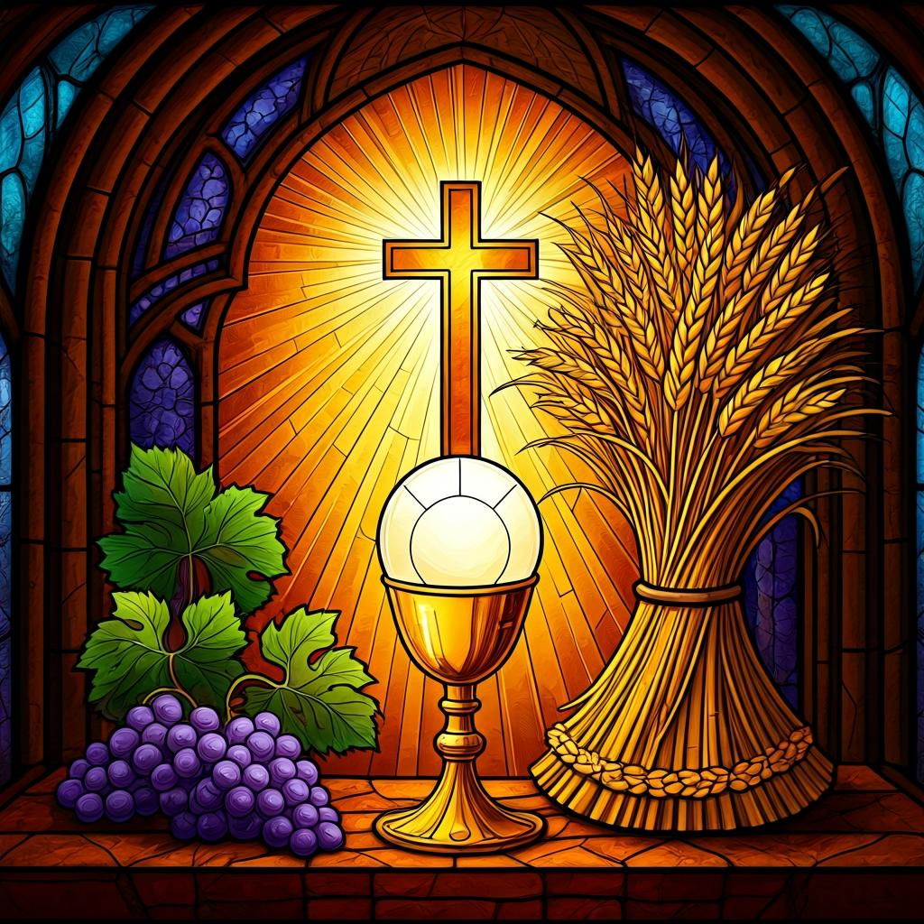
Oh, my Lord Jesus I turn to you present at the Altar and in the Tabernacle. I believe that you are present in the Holy Sacrament of your most Sacred Body and Blood. I love you above all things and I desire to receive you into my Soul. I cannot at this moment receive you Sacramentally in Holy Communion. Come spiritually into my heart. Purify it, Sanctify it. Render my heart like your own heart. I embrace you as if you were already there and unite myself wholly with you. Never permit me to be separated from you. Lord, I am not worthy to receive you, but only say the word and I shall be healed. Amen
Making a
Spiritual Communion
(Prayed in silence)

Slide 47
Leader unmutes
Our final song is
Psalm 23
https://www.youtube.com/watch?v=A-qLa_2GPcM
​We stay on mute
Leader and Cantor mute

Slide 48
Leader and cantor unmute
Sending Prayer
Leader: We pray our sending prayer together.
All (cantor): Lord, as we leave this place of worship,
go before us.
Let us hear your voice this week
and lead us through the gate
to live an abundant life with you.
Amen.

Slide 49
The Benediction
Leader: Let us all invite God’s blessings together,
All (cantor): As we leave, leave with us, Lord,
walk with us always.
Be there as we share bread
and help us to share with others in need.
Amen.

Slide 50
Notices
Today at 11am is our Companion Animal Ministry Workshop, all are welcome as we prepare for our AWL guest
If anyone is interested in sharing some information on a Saint, or Holy Hermit for our 2nd Sunday Saint Spotlight in June please contact Rev’d Lauren.
See HHO Events page for further upcoming events HHO Events

Slide 51
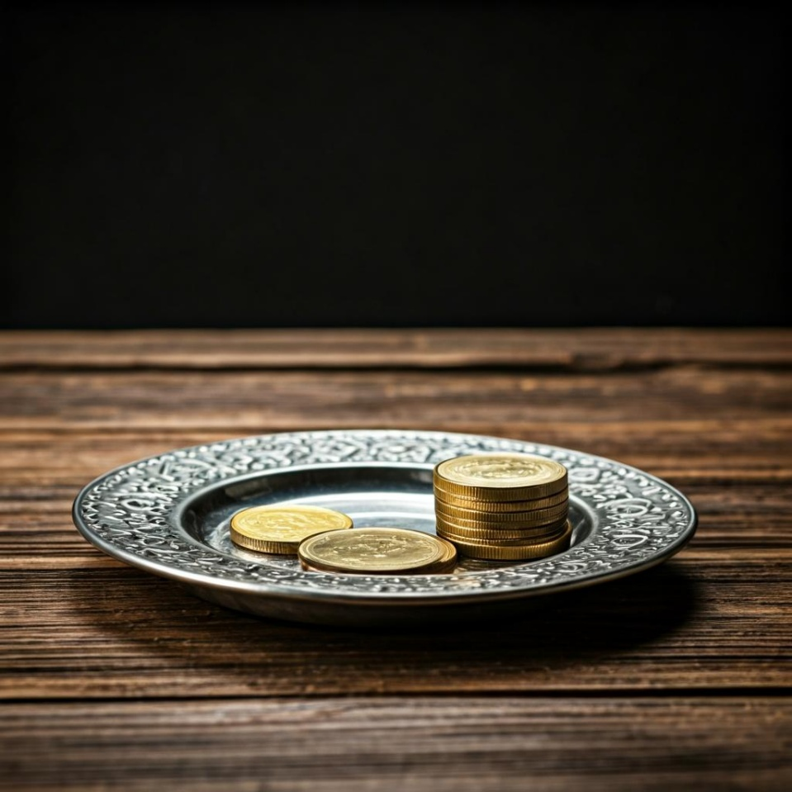
Leader: Thank you for your regular gifts to this ministry. Offerings are most welcome via:
The HHO App
Direct Debit
International Direct Debit
Please consider a one-off donation
or leaving a legacy in your Will
For further information go to HHO give page
https://holyhermits.com.au/give

Slide 52
Serving next week
3 May 2026
5th Sunday of Easter
9:00 am AEST
Service Prep: Lauren | Chat Host: Rachel | First Reader: Barry
Music: Lauren | Welcomer: Chris | Second Reader: Bob
Proof-reader: Rachel | Priest: N/A | Preacher: Lauren
Broadcaster: Lauren | Deacon: Lauren | Fellowship: Rachel
Backup Broadcaster: Barry | Leader: Jeremy | Safety Officer: Julie
Zoom Buttons: Lauren | Cantor: Julie | Attendance: Rachel
Thank you for your ministry gifts
New Servers always welcome!
Please email Rev’d Lauren to get involved
holyhermits@anglicanchurchsq.org.au

Slide 53
The Dismissal
Leader: I invite everyone to unmute for the Dismissal
Leader: Go in peace to love and serve the Lord.
All: In the name of Christ, Amen.

Slide 54
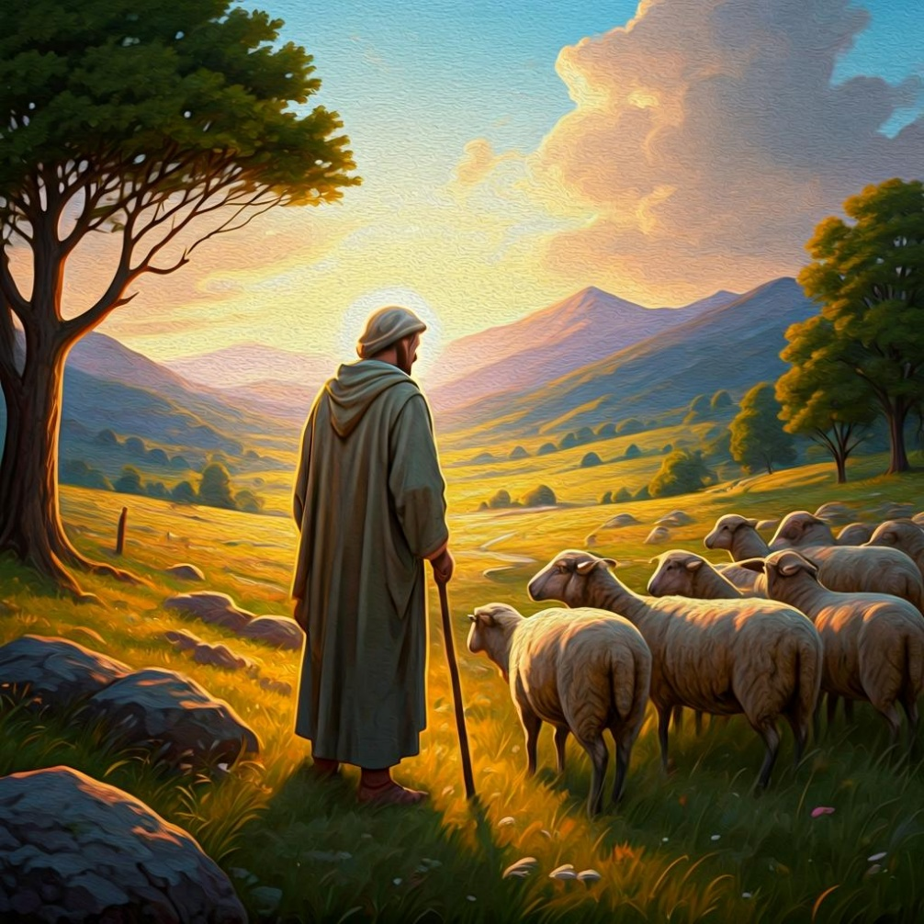
Fellowship time
Thank you, Julie for leading Fellowship
Please feel welcome to linger or pop a message in the chat and head off when you are ready.​
Extra resources developed
by Roots on the Web
Artwork created on Padlet

