Slide 1
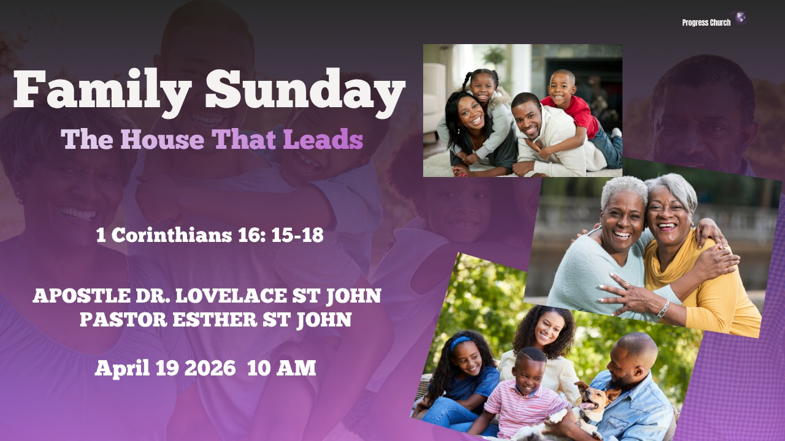

Slide 2



Scripture:
1 CORINTHIANS 16: 15 – 18

Slide 3
INTRODUCTION
What will your house become?
Every house is leading somewhere.
Every family is shaping a future.
Every life is leaving a legacy.
Stephanas:
He is not known for miracles.
He is not known for preaching sermons.
He is not known for writing epistles.
He is known for something powerful:
He built a household that served God.

Slide 4
1. A HOUSE THAT LEADS IN SALVATION
Stephanas and his household were the first converts in Achaia.
That means someone had to go first.
Someone had to say yes before it was popular.
Someone had to believe before there was a crowd.
Someone had to step into faith before there was evidence.
And that someone was Stephanas.

Slide 5
A HOUSE THAT LEADS IN SALVATION (cont)
His decision did not stop with him, it touched his entire household.
This is the power of one decision.
One yes to Jesus can echo through an entire family.
One act of faith can open a door for generations.
One invitation can become someone else’s transformation.

Slide 6
A HOUSE THAT LEADS IN SALVATION
On this Family Sunday, look around you.
Someone invited someone.
Someone brought someone.
Someone believed enough to say, “Come and see.”
God is still saving households.
In Acts 16, the jailer asked, “What must I do to be saved?” The answer was: “Believe in the Lord Jesus, and you will be saved, you and your household.”
God is not just interested in individuals, He is after families.

Slide 7
2. A HOUSE THAT LEADS IN SERVICE
His household devoted themselves to the service of the Lord’s people.
They didn’t just get saved, they got involved.
They didn’t just receive, they responded.
They didn’t just believe, they became a blessing.
A house that leads says:
How can we serve?
How can we help?
How can we make a difference?

Slide 8
A HOUSE THAT LEADS IN SERVICE
Stephanas’ house became known not just for what they believed, but for how they lived.
Their faith had hands.
Their love had action.
Their house had purpose.
This is what God desires for every family:
Not just to be a place where we live, but a place where we serve, we give, and we impact others.
When a house begins to serve, it begins to lead.

Slide 9
3. A HOUSE THAT LEADS IN SPIRITUAL INFLUENCE:
They have refreshed my spirit and yours also.
Stephanas’ house was not just present, it was impactful.
Their presence brought encouragement.
Their lives brought strength.
Their service brought refreshment.

Slide 10
3. A HOUSE THAT LEADS IN SPIRITUAL INFLUENCE
What happens when your house shows up?
Does peace come?
Does encouragement come?
Does faith rise?
Or does tension follow?
Does confusion increase?
Does heaviness linger?

Slide 11
A HOUSE THAT LEADS IN SPIRITUAL INFLUENCE
Stephanas built a house that when people encountered it:
They left better than they came.
They built a homes that was not just places of residence:
Where God dwells.
Where peace flows.
Where lives are lifted.

Slide 12
CONCLUSION
BUILDING A HOUSE THAT OUTLIVES YOU
Stephanas did not build a platform.
He built a household of purpose.
God is not just calling individuals, He is calling families.

Slide 13
CONCLUSION (cont)
BUILDING A HOUSE THAT OUTLIVES YOU
Families that will:
Stand for truth
Serve with humility
Strengthen the body
Leave a legacy
Because at the end of your life, the question will not be: How successful were you?
But: What did your life produce in others?

