Slide 1
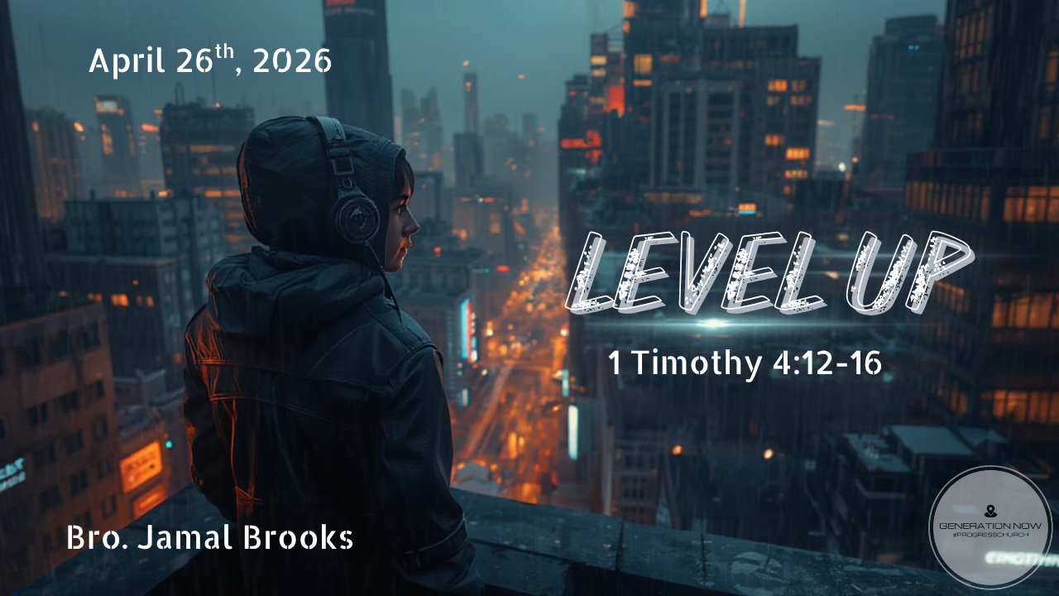

Slide 2
LEVEL UP
12 Don’t let anyone look down on you because you are young, but set an example for the believers in speech, in conduct, in love, in faith and in purity. 13 Until I come, devote yourself to the public reading of Scripture, to preaching and to teaching. 14 Do not neglect your gift, which was given you through prophecy when the body of elders laid their hands on you.
1 Timothy 4:12-14 NIV
BRO. JAMAL BROOKS | APRIL 26TH, 2026

Slide 3
LEVEL UP
15 Be diligent in these matters; give yourself wholly to them, so that everyone may see your progress. 16 Watch your life and doctrine closely. Persevere in them, because if you do, you will save both yourself and your hearers.
1 Timothy 4:15-16 NIV
BRO. JAMAL BROOKS | APRIL 26TH, 2026

Slide 4

What Does It Mean to Level Up?

Slide 5
Leveling up spiritually is not about status....
it’s about transformation.

Slide 6

Why Do We Need to Level Up?

Slide 7
Because Comfort Can Kill Calling
Hebrews 6:1 - moving beyond elementary things and becoming mature
There is a danger in:
Staying where it’s easy
Repeating the same cycles
Avoiding growth because it’s uncomfortable
Some people aren’t stuck because God isn’t moving—they’re stuck because they won’t.

Slide 8
Because Your Next Level Has People Attached to It
Genesis 12:2 - make you into a great nation and make your name great
God told Abraham:
“I will bless you… and you will be a blessing.”
Your growth is not just personal, it’s missional.
Someone is waiting on the version of you that has matured.

Slide 9
Because Growth is Evidence of Life
Colossians 2:6-7 - being rooted and built up in Him
Healthy things grow.
If nothing is changing, something is off.

Slide 10
SCRIPTURES THAT SPEAK TO LEVELING UP
Romans 12:2 – Mind renewal
2 Peter 1:5-8 – Add to your faith
Philippians 1:6 – God finishes what He starts
Proverbs 4:18 – Path gets brighter
Growth is not optional—it’s expected.

Slide 11
LEVELING UP & DISCIPLESHIP
Discipleship is not just teaching, it’s modeling growth.
Learning what it means to follow Jesus
Learning how to lead others to follow Jesus
Leveling up turns followers into leaders.
You can’t reproduce what you haven’t developed.

Slide 12

HOW TO LEVEL UP

Slide 13
MASTER WHERE YOU ARE

Slide 14
Luke 16:10 NIV “Whoever can be trusted with very little can also be trusted with much, and whoever is dishonest with very little will also be dishonest with much.

Slide 15
We often want:
Bigger platforms
Greater influence
More visibility
But ignore:
Small disciplines
Quiet obedience
Hidden integrity

Slide 16
PREPARE FOR THE NEXT LEVEL

Slide 17
Joshua 1:8 GW Never stop reciting these teachings. You must think about them night and day so that you will faithfully do everything written in them. Only then will you prosper and succeed.

Slide 18
Every level requires a new version of you.
New levels stretch your mindset
New levels expose weaknesses
New levels demand discipline
Real Talk:
Don’t pray for opportunity but avoid responsibility
Don’t ask for impact but resist structure

Slide 19
EMBRACE THE PROCESS (NOT JUST THE OUTCOME)

Slide 20
James 1: 2-4 GNT 2 My friends, consider yourselves fortunate when all kinds of trials come your way, 3 for you know that when your faith succeeds in facing such trials, the result is the ability to endure. 4 Make sure that your endurance carries you all the way without failing, so that you may be perfect and complete, lacking nothing.

Slide 21
We love promotion but avoid process.
Process feels slow
Process feels painful
Process feels unseen
But process is where:
Character is formed
Identity is developed
Faith becomes real
You don’t level up by skipping, you level up by staying.

Slide 22

LEVELING UP: THE PETER PROCESS

Slide 23
LEVEL 1: CALLED BUT UNREFINED - Luke 5
Peter is just a fisherman—working, grinding, living a normal life.
Then Jesus shows up.
Calls him to follow
Tells him to leave everything
Gives him purpose instantly
Peter responds immediately—but he’s still rough around the edges.

Slide 24
LEVEL 2: STEPPING OUT… THEN SINKING - Matthew 14
Peter does something wild—he steps out of the boat and walks on water.
But then:
He sees the wind
Fear creeps in
He starts sinking

Slide 25
LEVEL 3: FAILURE (THE BREAKING POINT) - Luke 22
This is Peter’s lowest moment.
He promised loyalty
Said he’d never leave Jesus
Then denies Him 3 times

Slide 26
LEVEL 4: RESTORATION (REBUILDING IDENTITY) - John 21
After the resurrection, Jesus meets Peter again.
He doesn’t:
Shame him
Lecture him
Replace him
Instead, He asks:
“Do you love Me?” (three times)

Slide 27
LEVEL 5: BOLD LEADERSHIP - Acts 2
Now everything changes.
Peter:
Stands in front of a crowd
Preaches Jesus boldly
3,000 people get saved
This is the same Peter who:
Was afraid of a servant girl
Hid in fear
Denied Jesus

Slide 28
Three Keys to Move Forward

Slide 29

Let Go of Who You Were So You Can Become Who God Is Calling You To Be

Slide 30
18 “Forget the former things; do not dwell on the past. 19 See, I am doing a new thing! Now it springs up; do you not perceive it? I am making a way in the wilderness and streams in the wasteland.
Isaiah 43:18-19 NIV

Slide 31
Some of us can’t level up because we’re:
Holding onto old habits
Holding onto past pain
Holding onto versions of ourselves that God is trying to grow us out of
You can’t step into new levels with old weights.

Slide 32
Say Yes to Growth Even When It Costs You

Slide 33
Then he said to them all: “Whoever wants to be my disciple must deny themselves and take up their cross daily and follow me.
Luke 9:23 NIV

Slide 34
Growth will cost:
Comfort
Convenience
Sometimes even relationships
But the cost of staying the same is greater.

Slide 35
Stay With God Even When You Don’t Understand the Season

Slide 36
Proverbs 3:5-6 - Trusting in the Lord with all you heart
Ecclesiastes 3:1-8 - There is a season for everything
There will be seasons where:
It doesn’t make sense
It feels delayed
It feels unfair
But God is not absent, He’s intentional.

