Slide 1


Slide 2


Slide 3
I AM The Living One!

Slide 4
Now after the Sabbath, as it began to dawn toward the first day of the week, Mary Magdalene and the other Mary
came to look at the tomb.
Matthew 28:1-10 NASB

Slide 5
2 And behold, a severe earthquake had occurred, for an angel of the Lord descended from heaven and came and rolled away the stone, and sat upon it.
Matthew 28:1-10 NASB

Slide 6
3 And his appearance was like lightning,
and his clothing as white as snow.
4 The guards shook from fear of him and became like dead men.
Matthew 28:1-10 NASB

Slide 7
5 And the angel said to the women,
“Do not be afraid; for I know that you are looking for Jesus who has been crucified.
6 He is not here, for He has risen,
just as He said.
Come, see the place where He was lying.
Matthew 28:1-10 NASB

Slide 8
⁷ And go quickly and tell His disciples that He has risen from the dead; and behold, He is going ahead of you to Galilee.
There you will see Him;
behold, I have told you.
Matthew 28:1-10 NASB

Slide 9
⁸ And they left the tomb quickly with fear and great joy, and ran to report to His disciples. ⁹ And behold, Jesus met them
and said, “Rejoice!”
And they came up and took hold of His feet, and worshiped Him.
Matthew 28:1-10 NASB

Slide 10
¹⁰ Then Jesus said to them,
“Do not be afraid; go,
bring word to My brothers to leave for Galilee, and there they will see Me.”
Matthew 28:1-10 NASB

Slide 11
I am the Living One;
I was dead, and now look,
I am alive for ever and ever!
Revelation 1:18

Slide 12
He Keeps His Word

Slide 13
⁶ He is not here, for He has risen,
just as He said.
Matthew 28:6

Slide 14
He said to them,
“The Son of Man is going to be delivered
into the hands of men.
They will kill him,
and after three days
he will rise.”
Mark 9:31

Slide 15
²⁰ For no matter how many promises God has made,
they are “Yes” in Christ.
And so through him the “Amen”
is spoken by us
to the glory of God.
2 Corinthians 1:20

Slide 16
It is Finished-
And It is Real.

Slide 17
Jesus himself stood among them and said to them, “Peace be with you.”
³⁷ They were startled and frightened, thinking they saw a ghost. ³⁸ He said to them, “Why are you troubled, and why do doubts rise in your minds? ³⁹ Look at my hands and my feet.
It is I myself! Touch me and see; a ghost does not have flesh and bones, as you see I have.”
Luke 24:36-39

Slide 18
⁴⁸ You are witnesses of these things.
Luke 24:48

Slide 19
He is Alive-
And He is Here.

Slide 20
⁴ In him was life, and that life was the light of all mankind.
⁵ The light shines in the darkness,
and the darkness has not overcome it.
John 1:4-5

Slide 21
“I have told you these things,
so that in me you may have peace.
In this world you will have trouble.
But take heart!
I have overcome the world.”
John 16:33

Slide 22
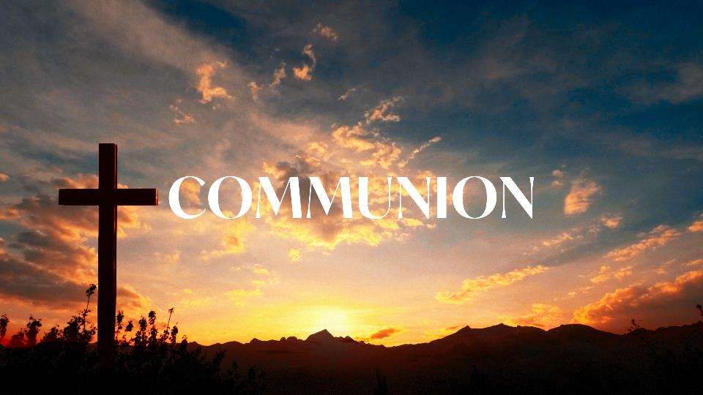

Slide 23
Believe
And Live.

Slide 24
Now faith is confidence in
what we hope for
and assurance about
what we do not see.
Hebrews 11:1

Slide 25
Whom the Son Sets Free is Free Indeed!
Don’t go back to the grave when the stone has already been rolled away.
Don’t keep wearing what He
already took off of you.
The resurrection is not just
something to celebrate—
it is something to step into.

Slide 26


Slide 27


