Slide 1
LUKE 1:26-56
The Gift of Salvation
Trusting God in Times of Uncertainty

Slide 2
LUKE 1:26-56 NIV
The Birth of Jesus Foretold
In the sixth month of Elizabeth’s pregnancy, God sent the angel Gabriel to Nazareth, a town in Galilee,27 to a virgin pledged to be married to a man named Joseph, a descendant of David. The virgin’s name was Mary. 28 The angel went toher and said, “Greetings, you who are highly favored! The Lord is with you.”
29 Mary was greatly troubled at his words and wondered what kind of greeting this might be. 30 But the angel said to her, “Do not be afraid, Mary; you have found favor with God. 31 You will conceive and give birth to a son, and you are to call him Jesus. 32 He will be great and will be called the Son of the Most High. The Lord God will give him the throne of his father David, 33 and he will reign over Jacob’s descendants forever; his kingdom will never end.”
34 “How will this be,” Mary asked the angel, “since I am a virgin?”

Slide 3
LUKE 1:26-56 NIV
34 “How will this be,” Mary asked the angel, “since I am a virgin?”
35 The angel answered, “The Holy Spirit will come on you, and the power of the Most High will overshadow you. So the holy one to be born will be called[a] the Son of God. 36 Even Elizabeth your relative is going to have a child in her old age, and she who was said to be unable to conceive is in her sixth month. 37 For no word from God will ever fail.”
38 “I am the Lord’s servant,” Mary answered. “May your word to me be fulfilled.” Then the angel left her.

Slide 4
LUKE 1:26-56 NIV
Mary Visits Elizabeth
39 At that time Mary got ready and hurried to a town in the hill country of Judea, 40 where she entered Zechariah’s home and greeted Elizabeth. 41 When Elizabeth heard Mary’s greeting, the baby leaped in her womb, and Elizabeth was filled with the Holy Spirit. 42 In a loud voice she exclaimed: “Blessed are you among women, and blessed is the child you will bear! 43 But why am I so favored, that the mother of my Lord should come to me? 44 As soon as the sound of your greeting reached my ears, the baby in my womb leaped for joy. 45 Blessed is she who has believed that the Lord would fulfill his promises to her!”

Slide 5
LUKE 1:26-56 NIV
Mary’s Song
46 And Mary said:
“My soul glorifies the Lord
47 and my spirit rejoices in God my Savior,
48 for he has been mindful
of the humble state of his servant.
From now on all generations will call me blessed,
49 for the Mighty One has done great things for me—
holy is his name.
50 His mercy extends to those who fear him,
from generation to generation.

Slide 6
LUKE 1:26-56 NIV
He has performed mighty deeds with his arm;
he has scattered those who are proud in their inmost thoughts.
52 He has brought down rulers from their thrones
but has lifted up the humble.
53 He has filled the hungry with good things
but has sent the rich away empty.
54 He has helped his servant Israel,
remembering to be merciful
55 to Abraham and his descendants forever,
just as he promised our ancestors.”
56 Mary stayed with Elizabeth for about three months and then returned home.

Slide 7
LUKE 1:26-56
Trusting God in Times of Uncertainty

Slide 8
EMBRACE THE REVERSAL
LUKE 1:46-56

Slide 9
The Magnificat
  The proud are scattered
  The humble are lifted
  The hungry are filled
The upside-down kingdom of God

Slide 10
The reversal of God’s kingdom
  The proud are scattered
  The powerful are brought down
  The humble are lifted up
  The hungry are filled

Slide 11
Isaiah 9:6–7
For to us a child is born, to us a son is given, and the government will be on his shoulders.
And he will be called Wonderful Counselor, Mighty God, Everlasting Father, Prince of Peace.
7 Of the greatness of his government and peace there will be no end.
He will reign on David’s throne and over his kingdom, establishing and upholding it with justice and righteousness from that time on and forever.
The zeal of the Lord Almighty will accomplish this.

Slide 12
They expected:
A ruler
A kingdom
Authority and power

Slide 13
Daniel 2:44 NIV
In the time of those kings, the God of heaven will set up a kingdom that will never be destroyed, nor will it be left to another people. It will crush all those kingdoms and bring them to an end, but it will itself endure forever.
They were looking for:
  A kingdom that destroys all others
  Total victory
  Permanent rule

Slide 14
He didn’t take a throne.
He went to a cross instead.
He didn’t crush Rome.
He carried our sin.”

Slide 15
world says:
  Be strong
  Be in control
  Be successful
God says:
  Be humble
  Be surrendered
  Be dependent

Slide 16
Will we embrace God’s way…
even when it feels upside down?

Slide 17
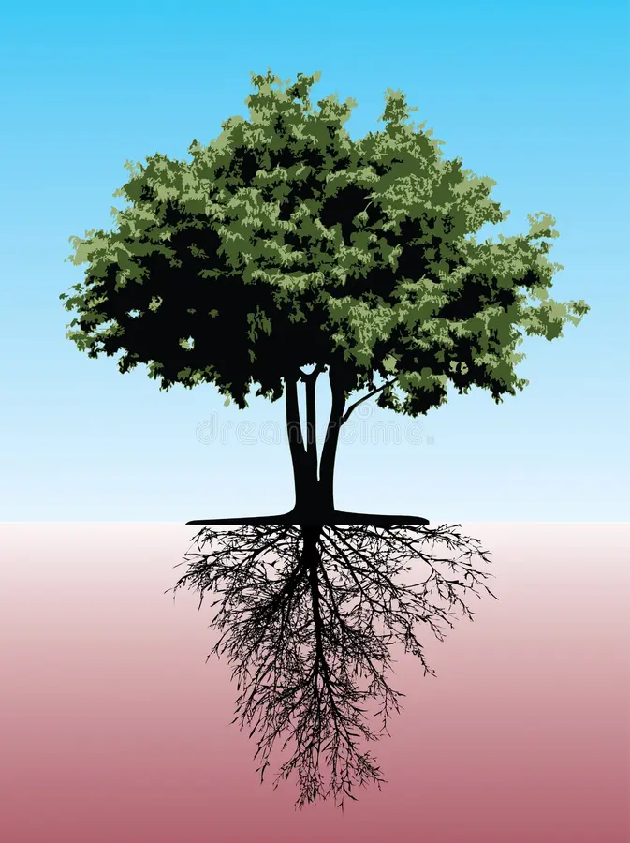
Gravitropic
Phototropic

Slide 18
Colossians 2:6–7, it says,
“So then, just as you received Christ Jesus as Lord, continue to live your lives in him, rooted and built up in him…”

Slide 19
SURRENDER CONTROL
LUKE 1:34-38

Slide 20
We feel safe whe we are in control.
  What is happening
  When it will happen
  How it will happen

Slide 21
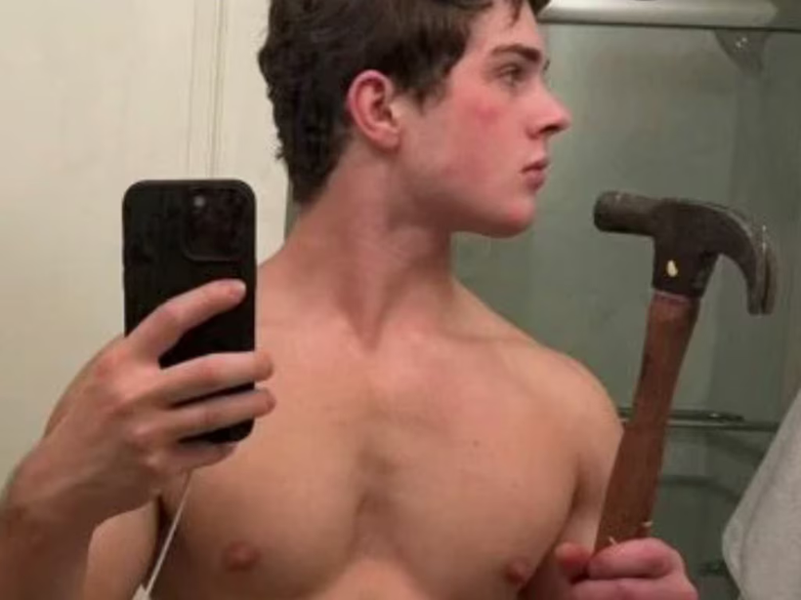




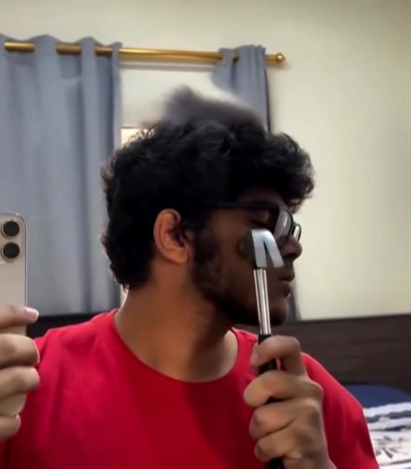
LOOKSMAXXING

Slide 22
1 PETER 3:3–4
“Your beauty should not come from outward adornment… Rather, it should be that of your inner self, the unfading beauty of a gentle and quiet spirit…”

Slide 23
Faith requires:
  Surrender before clarity
  Obedience before understanding
  Trust before resolution

Slide 24
LUKE 22:42
“Father, if You are willing, take this cup from Me; yet not My will, but Yours be done.”

Slide 25
Trust the Disruption
LUKE 1:26-33

Slide 26
LEVITICUS 20:10
“If a man commits adultery with another man’s wife… both the adulterer and the adulteress are to be put to death.”

Slide 27
Greek
“Favoured one" - kecharitomene, (κεχαριτωμένη) one who has received grace or favour
"you have found favour [charis (χάρις) = favour or grace]

Slide 28
Marry carry Jesus Christ into the world.
Which is:
  Costly
  Risky
  Uncertain
But also carry:
  Redemptive
  Eternal
  Glorious

Slide 29
He interrupts our separation from God.
He interrupts our guilt.
He interrupts our shame.
He interrupts our constant attempt to save ourselves.

Slide 30
Can you trust God’s plan…
even when it disrupts yours?

Slide 31
When life feels out of control, God is still in control.

