Slide 1
Welcome to Holy Hermits Online Worship
Third Sunday in Easter
Today we are remembering
Holy Hermit Jan Tyranowski
Service Prep: Kristine | Chat Host: Rachel | First Reader: Helen
Music: Wiggles 🐶 | Welcomer: Chris | Second Reader: Roselyn
Proof-reader: Viki | Priest: N/A | Preacher: Lauren
Broadcaster: Barry | Deacon: Lauren | Fellowship: Julie
Backup Broadcaster: Paul | Leader: Jeremy | Safety Officer: Julie
Zoom Buttons: Lauren | Cantor: Margo | Attendance: Rachel

Slide 2






Hospitality
Leader:
Please mute for the service unless invited to offer your voice as part of the service ministry
Have the video camera on or off and turn the volume and brightness up or down on your device if things are too loud 🔉🔊or too bright🔅🔆
Our Cantor acts as our voice, offering the responses, in Bold Text, which we say together
Feel welcome to use the chat and reaction emojis 👍
🙏 Please take care of yourself in this space. 🙏 Come and go as you need
😴 It is great to take rest in this space, so falling asleep is also OK 😴
👂️ Remember, pastoral care is available to all in the community, if you'd like to speak to someone about anything spiritual. ❤️ Visit the help page at the website to reach out 🌐
Our Being Together ethos and safeguarding practices can also be accessed on the website 🫶​
🙌 Come as you are – we are all here together! 🙌
Notes:
Used Lent 2022

Slide 3
Leader: Our Holy Hermit today is Jan Tyranowski
Servant of God and Mystic.
You never know what your particular ‘yes’ to God can do: Maybe transform a family, a community, a parish. Maybe lead someone else to the Faith. Maybe introduce the healing journey to a wounded heart. Or maybe, just maybe—form the soul of a future pope.
In the middle of the madness of Nazi-occupied Poland, with priests sent to concentration camps and youth in desperate need of connection and spiritual nourishment,
Continue…

Slide 4
a simple tailor with a mystical bent volunteered to step into the breach and lead youth ministry at his parish. Jan Tyranowski’s simple holiness, genuine love, and zeal for the Lord would prove transformative to a young student-worker there named Karol Wojtyla. The future John Paul II would be introduced to the writings of St. John of the Cross by this unassuming layman—and from that point on, his personal spirituality would take on a particularly Carmelite charism.
To read more about our hermits click the link​​ in the send out

Slide 5
Invitation
Leader: As we come into worship let’s take a few deep breaths,
Let go of anything that isn’t serving us,
And become aware of God’s presence here with us.
Opening Music: Road to Emmaus -
Instrumental Solo by Moments of Prayer and Stacey Plays Hymns

Slide 6
Leader and Cantor unmute
The Greeting
Leader: Christ has risen, Alleluia!
All: Christ is risen indeed, Alleluia!

Slide 7
Gathering Prayer
Leader:
We break open the doors and gather together. We break down the walls and invite others in. We break open the word of God as we share. We break bread together and see God among us. Come, let us break bread together.

Slide 8
Gathering Prayer
All: ​Heavenly Father, you brought us together in this place. Let us worship you, that we may know your Son,
Jesus, through word and deed. Let our hearts burn within us as we worship you.
Amen.

Slide 9
Sentence
Leader: I invite our Cantor to proclaim the sentence for today.
Cantor: Repent, and be baptised every one of you in the name of Jesus Christ so that your sins may be forgiven; and you will receive the gift of the Holy Spirit.
Acts 2.38-39

Slide 10
Prayer of Approach
Leader: We pray the prayer of approach together
All:
O Lord, who walks with us along life’s way, we come before you today, joyful to be back in your house. Draw near to us as we draw near to you, we pray, and may we step forward together on this journey of worship and praise. Amen.

Slide 11
The Gloria​
(to be sung every Sunday during the Season of Easter)
Leader: We now sing the Gloria together
https://www.youtube.com/watch?v=Zn4SQmcFqUQ
Leader Mutes

Slide 12
Collect
Leader: O God,
your Son made himself known to his disciples
in the breaking of bread:
open the eyes of our faith,
that we may see him in his redeeming work;
who is alive and reigns with you and the Holy Spirit,
one God, now and for ever.
Amen.

Slide 13
The 1st reader unmutes
Leader: I invite the 1st reader to unmute and offer the 1st lesson when ready.
Reader 1: The 1st Reading is from Acts 2.14a; 2.36-41
¹⁴ But Peter, standing with the eleven, raised his voice and addressed them: ‘Men of Judea and all who live in Jerusalem, let this be known to you, and listen to what I say. ³⁶ Therefore let the entire house of Israel know with certainty that God has made him both Lord and Messiah, this Jesus whom you crucified.’ ³⁷ Now when they heard this, they were cut to the heart and said to Peter and to the other apostles, ‘Brothers, what should we do?’
Continue…

Slide 14
³⁸ Peter said to them, ‘Repent, and be baptized every one of you in the name of Jesus Christ so that your sins may be forgiven; and you will receive the gift of the Holy Spirit. ³⁹ For the promise is for you, for your children, and for all who are far away, everyone whom the Lord our God calls to him.’ ⁴⁰ And he testified with many other arguments and exhorted them, saying, ‘Save yourselves from this corrupt generation.’ ⁴¹ So those who welcomed his message were baptized, and that day about three thousand persons were added.
For the word of the Lord. Thanks be to God.​

Slide 15
Leader: We now say the psalm antiphonally, I invite the first reader to lead, and we will all respond with our cantor as our voice.
Psalm 116
1-4
11-18
¹ I love the Lord, because he heard my voice:
the voice of my supplication;
² Because he inclined his ear to me:
in the day that I called to him.
³ The cords of death encompassed me,
the snares of the grave took hold on me:
I was in anguish and sorrow.
Continue…

Slide 16
⁴ Then I called upon the name of the Lord:
‘O Lord, I beseech you, deliver me !’
¹¹ How shall I repay the Lord:
for all his benefits to me?
¹² I will take up the cup of salvation:
and call upon the name of the Lord.
¹³ I will pay my vows to the Lord:
in the presence of all his people.
Continue…

Slide 17
¹⁴ Grievous in the sight of the Lord:
is the death of his faithful ones.
¹⁵ O Lord, I am your servant,
your servant and the child of your handmaid:
you have unloosed my bonds.
¹⁶ I will offer you a sacrifice of thanksgiving:
and call upon the name of the Lord.
Continue…

Slide 18
¹⁷ I will pay my vows to the Lord:
in the presence of all his people,
¹⁸ In the courts of the house of the Lord:
even in your midst, O Jerusalem.
Praise the Lord.
Continue…

Slide 19
The 2nd reader unmutes
Leader: Thank you, I invite the 2nd reader to unmute and offer the 2nd lesson when ready.
Reader 2: The 2nd Reading is from 1 Peter 1.13-25
¹³ Therefore prepare your minds for action; discipline yourselves; set all your hope on the grace that Jesus Christ will bring you when he is revealed. ¹⁴ Like obedient children, do not be conformed to the desires that you formerly had in ignorance. ¹⁵ Instead, as he who called you is holy, be holy yourselves in all your conduct;
Continue…

Slide 20
¹⁶ for it is written, ‘You shall be holy, for I am holy.’ ¹⁷ If you invoke as Father the one who judges all people impartially according to their deeds, live in reverent fear during the time of your exile. ¹⁸ You know that you were ransomed from the futile ways inherited from your ancestors, not with perishable things like silver or gold, ¹⁹ but with the precious blood of Christ, like that of a lamb without defect or blemish.
Continue…

Slide 21
²⁰ He was destined before the foundation of the world, but was revealed at the end of the ages for your sake. ²¹ Through him you have come to trust in God, who raised him from the dead and gave him glory, so that your faith and hope are set on God. ²² Now that you have purified your souls by your obedience to the truth so that you have genuine mutual love, love one another deeply from the heart.
Continue…

Slide 22
²³ You have been born anew, not of perishable but of imperishable seed, through the living and enduring word of God. ²⁴ For ‘All flesh is like grass and all its glory like the flower of grass. The grass withers, and the flower falls, ²⁵ but the word of the Lord endures for ever.’ That word is the good news that was announced to you.
For the word of the Lord. Thanks be to God.​

Slide 23

We pause before
​the Gospel ​​

Slide 24
Deacon: The Gospel of our Lord Jesus Christ according to St Luke Chapter 24 beginning at the 13th verse
All: Glory to you Lord Jesus Christ.
¹³ Now on that same day two of them were going to a village called Emmaus, about seven miles from Jerusalem, ¹⁴ and talking with each other about all these things that had happened. ¹⁵ While they were talking and discussing, Jesus himself came near and went with them, ¹⁶ but their eyes were kept from recognizing him. ¹⁷ And he said to them, ‘What are you discussing with each other while you walk along?’ They stood still, looking sad.
Continue…

Slide 25
¹⁸ Then one of them, whose name was Cleopas, answered him, ‘Are you the only stranger in Jerusalem who does not know the things that have taken place there in these days?’ ¹⁹ He asked them, ‘What things?’ They replied, ‘The things about Jesus of Nazareth, who was a prophet mighty in deed and word before God and all the people, ²⁰ and how our chief priests and leaders handed him over to be condemned to death and crucified him. ²¹ But we had hoped that he was the one to redeem Israel. Yes, and besides all this, it is now the third day since these things took place.
Continue…

Slide 26
²² Moreover, some women of our group astounded us. They were at the tomb early this morning, ²³ and when they did not find his body there, they came back and told us that they had indeed seen a vision of angels who said that he was alive. ²⁴ Some of those who were with us went to the tomb and found it just as the women had said; but they did not see him.’ ²⁵ Then he said to them, ‘Oh, how foolish you are, and how slow of heart to believe all that the prophets have declared! ²⁶ Was it not necessary that the Messiah should suffer these things and then enter into his glory?’
Continue…

Slide 27
²⁷ Then beginning with Moses and all the prophets, he interpreted to them the things about himself in all the scriptures. ²⁸ As they came near the village to which they were going, he walked ahead as if he were going on. ²⁹ But they urged him strongly, saying, ‘Stay with us, because it is almost evening and the day is now nearly over.’ So he went in to stay with them. ³⁰ When he was at the table with them, he took bread, blessed and broke it, and gave it to them. ³¹ Then their eyes were opened, and they recognized him; and he vanished from their sight.
Continue…

Slide 28
³² They said to each other, ‘Were not our hearts burning within us while he was talking to us on the road, while he was opening the scriptures to us?’ ³³ That same hour they got up and returned to Jerusalem; and they found the eleven and their companions gathered together. ³⁴ They were saying, ‘The Lord has risen indeed, and he has appeared to Simon!’ ³⁵ Then they told what had happened on the road, and how he had been made known to them in the breaking of the bread.
This is the Gospel of the Lord. Praise to you Lord Jesus Christ.

Slide 29
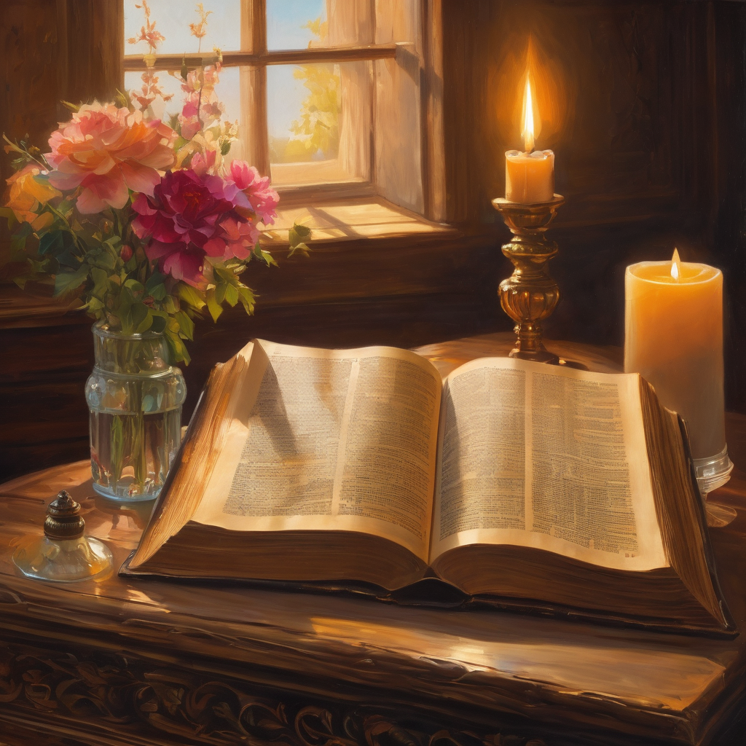
We pause
after ​the Gospel ​​

Slide 30
Leader: The Sermon is recorded to YouTube for sharing later.
Only the preacher's video and audio will be recorded.
The chat and other participants' feeds remain out of sight of the recording.
Leader and Cantor mute
Broadcaster exits screenshare
Preacher unmutes
Zoom buttons ”pins” preacher’s screen + selects “record to the cloud”
Sermon
Notes:
Add note to slides to check with broadcaster/zoom button about recording when clergy away.

Slide 31
Leader unmutes
Our next Hymn
Two Were Bound for Emmaus
Two Were Bound for Emmaus
We stay on mute
Leader mutes

Slide 32
The Leader and Cantor unmute
The Greeting of Peace
Leader: We are the body of Christ
All: God’s Spirit is with us
Leader: The peace of the Lord be always with you.
All: And also with you.
Leader: A sign of peace may be exchanged
You may like to type 'Peace' into the chat, use the 'raise hand’ or other reaction buttons, or just simply wave via the screen with your video turned on
(Broadcaster exits shared screen for a few moments for the exchange of peace)

Slide 33
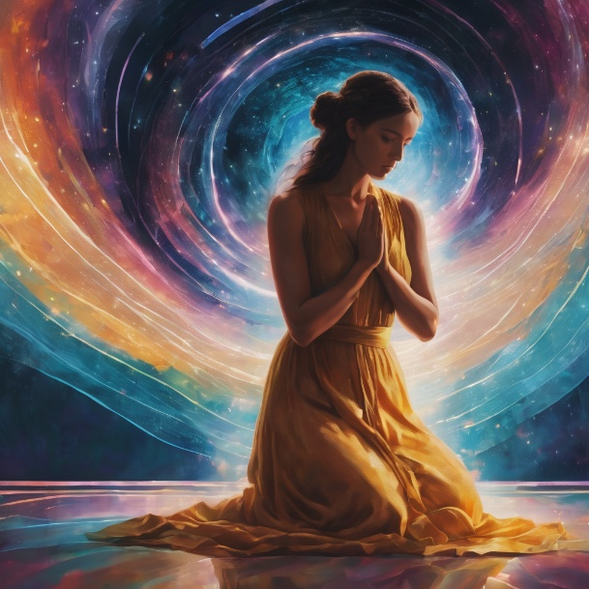
Prayer of Thanksgiving before Intercessions
Leader: As we enter prayer, I invite the second reader to unmute to lead our intercessions which follow the prayer of thanksgiving on the next slide. Please feel free to change your body position as you need.
Continue…

Slide 34
Leader: In this hallowed hour when you welcome us into your house, O Lord, and we experience your hospitality: we offer our humble thanks and praise. When you stop us in the tracks of our frantic lives, and offer succour to our weary souls: we offer our humble thanks and praise. When our eyes are opened and we realise how blind we have been, unheeding of your presence: we offer our humble thanks and praise to Father, Son, and Holy Spirit. Amen.

Slide 35
Intercessions
Reader 2: We pray for creation and communities we share our lives with. We pause for a few moments to name either in our hearts, or out loud, or in the chat, those environments and communities we bring to the Lord in prayer.
PAUSE…
Continue…

Slide 36
Intercessions
Reader 2: We entrust to you the community of Holy Hermits Online and our ministry partners:
Prosper the work of our hands and show us the way to your new creation.
Creator God, Hear our prayer.
St John's Cathedral Brisbane The Anglican Diocese of Southern Queensland St Gabriel’s, Carindale Benedictus Contemplative Church, Canberra Anglican Focus and Tithe.ly

Slide 37
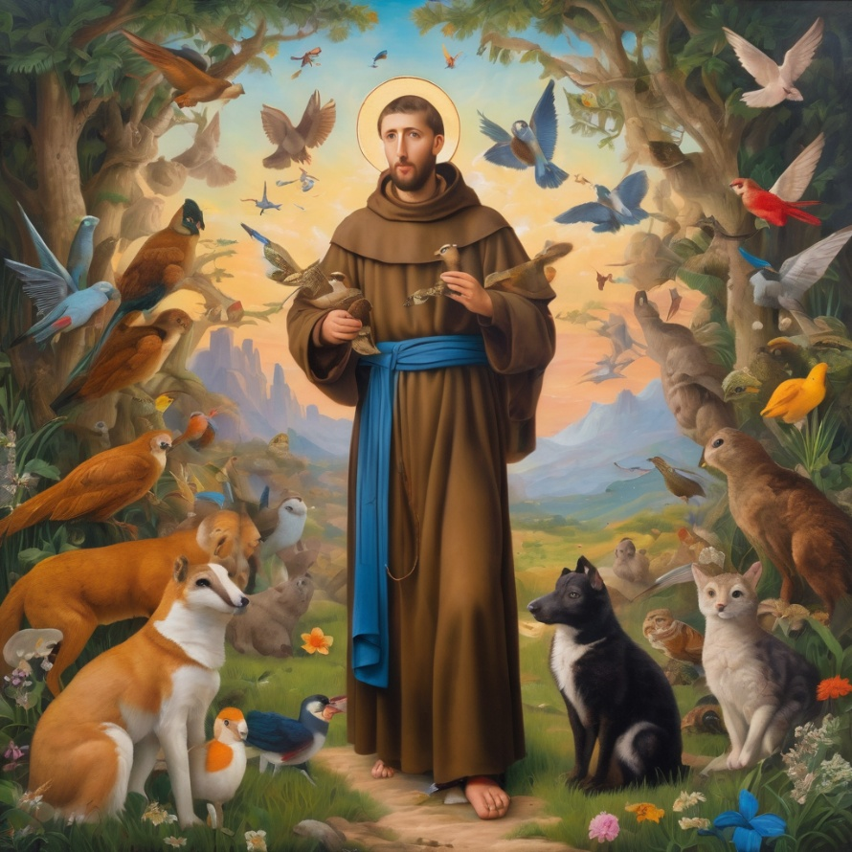
Reader 2: Loving Creator, we entrust to you all animals, especially those who are sick, anxious, ageing, lost, at risk, lonely, sad, hungry, in pain, homeless, abused, living in fear, encountering violence of any kind, in need of comfort, rehabilitation or transformation.
Continue…

Slide 38
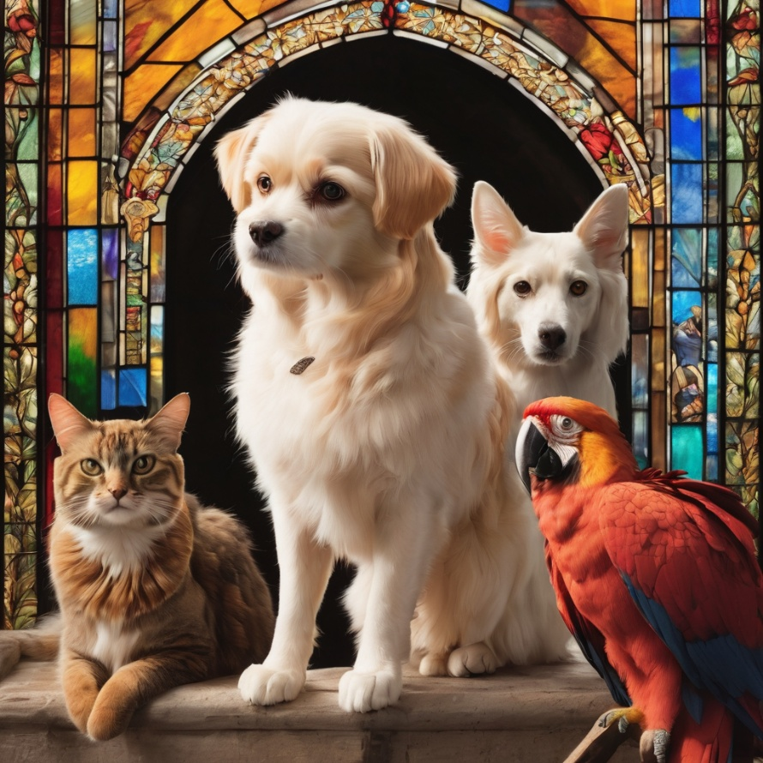
Reader 2: We invite your loving compassion for:
We name in our hearts, out loud or in the chat,
the animals we bring to the Lord in prayer. PAUSE…
Jasmine, ​
Leese(y), ​
Sid, Toots & Lulu​
Polly and Suki​
Fred, George & Percy​
Koshka ​
Jax
Lambert ​​
Kala, Nigel & Little One ​​
Toby​​
Taco​​
Paddy ​​
Rosie​

Slide 39
Reader 2: Eternal Trinity of Love, we uphold to you the people we love and carry cares for:
Kerry, Les & Jake Julie, Ray, Tracey & Shane Mark, Desley & Bob ​​ Rachel, Mervyn & Gillian ​​Rev'd Shane & Janette​​ Alecia, Martin & Aidan​​ Steven & Vanessa Tina | Barry​​ Dr Julie ​​ Ruth​​ Phil​ May Susan Tanya​ Craig Neva​ | Bill & Marjorie​​ Aaron & Andrea Dilys & Tony, Paul & Darhon Judy & Mary​​ Bob & Di​ Pat & Julie Miriam Gayanne | Kirsten, Greg, Daphne & Beau Alan & Gaylene​ Jess & Leah ​​ Bonnie & girls Liz’s Godchildren Barry & Gwen Matthew & Nicholas​ Kathy
Continue…

Slide 40
Reader 2:
We name in our hearts, out loud or in the chat, those we bring to the Lord in prayer.
PAUSE…
We entrust to you those who have died, those who have died peacefully and those who have died tragically, The old and the young. Receive them into your Kingdom. Lord in your mercy, Hear our prayers. Amen.

Slide 41
Pray Daily Cycle of Prayer
Leader: Loving God, joining with the Church in our cycle of prayer, we ask your blessings on:
The Church of the Province of Myanmar (Burma)
The Diocese of Perth: †Kay; Assistant Bishops - †Kate, †David, †Hans; Clergy and People
The Parish of Bulimba: Paul, Sharon, Greg
Mathew Hale Public Library
Toowoomba Anglican School: Principal – Nick; Chaplaincy team; Chair of School Council - Mac; members of School Council; staff & students

Slide 42

Commitment prayer for the week: Emergence of AI
https://youtu.be/uhkBwPKHNXw?si=WwSOZUNb3P8SiEm7
Notes:
Link to prayer group ministry page for weekly commitment prayer Prayer Group | Ministries | Holy Hermits Online

Slide 43
Leader: Let us pray together the prayer which Jesus gave us saying:
All: Our Father in heaven, hallowed be your name,
your kingdom come, your will be done, on earth as in heaven.
Give us today our daily bread.
Forgive us our sins
as we forgive those who sin against us.
Save us from the time of trial and deliver us from evil.
For the kingdom, the power, and the glory are yours
now and for ever.
Amen.

Slide 44
Devotions

Slide 45
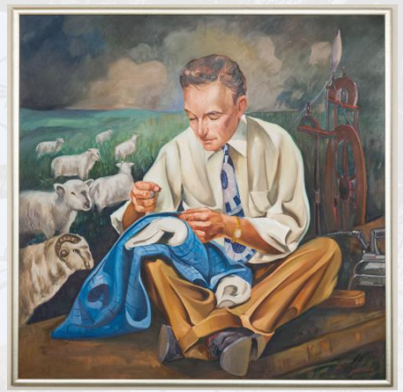
Hermit Wisdom

Slide 46
Recognising the Call
Leader: As priests were carted off by the Gestapo during the
oc­cupation of Poland in World War II, Jan Tyranowski, a tailor by trade, reluctantly stepped into unknown territory. He was asked to form and advise a group of young men, creating a youth ministry team for the young people of the parish. “Living Rosary” prayer groups were born from the undertaking. These groups, led by Tyranowski and his team members, provided the sorely needed spiritual, emotional, and practical support to young Poles through prayer, fellowship, and practicing the works of mercy.

Slide 47
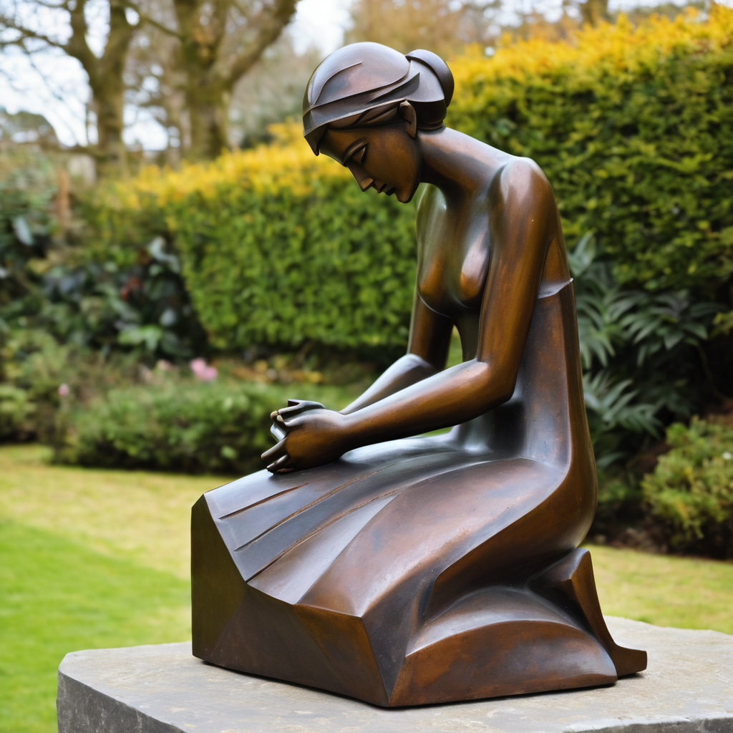
​
Leader: ​As we enter a few minutes of silence together, you are invited to pray our prayer of adoration on the next slide and/or spend this time in contemplation. ​
The Spiritual Communion prayer follows on the slide after that.
Let us be still.
Leader and Cantor Mute.
Continue…

Slide 48
Dear God,
thank you for the gift of faith,
which is more precious than gold.
Thank you for the different ways we have of knowing you.
Help us to leave everything that takes us away from you
at the cross. Amen.
​

Slide 49

Oh, my Lord Jesus I turn to you present at the Altar and in the Tabernacle. I believe that you are present in the Holy Sacrament of your most Sacred Body and Blood. I love you above all things and I desire to receive you into my Soul. I cannot at this moment receive you Sacramentally in Holy Communion. Come spiritually into my heart. Purify it, Sanctify it. Render my heart like your own heart. I embrace you as if you were already there and unite myself wholly with you. Never permit me to be separated from you. Lord, I am not worthy to receive you, but only say the word and I shall be healed. Amen
Making a
Spiritual Communion
(Prayed in silence)

Slide 50
Leader unmutes
Our final song is
Emmaus Road – When Jesus Walks with You and You Don’t Even Know It.
Emmaus Road
​We stay on mute
Leader and Cantor mute

Slide 51
Leader and cantor unmute
Sending Prayer
Leader: We pray our sending prayer together.
All: Dear God,
thank you that we can know you
and that we know you in different ways.
Help us to know you more as we go out
and share your love with all we meet.
Amen.

Slide 52
The Benediction
Leader: Let us all invite God’s blessings together,
All:
As we leave, leave with us, Lord, walk with us always. Be there as we share bread and help us to share with others in need. Amen.

Slide 53
Notices
Next Sunday at 11am we have our next Companion Animal Ministry Workshop. All are welcome.
Wednesday study is still on a short break.
Our 2nd Sunday Saint Spotlight is starting soon, please contact Rev’d Lauren for more info or to offer to prep one.
See HHO Events page for further upcoming events HHO Events

Slide 54
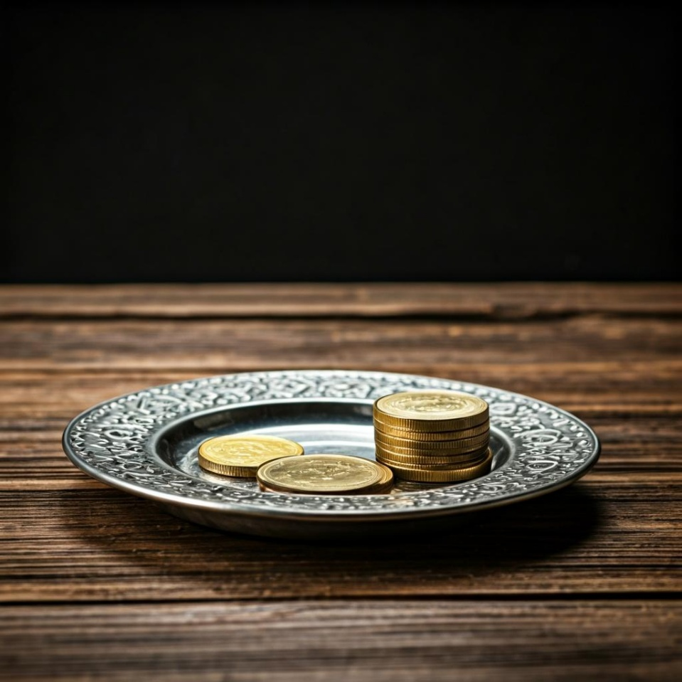
Leader: Thank you for your regular gifts to this ministry. Offerings are most welcome via:
The HHO App
Direct Debit
International Direct Debit
Please consider a one-off donation
or leaving a legacy in your Will
For further information go to HHO give page
https://holyhermits.com.au/give

Slide 55
Serving next week
26 April 2026
4th Sunday of Easter
9:00 am AEST
Service Prep: Kristine | Chat Host: Viki | First Reader: Jeremy
Music: Wiggles 🐶 | Welcomer: Julie | Second Reader: Vanessa
Proof-reader: Viki | Priest: N/A | Preacher: Lauren
Broadcaster: Kieron | Deacon: Lauren | Fellowship: Julie
Backup Broadcaster: Barry | Leader: Julie | Safety Officer: Chris
Zoom Buttons: Barry | Cantor: Barry | Attendance: Viki
Thank you for your ministry gifts
New Servers always welcome!
Please email Rev’d Lauren to get involved
holyhermits@anglicanchurchsq.org.au

Slide 56
The Dismissal
Leader: I invite everyone to unmute for the Dismissal
Leader: Go in peace to love and serve the Lord.
All: In the name of Christ, Amen.

Slide 57
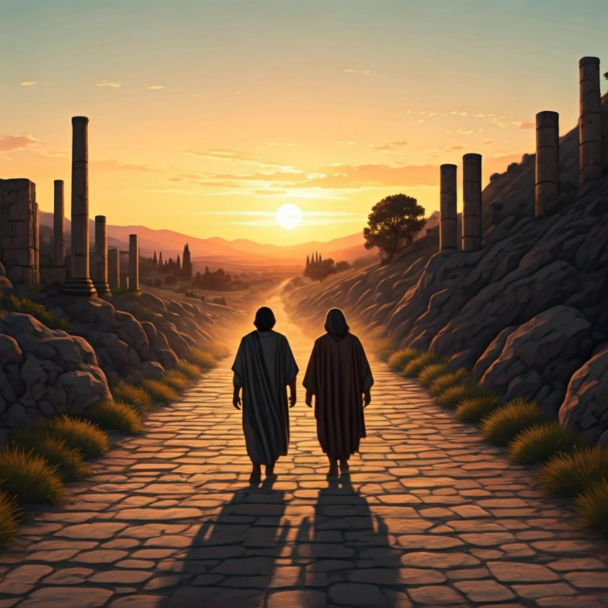
Fellowship time
Thank you, Julie for leading Fellowship
Please feel welcome to linger or pop a message in the chat and head off when you are ready.​
Extra resources developed
by Roots on the Web
Artwork by Padlet

