Slide 1
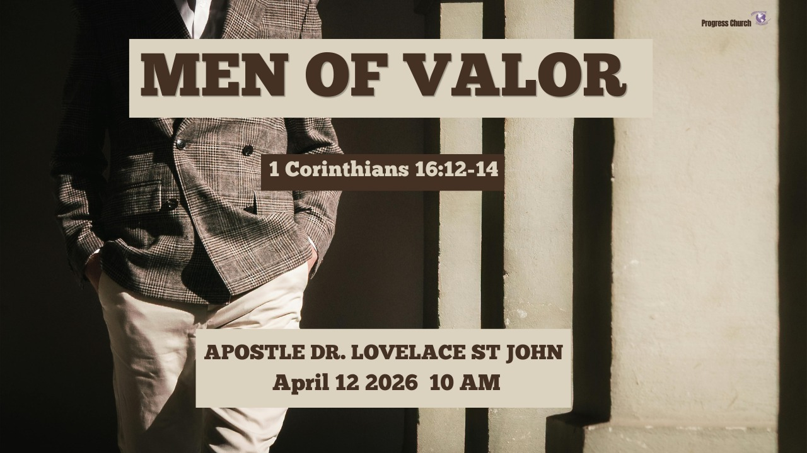

Slide 2



SCRIPTURE
1 CORINTHIANS 16: 12 – 14

Slide 3
INTRODUCTION
Sentry - A soldier stationed to keep guard or to control access to a place.
Imagine a city with massive walls, fortified gates, and a wealth of resources, but the sentries at the post have fallen asleep.
The strength of the wall doesn’t matter if the Sentry (men) guarding it have lost their focus.
In the kingdom of God, you are the sentry.

Slide 4
INTRODUCTION (cont)
You Guard:
Your family, your church, and your community are the city.
Men of Valor are Men who know how to stand their ground

Slide 5
The Blueprint of Valor
(1 Corinthians 16:13–14)
Five military-style commands. These are the DNA of a man of valor:
"Be on your guard" (Watch):
A man of valor is spiritually alert. He sees the enemy’s traps, pride, lust, and apathy, before they spring.
A man of valor is alert. He is not asleep spiritually. He is not careless about his life.

Slide 6
The Blueprint of Valor (con’t)
(1 Corinthians 16:13–14)
He guards:
His mind; His heart; His family; His environment
He understands that what he allows, will eventually shape him.

Slide 7
2. "Stand firm in the faith":
He isn't swayed by cultural shifts or popular opinion. His anchor is the Word of God.
This generation needs men who will stand.
Stand when culture shifts.
Stand when pressure rises.

Slide 8
2. "Stand firm in the faith": (con’t)
He isn't swayed by cultural shifts or popular opinion. His anchor is the Word of God.
Stand when compromise is easier.
A man of valor is not double-minded. He is anchored.
When everything else is shaking, He remains standing.

Slide 9
3. "Be courageous" (Act like men):
True valor is not the absence of fear, but the decision that something else is more important than fear.
The original language here means: “Show yourselves to be men.”
Grow up into maturity.
Take responsibility.
Face what needs to be faced.
Courage is not the absence of fear, It is the decision to move forward anyway.

Slide 10
4. "Be strong":
This is an internal strength, a fortification of the spirit through the Holy Spirit.
Not just physical strength, But spiritual strength.
Strength to:
Resist temptation
Carry responsibility
Endure hardship
Stay consistent
A man of valor is not fragile. He is fortified.

Slide 11
5. "Do everything in love":
Power without love is tyranny; courage without love is recklessness.
A man of valor fights for those he loves, not just against what he hates.
Strength without love becomes harsh. But strength with love becomes Christ-like.
A man of valor is:
Firm, but compassionate
Strong, but gentle
Bold, but loving

Slide 12
II. The Model of Valor: Apollos (The Eloquent Warrior) ACTS 18: 24 – 28
Apollos was:
A Jew from Alexandria
An eloquent man
Mighty in the Scriptures
Fervent in spirit
Bold in speaking

Slide 13
CONCLUSION
Being a "Man of Valor" isn't a title you earn once; it’s a posture you take every morning. When you wake up, put on your armor, stand at your post, and remember: The King is with you.
Men: You don’t have to be the loudest. You don’t have to be the most visible.

Slide 14
CONCLUSION (con’t)
But you must be:
Watchful; Grounded; Courageous; Strong; And loving.
Men of valor like Apollos:
Strong but humble; Bold but teachable; Gifted but submitted.
I declare today: The men of valor are rising.

