Slide 1
Scripture Led Prayer
Psalm 103:9-12-
¹⁰He does not deal with us according to our sins nor repay us according to our iniquities. ¹¹For high as the heavens are above the earth, so great is his steadfast love toward those who fear him; ¹²as far as the east is from the west, so far does he remove our transgressions from us.

Slide 2
Prompts
Lord, You are merciful, forgiving, and compassionate.
I praise You, Lord , for not treating me as my sin deserved when I….
Please show You compassion to… as they….
Assure me of your steadfast love when I …..

Slide 3


Slide 4
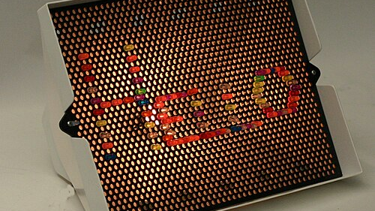
This Photo by Unknown Author is licensed under CC BY-SA

Slide 5
Abram
Married to Sarai
Son of Terah
Descendant of Shem
Inhabitant of Ur

Slide 6
Gen 11:31
“Terah took Abram his son and Lot the son of Haran, his grandson, and Sarai his daughter-in-law, his son Abram’s wife, and they went forth together from Ur of the Chaldeans to go into the land of Canaan, but when they came to Haran, they settled there.”

Slide 7
God chose Abram not because of anything Abram had done, but because it was simply His will to do so.

Slide 8
Faithful obedience to God always leads to God’s blessing.

Slide 9
Those with a deep abiding intimacy with God are always a blessing to those around them.

Slide 10
God’s calling of Abram is a testament of His goodness and grace.

Slide 11
Obedience to God often requires leaving one thing for something better.

Slide 12
Faith is marked by action.

Slide 13
Faithful obedience does not require full understanding.

Slide 14
If you're not dead God is not done with you.

Slide 15
Abram did not hesitate to declare his faith in the Lord before those that did not worship the Lord.

Slide 16
Those who walk in faithful obedience with the Lord have lives marked with consistent communion with the God.

