Slide 1
Welcome to Holy Hermits Online Worship
The Second Sunday in Easter
Today we are remembering
Holy Hermit St Aengus
Service Prep: Lauren | Chat Host: Viki | First Reader: Bob
Music: Lauren | Welcomer: Julie | Second Reader: Liz
Proof-reader: Chris | Priest: N/A | Preacher: Lauren
Broadcaster: Lauren | Deacon: Lauren | Fellowship: Lauren
Backup Broadcaster: Barry | Leader: Lauren | Safety Officer: Chris
Zoom Buttons: Barry | Cantor: Kieron | Attendance: Viki

Slide 2






Hospitality
Leader:
Please mute for the service unless invited to offer your voice as part of the service ministry
Have the video camera on or off and turn the volume and brightness up or down on your device if things are too loud 🔉🔊or too bright🔅🔆
Our Cantor acts as our voice, offering the responses, in Bold Text, which we say together
Feel welcome to use the chat and reaction emojis 👍
🙏 Please take care of yourself in this space. 🙏 Come and go as you need
😴 It is great to take rest in this space, so falling asleep is also OK 😴
👂️ Remember, pastoral care is available to all in the community, if you'd like to speak to someone about anything spiritual. ❤️ Visit the help page at the website to reach out 🌐
Our Being Together ethos and safeguarding practices can also be accessed on the website 🫶​
🙌 Come as you are – we are all here together! 🙌
Notes:
Used Lent 2022

Slide 3
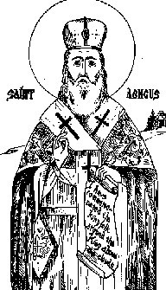
Leader: Our Holy Hermit today is St Aengus.
Aengus of Clonenagh was a monk and Culdee reformer famed for deep devotion to the saints and a life of rigorous prayer, fasting, and penance. Trained in Laois, he lived as a hermit at Dysert Beagh and Dysert Enos before seeking refuge at Tallaght, where he collaborated with St Máelrúain on the Martyrology of Tallaght. Returning home, he became abbot and later bishop, compiling his own Féilire of Irish saints. Remembered as a founder of the Céilí Dé movement, he died in 824, honoured for shaping Ireland’s ascetic spiritual tradition. His feast is celebrated on March 11.
To read more about our hermits click the link​​ in the send out

Slide 4
Invitation
Leader: As we come into worship let’s take a few deep breaths,
Let go of anything that isn’t serving us,
And become aware of God’s presence here with us.
(A Gregorian Chant for Eastertide)
https://www.youtube.com/watch?v=shG6lJULZ6E

Slide 5
Leader and Cantor unmute
The Greeting
Leader: Christ has risen, Alleluia!
All: Christ is risen indeed, Alleluia!

Slide 6
Gathering Prayer
Leader: Come and know the Lord your God.
Come and know the joy of your God.
Come and know the love of your God.
Come and know by faith alone.

Slide 7
Gathering Prayer
All: ​God of knowledge and truth,
help us to know you more fully,
to seek joy in knowing you,
and to share this with our sisters and brothers.
Amen.

Slide 8
Sentence
Leader: I invite our Cantor to proclaim the sentence for today.
Cantor: Blessed be the God and Father of our Lord Jesus Christ! By his great mercy he has given us a new birth into a living hope through the resurrection of Jesus Christ from the dead.
1 Peter 1.3

Slide 9
Prayer of Approach
Leader: We pray the prayer of approach together
All: Heavenly Father,
although we can’t see you, we love you,
and we know your voice.
We answer your call to draw close to you today.
Setting aside our other cares and concerns,
we gather together to know you better in worship.
Amen.

Slide 10
The Gloria​
(to be sung every Sunday during the Season of Easter)
Leader: We now sing the Gloria together
https://www.youtube.com/watch?v=8AK9zPuyQ2o
Leader Mutes

Slide 11
Collect
Leader: Almighty and eternal God,
the strength of those who believe
and the hope of those who doubt:
may we, who have not seen, have faith
and receive the fullness of Christ’s blessing;
who is alive and reigns with you and the Holy Spirit,
one God, now and for ever.
Amen.

Slide 12
The 1st reader unmutes
Leader: I invite the 1st reader to unmute and offer the 1st lesson when ready.
Reader 1: The 1st Reading is from Acts 2.14a; 2.22-32
¹⁴ But Peter, standing with the eleven, raised his voice and addressed them: ‘Men of Judea and all who live in Jerusalem, let this be known to you, and listen to what I say.
²² ‘You that are Israelites, listen to what I have to say: Jesus of Nazareth, a man attested to you by God with deeds of power, wonders, and signs that God did through him among you,
Continue…

Slide 13
as you yourselves know— ²³ this man, handed over to you according to the definite plan and foreknowledge of God, you crucified and killed by the hands of those outside the law.
²⁴ But God raised him up, having freed him from death, because it was impossible for him to be held in its power.
²⁵ For David says concerning him,
“I saw the Lord always before me,
for he is at my right hand so that I will not be shaken;
²⁶ therefore my heart was glad, and my tongue rejoiced;
Continue…

Slide 14
moreover, my flesh will live in hope.
²⁷ For you will not abandon my soul to Hades,
or let your Holy One experience corruption.
²⁸ You have made known to me the ways of life;
you will make me full of gladness with your presence.”
²⁹ ‘Fellow Israelites, I may say to you confidently of our ancestor David that he both died and was buried, and his tomb is with us to this day.
Continue…

Slide 15
³⁰ Since he was a prophet, he knew that God had sworn with an oath to him that he would put one of his descendants on his throne.
³¹ Foreseeing this, David spoke of the resurrection of the Messiah, saying,
“He was not abandoned to Hades,
nor did his flesh experience corruption.”
³² This Jesus God raised up, and of that all of us are witnesses.
For the word of the Lord. Thanks be to God.​

Slide 16
Leader: We now say the psalm antiphonally, I invite the first reader to lead, and we will all respond with our cantor as our voice.
Psalm 16
¹ Preserve me, O God:
for in you have I taken refuge.
² I have said to the Lord, You are my lord:
and all my good depends on you.
³ As for those who are held holy on the earth:
the other gods in whom people delight,
Continue…

Slide 17
⁴ Though the idols are many that they run after:
their offerings of blood I will not offer,
nor take their name upon my lips.
⁵ The Lord is my appointed portion and my cup:
you hold my lot in your hands.
⁶ The share that has fallen to me is in pleasant places:
and a fair land is my possession.
⁷ I will bless the Lord who has given me counsel:
at night also he has instructed my heart.
Continue…

Slide 18
⁸ I have set the Lord always before me:
he is at my right hand, and I shall not fall.
⁹ Therefore my heart is glad and my spirit rejoices:
my flesh also shall rest secure.
¹⁰ For you will not give me over to the power of death:
nor suffer your faithful one to see the Pit.
¹¹ You will show me the path of life:
in your presence is the fulness of joy,
and from your right hand flow delights for evermore.

Slide 19
The 2nd reader unmutes
Leader: Thank you, I invite the 2nd reader to unmute and offer the 2nd lesson when ready.
Reader 2: The 2nd Reading is from 1 Peter 1.1-12
¹ Peter, an apostle of Jesus Christ, To the exiles of the Dispersion in Pontus, Galatia, Cappadocia, Asia, and Bithynia, ² who have been chosen and destined by God the Father and sanctified by the Spirit to be obedient to Jesus Christ and to be sprinkled with his blood: May grace and peace be yours in abundance. ³ Blessed be the God and Father of our Lord Jesus Christ!
Continue…

Slide 20
By his great mercy he has given us a new birth into a living hope through the resurrection of Jesus Christ from the dead, ⁴ and into an inheritance that is imperishable, undefiled, and unfading, kept in heaven for you, ⁵ who are being protected by the power of God through faith for a salvation ready to be revealed in the last time. ⁶ In this you rejoice, even if now for a little while you have had to suffer various trials, ⁷ so that the genuineness of your faith—being more precious than gold that, though perishable, is tested by fire—may be found to result in praise and glory and
Continue…

Slide 21
honour when Jesus Christ is revealed. ⁸ Although you have not seen him, you love him; and even though you do not see him now, you believe in him and rejoice with an indescribable and glorious joy, ⁹ for you are receiving the outcome of your faith, the salvation of your souls. ¹⁰ Concerning this salvation, the prophets who prophesied of the grace that was to be yours made careful search and inquiry, ¹¹ inquiring about the person or time that the Spirit of Christ within them indicated,
Continue…

Slide 22
when it testified in advance to the sufferings destined for Christ and the subsequent glory. ¹² It was revealed to them that they were serving not themselves but you, in regard to the things that have now been announced to you through those who brought you good news by the Holy Spirit sent from heaven—things into which angels long to look!
For the word of the Lord. Thanks be to God.​

Slide 23
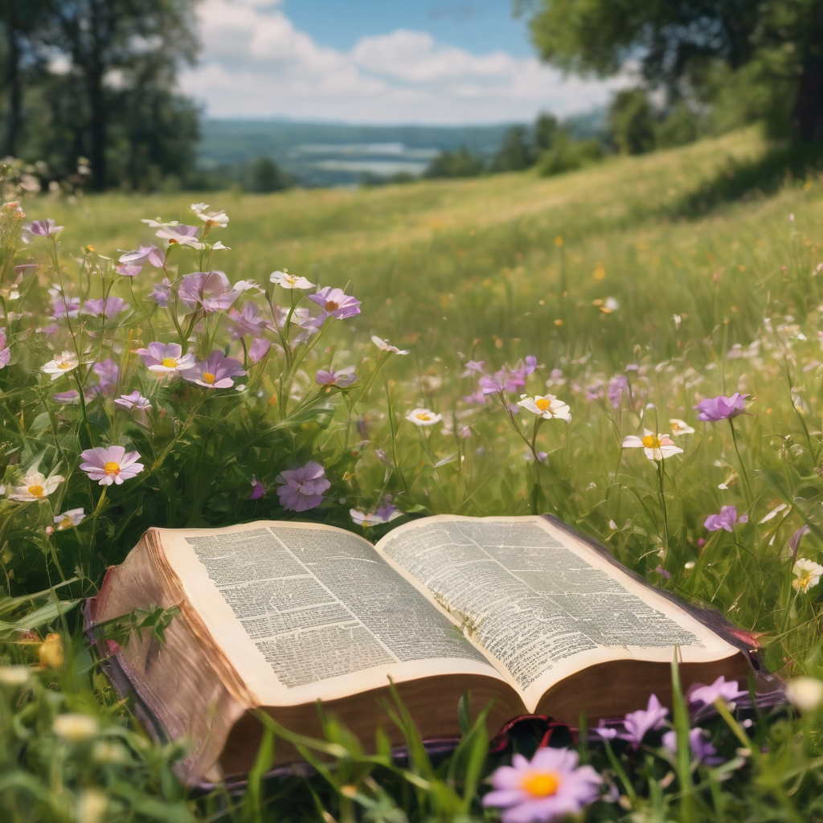
We pause before
​the Gospel ​​

Slide 24
Deacon: The Gospel of our Lord Jesus Christ according to St John Chapter 20 beginning at the 19th verse
All: Glory to you Lord Jesus Christ.
¹⁹ When it was evening on that day, the first day of the week, and the doors of the house where the disciples had met were locked for fear of the Jews, Jesus came and stood among them and said, ‘Peace be with you.’ ²⁰ After he said this, he showed them his hands and his side. Then the disciples rejoiced when they saw the Lord. ²¹ Jesus said to them again, ‘Peace be with you. As the Father has sent me, so I send you.’
Continue…

Slide 25
²² When he had said this, he breathed on them and said to them, ‘Receive the Holy Spirit. ²³ If you forgive the sins of any, they are forgiven them; if you retain the sins of any, they are retained.’ ²⁴ But Thomas (who was called the Twin), one of the twelve, was not with them when Jesus came. ²⁵ So the other disciples told him, ‘We have seen the Lord.’ But he said to them, ‘Unless I see the mark of the nails in his hands, and put my finger in the mark of the nails and my hand in his side, I will not believe.’ ²⁶ A week later his disciples were again in the house, and Thomas was with them.
Continue…

Slide 26
Although the doors were shut, Jesus came and stood among them and said, ‘Peace be with you.’ ²⁷ Then he said to Thomas, ‘Put your finger here and see my hands. Reach out your hand and put it in my side. Do not doubt but believe.’ ²⁸ Thomas answered him, ‘My Lord and my God!’ ²⁹ Jesus said to him, ‘Have you believed because you have seen me? Blessed are those who have not seen and yet have come to believe.’
Continue…

Slide 27
³⁰ Now Jesus did many other signs in the presence of his disciples, which are not written in this book. ³¹ But these are written so that you may come to believe that Jesus is the Messiah, the Son of God, and that through believing you may have life in his name.
This is the Gospel of the Lord. Praise to you Lord Jesus Christ.

Slide 28
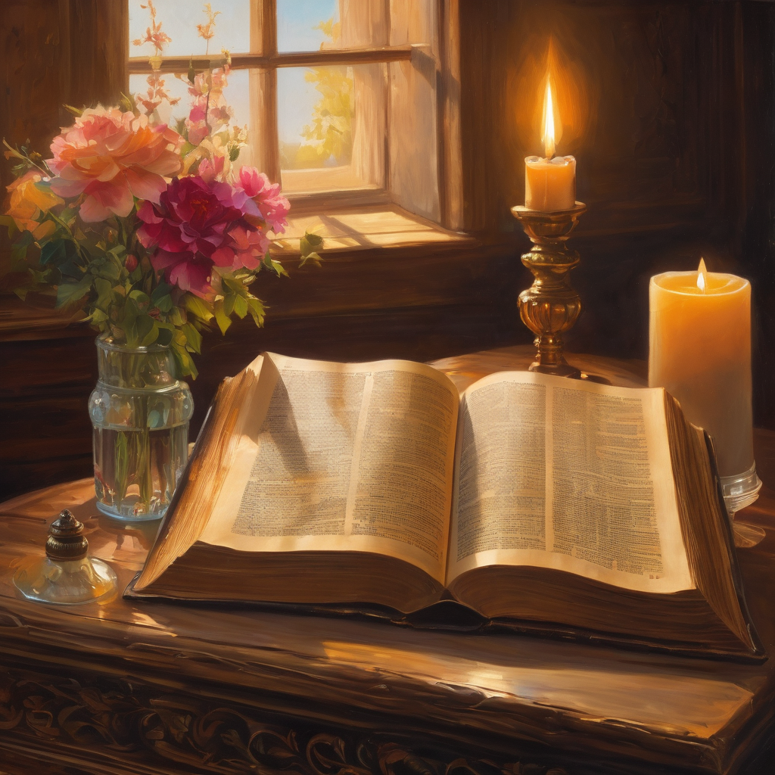
We pause
after ​the Gospel ​​

Slide 29
Leader: The Sermon is recorded to YouTube for sharing later.
Only the preacher's video and audio will be recorded.
The chat and other participants' feeds remain out of sight of the recording.
Leader and Cantor mute
Broadcaster exits screenshare
Preacher unmutes
Zoom buttons ”pins” preacher’s screen + selects “record to the cloud”
Sermon

Slide 30
Leader unmutes
Our next Hymn is
O Sons and Daughters
https://www.youtube.com/watch?v=_qAaifGB_i8
We stay on mute
Leader mutes

Slide 31
The Leader and Cantor unmute
The Greeting of Peace
Leader: We are the body of Christ
All: God’s Spirit is with us
Leader: The peace of the Lord be always with you.
All: And also with you.
Leader: A sign of peace may be exchanged
You may like to type 'Peace' into the chat, use the 'raise hand’ or other reaction buttons, or just simply wave via the screen with your video turned on
(Broadcaster exits shared screen for a few moments for the exchange of peace)

Slide 32
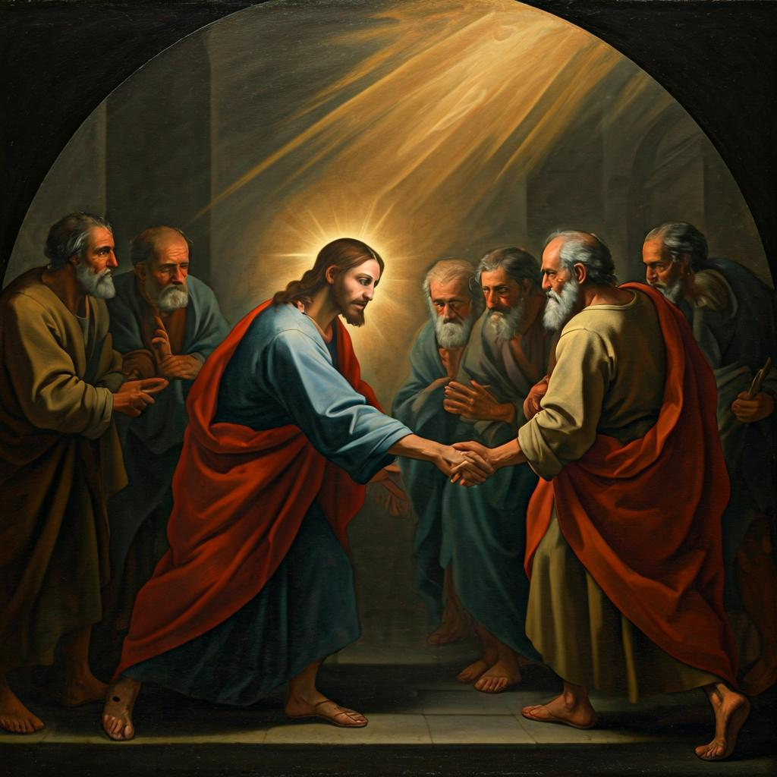
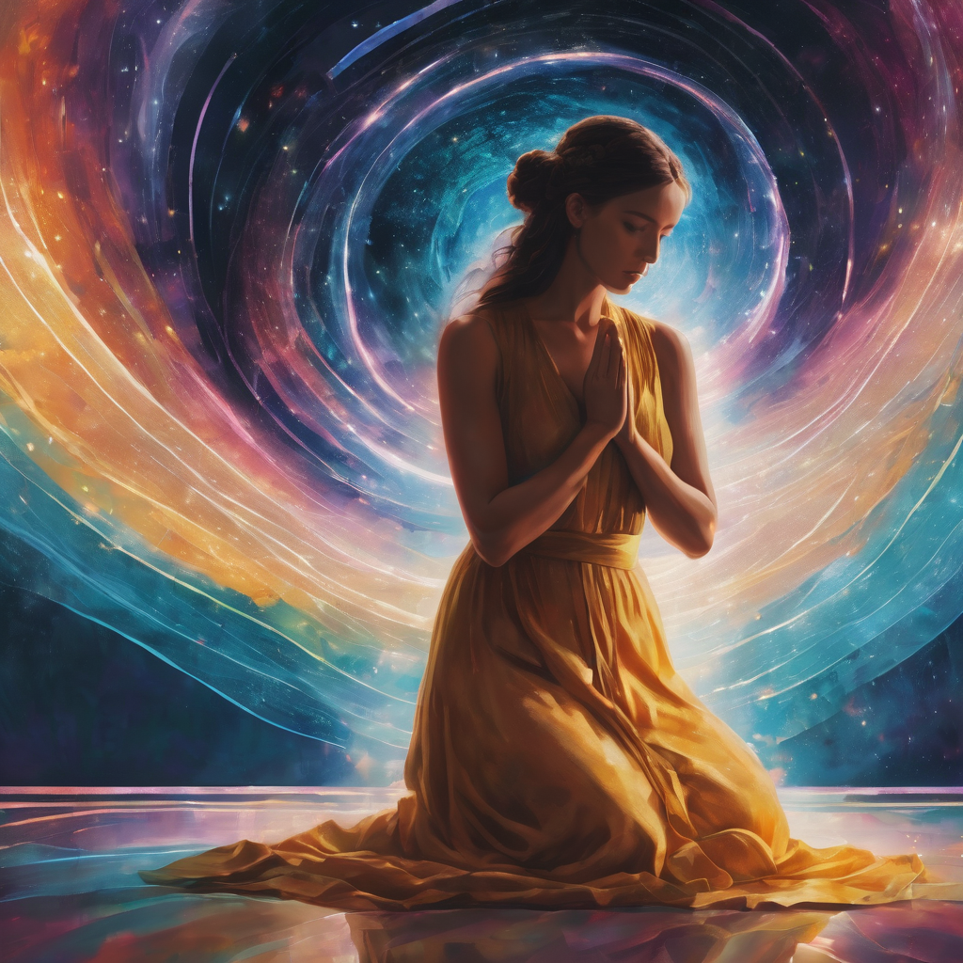
Prayer of Thanksgiving before Intercessions
Leader: As we enter prayer, I invite the second reader to unmute to lead our intercessions which follow the prayer of thanksgiving. Please feel free to change your body position as you need.
Continue…

Slide 33
Prayer of Thanksgiving before Intercessions
Leader: Almighty God, we give thanks
that you have welcomed us as your children;
and we praise you for our inheritance,
imperishable, undefiled and unfading.
In your family, we are sisters and brothers
bound by faith and the knowledge and love of you.
We thank and praise you, Lord,
for the joy of learning and growing in you.
All: Amen.

Slide 34
Intercessions
Reader 2: We pray for creation and communities we share our lives with. We pause for a few moments to name either in our hearts, or out loud, or in the chat, those environments and communities we bring to the Lord in prayer.
PAUSE…
Continue…

Slide 35
Intercessions
Reader 2: We entrust to you the community of Holy Hermits Online and our ministry partners:
Prosper the work of our hands and show us the way to your new creation.
Creator God, Hear our prayer.
St John's Cathedral Brisbane The Anglican Diocese of Southern Queensland St Gabriel’s, Carindale Benedictus Contemplative Church, Canberra Anglican Focus and Tithe.ly

Slide 36
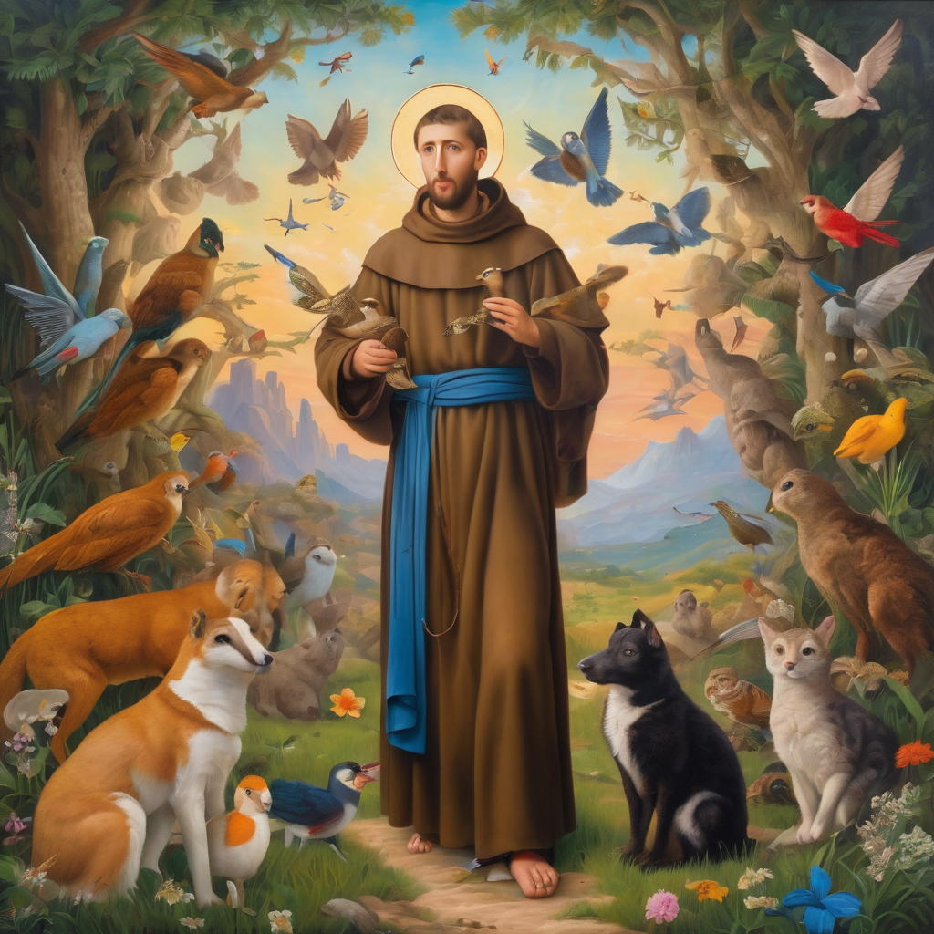
Reader 2: Loving Creator, we entrust to you all animals, especially those who are sick, anxious, ageing, lost, at risk, lonely, sad, hungry, in pain, homeless, abused, living in fear, encountering violence of any kind, in need of comfort, rehabilitation or transformation.
Continue…

Slide 37
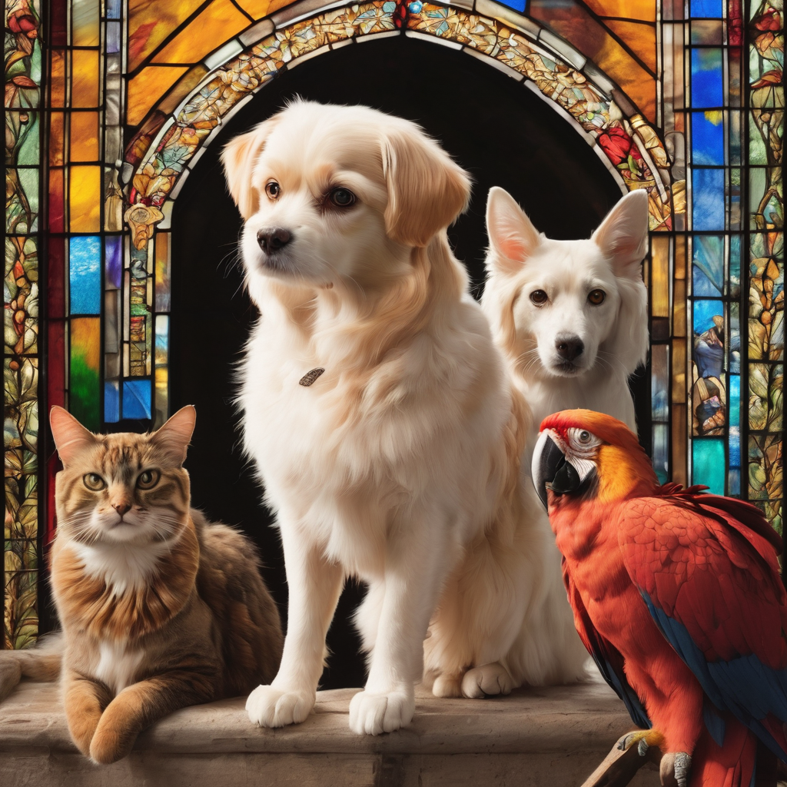
Reader 2: We invite your loving compassion for:
We name in our hearts, out loud or in the chat,
the animals we bring to the Lord in prayer. PAUSE…
Jasmine, ​
Leese(y), ​
Sid, Toots & Lulu​
Polly and Suki​
Fred, George & Percy​
Koshka ​
Jax
Lambert ​​
Kala, Nigel & Little One ​​
Toby​​
Taco​​
Paddy ​​
Rosie​

Slide 38
Reader 2: Eternal Trinity of Love, we uphold to you the people we love and carry cares for:
Kerry, Les & Jake Julie, Ray, Tracey & Shane Mark, Desley & Bob ​​ Rachel, Mervyn & Gillian ​​Rev'd Shane & Janette​​ Alecia, Martin & Aidan​​ Steven & Vanessa Tina | Barry​​ Dr Julie ​​ Ruth​​ Phil​ May Susan Tanya​ Craig Neva​ | Bill & Marjorie​​ Aaron & Andrea Dilys & Tony, Paul & Darhon Judy & Mary​​ Bob & Di​ Pat & Julie Miriam Gayanne | Kirsten, Greg, Daphne & Beau Alan & Gaylene​ Jess & Leah ​​ Bonnie & girls Liz’s Godchildren Barry & Gwen Matthew & Nicholas​ Kathy
Continue…

Slide 39
Reader 2:
We name in our hearts, out loud or in the chat, those we bring to the Lord in prayer.
PAUSE…
We entrust to you those who have died, those who have died peacefully and those who have died tragically, The old and the young. Receive them into your Kingdom. Lord in your mercy, Hear our prayers. Amen.

Slide 40
Pray Daily Cycle of Prayer
Leader: Loving God, joining with the Church in our cycle of prayer, we ask your blessings on:
Igreja Anglicana de Mocambique e Angola
The Diocese of Grafton: †Murray & †Tiffany; Clergy and People
The Parish of Brisbane Mar Thoma Church: †Gregorios
St Margaret’s Home Assist, Secure, Sandgate
St John’s Anglican College, Forest Lake: Principal – Maria; Chaplain – Juliana; Chair of College Council – Carla; members of College Council; staff & students

Slide 41
Commitment prayer for the week: Deliverance​ Ministry Team
Come Holy Spirit and make the hearts of your servants, Reverend Claye and the deliverance ministry team, your dwelling place and home. ​May darkness be dispelled by your light, and troubles calmed by your peace. ​​​
​Lord Jesus, we ask that you protect, guide and strengthen them, and all whom they encounter. ​​Give them courage, ability, wisdom and discernment. ​​​
Continue…
Notes:
Link to prayer group ministry page for weekly commitment prayer Prayer Group | Ministries | Holy Hermits Online

Slide 42
Commitment prayer for the week: Deliverance​ Ministry Team
​​​Surround them with sound advice and support, that they may have insight and discretion. ​​Drawing on the Holy Spirit may they be strong in vocation and trust in you. ​​​
​We pray for those in need of healing and their ongoing relationship with you, as they journey towards the fullness and freedom of eternal life. ​May all evil and pain be transformed through the suffering of Christ and all dying glorified by your risen life. ​Amen.
Notes:
Link to prayer group ministry page for weekly commitment prayer Prayer Group | Ministries | Holy Hermits Online

Slide 43
Leader: Let us pray together the prayer which Jesus gave us saying:
All: Our Father in heaven, hallowed be your name,
your kingdom come, your will be done, on earth as in heaven.
Give us today our daily bread.
Forgive us our sins
as we forgive those who sin against us.
Save us from the time of trial and deliver us from evil.
For the kingdom, the power, and the glory are yours
now and for ever.
Amen.

Slide 44
Devotions

Slide 45
Hermit Wisdom

Slide 46
Hermit Prayer
Leader: A prayer inspired by St Aengus
​
O Christ,
make me your close companion,
in prayer, in silence, and in love.
Root me in the faith of your saints,
and keep my heart near to you;
for you live and reign for ever. Amen.

Slide 47
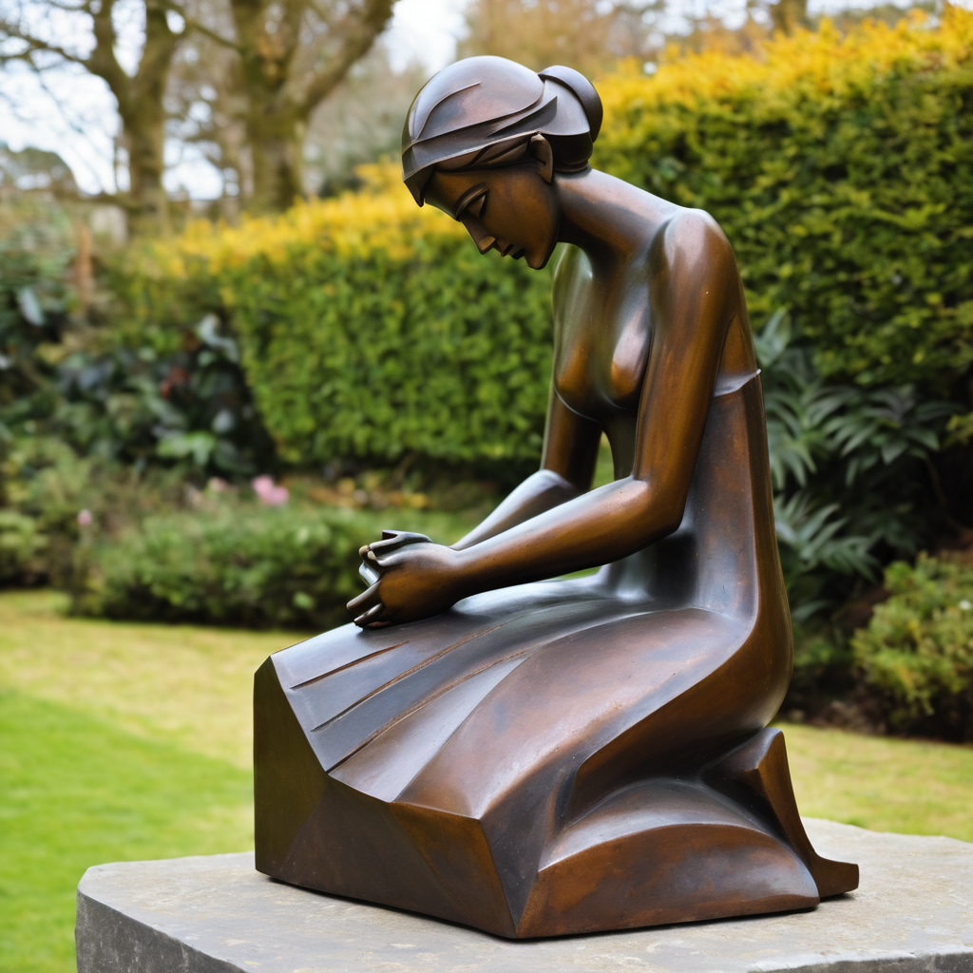
​
Leader: ​As we enter a few minutes of silence together, you are invited to pray this prayer of adoration and/or spend this time in contemplation. ​
The Spiritual Communion prayer follows on the next slide.
Let us be still.
Leader and Cantor Mute.
Continue…

Slide 48
Dear God,
thank you for the gift of faith,
which is more precious than gold.
Thank you for the different ways we have of knowing you.
Help us to leave everything that takes us away from you
at the cross. Amen.
​

Slide 49
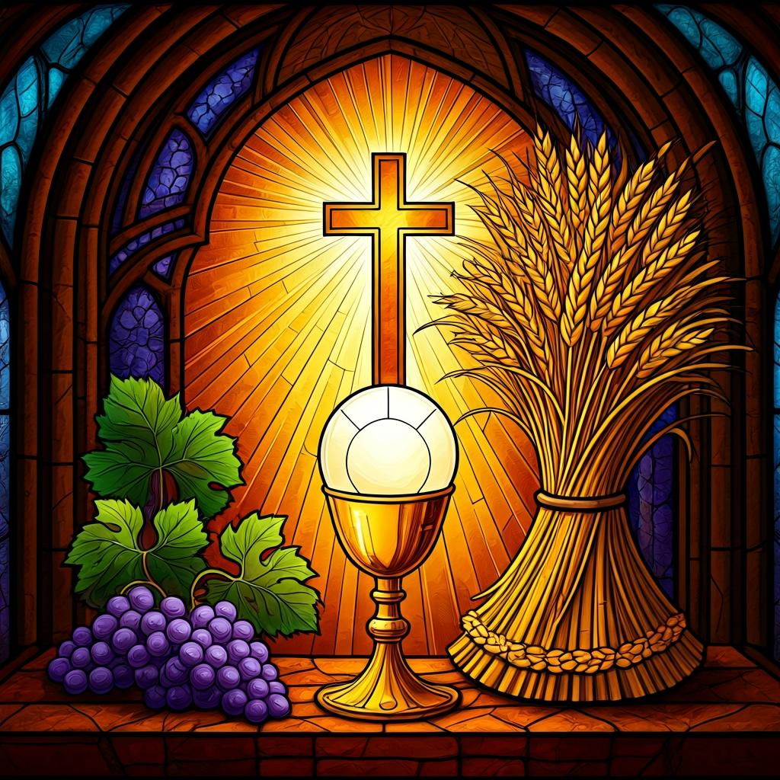
Oh, my Lord Jesus I turn to you present at the Altar and in the Tabernacle. I believe that you are present in the Holy Sacrament of your most Sacred Body and Blood. I love you above all things and I desire to receive you into my Soul. I cannot at this moment receive you Sacramentally in Holy Communion. Come spiritually into my heart. Purify it, Sanctify it. Render my heart like your own heart. I embrace you as if you were already there and unite myself wholly with you. Never permit me to be separated from you. Lord, I am not worthy to receive you, but only say the word and I shall be healed. Amen
Making a
Spiritual Communion
(Prayed in silence)

Slide 50
Leader unmutes
Our final song is
You Have Been Raised
https://www.youtube.com/watch?v=QYqbNcxA8-A
​We stay on mute
Leader and Cantor mute

Slide 51
Leader and cantor unmute
Sending Prayer
Leader: We pray our sending prayer together.
All: Dear God,
thank you that we can know you
and that we know you in different ways.
Help us to know you more as we go out
and share your love with all we meet.
Amen.

Slide 52
The Benediction
Leader: Let us all invite God’s blessings together,
All: May the Lord bless us and keep us.
May the Lord’s face shine upon us and be gracious to us.
May the Lord’s countenance be lifted upon us,
and bring us peace. Amen

Slide 53
Notices
Our Wednesday study is on a short break.
If anyone is interested in sharing some information on a Saint, or Holy Hermit for our 2nd Sunday Saint Spotlight in June please contact Rev’d Lauren.
See HHO Events page for further upcoming events HHO Events

Slide 54
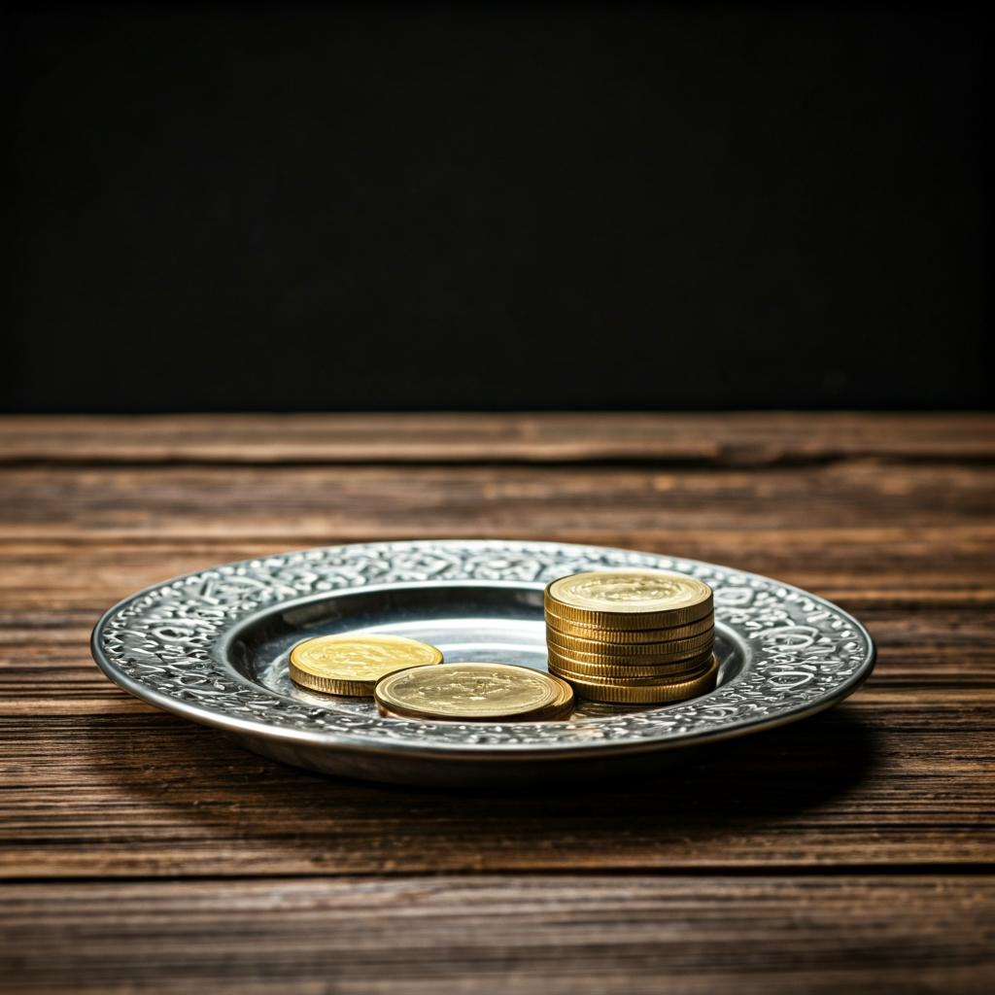
Leader: Thank you for your regular gifts to this ministry. Offerings are most welcome via:
The HHO App
Direct Debit
International Direct Debit
Please consider a one-off donation
or leaving a legacy in your Will
For further information go to HHO give page
https://holyhermits.com.au/give

Slide 55
Serving next week
19th April - 3rd Sunday of Easter
9:00 am AEST
Service Prep: Kristine | Chat Host: Rachel | First Reader: Helen
Music: Wiggles 🐶 | Welcomer: Chris | Second Reader: Roselyn
Proof-reader: Viki | Priest: N/A | Preacher: Lauren
Broadcaster: Barry | Deacon: Lauren | Fellowship: Julie
Backup Broadcaster: Paul | Leader: Jeremy | Safety Officer: Julie?
Zoom Buttons: Lauren | Cantor: Margo | Attendance: Rachel
Thank you for your ministry gifts
New Servers always welcome!
Please email Rev’d Lauren to get involved
holyhermits@anglicanchurchsq.org.au

Slide 56
The Dismissal
Leader: I invite everyone to unmute for the Dismissal
Leader: Go in peace to love and serve the Lord.
All: In the name of Christ, Amen.

Slide 57
Fellowship time
Thank you Lauren for leading Fellowship
Please feel welcome to linger or pop a message in the chat and head off when you are ready.​
Extra resources developed
by Roots on the Web
Artwork by Padlet

