Slide 1
Leader: Welcome to Holy Hermits Online Worship
Palm Sunday
Today, we mark the entry into
Holy Week
Prep: 22/3/2026 Proofed:Mar26
Service Prep: Kristine | Chat Host: Viki | First Reader: Helen
Music: Wiggles 🐶 | Welcomer: Chris | Second Reader: Barry
Proof-reader: Viki | Priest: N/A | Preacher: Flashback
Broadcaster: Barry | Deacon: N/A | Fellowship: Leonie
Backup Broadcaster: Paul | Leader: Julie | Safety Officer: Chris
Zoom Buttons: Viki | Cantor: Margo | Attendance: Viki

Slide 2






Hospitality
Leader:
Please mute for the service unless invited to offer your voice as part of the service ministry
Have the video camera on or off and turn the volume and brightness up or down on your device if things are too loud 🔉🔊or too bright🔅🔆
Our Cantor acts as our voice, offering the responses, in Bold Text, which we say together
Feel welcome to use the chat and reaction emojis 👍
🙏 Please take care of yourself in this space. 🙏 Come and go as you need
😴 It is great to take rest in this space, so falling asleep is also OK 😴
👂️ Remember, pastoral care is available to all in the community, if you'd like to speak to someone about anything spiritual. ❤️ Visit the help page at the website to reach out 🌐
Our Being Together ethos and safeguarding practices can also be accessed on the website 🫶​
🙌 Come as you are – we are all here together! 🙌
Notes:
Used Lent 2022

Slide 3
Invitation
Leader: As we settle into worship let your breath be soft, your mind be still, and your heart be open to the presence of God.
Opening Music: https://www.youtube.com/watch?v=4mHmZV1BC7g

Slide 4
Leader and Cantor unmute
The Greeting
Leader: The Grace of the lord Jesus Christ, and the
love of God, and the fellowship of the Holy
Spirit, be with you all.
All: And also with you.

Slide 5
Call to Worship
Leader: At the beginning of this Holy Week,
let us join with the crowds of Palm Sunday
in welcoming Jesus and celebrating all he means to us.
Celebrate, praise, sing and shout, Hosanna!

Slide 6
Gathering Prayer
Leader: Lord Jesus,
we welcome you in our midst this Palm Sunday.
With the crowds in Jerusalem, we cry ‘Hosanna’
and ‘Blessed is the one who comes in the name of the Lord’.
May this time of celebration help us to walk faithfully with you
from Palm Sunday to Good Friday.
For your name’s sake, we pray.
Amen.

Slide 7
Sentence
Leader: I invite our Cantor to proclaim the sentence for today.
Cantor:
At the name of Jesus, every knee shall bend, in heaven and
on earth and under the earth, and every tongue confess that Jesus Christ is Lord, to the glory of God the Father.
Phillippians 2.10-11

Slide 8
Prayer of Approach
Leader: We pray the prayer of approach together
All: God of the journey,
of the beginning and the end
and the promise of new beginnings,
we come before you on this day
when we remember Jesus journeying to Jerusalem,
to sing our Hosannas to your Holy Name.
Amen.

Slide 9
Our First Hymn is
Ride on, Ride on, in Majesty
https://www.youtube.com/watch?v=uHeIX8xTpYs
We stay on mute
Leader and Cantor mute

Slide 10
Kyrie Eleison​
Leader: Lord, have mercy ​
All: Lord have mercy​
Leader: Christ have mercy​
All: Christ have mercy​
Leader: Lord have mercy​
All: Lord, have mercy​

Slide 11
The LA Introduces Confession​
The Lord comes, bringing to light things now hidden in darkness, and disclosing the purposes of the heart.
​​
Silence may be kept.​..
​
Let us then ask for mercy, confessing our sins in penitence and faith.

Slide 12
All: Merciful God, our maker and our judge,
we have sinned against you in thought, word, and deed,
and in what we have failed to do:
we have not loved you with our whole heart;
we have not loved our neighbours as ourselves;
we repent, and are sorry for all our sins.
Father, forgive us.
Strengthen us to love and obey you in newness of life;
through Jesus Christ our Lord.
Amen.

Slide 13
Words of Assurance offered by the LA
These words of assurance from the First Letter of John declare that:
If anyone sins, we have an advocate with the Father, Jesus Christ the righteous. He is the perfect offering for our sin, and not for ours only, but for the sins of the whole world.
(1 John 2: 1-2)
In this is love, not that we loved God, but that he loved us and sent his Son to be the perfect offering for our sins.
(1 John 4:10)

Slide 14
Collect
Leader: Everlasting God,
in your tender love for the human race
you sent your Son to take our nature,
and to suffer death upon the cross:
in your mercy enable us to share in his obedience to your will and in the glorious victory of his resurrection;
through Jesus Christ our Lord,
who lives and reigns with you and the Holy Spirit,
one God, for ever and ever.
Amen.

Slide 15
≈
The 1st reader unmutes
Leader: I invite the 1st reader to unmute and offer the 1st lesson when ready.
Reader 1: The 1st Reading is from Isaiah 50.4-9a
  ⁴ The Lord God has given me the tongue of a teacher,
  that I may know how to sustain
  the weary with a word.
  Morning by morning he wakens — wakens my ear
  to listen as those who are taught.
  ⁵ The Lord God has opened my ear, and I was not rebellious,
  I did not turn backwards.
Continue…

Slide 16
≈
⁶ I gave my back to those who struck me,
and my cheeks to those who pulled out the beard;
I did not hide my face
from insult and spitting.
⁷ The Lord God helps me;
therefore I have not been disgraced;
therefore I have set my face like flint,
and I know that I shall not be put to shame;
⁸ he who vindicates me is near.
Continue…

Slide 17
≈
Who will contend with me?
Let us stand up together.
Who are my adversaries?
Let them confront me.
⁹ It is the Lord God who helps me;
who will declare me guilty?
All of them will wear out like a garment;
the moth will eat them up.
For the word of the Lord. Thanks be to God.​

Slide 18
Leader: We now say the psalm antiphonally, I invite the first reader to lead, and we will all respond with our cantor as our voice.
Psalm 31.
9-18
⁹ Have mercy upon me, O Lord, for I am in trouble:
my eye wastes away for grief,
my throat also and my inward parts.
¹⁰ For my life wears out in sorrow,
and my years with sighing:
my strength fails me in my affliction,
and my bones are consumed.
Continue…

Slide 19
¹¹ I am become the scorn of all my enemies:
and my neighbours wag their heads in derision.
¹² I am a thing of horror to my friends:
and those that see me in the street shrink from me.
¹³ I am forgotten like one dead and out of mind:
I have become like a broken vessel.
¹⁴ For I hear the whispering of many:
and fear is on every side;
Continue…

Slide 20
¹⁵ While they plot together against me:
and scheme to take away my life.
¹⁶ But in you, Lord, have I put my trust:
I have said ‘You are my God.’
¹⁷ All my days are in your hand:
O deliver me from the power of my enemies
and from my persecutors.
¹⁸ Make your face to shine upon your servant:
and save me for your mercy’s sake.

Slide 21
The 2nd reader unmutes
Leader: Thank you, I invite the 2nd reader to unmute and offer the 2nd lesson when ready.
Reader 2: The 2nd Reading is from Phillippians 2.5-11
⁵ Let the same mind be in you that was in Christ Jesus,
⁶ who, though he was in the form of God,
did not regard equality with God
as something to be exploited,
⁷ but emptied himself,
taking the form of a slave,
being born in human likeness.
Continue…

Slide 22
And being found in human form,
⁸ he humbled himself
and became obedient to the point of death—
even death on a cross.
⁹ Therefore God also highly exalted him
and gave him the name
that is above every name,
¹⁰ so that at the name of Jesus
every knee should bend,
Continue…

Slide 23
in heaven and on earth and under the earth,
¹¹ and every tongue should confess
that Jesus Christ is Lord,
to the glory of God the Father.
For the word of the Lord. Thanks be to God.

Slide 24

We pause before
​the Gospel ​​

Slide 25
The Passion Gospel
According to St Matthew
https://youtu.be/1KAQZrD810o
We stay on mute
Leader and Cantor mute

Slide 26

We pause
after ​the Gospel ​​

Slide 27
Leader: .
Leader and Cantor mute
Broadcaster exits screenshare
Flashback Sermon:
Via Dolorosa – Holy Week with God
https://holyhermits.com.au/podcasts/media/2023-04-02-via-dolorosa-holy-week-with-god

Slide 28
Leader unmutes
Our next Hymn is
Via Dolorosa
https://www.youtube.com/watch?v=n9Fa70hGf34
We stay on mute
Leader mutes

Slide 29
The Leader and Cantor unmute
The Greeting of Peace
Leader: We are the body of Christ
All: God’s Spirit is with us
Leader: The peace of the Lord be always with you.
All: And also with you.
Leader: A sign of peace may be exchanged
You may like to type 'Peace' into the chat, use the 'raise hand’ or other reaction buttons, or just simply wave via the screen with your video turned on
(Broadcaster exits shared screen for a few moments for the exchange of peace)

Slide 30
Prayer of Thanksgiving before Intercessions
Leader: As we enter prayer, I invite the second reader to unmute to lead our intercessions which follow the prayer of thanksgiving. Please feel free to change your body position as you need.

Slide 31
Prayer of Thanksgiving before Intercessions
Leader: Lord Jesus, gratitude can barely cover the turmoil of our emotions when we consider the humiliation you endured,
and the pain you suffered on the cross.
Yet to offer our thanks is the best we can do, and this we do with hearts overflowing with gratitude for all that you have done for us.
You who journeyed to Jerusalem to pass through death,
and who journeys with us evermore,
we kneel before you in thankfulness and praise!
Amen.

Slide 32
Intercessions
Reader 2: We pray for creation and communities we share our lives with. We pause for a few moments to name either in our hearts, or out loud, or in the chat, those environments and communities we bring to the Lord in prayer.
PAUSE…
We entrust to you the community of Holy Hermits Online and our ministry partners:
Prosper the work of our hands and show us the way to your new creation.
Creator God, Hear our prayer.
St John's Cathedral Brisbane The Anglican Diocese of Southern Queensland St Gabriel’s, Carindale Benedictus Contemplative Church, Canberra Anglican Focus and Tithe.ly

Slide 33
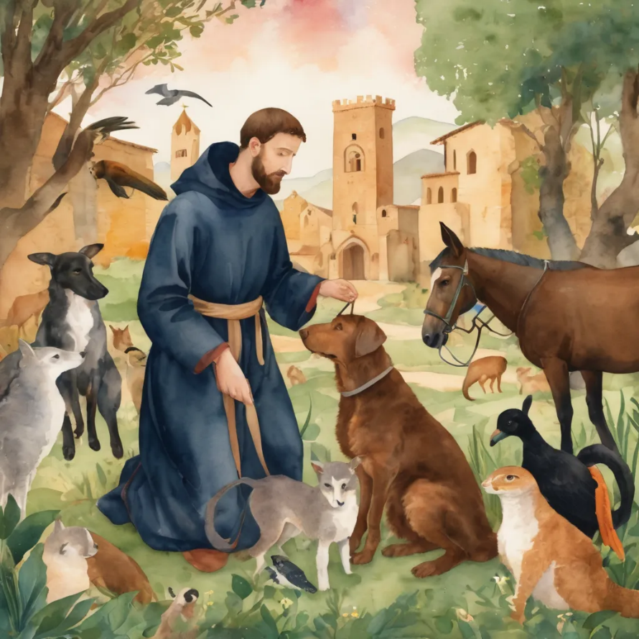
Reader 2: Loving Creator, we entrust to you all animals, especially those who are sick, anxious, ageing, lost, at risk, lonely, sad, hungry, in pain, homeless, abused, living in fear, encountering violence of any kind, in need of comfort, rehabilitation or transformation.
We invite your loving compassion for:
We name in our hearts, out loud or in the chat,
the animals we bring to the Lord in prayer. PAUSE…
Jasmine, ​
Leese(y), ​
Sid, Toots & Lulu​
Polly and Suki​
Fred, George & Percy​
Koshka ​
Jax
Lambert ​​
Kala, Nigel & Little One ​​
Toby​​
Taco​​
Paddy ​​
Rosie​

Slide 34
Reader 2: Eternal Trinity of Love, we uphold to you the people we love and carry cares for:
We name in our hearts, out loud or in the chat, those we bring to the Lord in prayer. PAUSE… We entrust to you those who have died, those who have died peacefully and those who have died tragically, The old and the young. Receive them into your Kingdom. Lord in your mercy, Hear our prayers. Amen.
Kerry, Les & Jake Julie, Ray, Tracey & Shane Mark, Desley & Bob ​​ Rachel, Mervyn & Gillian ​​Rev'd Shane & Janette​​ Alecia, Martin & Aidan​​ Matthew & Nicholas | Barry​​ Dr Julie ​​ Ruth​​ Phil​ May Susan Tanya​ Craig Neva​ | Bill & Marjorie​​ Aaron & Andrea Dilys & Tony, Paul & Darhon Judy & Mary​​ Bob & Di​ Pat & Julie Miriam Gayanne | Kirsten, Greg, Daphne & Beau Alan & Gaylene​ Jess & Leah ​​ Bonnie & girls Liz’s Godchildren Barry & Gwen ​

Slide 35
Pray Daily Cycle of Prayer
Leader: Loving God, joining with the Church in our cycle of prayer, we ask your blessings on:
The Anglican Church of Melanesia
The Parish of Wynnum: Sam, Keith, Keith
AnglicareSQ Family and Wellbeing

Slide 36
Commitment prayer for the week
Leader: Our commitment prayer for the week is for Companion Animals
God, we give thanks for your call to develop a Companion Animal Ministry at Holy Hermits Online. ​
We ask for your grace to guide us, as we build this ministry together. ​
Holy Spirit we ask your presence to be with us as we continue to develop resources together in this new season. ​

Slide 37
Provide us with wisdom and with compassion and with a sense of fun as we celebrate our companion animals and live this mission to outreach. ​
Alongside Holy Hermit St. Francis, we ask you Lord Jesus Christ, to enliven us in this ministry space. ​
Amen .

Slide 38
Leader: Let us pray together the prayer which Jesus gave us saying:
All: Our Father in heaven,
hallowed be your name,
your kingdom come, your will be done,
on earth as in heaven.
Give us today our daily bread.
Forgive us our sins
as we forgive those who sin against us.
Save us from the time of trial
and deliver us from evil.
For the kingdom, the power,
and the glory are yours
now and for ever.
Amen.

Slide 39
Devotions

Slide 40

Leader: ​As we enter a few minutes of silence together, you are invited to pray this prayer of adoration and/or spend this time in contemplation. ​
The Spiritual Communion prayer follows
on the next slide. Let us be still.
Leader and Cantor Mute
​

Slide 41
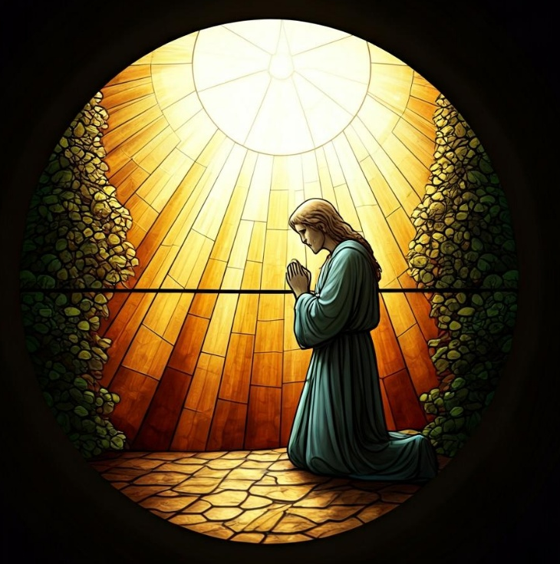
Prayer of Adoration
​
God, who watches over us on life’s journey –
we worship and adore you!
Jesus, who journeys with us –
we worship and adore you!
Holy Spirit, who guides us on our way –
through you, we worship and adore! Amen.

Slide 42
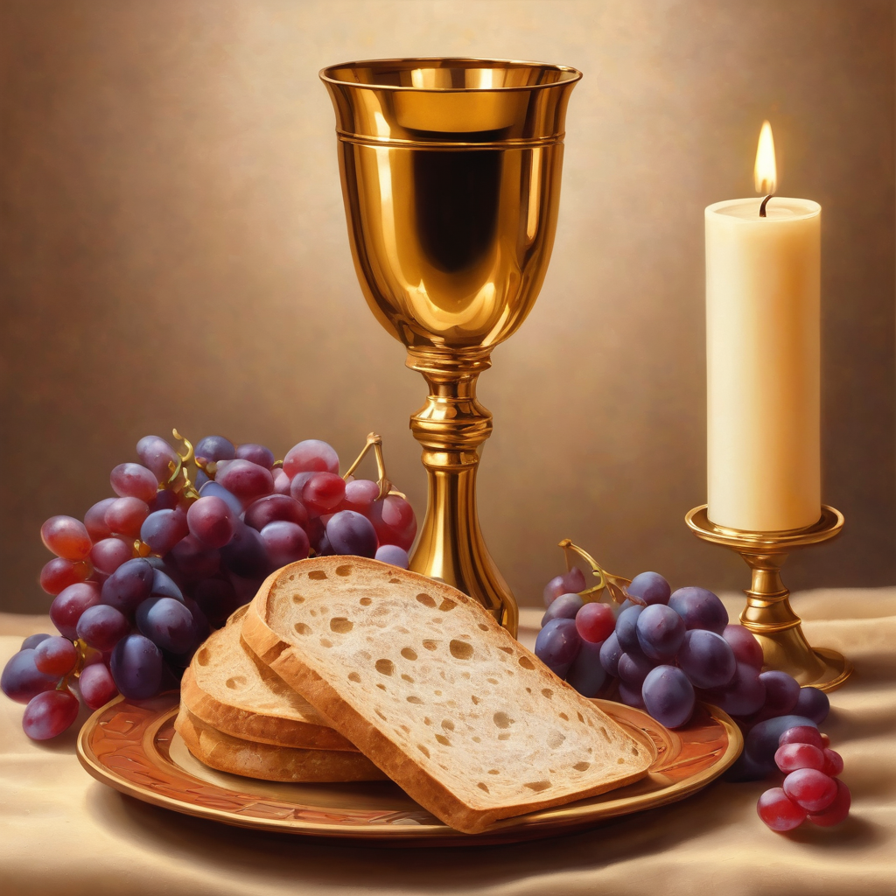
Oh, my Lord Jesus I turn to you
present at the Altar and in the
Tabernacle. I believe that you are
present in the Holy Sacrament of your
most Sacred Body and Blood. I love you
above all things and I desire to receive
you into my Soul. I cannot at this
moment receive you Sacramentally in
Holy Communion. Come spiritually into
my heart. Purify it, Sanctify it. Render
my heart like your own heart.
I embrace you as if you were already
there and unite myself wholly with
you. Never permit me to be separated
from you. Lord, I am not worthy to
receive you, but only say the word and I
shall be healed. Amen
Making a
Spiritual Communion
(Prayed in silence)

Slide 43
Leader unmutes
Our final song is
Hosanna
https://www.youtube.com/watch?v=5m-QB5hgMSE
​We stay on mute
Leader and Cantor mute

Slide 44
Leader and cantor unmute
Sending Prayer
Leader: We pray our sending prayer together.
All: Lord Jesus,
help us to see you in each person we meet in the days ahead.
May we reveal something of your love and goodness to them.
In your name, we pray.
Amen.

Slide 45
The Benediction
Leader: Let us all invite God’s blessings together,
All: May the Lord bless us and keep us.
May the Lord’s face shine upon us and be gracious to us. May the Lord’s countenance be lifted upon us, and bring us peace.
Amen

Slide 46
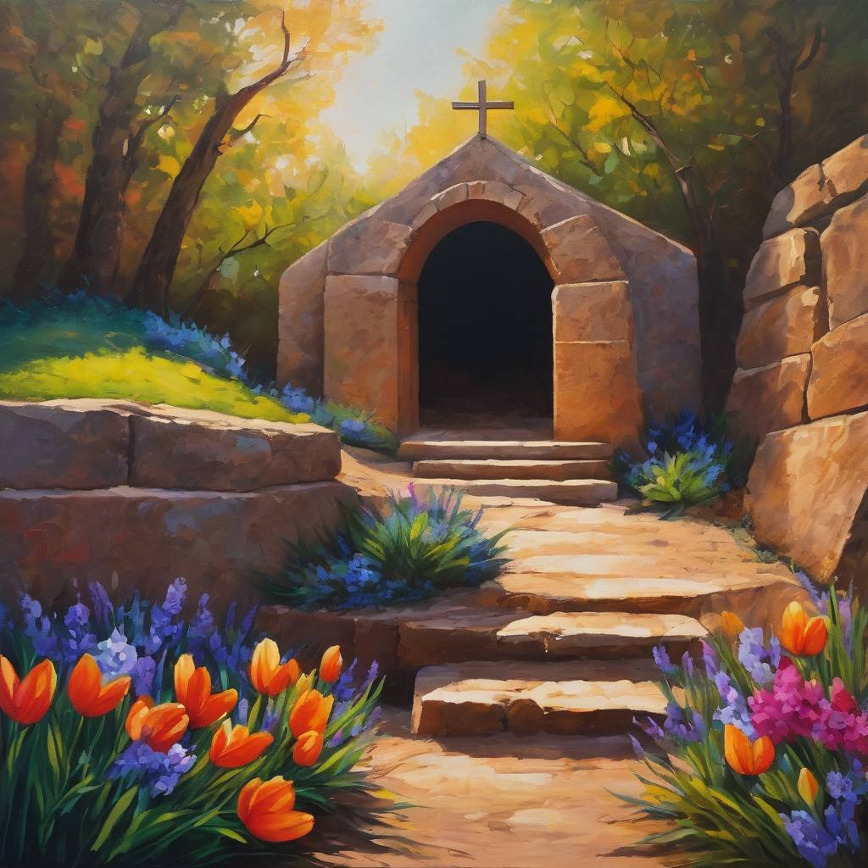
Notices
Easter Service times:
2nd April Maundy Thursday Contemplative service 6pm
3rd April Good Friday At the Cross Contemplative service 10am
4th April Holy Saturday The Great Pause Contemplative service 10am
5th April Easter Day Resurrection Party 9am

Slide 47
Notices
Our Lenten study with the Cathedral continues Wednesday @ 7:30pm Contact Rev’d Jess if you would like to sign up (jgrant@stjohnscathedral.com.au).
We are seeking a couple more broadcasters for weekly worship, if you’re interested, please email holyhermits@anglicanchurchsq.org.au
In May we will begin a monthly 'Spotlight on a Saint' during fellowship. Our first Saint will be St Carlo Acutis who is the patron saint of the Internet. More information in both our HHO Send Outs and in fellowship
See HHO Events page for further upcoming events HHO Events

Slide 48

Offerings: Thank you for your regular gifts to this ministry
Offerings are most welcome via
The HHO App
Direct Debit
International Direct Debit
Please consider a one-off donation
or leaving a legacy in your Will
For further information go to HHO give page https://holyhermits.com.au/give

Slide 49

Serving next week
Sunday 5th April – Easter Day
9:00 am AEST
Service Prep: Leonie | Chat Host: Rachel | First Reader: Phil
Music: Wiggles | Welcomer: Leonie | Second Reader: Viki
Proof-reader: Viki | Priest: N/A | Preacher: Flashback
Broadcaster: Barry | Deacon: Lauren | Fellowship: Julie
Backup Broadcaster: Lauren | Leader: Jeremy | Safety Officer: Leonie
Zoom Buttons: Lauren | Cantor: Roselyn | Attendance: Rachel
Thank you for your ministry gifts
New Servers always welcome!
Please email Rev’d Lauren to get involved
holyhermits@anglicanchurchsq.org.au

Slide 50
The Dismissal
Leader: I invite everyone to unmute for the Dismissal
Leader: Go in peace to love and serve the Lord.
All: In the name of Christ, Amen.

Slide 51
Fellowship time
Thank you, Leonie
for leading Fellowship
Please feel welcome to linger or pop a message in the chat and head off when you are ready.​
Extra resources developed
by Roots on the Web
Image credit: Roots on the Web

