Slide 1
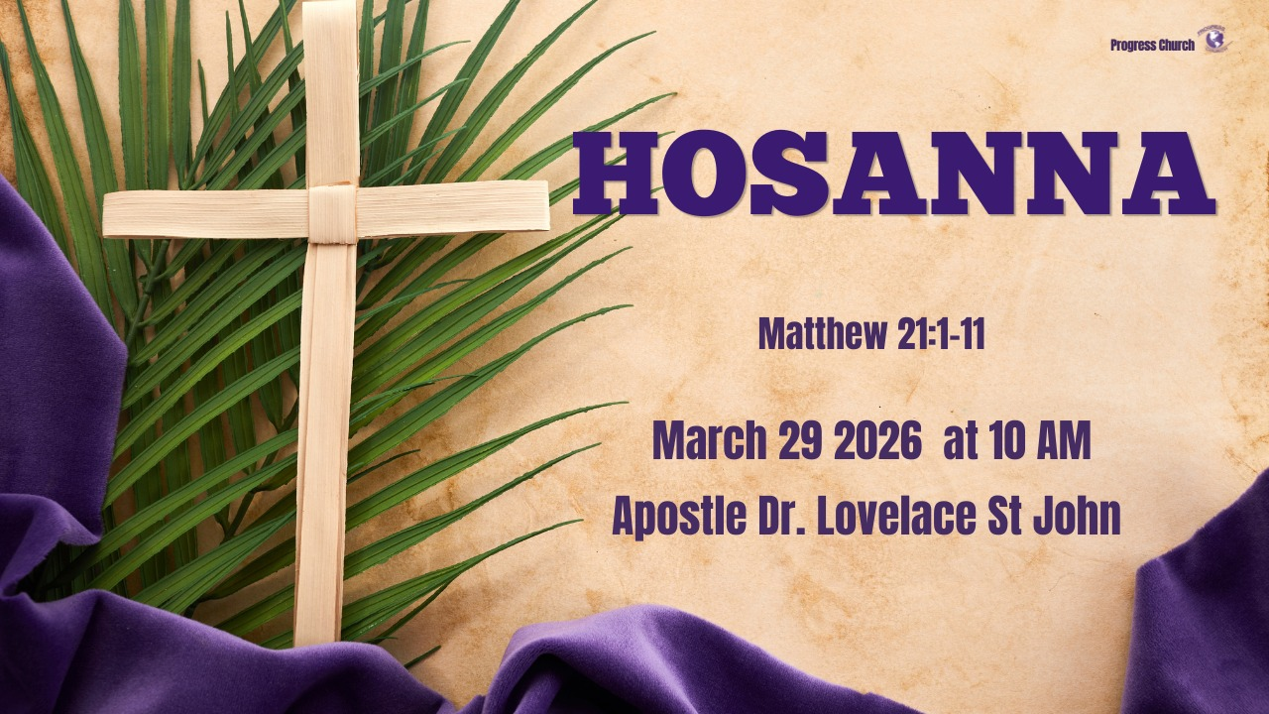

Slide 2



SCRIPTURE
Scripture:
MATTHEW 21: 1 – 11

Slide 3
INTRODUCTION
Hosanna
Not just a celebration. Not just a song
But a cry that means: Save us now!
The same voices that waved palm branches were not just honoring a King, they were pleading for deliverance from oppression, bondage, and brokenness.
Many people today are singing, but few are truly crying out. True worship is not polished, it is desperate.
Hosanna is the sound of someone who refuses to stay bound.

Slide 4
1. HOSANNA IS A CRY BEFORE IT IS A PRAISE
Scripture: Psalm 118:25 - Save now, I pray, O Lord; O Lord, I pray, send now prosperity.
Hosanna originates as a petition, not a Celebration.
Hosanna is the language of urgency: God, I need You now!
Deliverance begins when pride ends.
You cannot experience deliverance until you are willing to cry out.

Slide 5
2. HOSANNA INVITES THE KING INTO YOUR SITUATION
Scripture: Matthew 21:5 “Tell the daughter of Zion, ‘Behold, your King is coming to you, Lowly, and sitting on a donkey, A colt, the foal of a donkey.”
The cry of Hosanna activates divine intervention.
Jesus enters where He is welcomed.
The people didn’t go to the palace; the King came to them.
When your cry is real, God comes near.

Slide 6
3. HOSANNA RECOGNIZES JESUS AS DELIVERER.
Scripture: Luke 19:38–40
‘Blessed is the King who comes in the name of the Lord!’ Peace in heaven and glory in the highest!” 39 And some of the Pharisees called to Him from the crowd, “Teacher, rebuke Your disciples.” 40 But He answered and said to them, “I tell you that if these should keep silent, the stones would immediately cry out.”

Slide 7
3. HOSANNA RECOGNIZES JESUS AS DELIVERER (con’t)
They expected political rescue, but Jesus brought deeper deliverance.
Deliverance is not just from enemies, it is from sin, fear, bondage, and identity loss.
God may not answer how you expect, but He always delivers what you truly need.

Slide 8
4. BARTIMAEUS – THE HOSANNA MAN
Scripture: Mark 10:46–52
His Story:
He was blind (limited vision, limited future)
He was a beggar (dependent, overlooked)
He was silenced by the crowd
But when he heard Jesus was passing by, he cried: “Jesus, Son of David, have mercy on me!”
This was his Hosanna moment.

Slide 9
5. LESSONS FROM BARTIMAEUS
Deliverance begins when you refuse to stay silent. The crowd told him to be quiet; but he cried louder
2. Your condition does not cancel your cry. Blind, but not voiceless. Broken, but not powerless.
3. Jesus responds to desperate faith. Jesus stopped, for one man’s cry.
4. Deliverance requires participation. Throwing aside his garment. (identity shift). He left behind what defined his limitation.
5. Deliverance leads to purpose. He didn’t go back to begging; he followed Jesus.

Slide 10
CONCLUSION
True deliverance is not limited to what is happening around you; it is most of all what God is doing within you.
Deliverance is not just about receiving something new; it is also about releasing the past.
Today see Hosanna, as more than a word. It is a posture. It is the recognition that God alone has the power to save, restore, and change our condition.
Today, the question is not whether we can say Hosanna; but whether we can mean it.
When Hosanna becomes real, deliverance is not far behind.

