Slide 1

The Currency of Jesus
Matthew 27:1-27
Good Friday

Slide 2
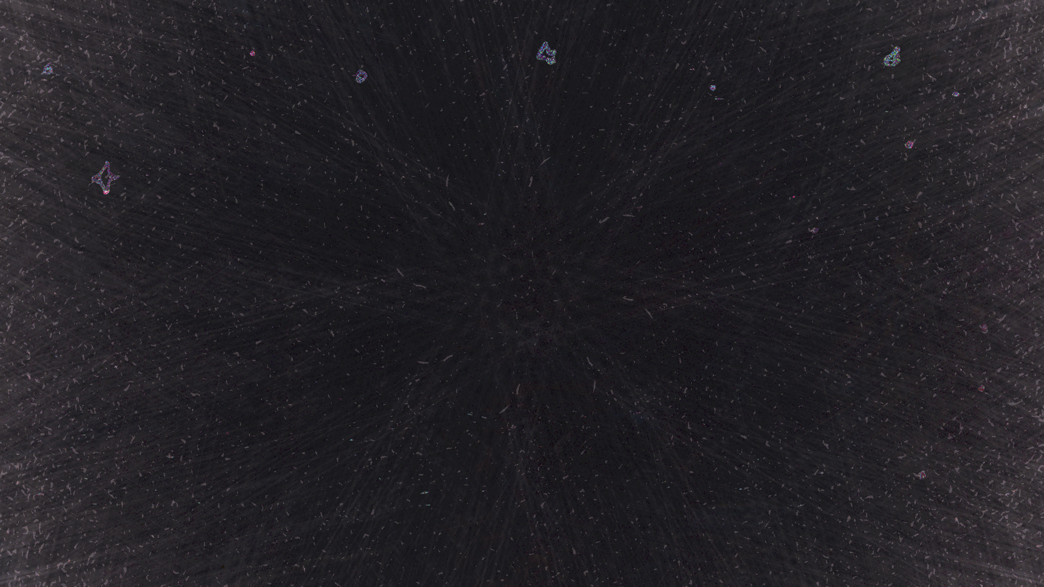
Very early in the morning the leading priests and the elders of the people met again to lay plans for putting Jesus to death. Then they bound him, led him away, and took him to Pilate, the Roman governor.
Matthew 27:1–2
NLT

Slide 3
When Judas, who had betrayed him, realized that Jesus had been condemned to die, he was filled with remorse. So he took the thirty pieces of silver back to the leading priests and the elders.
Matthew 27:3
NLT

Slide 4
“I have sinned,” he declared, “for I have betrayed an innocent man.” “What do we care?” they retorted. “That’s your problem.”
Matthew 27:4
NLT

Slide 5
Then Judas threw the silver coins down in the Temple and went out and hanged himself. The leading priests picked up the coins. “It wouldn’t be right to put this money in the Temple treasury,” they said, “since it was payment for murder.”
Matthew 27:5–6
NLT

Slide 6
After some discussion they finally decided to buy the potter’s field, and they made it into a cemetery for foreigners. That is why the field is still called the Field of Blood.
Matthew 27:7–8
NLT

Slide 7
This fulfilled the prophecy of Jeremiah that says, “They took the thirty pieces of silver— the price at which he was valued by the people of Israel, and purchased the potter’s field, as the Lord directed.”
Matthew 27:9–10
NLT

Slide 8
Now Jesus was standing before Pilate, the Roman governor. “Are you the king of the Jews?” the governor asked him. Jesus replied, “You have said it.” But when the leading priests and the elders made their accusations against him, Jesus remained silent.
Matthew 27:11–12
NLT

Slide 9
“Don’t you hear all these charges they are bringing against you?” Pilate demanded. But Jesus made no response to any of the charges, much to the governor’s surprise.
Matthew 27:13–14
NLT

Slide 10
Now it was the governor’s custom each year during the Passover celebration to release one prisoner to the crowd—anyone they wanted. This year there was a notorious prisoner, a man named Barabbas.
Matthew 27:15–16
NLT

Slide 11
As the crowds gathered before Pilate’s house that morning, he asked them, “Which one do you want me to release to you—Barabbas, or Jesus who is called the Messiah?” (He knew very well that the religious leaders had arrested Jesus out of envy.)
Matthew 27:17–18
NLT

Slide 12
Just then, as Pilate was sitting on the judgment seat, his wife sent him this message: “Leave that innocent man alone. I suffered through a terrible nightmare about him last night.”
Matthew 27:19
NLT

Slide 13
Meanwhile, the leading priests and the elders persuaded the crowd to ask for Barabbas to be released and for Jesus to be put to death.
Matthew 27:20
NLT

Slide 14
So the governor asked again, “Which of these two do you want me to release to you?” The crowd shouted back, “Barabbas!” Pilate responded, “Then what should I do with Jesus who is called the Messiah?” They shouted back, “Crucify him!”
Matthew 27:21–22
NLT

Slide 15
“Why?” Pilate demanded. “What crime has he committed?” But the mob roared even louder, “Crucify him!”
Matthew 27:23
NLT

Slide 16
Pilate saw that he wasn’t getting anywhere and that a riot was developing. So he sent for a bowl of water and washed his hands before the crowd, saying, “I am innocent of this man’s blood. The responsibility is yours!”
Matthew 27:24
NLT

Slide 17
And all the people yelled back, “We will take responsibility for his death—we and our children!” So Pilate released Barabbas to them. He ordered Jesus flogged with a lead-tipped whip, then turned him over to the Roman soldiers to be crucified.
Matthew 27:25–26
NLT

Slide 18
Some of the governor’s soldiers took Jesus into their headquarters and called out the entire regiment.
Matthew 27:27
NLT

Slide 19
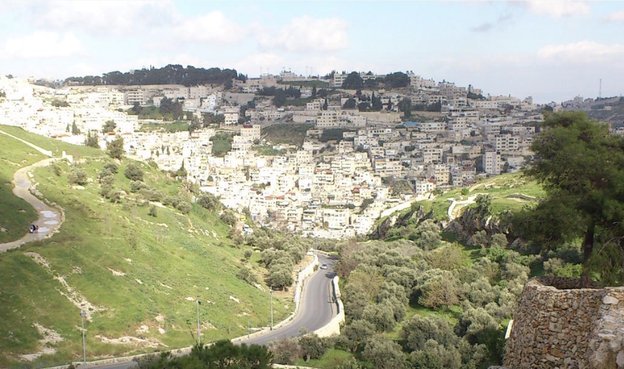
Akeldama - “The Field of Blood”

Slide 20
“ ‘Cursed be anyone who takes a bribe to shed innocent blood.’ And all the people shall say, ‘Amen.’
Deuteronomy 27:25
ESV

Slide 21
And all the people yelled back, “We will take responsibility for his death—we and our children!”
Matthew 27:25
NLT

Slide 22
But if we walk in the light, as he is in the light, we have fellowship with one another, and the blood of Jesus his Son cleanses us from all sin.
1 John 1:7
ESV

Slide 23
If we confess our sins, he is faithful and just to forgive us our sins and to cleanse us from all unrighteousness.
1 John 1:9
ESV

Slide 24
The blood that stains, is the blood that saves!

Slide 25
Indeed, under the law almost everything is purified with blood, and without the shedding of blood there is no forgiveness of sins.
Hebrews 9:22
ESV

Slide 26
In him we have redemption through his blood, the forgiveness of our trespasses, according to the riches of his grace,
Ephesians 1:7
ESV

Slide 27
and from Jesus Christ the faithful witness, the firstborn of the dead, and the ruler of kings on earth. To him who loves us and has freed us from our sins by his blood
Revelation 1:5
ESV

