Slide 1
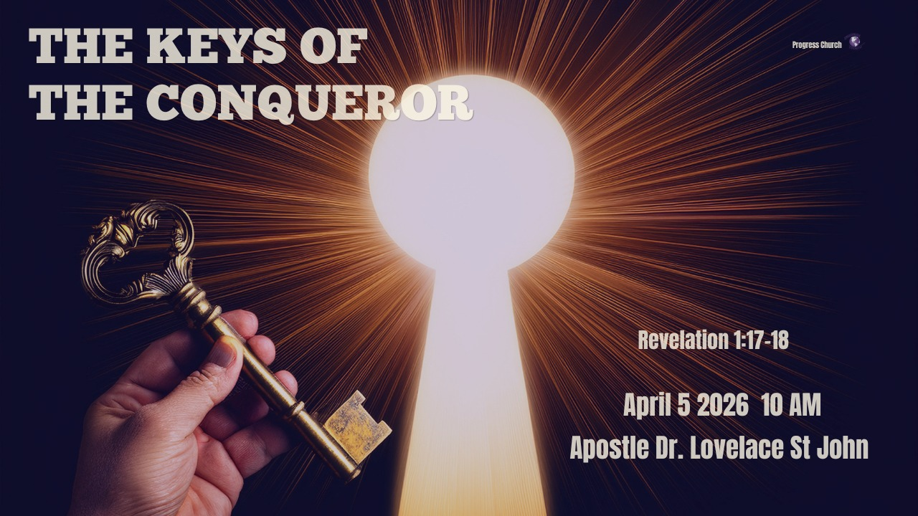

Slide 2



Scripture:
REVELATION 1:17–18

Slide 3
INTRODUCTION
Imagine someone locked in a prison cell, not because the door is strong, but because they don’t have the key.
The tragedy is not the prison; the tragedy is access without awareness.

Slide 4
INTRODUCTION (cont)
There are people today who are living in rooms they don’t have to stay in:
Rooms of Sin
Rooms of fear.
Rooms of shame.
Rooms of limitation.
Rooms of spiritual defeat.
Not because the door is locked, but because they don’t realize that the key already exists.

Slide 5
1. FOUNDATIONAL BACKGROUND: THE BOOK OF REVELATION
This book was written by John the Apostle, exiled on the island of Patmos, Isolated, Persecuted, and Under Pressure.
But notice this: What looked like punishment, became a platform for revelation.
The Book of Revelation is not just about the end times, It is about the unveiling of Jesus Christ in His full authority.

Slide 6
1. FOUNDATIONAL BACKGROUND: THE BOOK OF REVELATION
AUTHOR
Written by John the Apostle
Also wrote the Gospel of John and the Epistles (1–3 John)

Slide 7
FOUNDATIONAL BACKGROUND: THE BOOK OF REVELATION:
WHY WAS IT WRITTEN?
To reveal Jesus Christ in His glorified, victorious state
To encourage persecuted believers
To show the ultimate triumph of Christ over evil
To call the Church to faithfulness and endurance

Slide 8
FOUNDATIONAL BACKGROUND: THE BOOK OF REVELATION:
WHO WAS IT WRITTEN TO?
The Seven Churches of Asia Minor
(Revelation 1:4)
To Real churches facing persecution, compromise, and pressure

Slide 9
1. FOUNDATIONAL BACKGROUND: THE BOOK OF REVELATION:
WHEN WAS IT WRITTEN?
Around AD 90–95
During the reign of Emperor Domitian
(a time of intense persecution)
SETTING
John was exiled on the island of Patmos
He receives a divine vision of Christ’s glory and authority

Slide 10
2. REVELATION CHAPTER 1
The Revelation is About Jesus (v.1)
Not primarily about events, but about a Person
“The Revelation of Jesus Christ” = unveiling of His glory
2. The Position of John (v.9)
In tribulation, exile, and suffering
Yet positioned to receive revelation
Revelation often comes in isolation and pressure

Slide 11
2. REVELATION CHAPTER 1
The Voice and the Vision (v.10–16)
John hears a voice like a trumpet. He turns, and he sees Jesus.
Not the baby in the manger. Not the suffering servant on the cross. But the glorified Christ.
A trumpet-like voice = authority

Slide 12
2. REVELATION CHAPTER 1
Christ is seen:
In the midst of the lampstands (the Church)
Clothed in priestly and kingly garments
Eyes like fire (discernment)
Feet like bronze (judgment)
Voice like many waters (power)

Slide 13
2. REVELATION CHAPTER 1
The Reaction of Man (v.17)
John falls “as dead”
When humanity encounters glory, flesh cannot stand
The Comfort of Christ (v.17–18)
“Fear not” Before He reveals His power, He removes his fear.

Slide 14
2. REVELATION CHAPTER 1
Jesus introduces Himself:
Eternal (First and Last)
Victorious (was dead, now alive)
Authoritative (holds the keys)

Slide 15
3. THE KEYS OF THE CONQUEROR
Revelation 1:18
KEY 1: THE KEY OF VICTORY OVER DEATH
“I was dead and behold I am alive forevermore”
Jesus did not escape death.
He entered death.
He conquered death
He came back with authority over it.

Slide 16
3. THE KEYS OF THE CONQUEROR
1 Corinthians 15: 54 -55
So when this corruptible has put on incorruption, and this mortal has put on immortality, then shall be brought to pass the saying that is written: “Death is swallowed up in victory.” 55 “O Death, where is your sting? O Hades, where is your victory?”

Slide 17
KEY 2: THE KEY OF AUTHORITY OVER HELL
“I have the keys of hell”
That word “hell” (Hades) speaks of the realm of the dead. The domain that once held humanity captive.
Jesus went into that realm and took it’s authority.
Colossians 2:15 Having disarmed principalities and powers, He made a public spectacle of them, triumphing over them in it.
He disarmed principalities and powers.
The enemy does not control your outcome.

Slide 18
KEY 3: THE KEY OF FREEDOM FROM FEAR
“Fear not”
Fear will stop you from walking in what God has already given you
Fear will make you stay in rooms God already unlocked.
Some people are not bound by chains, they are bound by fear.
Fear of failure
Fear of rejection
Fear of stepping out
Fear must break. It’s not a suggestion, He is issuing a command backed by authority.

Slide 19
KEY 4. THE KEY OF ETERNAL IDENTITY
“I am the First and the Last”
Jesus is saying: “I am before everything, and I will be after everything.”
That means:
Your life is not random
Your destiny is not fragile
Your future is not uncertain
Stop measuring your life by temporary situations

Slide 20
KEY 5: THE KEY OF ACCESS AND CONTROL
“I have the keys…”
Biblical Meaning of Keys:
Authority
Access
Control
Whoever has the key, controls the outcome.
He still has authority over:
Every closed door
Every impossible situation
Every spiritual battle

Slide 21
CONCLUSION
You are not called to follow a victim; you are called to follow a Conqueror with keys in His hand.
Stop living like doors are still locked.
When Jesus rose, He didn’t just come out of the grave, He came out with the keys.
Today:
You are not a victim
You are not defeated
You are not stuck
You have access
You have authority
You have victory

