Slide 1


THE ROAD TO CALVARY

Slide 2

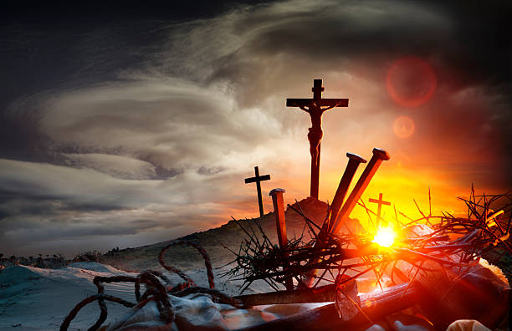
A DAY OF CONTRASTS
CLIC @ FEDERATION UNIVERSITY, BERWICK
3 APRIL 2026

Slide 3

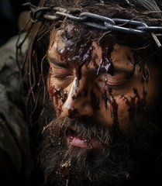
A LONG DAY THAT DID NOT SEEM TO END

Slide 4




A LONG DAY THAT BEGAN WITH…
A BETRAYAL;
THEN A DENIAL;
IT CONTINUED WITH ALL THE DISCIPLES ABANDONING HIM;
THEN CAME THE INTERROGATIONS
FIRST BY PILATE;
FOLLOWED BY HEROD.
THERE WAS TORTURE;
HUMILIATION;
PAIN;
A CROWN OF THORNS;
A PURPLE ROBE;
THEN THE CROSS…
…IT WAS A LONG DAY BUT IT WAS NOT OVER YET..
4

Slide 5
A LONG DAY THAT WAS NOT YET OVER…
A CRIMINAL ON A CROSS NEXT TO HIM WAS GIVEN ASSURANCE OF SALVATION.
THE MEN WHO HAMMERED IN THE NAILS WERE
GIVEN A PARDON OF SIN
THE MEN WERE PRAYED FOR BY THE ONE WHO
ALWAYS HAD HIS PRAYERS ANSWERED
THEN AS MEN GAMBLED FOR HIS ROBE, THAT MAN, BROKEN AND BLEEDING, TURNED HIS FACE TOWARDS HEAVEN AND CRIED “MY GOD, MY GOD, WHY HAVE YOU FORSAKEN ME? ” AND “IT IS FINISHED! FATHER, INTO YOUR HANDS I COMMIT MY SPIRIT.”
5

Slide 6
THAT SAME DAY…
…THE VEIL OF THE TEMPLE WAS TORN IN TWO FROM TOP TO BOTTOM (LUKE 23:45)
…THE TOMBS WERE OPENED AND THE SAINTS WHO
WERE DEAD AROSE AND WALKED AROUND
JERUSALEM (JOHN 27:52,53)
… A CENTURION PROCLAIMED ALOUD “TRULY THIS WAS THE SON OF GOD!” (MARK 15:39)
6

Slide 7
THAT SAME DAY…
THAT HEROD AND PILATE BECAME FRIENDS, GOD WAS IN CHRIST RECONCILING THE WORLD TO HIMSELF
(2 COR. 5:19)
HE WHO KNEW NO SIN WAS MADE SIN THAT WE
MIGHT BE MADE THE RIGHTEOUSNESS OF GOD IN
HIM (2 COR. 5:21)
THE HEAD OF THE SERPENT WAS BRUISED
(GEN. 3:15)
THE PRINCE OF THIS WORLD WAS JUDGED (JOHN 16:11)
7

Slide 8
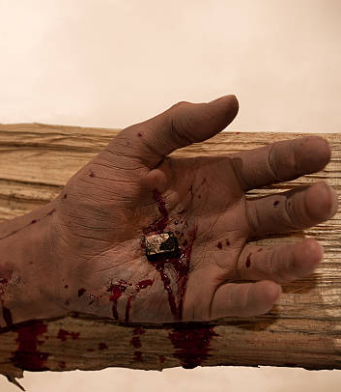
IT WAS A LONG DAY…
…YET
IT WAS ALSO A SHORT DAY

Slide 9
IT WAS A SHORT DAY…
…BY THE NINTH HOUR (3PM),
HE – THE ONE WHO COULD HAVE
CALLED ON TEN THOUSAND ANGELS
TO DELIVER HIM – WAS DEAD
IT WAS A LONG DAY BUT ALSO A SHORT ONE.
9

Slide 10
BUT,
THERE IS ANOTHER DAY COMING

Slide 11

BEHOLD, HE IS COMING WITH THE CLOUDS, AND EVERY EYE WILL SEE HIM, EVEN THOSE WHO PIERCED HIM; AND ALL THE TRIBES OF THE EARTH WILL MOURN OVER HIM.
SO IT IS TO BE.
AMEN
REVELATION 1: 7
(NASB, 1995)

Slide 12
THERE WILL BE A DAY WHEN JESUS CHRIST THE ALPHA & THE OMEGA WILL RETURN.
HE WILL RETURN – AS THE LION OF JUDAH, THE ROOT OF DAVID,
THE ONLY ONE WORTHY TO OPEN THE BOOK IN THE RIGHT HAND OF GOD.
IT WILL BE A DAY OF JUDGEMENT

Slide 13
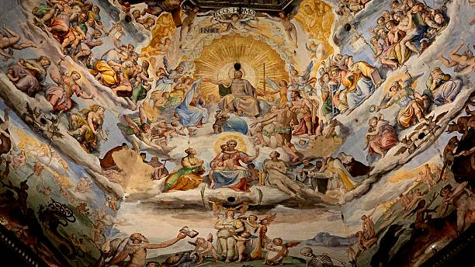
https://www.istockphoto.com/

Slide 14
THE SEA WILL GIVE UP HER DEAD.
EVERYONE - GREAT & SMALL-
SHALL STAND BEFORE GOD.
EVERY KNEE SHALL BOW AND EVERY TONGUE CONFESS THAT JESUS CHRIST IS LORD TO THE GLORY OF GOD

Slide 15
AND I SAW THE DEAD, THE GREAT AND THE SMALL, STANDING BEFORE THE THRONE, AND BOOKS WERE OPENED;
AND ANOTHER BOOK WAS OPENED, WHICH IS THE BOOK OF LIFE;
AND THE DEAD WERE JUDGED
FROM THE THINGS WHICH WERE WRITTEN IN THE BOOKS, ACCORDING TO THEIR DEEDS.
REVELATION 20: 12
(NASB, 1995)

Slide 16
AND THE SEA GAVE UP THE DEAD WHICH WERE IN IT, AND DEATH AND HADES GAVE UP THE DEAD WHICH WERE IN THEM; AND THEY WERE JUDGED, EVERYONE OF THEM ACCORDING TO THEIR DEEDS.
THEN DEATH AND HADES WERE THROWN INTO THE LAKE OF FIRE. THIS IS THE SECOND DEATH, THE LAKE OF FIRE.
AND IF ANYONE’S NAME WAS NOT FOUND WRITTEN IN THE BOOK OF LIFE, HE WAS THROWN INTO THE LAKE OF FIRE.
REVELATION 20: 13 - 15
(NASB, 1995)

Slide 17
THE JUDGEMENT WILL BE A DAY OF GREAT UNION AND GREAT DIVISION
THE SHEEP WILL BE SEPERATED FROM THE GOATS,
THE SAINTS FROM THE HYPOCRITES
THE WISE VIRGINS FROM THE FOOLISH VIRGINS
THE WICKED FROM THE RIGHTEOUS

Slide 18
JUDGEMENT WILL BE CARRIED OUT BY THE SAME ONE AROUND WHOM ALL THESE EVENTS TOOK PLACE ON THAT FIRST GOOD FRIDAY:
JESUS FROM NAZARETH OF THE TRIBE OF JUDAH, THE ROOT OF DAVID
WHO WAS BORN OF A VIRGIN IN BETHLEHAM –
THE ONE WHOSE BIRTH STILL DIVIDES THE CALENDAR FOR ALL MEN AND WHOSE DEATH ALTERED HISTORY FOR ALL MEN

Slide 19
THIS SAME JESUS WHO WENT TO THE CROSS FOR YOU AND FOR ME THAT FIRST GOOD FRIDAY WILL
BOTH UNITE AND DIVIDE ON THAT LAST DAY
THIS IS THE NEWS OF GOOD FRIDAY

Slide 20
A DAY OF UNITING & DIVIDING

Slide 21
NOW HEROD AND PILATE BECAME FRIENDS
WITH ONE ANOTHER THAT VERY DAY;
FOR BEFORE THAT THEY HAD BEEN ENEMIES
WITH ONE ANOTHER
LUKE 23: 12
(NASB, 1995)

Slide 22
WHAT WAS IT THAT HEROD AND PILATE WERE AGREED ON?
THE CROSS.
WHAT WAS THE BASIS FOR THEIR FRIENDSHIP?
THE CROSS
FOR THEY BOTH AGREED THAT THE CROSS WAS THE SOLUTION TO THEIR PROBLEM.

Slide 23
THE CROSS
UNITES THOSE WHO CANNOT SEE THE GLORY OF CHRIST.
ONCE MEN REJECT THE SON OF GOD
THEY DO UNTHINKABLE THINGS.
THEY SAY AND DO THINGS THEY ONCE THOUGHT THEMSELVES INCAPABLE OF DOING.
(JOHN 19:15)

Slide 24
BUT
THE CROSS
UNITES THOSE WHO SEE THE GLORY OF CHRIST.
AND IN SO DOING THE CROSS ALSO DIVIDES THOSE WHO SEE
EVEN FROM NATURAL TIES –
FOR THE CROSS – THE GLORY OF CHRIST –
TRANSCENDS EVERYTHING

Slide 25
“DO YOU SUPPOSE THAT I CAME TO GRANT PEACE ON EARTH? I TELL YOU, NO, BUT RATHER DIVISION;
FOR FROM NOW ON FIVE MEMBERS IN ONE HOUSEHOLD WILL BE DIVIDED, THREE AGAINST TWO AND TWO AGAINST THREE.
THEY WILL BE DIVIDED, FATHER AGAINST SON AND SON AGAINST FATHER, MOTHER AGAINST DAUGHTER AMD DAUGHTER AGAINST MOTHER, MOTHER-IN-LAW AGAINST DAUGHTER-IN-LAW AND DAUGHTER-IN-LAW AGAINST MOTHER-IN-LAW”
LUKE 12: 51 – 53 (NASB)

Slide 26
THE CROSS UNITES AS WELL AS DIVIDES
THE NAME OF JESUS CHRIST
ALWAYS PRODUCES SOME TYPE OF PAINFUL DIVISION,
EVEN IN THE MOST PERSONAL OF RELATIONSHIPS

Slide 27
“I AM THE WAY, AND THE TRUTH, AND THE LIFE. NO ONE COMES TO THE FATHER EXCEPT THROUGH ME”
JOHN 14:6
ALL PATHS DO NOT LEAD TO GOD.
IT DOES MATTER WHAT YOU BELIEVE.
JESUS DID NOT BELIEVE THAT ALL PEOPLE ARE GOOD.
JESUS DID NOT SAY YOU CAN DO WHATEVER YOU WANT AS LONG AS YOU DO NOT HURT ANYONE ELSE.

Slide 28
JESUS’ ETHICS ARE RADICAL.
TO FOLLOW JESUS CHRIST DEMANDS CAREFUL OBEDIENCE AND COSTLY LOYALTY.
ARE YOU WILLING TO PAY THE PRICE
OF
FOLLOWING JESUS CHRIST?

Slide 29
IT IS A FACT THAT
“ALL WHO DESIRE TO LIVE A GODLY LIFE IN CHRIST JESUS WILL BE PERSECUTED”
2 TIMOTHY 3: 12
IF YOU WISH TO FOLLOW CHRIST,
YOU WILL EXPERIENCE DIVISION.
AND SOMETIMES THAT DIVISION AND PERSECUTION WILL COME FROM THOSE WE LOVE THE MOST.

Slide 30
BUT
JESUS ALSO BRINGS PEACE WITH GOD.
JESUS GIVES US HIS OWN PERSONAL PEACE
(JOHN 14:27).
HE GIVES US THE PEACE HE HAD FOR HIS 33 YEARS HERE ON EARTH AMIDST ALL THE TURMOIL, MISUNDERSTANDINGS AND PERSECUTIONS. THE PEACE THAT IS NOW HIS IN GLORY!
JESUS ALSO GIVES US PEACE WITH HIS OWN PEOPLE (EPHESIANS 2; 17,18; JOHN 17:21)

Slide 31


PEACE WITH GOD
CHRIST’S PERSONAL PEACE IN OUR HEARTS
PEACE WITH THE PEOPLE OF GOD

Slide 32



A
FINAL CONSIDERATION

Slide 33
“HE WILL BAPTISE YOU WITH THE HOLY SPIRIT AND WITH FIRE.
HIS WINNOWING FORK IS IN HIS HAND TO THOROUGHLY CLEAR HIS THRESHING FLOOR, AND TO GATHER THE WHEAT INTO THE BARN; BUT HE WILL BURN UP THE CHAFF WITH UNQUENCHABLE FIRE”
LUKE 3: 16b, 17 (NASB, 1995)

Slide 34
JESUS LONGED TO BRING “FIRE ON THE EARTH”, TO BAPTISE HIS OWN WITH THE HOLY SPIRIT AND WITH FIRE
WHY?
THAT THEY WOULD BE REGENERATED, INDWELT, SEALED, SANCTIFIED; AND THAT JUDGEMENT WOULD BE SET IN MOTION FOR THE WORLD.
LUKE 3: 16b, 17 (NASB, 1995)

Slide 35
THIS IS WHY HE HAD TO BE BAPTISED IN DEATH,
A FACT THAT DOMINATED AND DISTRESSED HIM UNTIL THE END.
HE WISHED THAT THERE WAS ANOTHER WAY BUT HE WAS WILLING TO SUBMIT TO THE WILL OF HIS FATHER UNTIL IT WAS DONE.
HE WENT TO THE CROSS FOR US

Slide 36
JESUS GAVE HIS ALL.
HE SANK INTO DEATH’S WATERS THAT WE MIGHT HAVE HIS FIRE AND HIS PEACE.
WE OWE EVERYTHING TO HIS BLOOD.

Slide 37
WHAT BEGAN ON GOOD FRIDAY,
THAT SAME DAY WHEN HEROD AND PILATE BECAME FRIENDS,
JESUS CHRIST WENT ON TO ACCOMPLISH THE VICTORY
THAT WON THE WAR.
THAT IS THE NEWS OF GOOD FRIDAY THAT IS PROCLAIMED WHENEVER THE GOSPEL IS PREACHED

Slide 38


www.clichurch.com
clic church inc
clic.church
Email: connect@clichurch.com

Slide 39
