Slide 1
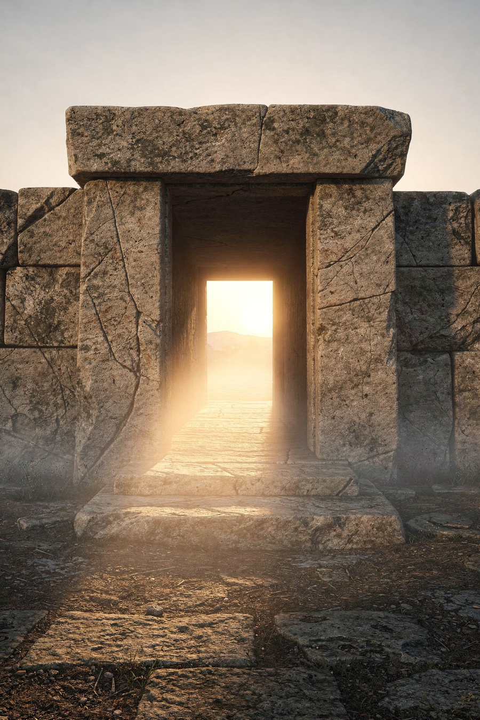
Empty Tomb, Full Life
Hope That Cannot Be Shaken

Slide 2

Everyone Is Hoping for Something
Health
Relationships
Finances
Peace

Slide 3
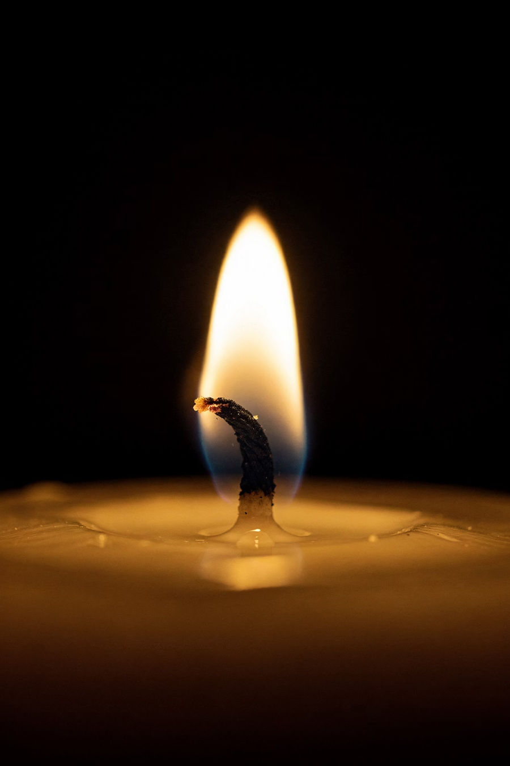
Hope is powerful

Slide 4
"Hope is both the earliest and the most indispensable virtue inherent in the state of being alive. If life is to be sustained, hope must remain — even where confidence is wounded, trust impaired."
— Erik H. Erikson, Developmental Psychologist, The Erik Erickson Reader (2000)

Slide 5

But what is your hope built on?

Slide 6

The greatest hope in history is built on one claim

Slide 7
"If Christ has not been raised, our preaching is useless and so is your faith."
— 1 Corinthians 15:14

Slide 8
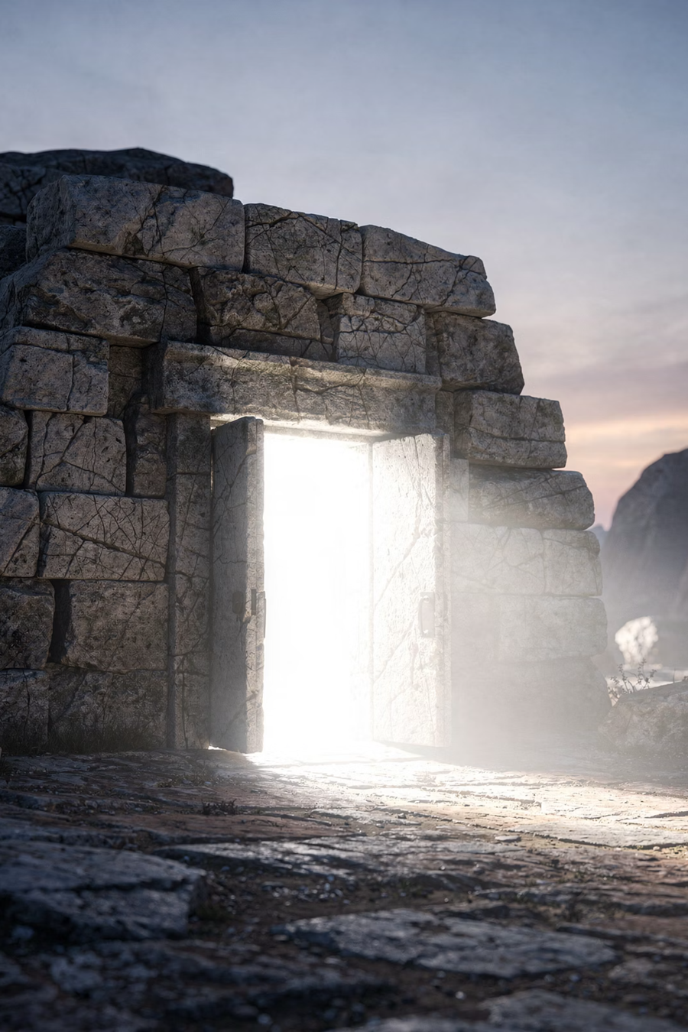
An Empty Tomb

Slide 9
THE ONE CLAIM
Jesus Christ rose from the dead.
It conquers death
It's grounded in history
Every other hope can be taken away by death. This one defeats it.
Not a wish about the future, but a claim about something that already happened.
It answers our deepest fears
It cannot be taken away
Guilt, meaninglessness, and death — all addressed in one event.
Health, money, relationships can all be lost. This hope cannot.

Slide 10

Let's Examine This Together
Not blind faith
Not blind rejection

Slide 11
What if Jesus Did Not Rise?
1
2
3
He didn't really die
The body was taken
It was made up

Slide 12
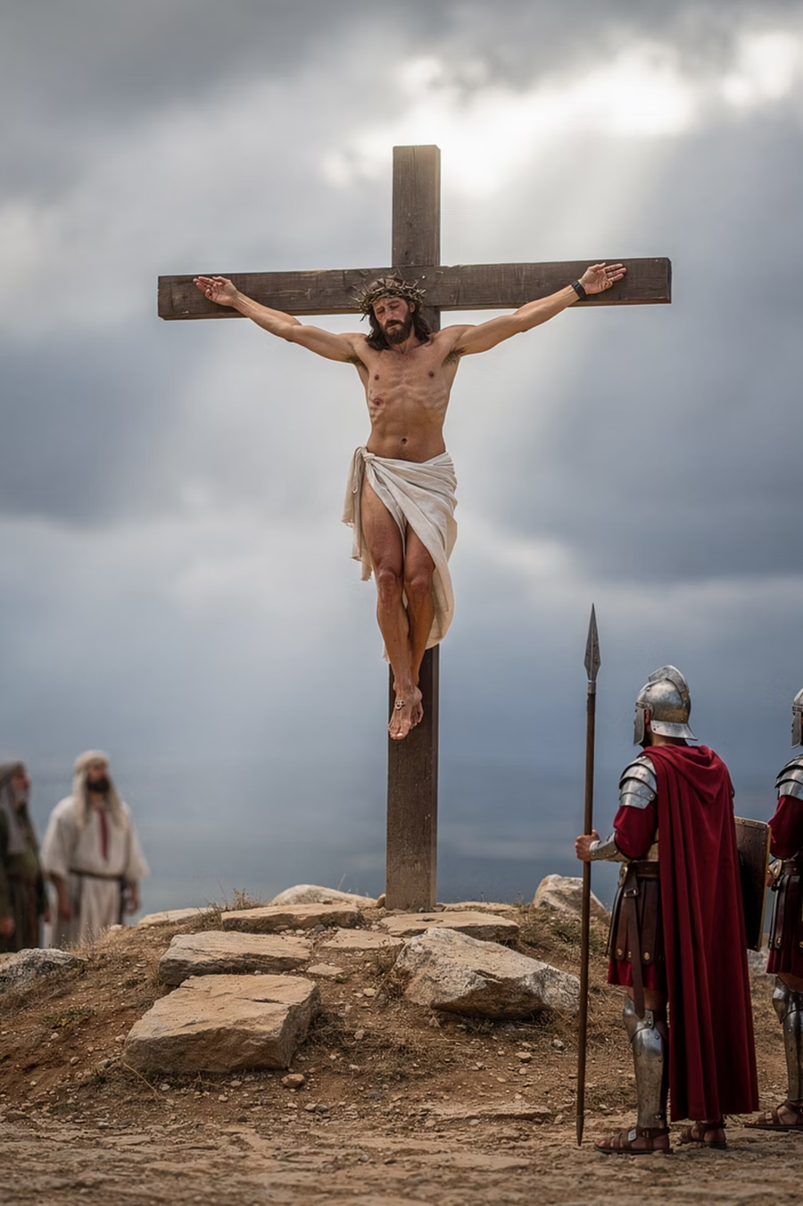
Theory 1
He didn't really die?
Roman execution was precise. Soldiers ensured death. Does this really hold up?

Slide 13
WHAT THE MEDICAL EVIDENCE SAYS
Edwards, Gabel, and Hosmer were medical researchers at the Mayo Clinic who conducted a peer-reviewed study published in one of the world’s most respected medical journals, with no theological agenda.
"Modern medical interpretation of the historical evidence indicates that Jesus was dead when taken down from the cross."
— Edwards, Gabel & Hosmer, Journal of the American Medical Association (JAMA), 1986

Slide 14
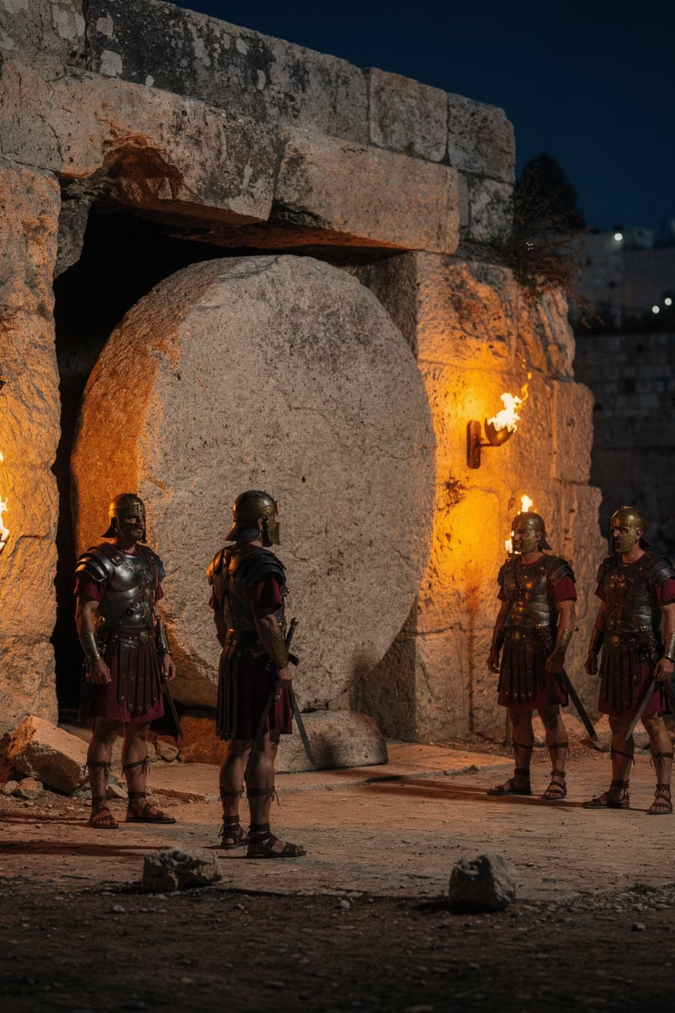
Theory 2
The body was taken?
The tomb was sealed and guarded by Roman soldiers. Anyone attempting to steal the body would have had to get past an armed guard and break a Roman seal — a capital offence.

Slide 15
WHAT A ROMAN HISTORIAN RECORDED
Tacitus was one of ancient Rome's greatest historians — a Roman senator who was openly hostile to Christianity. He had every reason to dismiss it, not document it.
"Christus, from whom the name had its origin, suffered the extreme penalty during the reign of Tiberius at the hands of one of our procurators, Pontius Pilatus, and a most mischievous superstition, thus checked for the moment, again broke out."
— Tacitus, Roman Senator & Historian, Annals 15.44 (c. 116 AD)

Slide 16
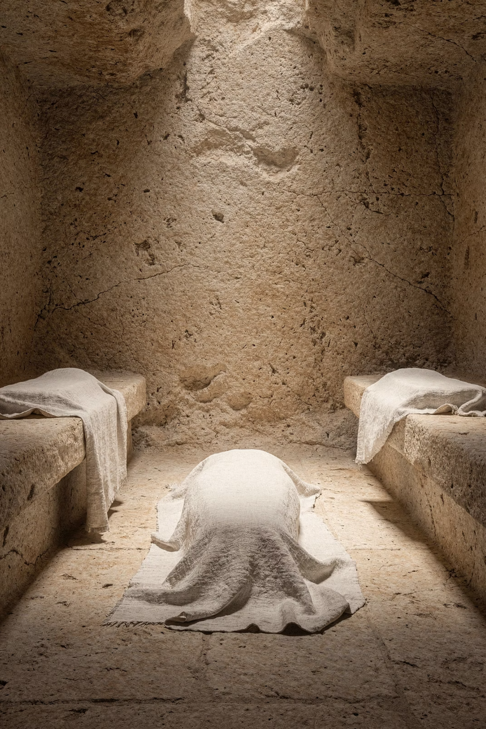
Theory 3
It was made up?
Then where is the body?
The disciples faced persecution and death for this claim. Who willingly dies for something they know is a lie?

Slide 17
WHAT A JEWISH HISTORIAN RECORDED
Flavius Josephus was a 1st-century Jewish historian — not a Christian — who wrote a comprehensive history of the Jewish people for a Roman audience. He had no motive to promote the resurrection.
"When Pilate, at the suggestion of the principal men amongst us, had condemned him to the cross, those that loved him at the first did not forsake him; for he appeared to them alive again the third day… And the tribe of Christians, so named from him, are not extinct at this day."
— Flavius Josephus, Jewish Historian, Antiquities of the Jews 18.64 (c. 93 AD)

Slide 18
It takes more faith to explain it away
Every alternative theory requires more assumptions, more coincidences, and more unanswered questions than the resurrection itself.

Slide 19
"If only for this life we have hope in Christ, we are of all people most to be pitied."
— 1 Corinthians 15:19

Slide 20

But this is not just about evidence
It's about what it means for you

Slide 21
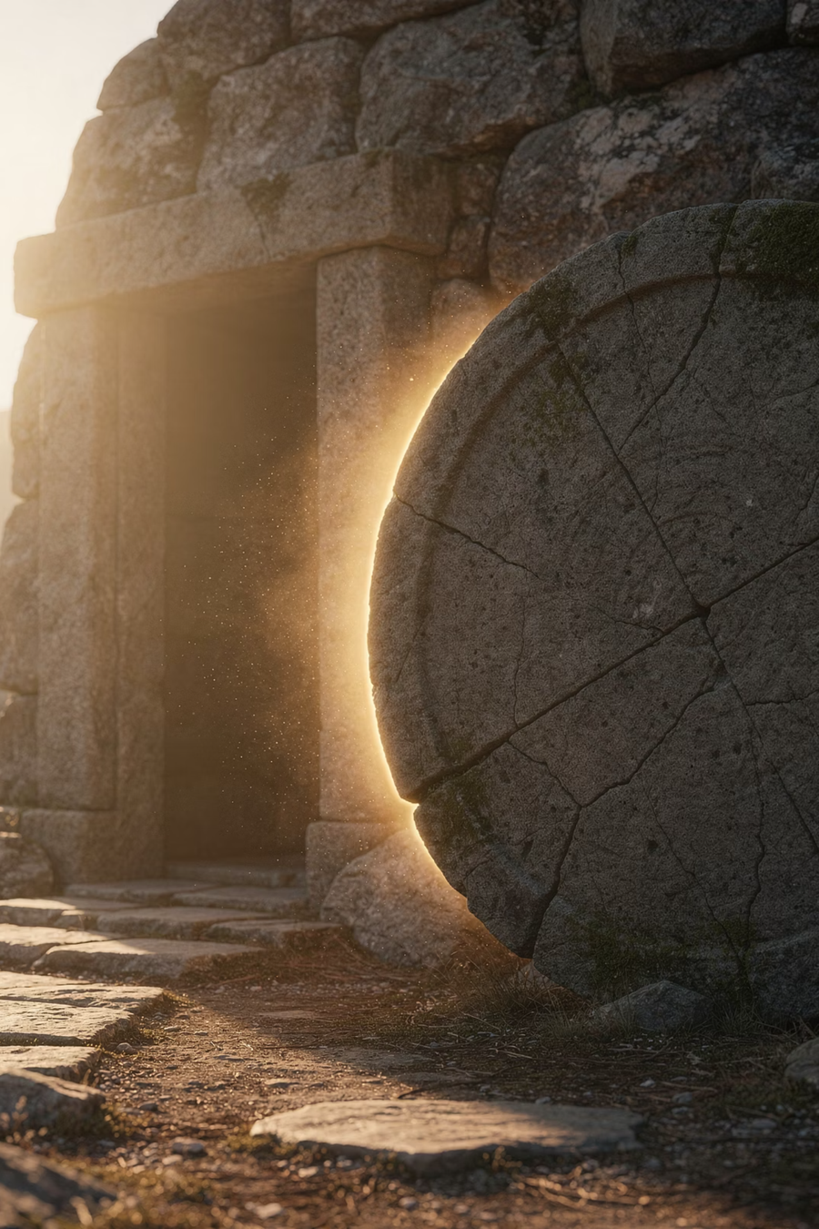
Because the tomb is empty…

Slide 22
Three Truths That Change Everything
Your past can be forgiven
Your present has meaning
Your future is secure

Slide 23
THE FEAR OF GUILT
Your past can be forgiven
Because Jesus rose from the dead, His sacrifice is confirmed, sin and guilt no longer have the final word.
"He was delivered over to death for our sins and was raised to life for our justification."
— Romans 4:25

Slide 24
THE FEAR OF MEANINGLESSNESS
Your present has meaning
The resurrection means Jesus is alive today, and that He is actively at work in your life, giving purpose to every moment.
"I have been crucified with Christ and I no longer live, but Christ lives in me."
— Galatians 2:20

Slide 25
THE FEAR OF DEATH
Your future is secure
Because Jesus conquered death, those who trust in Him share in that victory.
"Because I live, you also will live."
— John 14:19

Slide 26
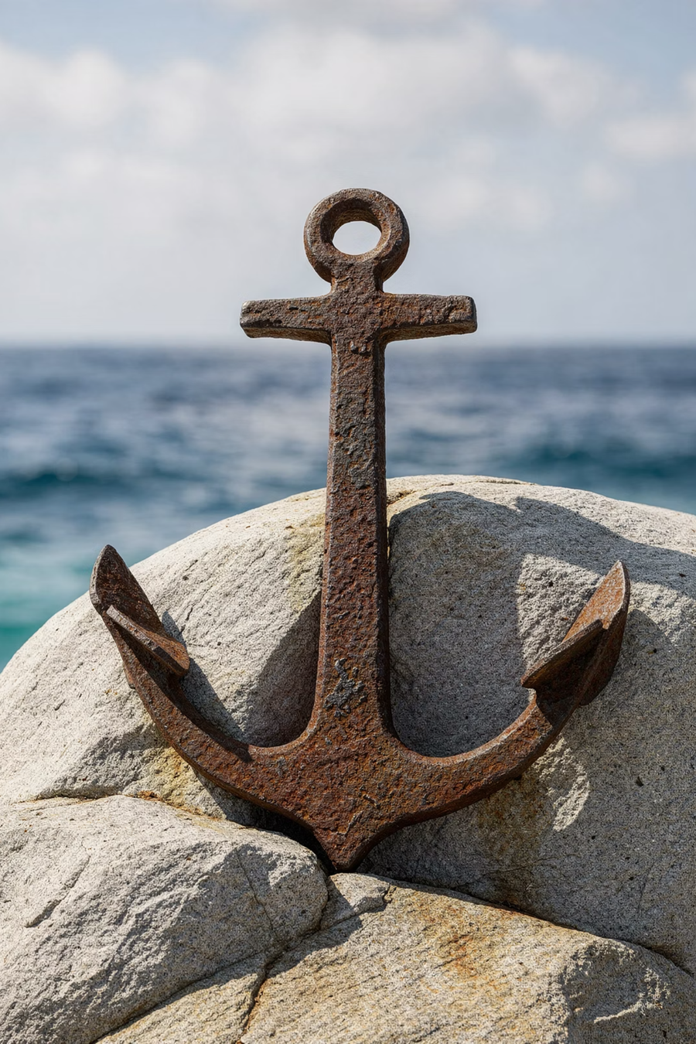
This is not wishful thinking
This is hope anchored in Jesus Christ

Slide 27

You Don't Have to Have All the Answers
But you can take a step

Slide 28
TAKING A STEP — 1 OF 3
Accept God's Invitation
God is not waiting for you to be good enough. He is inviting you as you are.
"Come to me, all you who are weary and burdened, and I will give you rest."
— Matthew 11:28

Slide 29
TAKING A STEP — 2 OF 3
Acknowledge Your Helplessness
Trusting Jesus begins with honesty: I cannot save myself. I need Him.
"For it is by grace you have been saved, through faith — and this is not from yourselves, it is the gift of God."
— Ephesians 2:8

Slide 30
TAKING A STEP — 3 OF 3
Ask for Help
You can pray, talk to someone, or simply tell God where you are. He hears you.
"Everyone who calls on the name of the Lord will be saved."
— Romans 10:13

Slide 31

The tomb is empty
So your life doesn't have to be
If that's where you are, you can simply say:
Jesus, I put my hope in You.

