Slide 1
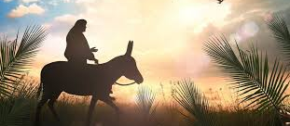
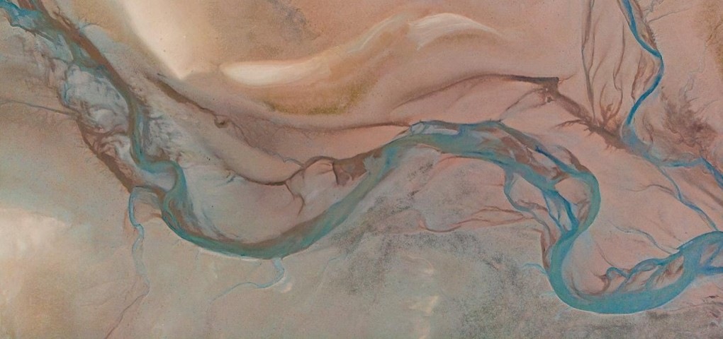
The triumphal Entry
Matt 21: 1-9

Slide 2
Psalm:100:1-3
¹Make a joyful noise to the lord, all the earth! ²serve the lord with gladness! Come into his presence with singing!
³Know the lord, he is god! It is he who made us, and we are his; we are his people , and sheep of his pasture.

Slide 3
Lord, we praise you because you have made us and we are yours!
Lord, I shout for Joy to you today because….
I confess Lord, that I do not always serve you with gladness when….
God, help me to remain joyful as I endure….

Slide 4
Luke 19:41-
And when he drew near and saw the city, he wept over it…

Slide 5
His command had divine purpose.

Slide 6
The people had been deaf to the words of the prophets and blind to the mission of Jesus.

Slide 7
The people had made the king into who they thought he should be, not who God said he would be.

Slide 8
The only time Jesus will ever disappoint is when we place wrong expectations on Him

Slide 9
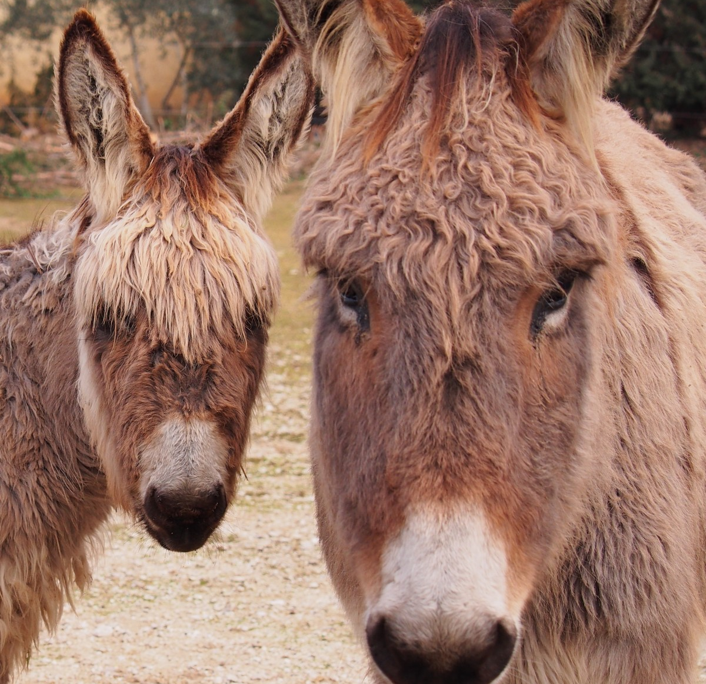

Slide 10
All we know of The two unnamed disciples is their willingness to serve the king!

Slide 11
Their trust in the savior outweighed their doubt.

Slide 12
Salvation is marked by fruit, not emotion.

Slide 13
We are called to lay the fullness of ourselves down at the feet of the king.

