Slide 1


Slide 2
I Will Redeem You
Exodus 6:1-9 NIV

Slide 3
Then the Lord said to Moses,
“Now you will see what I will do to Pharaoh: Because of my mighty hand he will let them go; because of my mighty hand he will
drive them out of his country.”
Exodus 6:1-9 NIV

Slide 4
2 God also said to Moses, “I am the Lord.
3 I appeared to Abraham, to Isaac and to Jacob as God Almighty, but by my name the Lord
I did not make myself fully known to them.
Exodus 6:1-9 NIV

Slide 5
4 I also established my covenant with them to give them the land of Canaan, where they resided as foreigners. 5 Moreover, I have heard the groaning of the Israelites, whom the Egyptians are enslaving, and I have remembered my covenant.
Exodus 6:1-9 NIV

Slide 6
6 “Therefore, say to the Israelites:
‘I am the Lord,
and I will bring you out
from under the yoke of the Egyptians.
I will free you from being slaves to them, and I will redeem you with an outstretched arm and with mighty acts of judgment.
Exodus 6:1-9 NIV

Slide 7
7 I will take you as my own people,
and I will be your God.
Then you will know that I am the Lord your God, who brought you out from under the yoke of the Egyptians.
Exodus 6:1-9 NIV

Slide 8
8 And I will bring you to the land I swore with uplifted hand to give to Abraham, to Isaac and to Jacob. I will give it to you as a possession.
I am the Lord.’”
Exodus 6:1-9 NIV

Slide 9
9 Moses reported this to the Israelites,
but they did not listen to him
because of their discouragement
and harsh labor.
Exodus 6:1-9 NIV

Slide 10
I Will Redeem You
The Lord Redeems by
Delivering His People

Slide 11
6 “Therefore, say to the Israelites:
‘I am the Lord,
and I will bring you out
from under the yoke of the Egyptians.
I will free you from being slaves to them, and I will redeem you with an outstretched arm and with mighty acts of judgment.
Exodus 6:6 NIV

Slide 12
8 And I will bring you to the land I swore with uplifted hand to give to Abraham,
to Isaac and to Jacob.
I will give it to you as a possession.
I am the Lord.
Exodus 6:8 NIV

Slide 13
15 For by now I could have stretched out my hand and struck you and your people with a plague that would have wiped you off the earth. 16 But I have raised you up for
this very purpose,
that I might show you my power and that my name might be proclaimed in all the earth.
Exodus 9:15-16 NIV

Slide 14
I Will Redeem You
The Lord Redeems by
Providing a Substitute

Slide 15
6 There will be loud wailing throughout Egypt—worse than there has ever been or ever will be again. 7 But among the Israelites not a dog will bark at any person or animal.
Then you will know that the Lord makes a distinction between Egypt and Israel.
Exodus 11:6-7 NIV

Slide 16
7 Then they are to take some of the blood and put it on the sides and tops of the doorframes of the houses where they eat the lambs.
Exodus 12:7 NIV

Slide 17
12 On that same night I will pass through Egypt and strike down every firstborn of both people and animals,
and I will bring judgment on all the
gods of Egypt.
I am the Lord.
Exodus 12:12 NIV

Slide 18
13 The blood will be a sign for you on the houses where you are, and when I see the blood, I will pass over you.
No destructive plague will touch you when I strike Egypt.
Exodus 12:13 NIV

Slide 19
14 This is a day you are to commemorate;
for the generations to come you shall celebrate it
as a festival to the Lord—a lasting ordinance.
Exodus 12:14 NIV

Slide 20
7 For Christ, our Passover lamb,
has been sacrificed.
8 Therefore let us keep the Festival, not with the old bread leavened with malice and wickedness, but with the unleavened bread of sincerity and truth.
2 Corinthians 5:7-8 NIV

Slide 21
I Will Redeem You
The Lord Redeems by
Revealing Himself

Slide 22
2 God also said to Moses, “I am the Lord.
3 I appeared to Abraham, to Isaac and to Jacob as God Almighty, but by my name the Lord
I did not make myself fully known to them.
Exodus 6:2-3 NIV

Slide 23
13 Moses answered the people,
“Do not be afraid. Stand firm and
you will see the deliverance the Lord
will bring you today.
The Egyptians you see today you will never see again. 14 The Lord will fight for you;
you need only to be still.”
Exodus 14:13-14 NIV

Slide 24
7 I will take you as my own people,
and I will be your God.
Then you will know that
I am the Lord your God,
who brought you out from under
the yoke of the Egyptians.
Exodus 6:7 NIV

Slide 25
31 And when the Israelites saw the mighty hand of the Lord displayed against the Egyptians, the people feared the Lord
and put their trust in him
and in Moses his servant.
Exodus 14:31 NIV

Slide 26
3 Now this is eternal life:
that they know you,
the only true God,
and Jesus Christ,
whom you have sent.
John 17:3 NIV

Slide 27
Conclusion:
God delivers. God provides the Lamb.
God reveals Himself as Redeemer.
What started at Passover is fulfilled in Christ.
Don’t just hear this—respond: come under the blood and trust
your Redeemer today with what you’ve been trying to carry on your own.

Slide 28
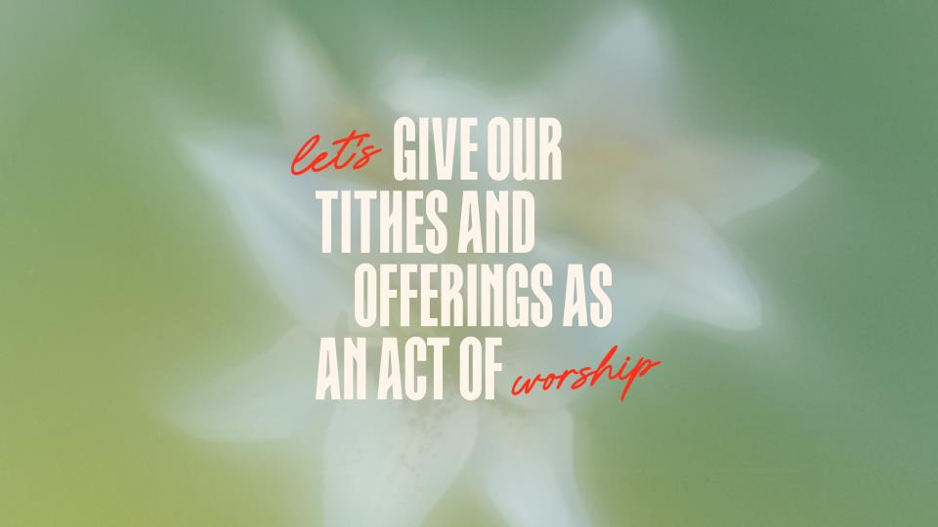

Slide 29


