Slide 1

Acts 4:13-31
February 4, 2026

Slide 2
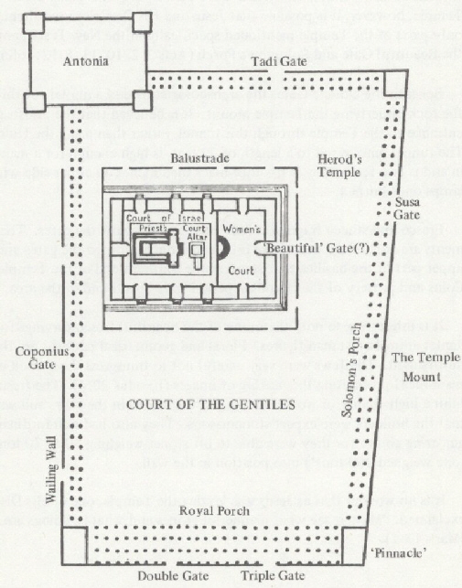

Slide 5
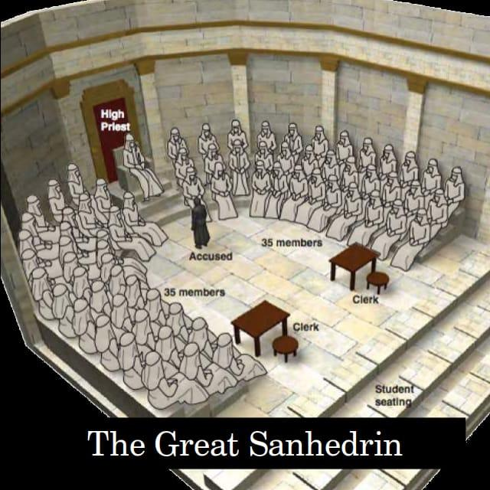

Slide 6
How were you able to do this miracle?

Slide 7
v.10 Jesus of Nazareth, the Messiah

Slide 8

Acts 4:12
¹² Salvation is found in no one else, for there is no other name under heaven given to mankind by which we must be saved.”

Slide 9
According to v.13, the Religious Leaders realized 3 things

Slide 10
3 Things were recognized
The boldness of Peter and John

Slide 11
3 Things were recognized
The boldness of Peter and John
They realized that they were uneducated

Slide 12
3 Things were recognized
The boldness of Peter and John
They realized that they were uneducated
They realized that they were unskilled or amateurs

Slide 13
According to v.13, what were the results of these three things on the Religious Leaders?

Slide 14
They were impressed and they knew Peter and John were with Jesus

Slide 15
What did the Religious Leaders do? (v.15-17)

Slide 16
Acts 4:18
¹⁸ Then they called them in again and commanded them not to speak or teach at all in the name of Jesus.

Slide 17
Acts 4:18
¹⁸ Then they called them in again and commanded them not to speak or teach at all in the name of Jesus.
- “Directed” – this is what you will do

Slide 18
How did Peter and John respond? v.19-20

Slide 19
Acts 4:19-20 (Literal translation)
¹⁹ But Peter and John having replied said to them, “What is more right in the sight of God; to listen to you or to God, you judge; we are not able not to speak which we see and hear.”

Slide 20
The Religious Leaders let Peter and John go because of the people in Jerusalem

Slide 21
The Religious Leaders let Peter and John go because they could not deny this miracle

Slide 22
Peter and John go back to the believers and filled them in on the threats of the Religious Leaders v.23-24

Slide 23
How did the believers respond?

Slide 24
How did the believers respond? prayer

Slide 25
How do the believers start off their prayer?

Slide 26
How do the believers start off their prayer? Reminding themselves of God’s character

Slide 27
The believers realized that these leaders came against Christ, so they will come against His followers as well

Slide 28
What did the believers ask?

Slide 29
What did the believers ask? To speak all of God’s word with boldly, plainly

Slide 30
What did the believers ask? God would continue to show Himself through healings, signs, wonders

Slide 31
Why does God do miracles?

Slide 32
Why did Jesus do miracles?

Slide 33
To prove His character and for His glory

Slide 34
What was the result? v.31

Slide 35
What was the result? Spoke the word of God with boldness

Slide 36
Acts 1:8
⁸ But you will receive power when the Holy Spirit comes on you; and you will be my witnesses in Jerusalem, and in all Judea and Samaria, and to the ends of the earth.”

